Slide 1




SMART-JAM
gantt chart

Slide 2


Research
Data & Design
MAIN POINTS
Build & Test
Delivery / Maintenance

Slide 3
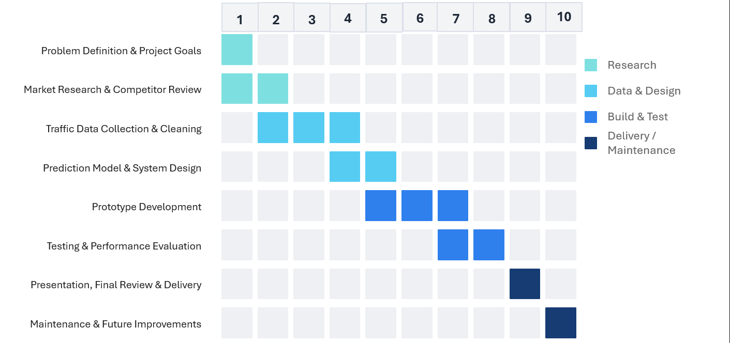

Slide 4

Research
Problem Definition & Project Goals
Market Research & Competitor Review

Slide 5

Data & Design
Traffic Data Collection & Cleaning
Prediction Model & System Design

Slide 6

Build & Test
Prototype Development
Testing & Performance Evaluation

Slide 7

Delivery / Maintenance
Presentation, Final Review & Delivery
Maintenance & Future Improvements

Slide 8
Thank you
for attention!

