Slide 1

Entity Relationship
Diagram
Team SMART-JAM

Slide 2
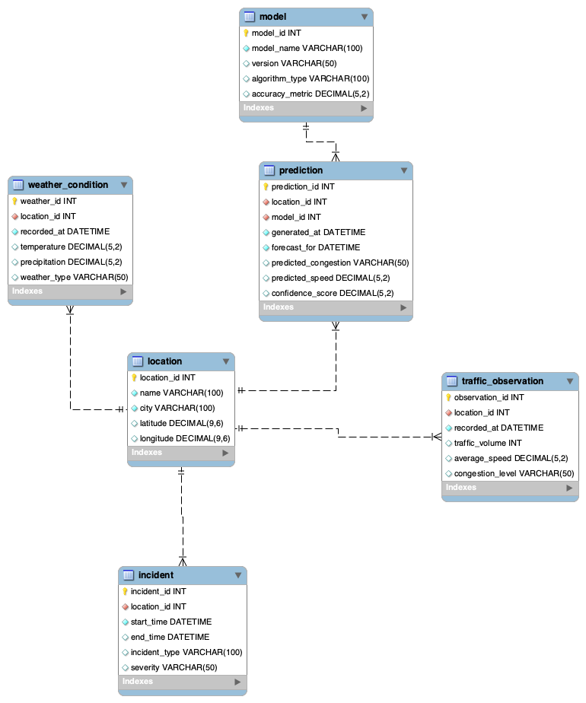

Complete ERD
The Smart-Jam database is designed to support the collection, storage, and analysis of traffic-related data for short-term traffic congestion prediction.
It stores information about monitored locations, real traffic observations, weather conditions, incidents affecting traffic flow, machine learning models, and generated predictions.

Slide 3
Location
stores information about monitored road locations, including the location name, city, and geographic coordinates.
A single location can have multiple traffic observations, weather records, incidents, and predictions.
Cardinality summary >
location → traffic_observation = 1:N
location → weather_condition = 1:N
location → incident = 1:N
location → prediction = 1:N

Slide 4

Weather condition
stores weather-related data for a location and time, including temperature, precipitation, and weather type.

Slide 5

Model
stores information about the forecasting models used in the system, including model name, version, algorithm type, and accuracy metric.
Cardinality summary >
model → prediction = 1:N

Slide 6

Prediction
contains generated traffic forecasts for specific locations and times, including predicted congestion, predicted speed, and confidence score.
each prediction is generated by one specific model.

Slide 7

Traffic observation
records real traffic data for a specific location and time, such as traffic volume, average speed, and congestion level.

Slide 8

Incident
contains information about traffic-related events that may influence road conditions, such as accidents or roadworks, together with their severity and duration.

Slide 9
Database logic
The relationships between these entities reflect the main logic of the system.
This structure ensures clear organization of input data and forecasting results while keeping the database simple and suitable for the project scope.
The database allows the system to analyze current road conditions and produce forecasts for the next 30–60 minutes.

Slide 10
Thanks for your attention !
Team SMART-JAM

