Slide 1

BDAT 1001 - FINAL PROJECT
Presented By
Hellyben Vaghasiya
Vishesh Shukla
Saikrishna Vinjamoori

Slide 2
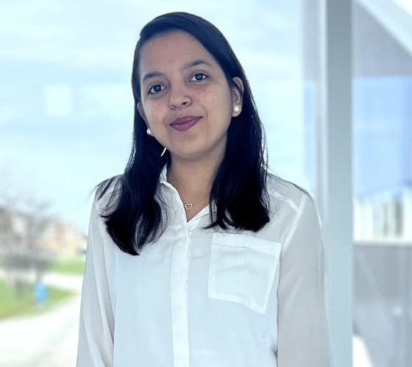
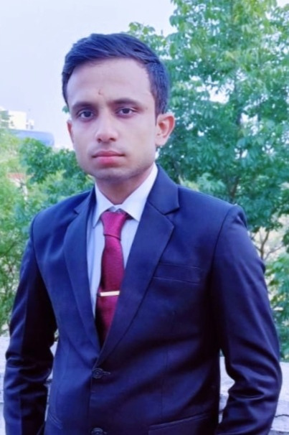
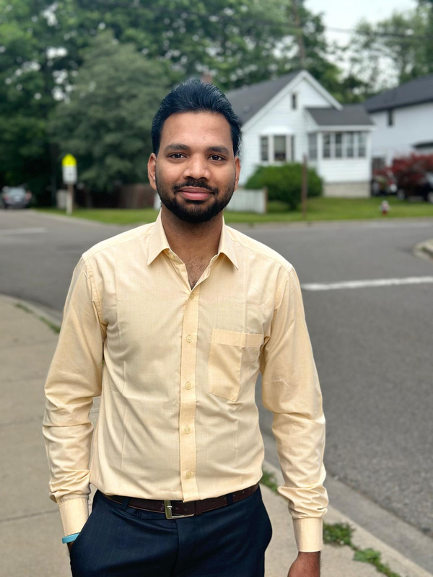
OUR TEAMS
Hellyben Vaghasiya
200544282
Vishesh Shukla
200591496
Saikrishna Vinjamoori
200594584

Slide 3


PROJECT SUMMARY
Create a ASP.NET Core web app with user protected by authorization.
This web app is built using ASP.NET Core, a powerful and flexible framework for building web applications. It incorporates authentication and authorization mechanisms to protect user data, ensuring that only authorized users can access sensitive information. By implementing these security features, the app provides a secure environment for managing and interacting with user data.

Slide 4
PART1-DEMONSTRATION

Slide 5
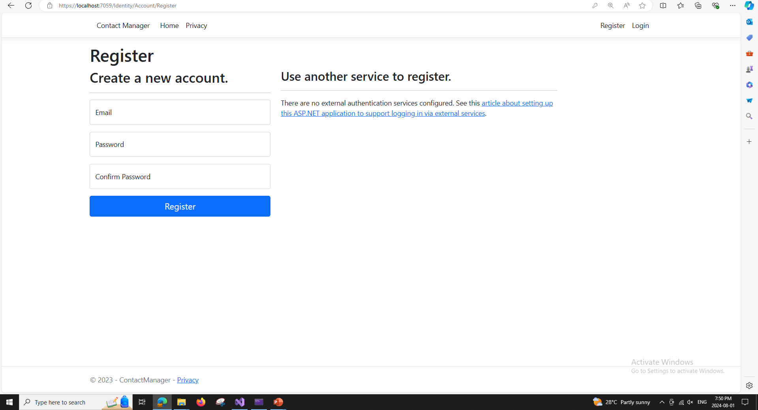
REGISTER PAGE

Slide 6
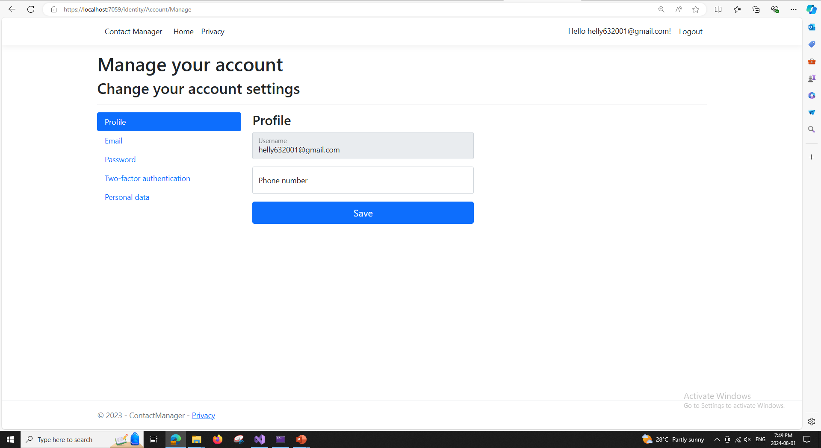
MANAGE YOUR ACCOUNT

Slide 7
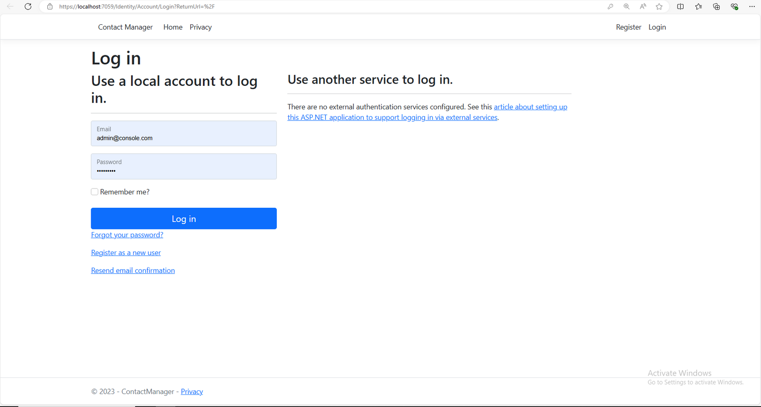
LOGIN PAGE

Slide 8
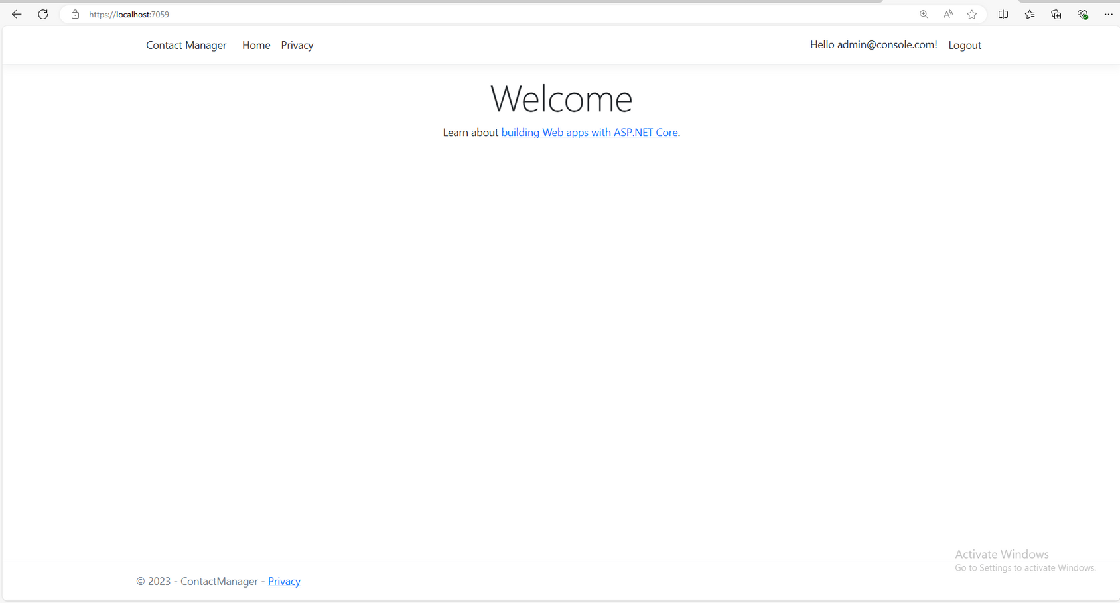
HOME PAGE

Slide 9
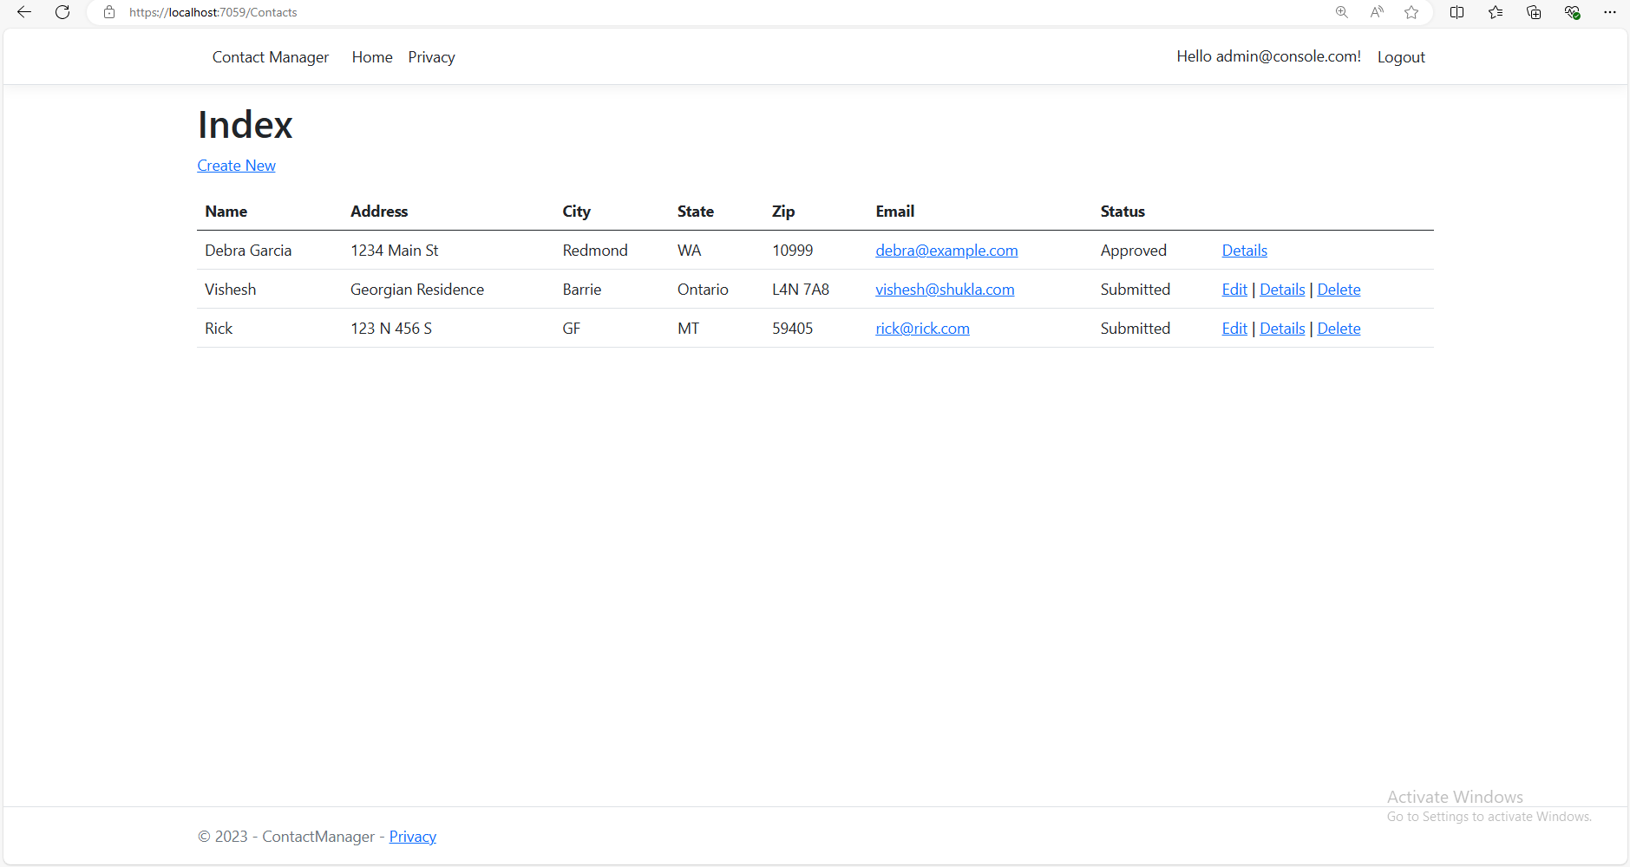
INDEX PAGE

Slide 10
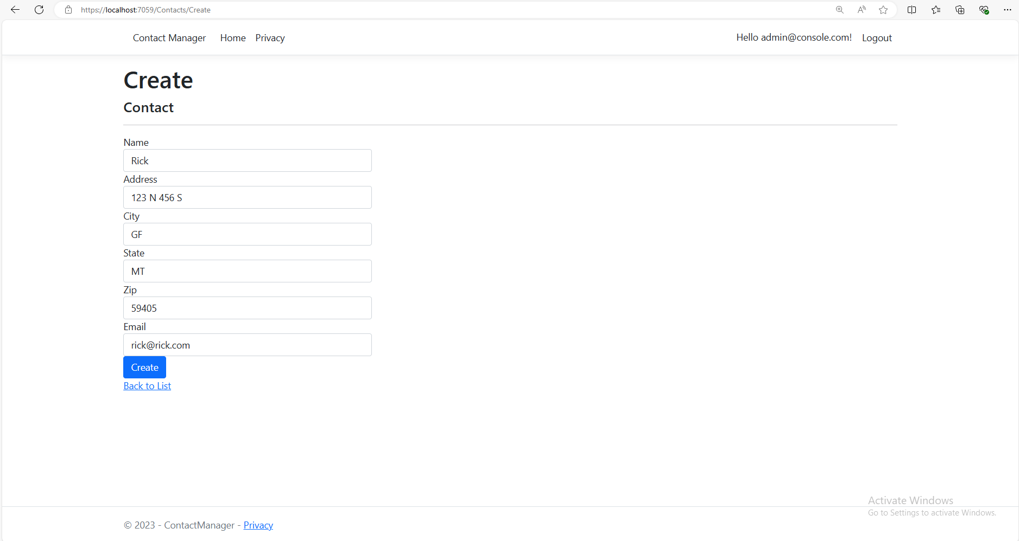
CREATE PAGE

Slide 11
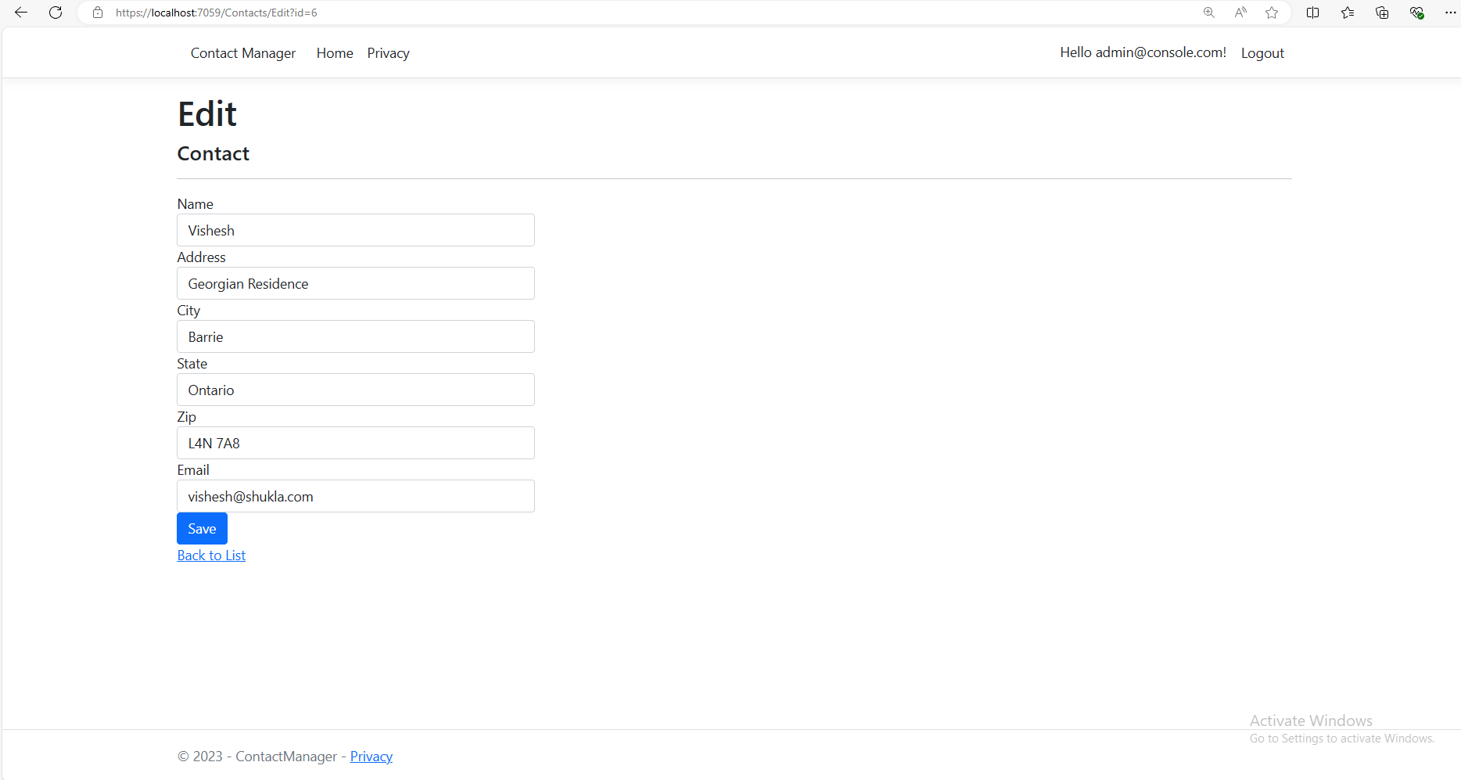
EDIT PAGE

Slide 12
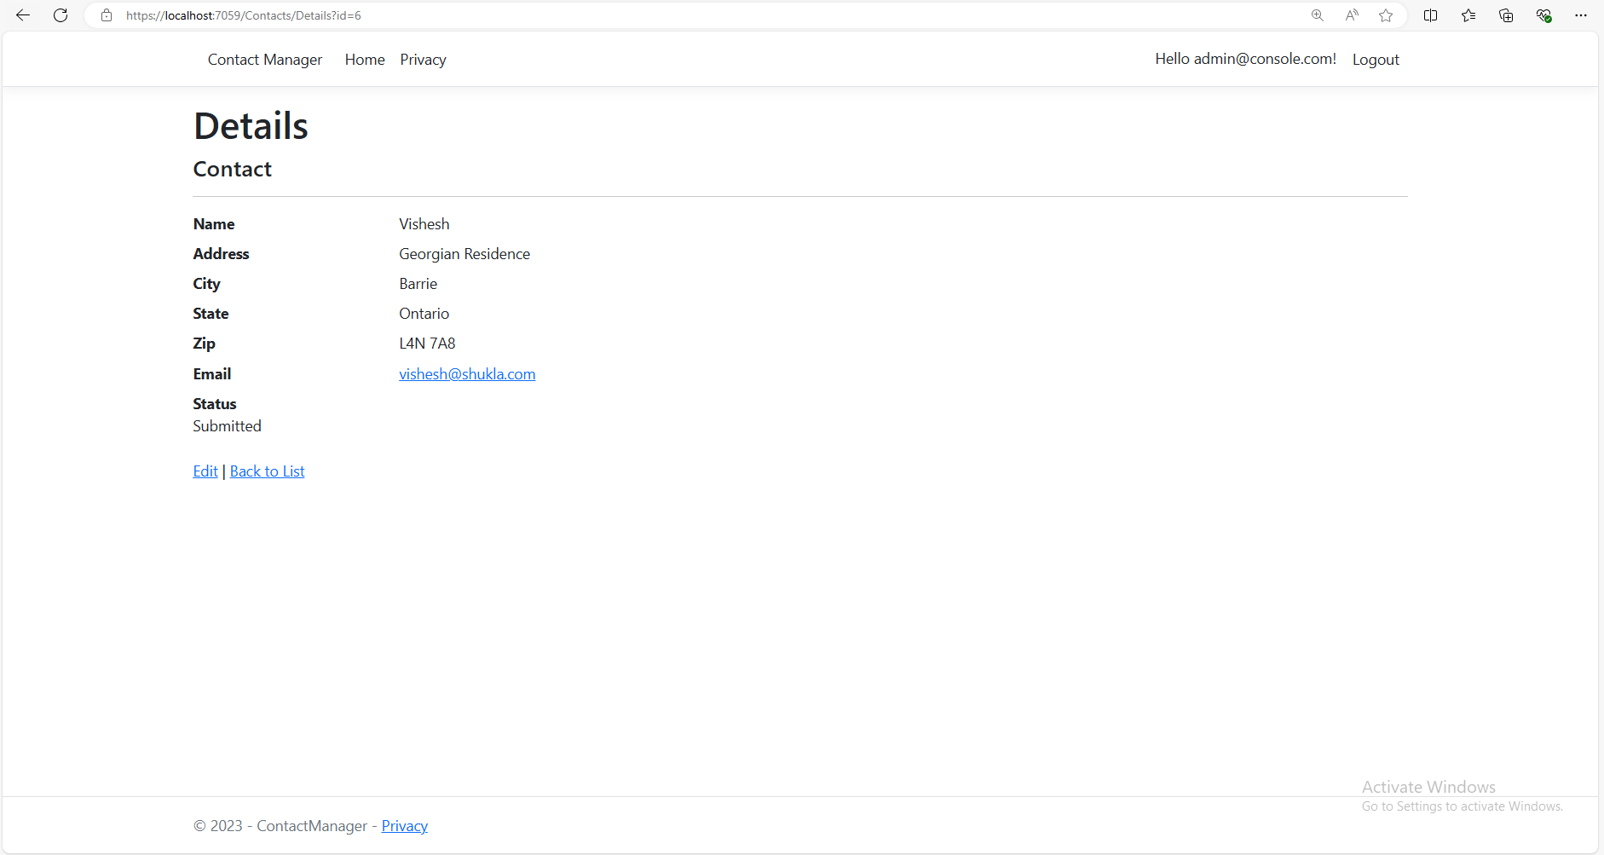
DETAILS PAGE

Slide 13
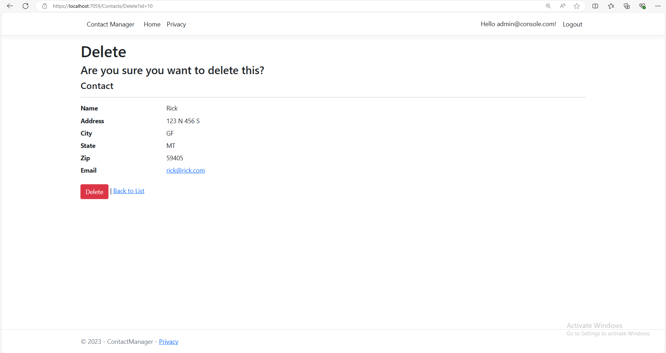
DELETE PAGE

Slide 14
ADMIN LOGIN PAGE

Slide 15
ADMIN CAN CHANGE THE STATUS

Slide 16
THANK YOU

