Slide 1
Arth Infosoft
Role: Web Development
Name: Hussain Vakharwala
Enrollment No: 180010107063
Internal Guide: Prof Siddharth

Slide 2
Content

Slide 3
Index
About Arth Infosoft
2. About Project
3. Roles & Responsibilities
4. Tools & Technologies Used
5. Additional Learning

Slide 4
About Arth Infosoft

Slide 5
We are Arth Infosoft
Arth Infosoft Pvt. Ltd. Is an Indian Origin growing IT company which aims to serve clients with affordable Graphic, Web and Software solutions. Arth specializes, but is not limited to graphic, website designing, web application, web portal development and SEO Services.
Ahmedabad Office:
We specialize in Web Application Development, Website/Layout Designing, Internet Marketing, PHP Web Application Development, Shopping Cart Development, Custom Software Development, and School Management System

Slide 6
About Project

Slide 7
Problem Statement
Travelling is a very common activity and consider a scenario where in a solo traveler wants to travel from one location to another and the traveler wants some company for barring his travel expense, our application is the solution for that. Consider another user who wants to travel from the same path and hence needs some help. Our application connects both the users. Travel captain is who travel from one place to another by their own transportation. Travel patrons are those who want to travel from one place to another place, but they don't have any transportation on their own. Patron can request Captain for a trip in exchange of a fixed or custom fair.

Slide 8
Aim:
To complete the 1st phase of project which includes providing functionality of Scheduling Trips.
Key Outcomes
Creating and updating the data dictionary for the project based on input from project manager.

Slide 9
Roles & Responsibilities

Slide 10
Responsibilities
Creating and updating data dictionary for the project based on input from project manager.
Working with ReactJS on front end for front end development of the web application.
Working with NodeJS and express for backend logic and functionality.

Slide 11
Tools & Technology Used

Slide 12
Technology Used
MongoDB Compass
It is a powerful GUI for querying, aggregating, and analyzing your MongoDB Data in visual environment.
We are using it as it makes working with NoSQL data easy by providing GUI for databased management and modification.

Slide 13




Tools Used
MongoDB
Using MongoDB as it is a reliable and flexible No SQL database.
ExpressJS
Using ExpressJS with NodeJS setup middleware to respond to
HTTP requests.
ReactJS
As a frontend web application framework.
NodeJS
For referring design requirements
Postman
It is an application used for API testing.

Slide 14
Additional Learning

Slide 15
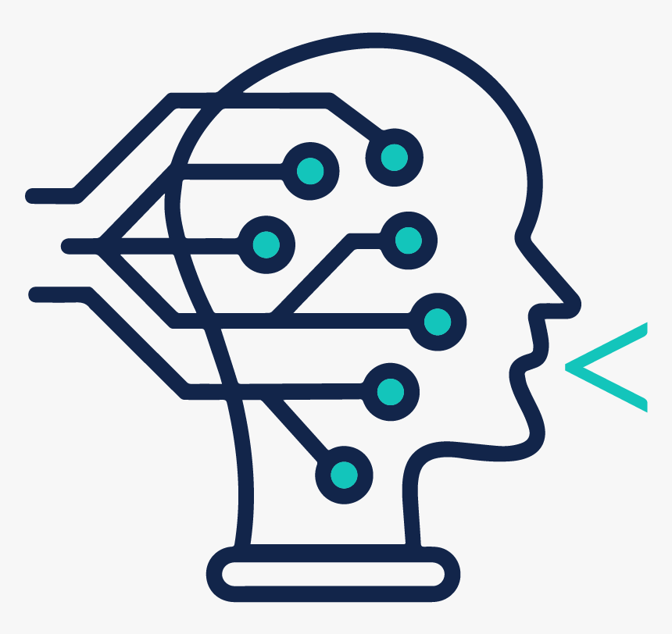
Soft Skills
Work Ethics
Adaptability
Importance of Effective Communication
Time Management
Collaboration
Technical Skills
Testing Fundamentals
Agile Methodology
SCRUM Ceremonies
Different Types of Testing

Slide 16

ARTH INFOSOFT
THANK YOU!!!

