Slide 1
The Florida Question: Trends, Performance, and the ACT
Henry Valk

Slide 2
Of US States that underperform on the ACT, which are trending positively and why?
Which states need the most help?
Which of these states are on a positive path forward?
What explains this positive trend? Are there policy ideas that could be exported to states in similar positions?

Slide 3
The Data
Three ACT datasets from 2017, 2018, and 2019
Each contains participation rate and composite (total) score data for all 50 states and Washington D.C.
Let’s start by exploring nationwide trends in the mean of our 2017, 2018, and 2019 datasets

Slide 4
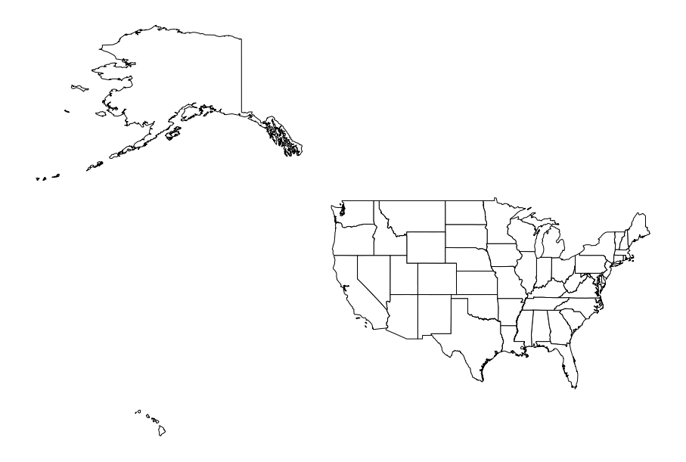

Slide 5
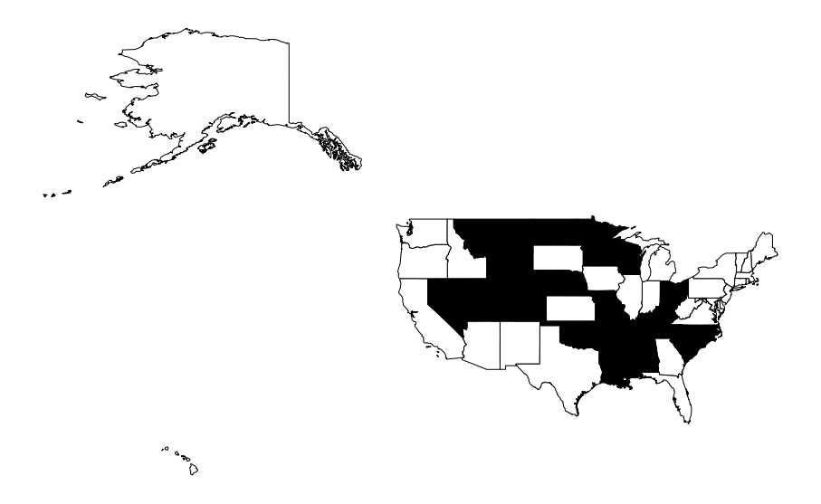
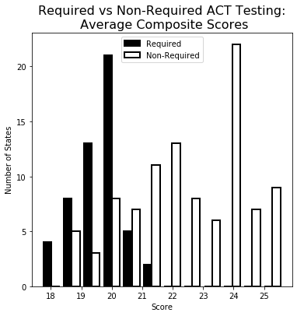
20 states require students take the ACT
31 states do not require students take the ACT

Slide 6
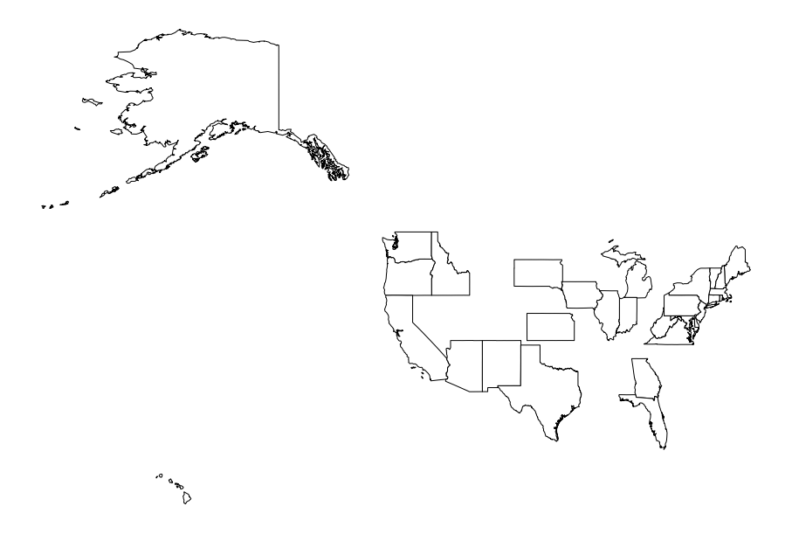
20 states require students take the ACT
31 states do not require students take the ACT

Slide 8
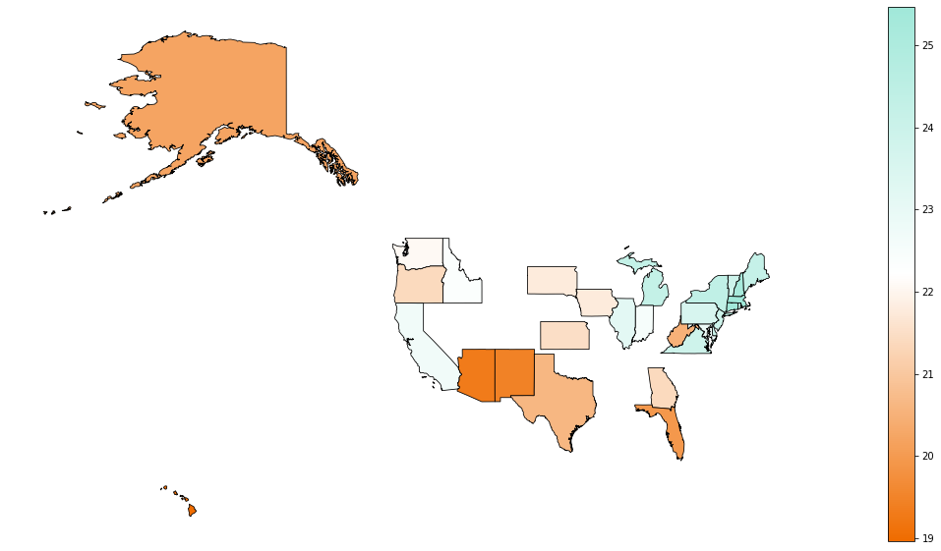
Mean Composite ACT Score by State

Slide 9
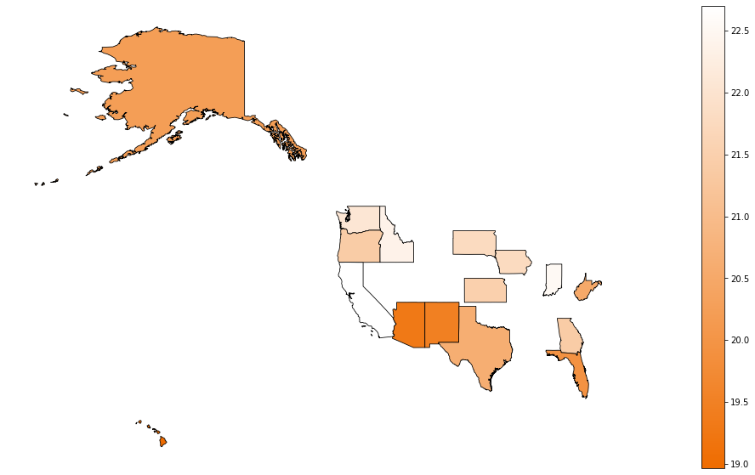
Mean Composite ACT Score by State:
Median-Split: Lower Scoring States

Slide 10
Of these remaining states, which has improved ACT scores every year for the last 3 consecutive years?

Slide 11
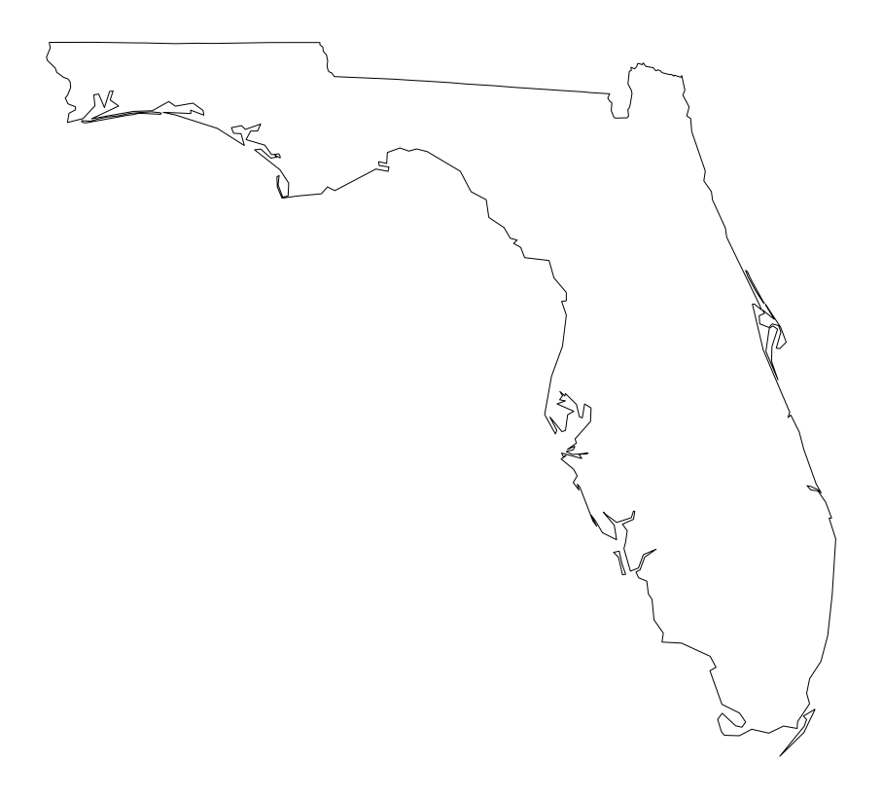

Slide 12
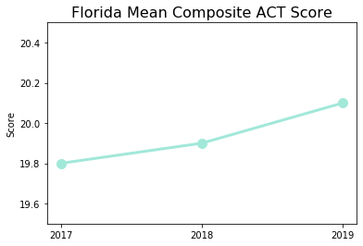

Slide 13
Why?
SB 926
Pushes back test dates
Allows students to opt-out
of other tests

Slide 14
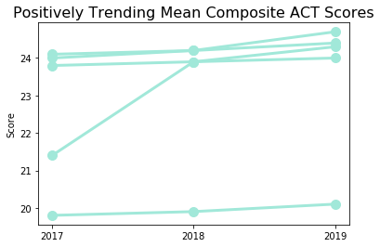
Why?
Rhode Island, Michigan, Illinois, Virginia, Florida

Slide 15
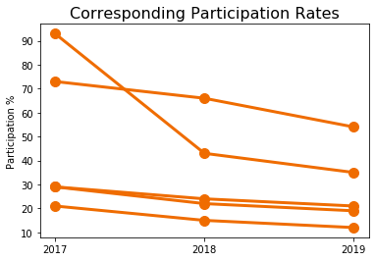
Why?
Rhode Island, Michigan, Illinois, Virginia, Florida

Slide 16
Conclusions and Recommendations
Participations rates strongly influence ACT scores
Few states are trending positively
Consider variables other than standardized test scores
Are test scores the best reflection of a positive learning experience? Perhaps looks at graduation rates instead
Determine if the relationship between participation rates and test scores is statistically significant

Slide 17
Thank You!
https://www.orlandoweekly.com/Blogs/archives/2017/04/04/new-bill-would-overhaul-floridas-standardized-testing-system
https://geopandas.org/mapping.html#choropleth-maps
https://www.arcgis.com/home/item.html?id=f7f805eb65eb4ab787a0a3e1116ca7e5
https://towardsdatascience.com/a-beginners-guide-to-create-a-cloropleth-map-in-python-using-geopandas-and-matplotlib-9cc4175ab63
https://stackoverflow.com/questions/16834861/create-own-colormap-using-matplotlib-and-plot-color-scale0

