Slide 1
COVID-19 Rates via Sentiment Analysis of Tweets
Margaret Rubio-Keefer
Henry Valk
Lucas Dwyer
Notes:
Problem: Sentiment Analysis of COVID-19 Social Media Posts
Problem: Mapping Hotspots of COVID-19 Cases

Slide 2
Questions
How is covid-related tweet sentiment related to covid metrics by region?
Is information gained by examining the derivatives of covid metric? How about tweet sentiment variance?
Are there certain timelag windows that more clearly reveal a relationship?
Notes:
Problem: Sentiment Analysis of COVID-19 Social Media Posts
Problem: Mapping Hotspots of COVID-19 Cases

Slide 3
Datasets
IEEE Coronavirus (COVID-19) Geo-tagged Tweets Dataset
COVID-19 Data Repository by the Center for Systems Science and Engineering (CSSE) at Johns Hopkins University
Specifically we are considering the states of Texas, New York, California, Georgia, and Florida only.
Notes:
These 5 states had at least 1000 tweets

Slide 4

Tweet Corpus
182,486 geo-tagged tweets
"corona", "#corona", "coronavirus", "#coronavirus", "covid", "#covid", "covid19", "#covid19", "covid-19", "#covid-19", "sarscov2", "#sarscov2", "sars cov2", "sars cov 2", "covid_19", "#covid_19", "#ncov", "ncov", "#ncov2019", "ncov2019", "2019-ncov", "#2019-ncov", "pandemic", "#pandemic" "#2019ncov", "2019ncov", "quarantine", "#quarantine","#covidiots", "covidiots", "herd immunity", "#herdimmunity", "pneumonia", "#pneumonia", "chinese virus", "#chinesevirus", "wuhan virus", "#wuhanvirus"
Notes:
hydrator

Slide 5
Sentiment Analysis: TextBlob
TextBlob is based on the Stanford NLTK (Natural Language ToolKit) and uses Naive Bayes Classification to assess string sentiment. Sentiment is broken down in two ways:
polarity: negative vs. positive (-1.0 => +1.0)
subjectivity: objective vs. subjective (+0.0 => +1.0)
Notes:
Polarity standardized
Subjectivity normalized

Slide 6
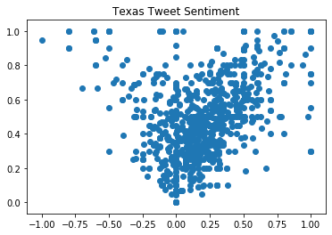
more subjective
more objective
negative
positive

Slide 7
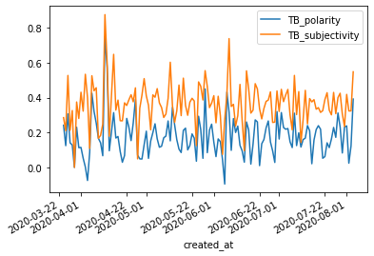
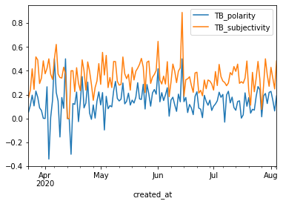
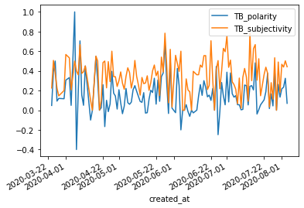
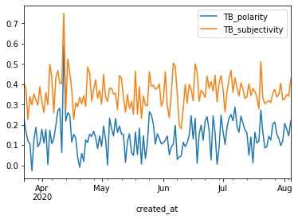
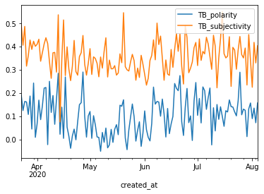
Florida
Texas
Georgia
California
New York

Slide 8

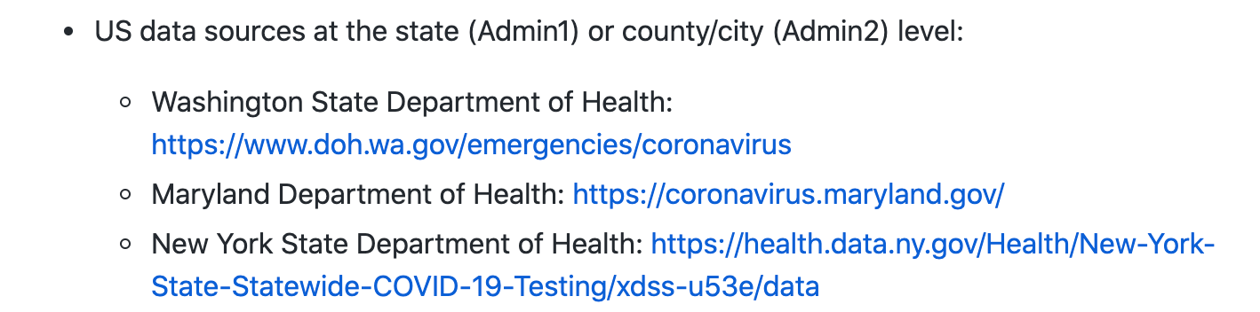
Covid Data
...
County data aggregated by State, dataframe indexed by date

Slide 9
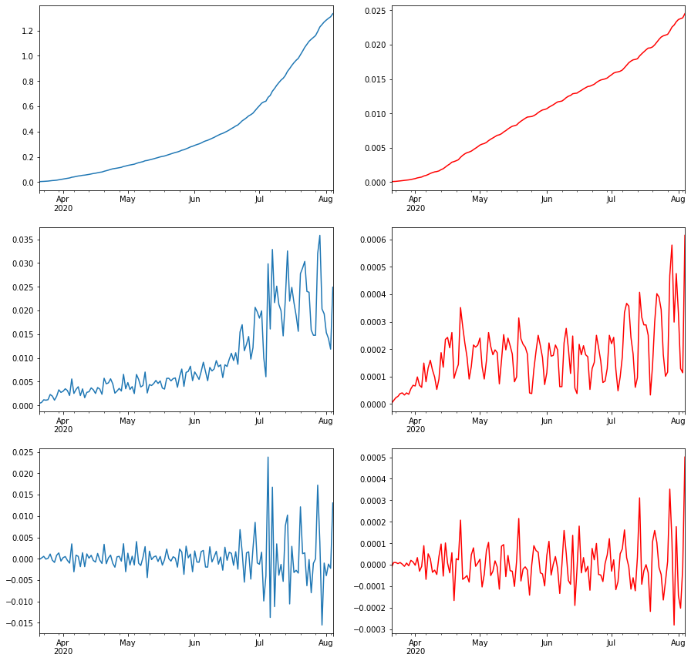
CA cases per capita
CA deaths per capita
total
1st derivative
2nd derivative

Slide 10
The two modeling Approaches
1) Logistic Regression for Binary Classification
Here we simply consider the 2nd derivative of the confirmed case load as the target; that is the change in the change of number of confirmed cases every day.
Reminder on 2nd derivatives: if x the position, the 1st derivative is the velocity, and the 2nd derivative is the acceleration!
2) OLS Regression for Covid Prediction
Here we look at mean sentiment and sentiment standard deviation at multiple time lags as predictors of covid-19 metrics.
Cases per capita and deaths per capita were considered as target variables, as well as their 1st order and 2nd order derivatives

Slide 11
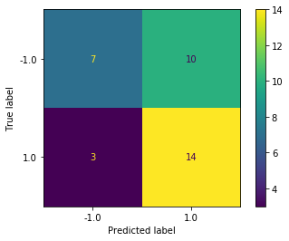
Florida next-day model
Our best performing binary classification model was specifically for Florida, and had an accuracy of nearly 62%, but, importantly had a very low False Negative Rate.

Slide 12
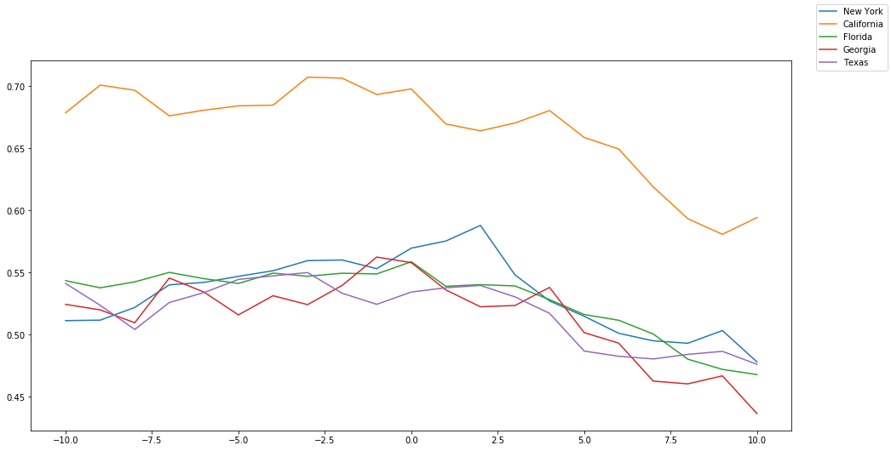
Cross-Correlation between sentiment polarity and 1st derivative of cases
R value
Sentiment lagged behind covid data
Covid data lagged behind sentiment

Slide 13
California Lagged OLS Model
Cross-validated model ...
Tweet polarity and subjectivity means and standard deviations aggregated by day. At 7 different time lags
California_cases r2 score: | 0.147
California_deaths r2 score: | 0.088
California_cases_diff1 r2 score: | 0.155
California_deaths_diff1 r2 score: | 0.173
California_cases_diff2 r2 score: | 0.123
California_deaths_diff2 r2 score: | 0.125
California_cases r2 score: | -56.0256
California_deaths r2 score: | -21.907
California_cases_diff1 r2 score: | -36.093
California_deaths_diff1 r2 score: | -1.222
California_cases_diff2 r2 score: | -3.462
California_deaths_diff2 r2 score: | -0.973

Slide 14
Limitations and Future Directions
In both cases, the models will improve as the length of the pandemic goes on, especially since we’re averaging the mean sentiment per day, so that we currently only have roughly 130ish days.
A model which was trained on all states time series but used to predict only singular states may be beneficial.
Additional features, such as the agglomerated text vectors of each day’s tweets, may prove to be useful.
Feature transformation between certain keywords and sentiment may further improve the models.

