Slide 1
Jumbos Presentation

Slide 2
Challenge #1
Problem: finding 13 aircraft with wiring issues.

Slide 3
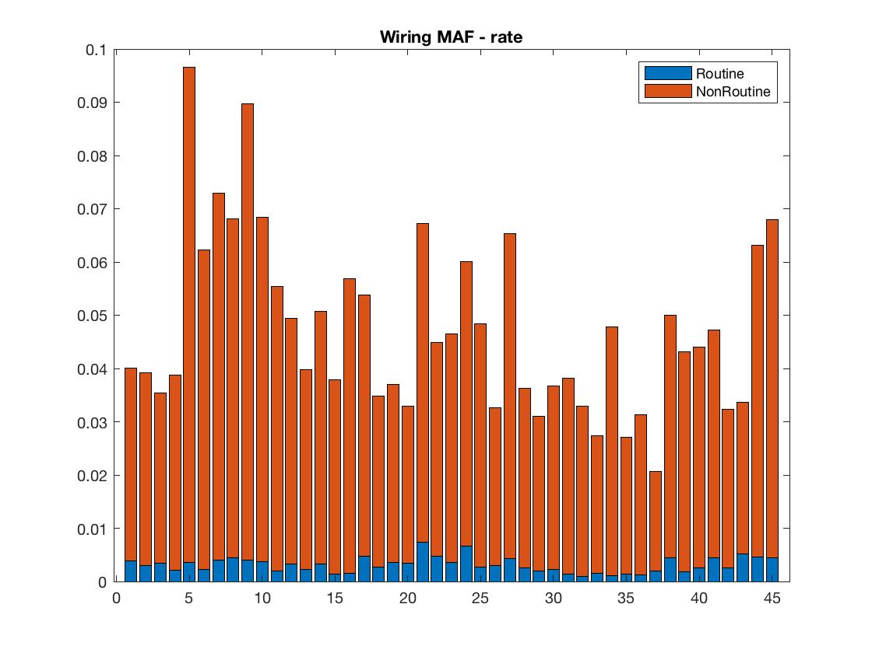
Rate of wiring issues separated by routine and non-routine maintenance for each aircraft

Slide 4
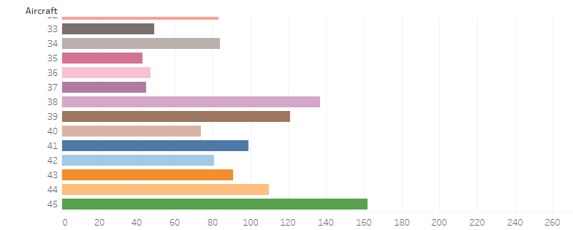
Number of wiring related problems per aircraft
Number of problem or correction descriptions containing “wir” or a W in the malfunction code.

Slide 5
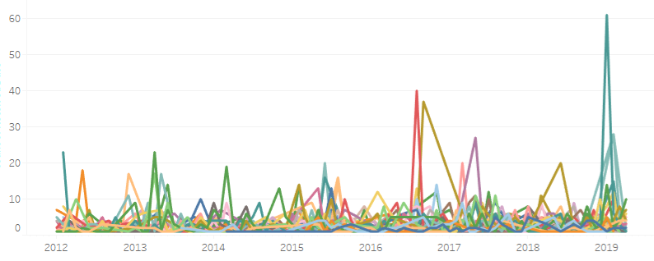
Time Series Analysis of Wiring Related Problems
Where each color represents a different aircraft. Aircraft with wiring problems were selected based off of spiking in wiring maintenance.

Slide 6
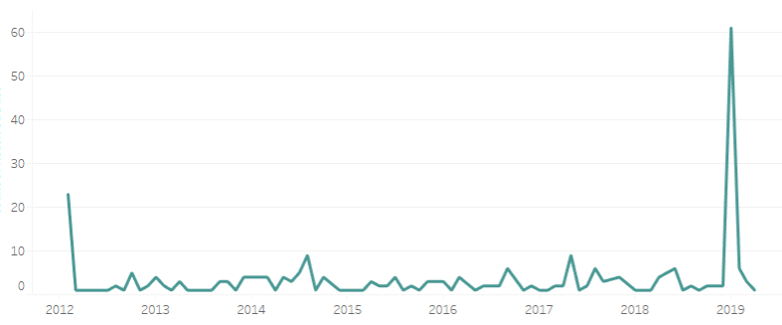
Time Series Analysis of Wiring Issues for Aircraft #9

Slide 7
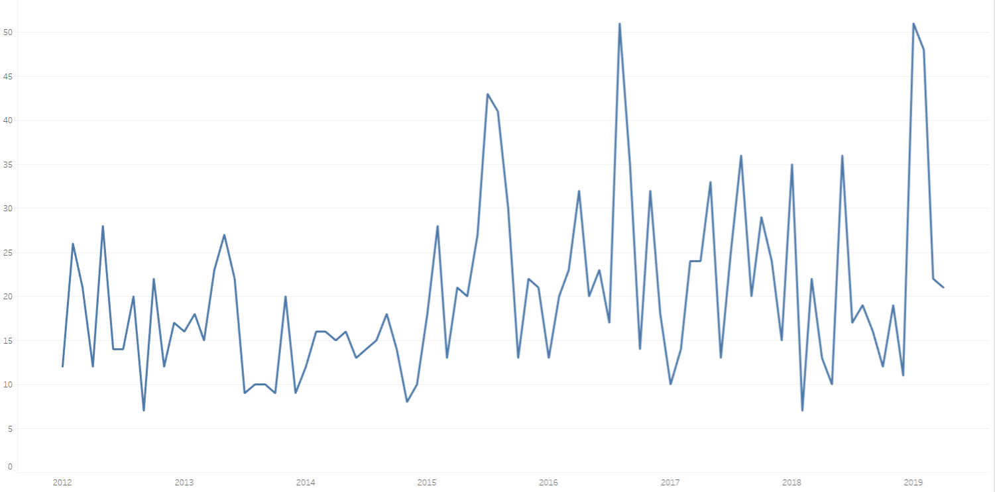
Number of Wiring Repairs by Month Across all Aircraft

Slide 8
Challenge #2
Problem: predicting corrosion from MAF and MSP data

Slide 9
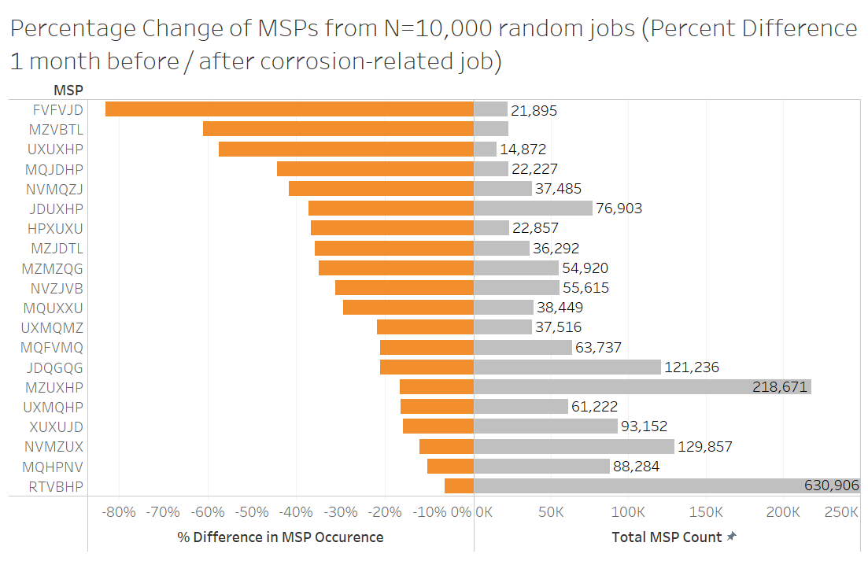

Slide 10
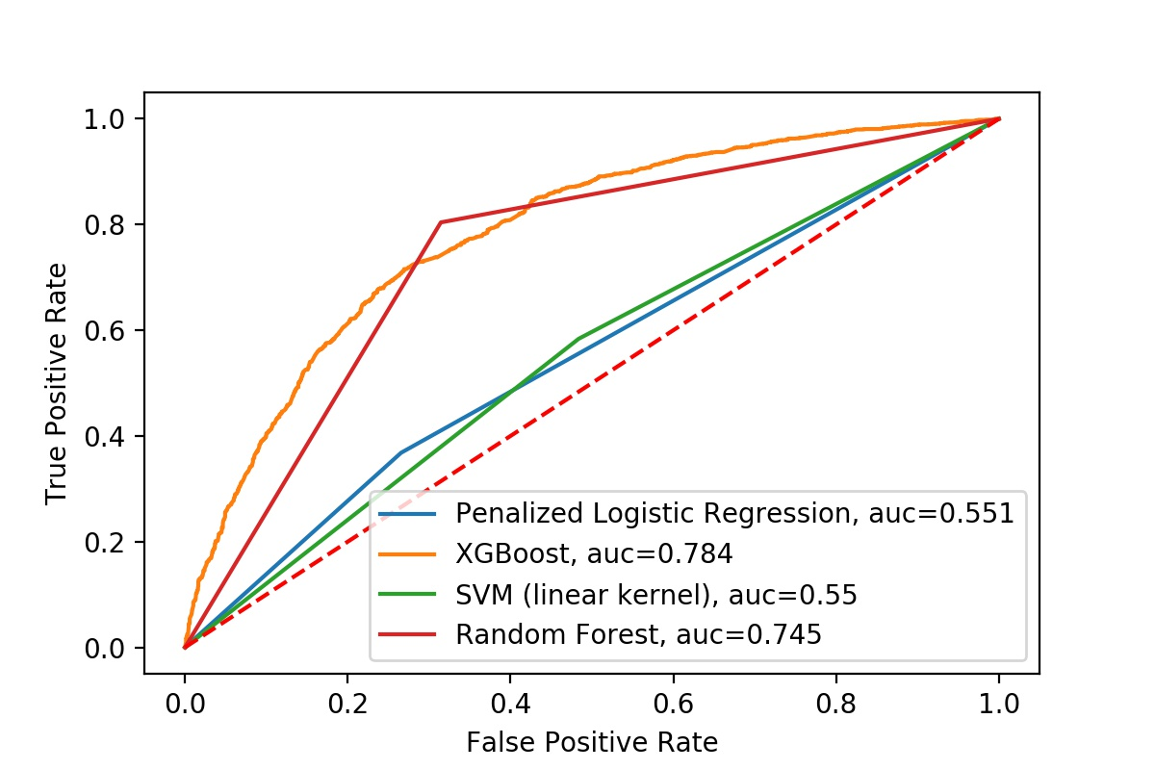

Slide 11
