Slide 1
Get a deal on your next home
Ames, Iowa
Henry Valk

Slide 2
How do we find the best deals on the Ames, Iowa housing market?
Understand what kinds of features influence home prices in the Ames, Iowa market
Build a model to accurately estimate home value
Find homes that are priced substantially below their theoretical value

Slide 3
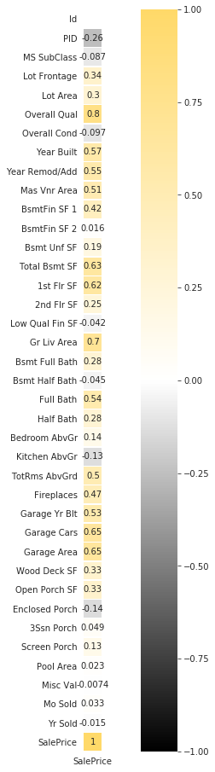
Feature Correlation with Sales Price
Here we can begin to see which features influence home price. ‘Overall Qual’ and ‘Gr Liv Area’ will prove particularly important

Slide 4
Using ridge regularized regression
trained on hundreds of features
from thousands of homes in Ames, Iowa ...

Slide 5
92%
of variance in sale price accounted for by model

Slide 6
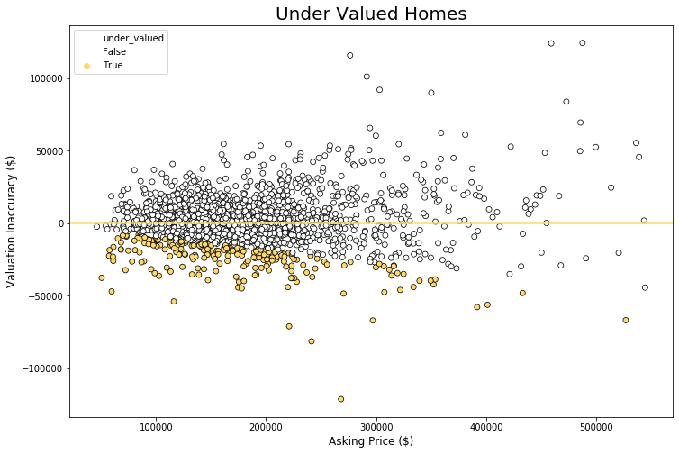

Slide 7
At a Glance
16%
Undervalued homes are located in the North Ames neighborhood
Mean asking price
$145k
+
More deck square footage, basement
square footage, and pool square footage
than overvalued counterparts

Slide 8


Slide 9
Limitations and Future Directions
Potential circularity problem. Are homes undervalued or is model
under fit?
Difficult to directly compare undervalued set to others given sample size disparity. Conduct t-tests in future work
Add drop down menu functionality to housing search widget

Slide 10
Thank you!
https://medium.com/@marekermk/guide-to-interactive-pandas-dataframe-representation-485
acae02946
https://www.oreilly.com/library/view/hands-on-machine-learning/9781492032632/

