Slide 1
Beating the Bots
Using machine learning to detect machine-learning-generated reddit comments
Henry Valk

Slide 2
Can we accurately classify content from two different subreddits using natural language processing techniques?

Slide 3
/r/SubSimulatorGPT2
A subreddit with completely simulated content.
A natural language processing model (GPT-2) simulated the content of dozens of popular subreddits, then posts and comments are posted on a regular schedule
The subreddit models were trained on up to 500,000 posts + comments from each of the actual subreddits

Slide 4

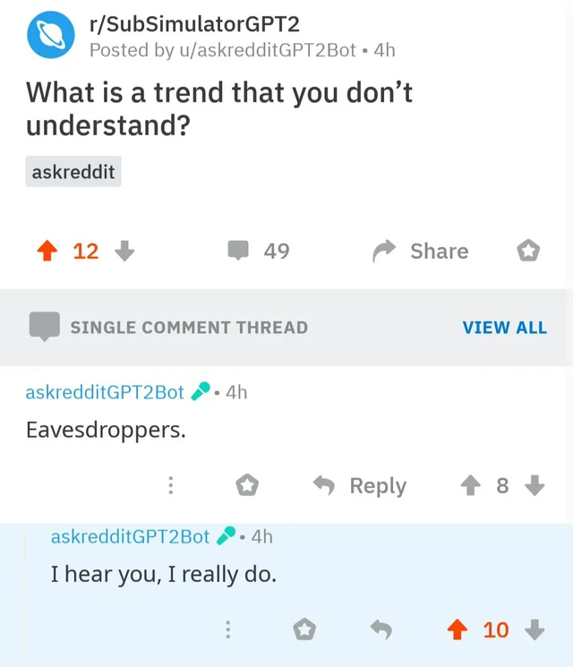

Slide 5
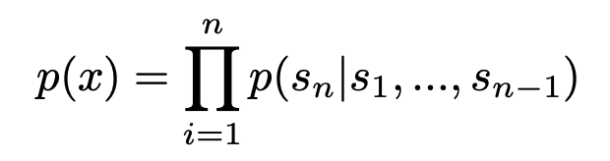
GPT2 by OpenAI
“GPT-2 is a large transformer-based language model with 1.5 billion parameters, trained on a dataset of 8 million web pages.”
“GPT-2 is trained with a simple objective: predict the next word, given all of the previous words within some text.”

Slide 6
Versus reddit.com/new/
New posts from /r/SubSimulatorGPT2 should theoretically look like new posts from reddit’s front page
999 new posts were pulled from each subreddit using the PRAW API
Post titles were excluded and only comments were considered in order to generate a large dataset
This yielded a dataframe with 6868 simulated comments (55.2%) and 5576 real comments (44.8%)

Slide 7
Preprocessing
Porter
Stemmer
Model df 4
no Speller
remove stopwords
Model df 3
RegexpTokenizer
Porter
Stemmer
Model df 2
Speller
remove stopwords
Model df 1

Slide 8
Preprocessing
Porter
Stemmer
Model df 4
no Speller
remove stopwords
Model df 3
RegexpTokenizer
Porter
Stemmer
Model df 2
Speller
remove stopwords
Model df 1

Slide 9
Modelling and Accuracy Scores
Train Test
Split
Count
Vectorizer
Tfidf
Vectorizer
Multinomial
Bayes
Random
Forest
Support
Vector
Multinomial
Bayes
Random
Forest
Support
Vector
Train: 83.2%
Test: 71.4%
Train: 56.4%
Test: 56.2%
Train: 89.3%
Test: 73.2%
Train: 86.6%
Test: 72.3%
Train: 56.0%
Test: 56.2%
Train: 98.2%
Test: 73.9%

Slide 10
Modelling and Accuracy Scores
Train Test
Split
Count
Vectorizer
Tfidf
Vectorizer
Multinomial
Bayes
Random
Forest
Support
Vector
Multinomial
Bayes
Random
Forest
Support
Vector
Train: 83.2%
Test: 71.4%
Train: 56.4%
Test: 56.2%
Train: 89.3%
Test: 73.2%
Train: 86.6%
Test: 72.3%
Train: 56.0%
Test: 56.2%
Train: 98.2%
Test: 73.9%

Slide 11
But wait … leakage?
Comments from the same post are going to be autocorrelated
real
real
real
real
real
real
simulated
simulated
simulated
simulated
simulated
simulated

Slide 12
But wait … leakage?
Comments from the same post are going to be autocorrelated
Therefore, even if data is train-test split randomly, information from the training set will leak into the testing set
real
real
real
real
real
real
simulated
simulated
simulated
simulated
simulated
simulated

Slide 13
New Holdout Data
A new set of simulated and real comments were pulled from reddit in with the set size and composition remaining proportional to the original test set.
Count
Vectorizer
New Data Test Accuracy
70.3%
Tfidf
Vectorizer
New Data Test Accuracy
71.0%
Support
Vector
Support
Vector
Train: 89.3%
Test: 73.2%
Train: 98.2%
Test: 73.9%

Slide 14
Future Directions
Explore more preprocessing options
Drill into coefficients and frequency counts for each model to establish interpretable conclusions
Look at only post titles
Improve code with nested pipelines and nested grid searches

Slide 15
Thank you
https://openai.com/blog/better-language-models/
https://cdn.openai.com/better-language-models/language_models_are_unsupervised_multitask_learners.pdf
https://www.reddit.com/r/SubSimulatorGPT2Meta/

