Slide 1
Unveiling Smoke’s Impact

Slide 2
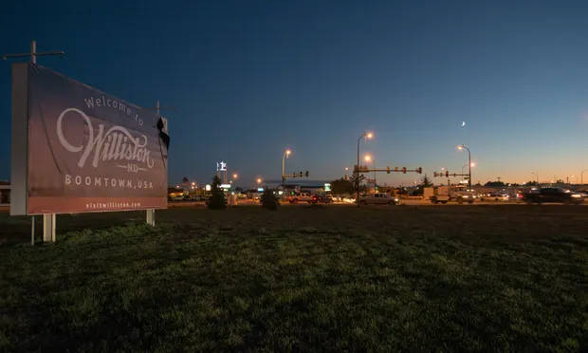
Williston
City in North Dakota
County - Williams
Population - 27,332
Grown 210% in size since 2010 - jumping from a population of 12,120 to 27,500 currently.

Slide 3
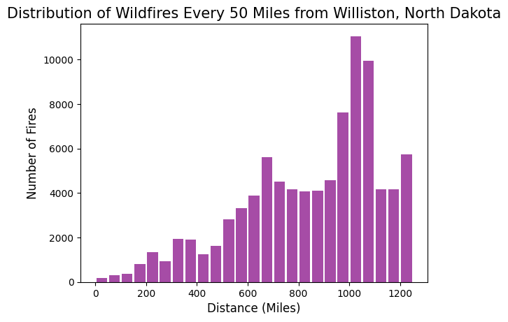

Slide 4
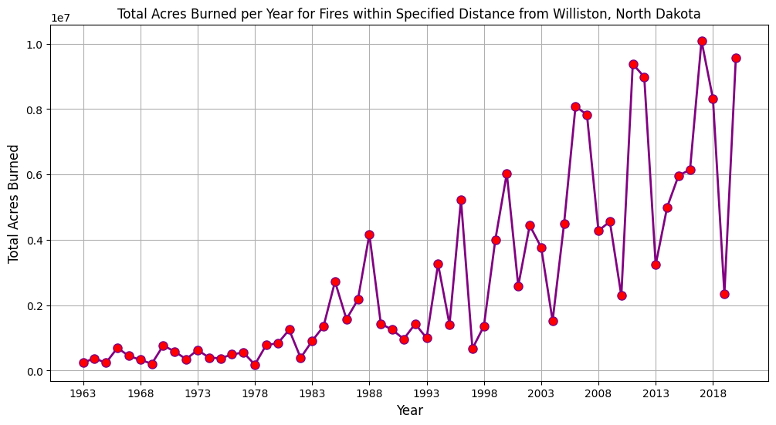

Slide 5
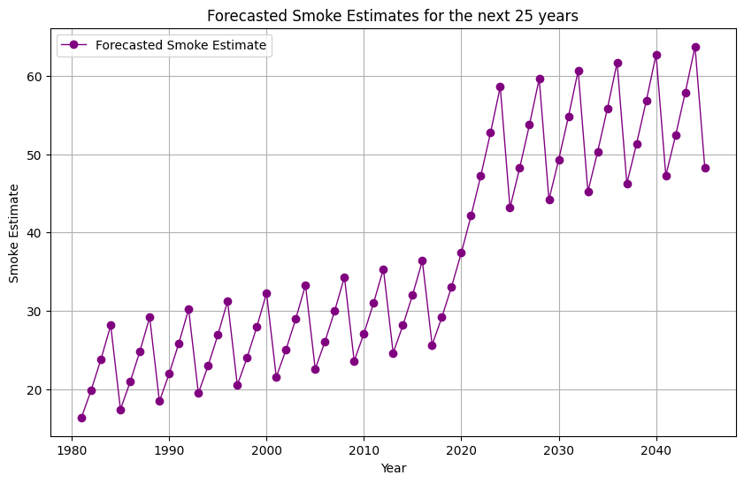

Slide 6
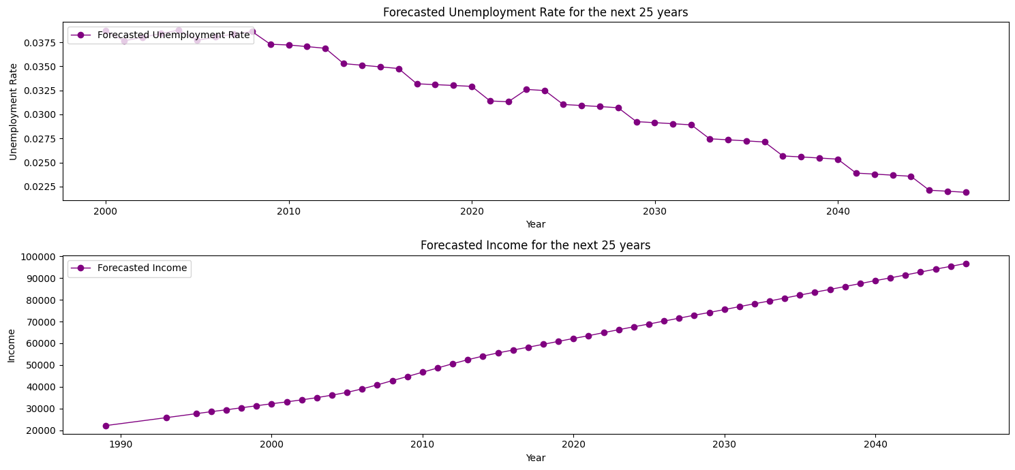

Slide 8
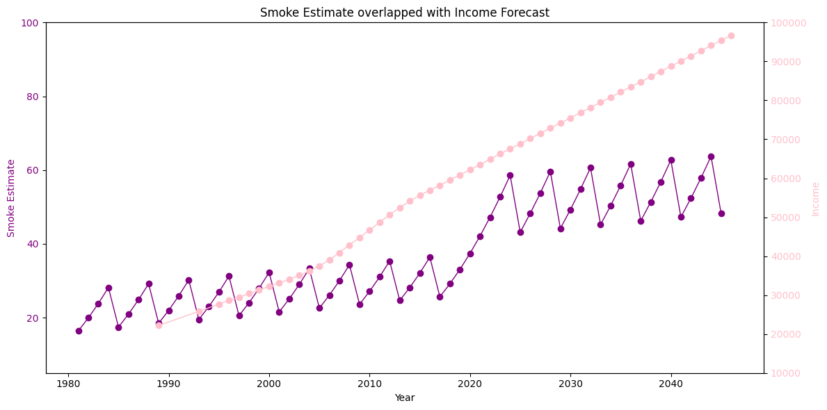

Slide 9
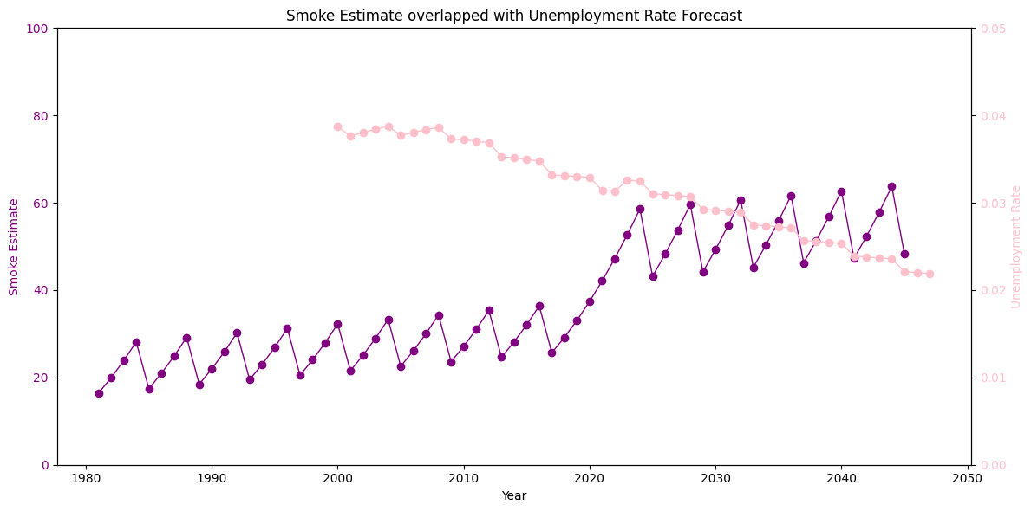

Slide 10


SUGGESTIONS
Economic Resilience Strategies
Public Private Partnerships

Slide 11


SUGGESTIONS
Data Driven Policies
Community Engagement Strategies

