Slide 1

HEROVIRED CAPSTONE PROJECT
End-to-End DevOps Pipeline for a Web Application with CI/CD
Complete Presentation: Objectives, AWS Architecture, Sprint Status & Evidence Standards

Slide 2
PROJECT OVERVIEW
Problem Statement & Project Goals
Automating cloud deployment pipelines to eliminate manual bottlenecks and configuration drift
Problem Statement
Core Project Goals
Operational Bottleneck: DevOps teams require a streamlined CI/CD pipeline to build, test, and deploy code consistently across environments.
Architect AWS environment featuring Load Balancers, EKS orchestration, and monitoring.
Provision VPCs, Subnets, and EKS clusters using modular Terraform scripts.
Orchestration Solution: Utilizing Jenkins as the master orchestrator for a Dockerized app deployed to AWS EKS.
Automate configuration management using Ansible playbooks for target instances.
Automation Drive: Automating infrastructure provisioning and server setup to reduce manual intervention.
Deploy scalable web apps to EKS with Prometheus & Grafana real-time metrics.

Slide 3
ARCHITECTURE & FINANCE
Implementation Strategy & Cost Optimization
Automated multi-tool delivery chain designed for production stability and cloud budget efficiency
Technical Implementation Workflow
Cost Efficiency Measures
Trigger & Build: Git commit triggers Jenkins via webhooks to build Docker container images.
EKS Dynamic Scaling: Auto-scaling node groups scale down to minimum capacity off-peak.
Provision & Config: Jenkins executes Terraform for EKS creation, followed by Ansible node configuration.
S3 Lifecycle Rules: Automatic cleanup of old state backups and build artifacts in AWS ECR.
Registry & Deploy: Images stored in AWS ECR and deployed to EKS via kubectl manifests.
Automated Cleanup: Complete infrastructure teardown validation via terraform destroy.

Slide 4

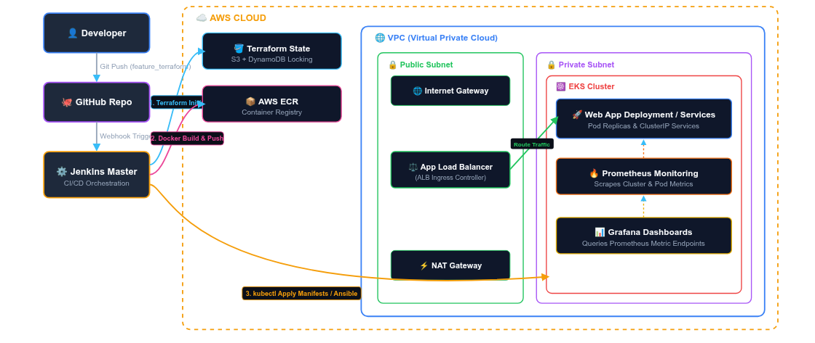
SYSTEM TOPOLOGY
Jenkins-Driven EKS Deployment Architecture
End-to-end cloud infrastructure flow from developer commit to AWS EKS cluster deployment and monitoring

Slide 5
MILESTONE SUMMARY
Complete Project Milestones Overview
Comprehensive breakdown of all 6 project milestones from foundation to teardown
Completed Milestones
Upcoming Execution Milestones
Milestone 1: Architecture Design, Containerization with Docker, ECR Repository, and EC2 Jenkins Server Setup.
Milestone 3: Configuration Management with Ansible Playbooks for dynamic node provisioning post-Terraform.
Milestone 2: AWS Infrastructure Provisioning using Modular Terraform (VPC, EKS, Subnets) with S3 Remote State Locking.
Milestone 4: Declarative Multi-stage Jenkins Pipeline for automated Docker builds, ECR pushing, and EKS deployments.
Milestone 5: Observability stack installation (Prometheus & Grafana Helm charts) with Alertmanager notifications.
Milestone 6: End-to-end integration testing, screenshots evidence documentation, and automated cloud resources teardown.

Slide 6
COMPLETED ARTIFACTS
Dockerization, Jenkins Pipeline and Terraform Infrastructure Provisioning
Established base architecture, containerization, and Terraform infrastructure
Sprint 1: Setup, Containerization & Jenkins Pipeline
Sprint 2: IaC Provisioning
Terraform Scripts: Created modular IaC for VPC, Subnets, Gateways, SGs & EKS.
EKS Design: Formulated multi-subnet VPC architecture with AWS Load Balancer.
Remote Backend: Configured AWS S3 bucket backend with DynamoDB locking.
Containerization: Wrote optimized Dockerfile; verified container image locally & pushed to ECR.
Jenkins Automation: Automated job executing terraform init, terraform plan, and terraform apply.
Jenkins Server: Deployed on EC2 with AWS CLI, Docker, Kubernetes & Git plugins.
State Locking: Secured state synchronization for team collaboration.
Pipeline & Webhooks: Configured Jenkins multi-stage pipeline, IAM credentials, and GitHub webhooks for automatic triggers.

Slide 7
PENDING EXECUTION
Sprints 3 & 4: Configuration & Deployment Plan
Target server configuration and end-to-end Kubernetes delivery pipeline
Sprint 3: Ansible Configuration Plan
Sprint 4: EKS Application CI/CD
Playbooks: Write playbooks to configure EC2, install Docker, kubectl, and dependencies.
Jenkinsfile: Develop multi-stage pipeline (Build, Test, Push, Deploy).
Jenkins Pipeline: Create pipeline job to run playbooks dynamically on AWS resources.
Container Push: Automate Docker image build and push to AWS ECR.
Downstream Flow: Trigger Ansible job automatically following Terraform completion.
K8s Manifests: Deploy Deployment.yaml and Service.yaml to EKS.
Validation: Verify playbook execution across provisioned environments.
Resilience: Configure K8s health checks, readiness probes, and HPA autoscaling.

Slide 8
PENDING EXECUTION
Sprints 5 & 6: Observability & Final Automation
Metrics monitoring, alert routing, final testing, and infrastructure teardown
Sprint 5: Monitoring & Alerting Plan
Sprint 6: Testing & Documentation
Prometheus Setup: Deploy Prometheus in EKS to monitor node and app metrics.
Test Suites: Execute test cases for app functionality and infrastructure integrity.
Grafana Dashboards: Build dashboards visualizing cluster performance and health.
Auto Triggers: Link stage-to-stage triggers (Code push → Build → Deploy).
Jenkins Integration: Monitor build pipelines and underlying infrastructure health.
Documentation: Finalize Terraform, Ansible, K8s, and Jenkins guides.
Alert Routing: Configure Prometheus alerting rules for build failure notifications.
Teardown Verification: Validate resource cleanup via terraform destroy.

Slide 9
EVIDENCE STANDARDS
Documentation & Evidence Plan
Capturing delivery screenshots, naming conventions, and security compliance
Evidence Captures Checklist
Compliance & Redaction
Tool Versions: Terminal captures for terraform, aws, and kubectl.
Naming Rules: Follow exact pattern: YYYY-MM-DD-m2-eks-cluster.png.
IaC Verification: Terminal outputs for terraform plan and AWS Console active EKS cluster.
Redaction Policy: Redact AWS account IDs, private keys, secrets, and IP addresses.
Deployment & App: Jenkins build console logs and live LoadBalancer endpoint HTTP test.
Repo Cleanliness: Keep state files local/backend; store captures under /docs/evidence.

Slide 10

INTERACTIVE DISCUSSION
Questions & Answers
We welcome your questions, feedback, and discussion regarding our architecture, implementation plan, and pipeline execution.
Q&A Session Open

Slide 11

PRESENTATION COMPLETE
Thank You!
End-to-End DevOps Pipeline for a Web Application with CI/CD

