Slide 1
An Analysis of Expenditure on Food
Harsha Vardhan Dasarathy
Dept. of Applied Math and Statistics,
Stony Brook University
Stony Brook, NY

Slide 2
Introduction
The analysis in the following slides inspects the spending patterns on food and specifically on food away from home.
The study focuses on two cities: Los Angeles and San Francisco.
All data presented is from publicly available data at http://www.bls.gov/cex/csxmsa.htm , extending from 1987 – 2013 (with a break in 1996).

Slide 3
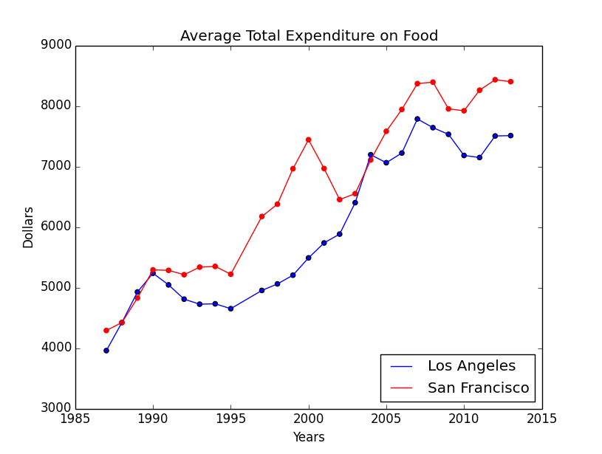
The adjoining image shows the total spending on food in the two cities.
Immediately, there are some interesting points to make note of in this image.

Slide 4
There is a remarkable rate of increase in spending on food in SF in the late ‘90s at the time of the dot-com bubble when Bay Area companies were doing incredibly well. This is followed by a drop in spending that is just as drastic at the time of the bursting of the dot-com bubble.
Both cities were adversely affected by the recession in 2008 – 2010 with spending dropping across those years.

Slide 5
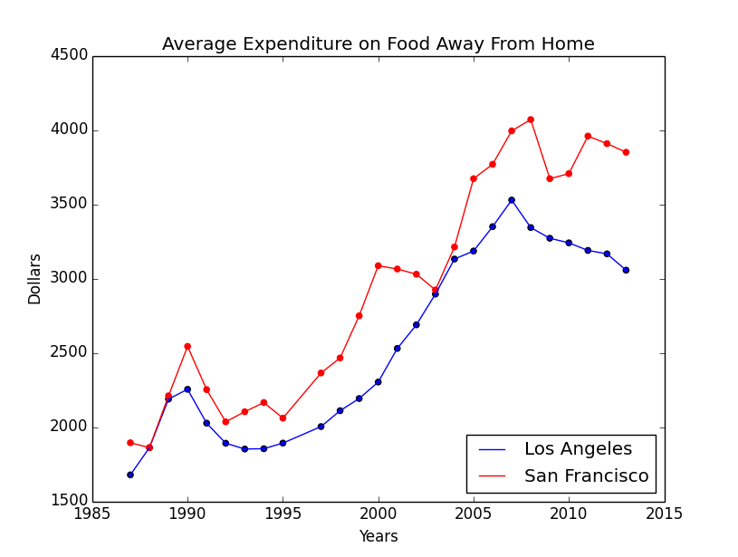
This image shows the average amount of expenditure on food away from home in the two cities.
Both lines are broadly very similar to the total expenditure lines, as would be expected.
However, this graph shows the effects of the early ‘90s recession more clearly than the previous graph.
This might help in ascertaining when we could expect the lines to start recovering from the decline they have been in since the last recession.

Slide 6
In addition, the LA line seems to follow a steady line growth curve in the period between the two recessions while the SF line is a lot more volatile.
The downturns are also a lot more steady in LA than SF.
This would seem to be in line with the difference in the two cities’ economies.
Broadly, one associates SF and the Bay Area with start-ups and a high growth/high volatility environment which is also exhibited in this expenditure graph.

Slide 7
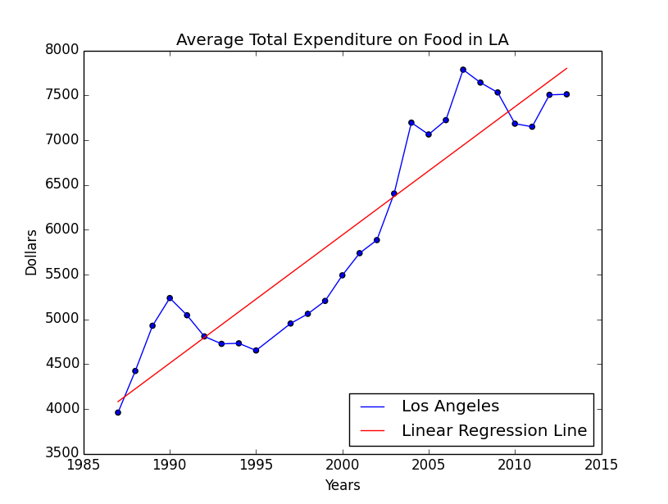
A More In-Depth Look at LA
This plot shows the linear regression line on total expenditure on food.
Using this line, the expected expenditure on food in 2014 would be $7942.90.
The square root of the average squared error over the years, is $447.44.

Slide 8
A More In-Depth Look at LA
Overall, the error exceeds the average error in 10 out of 26 years.
Therefore, we can say that forecast shown previously will be within the average error with probability 0.615.
Interestingly, the average error in the last 5 years is only $260, which is a positive trend and would give more confidence in the accuracy of the current forecast.

Slide 9
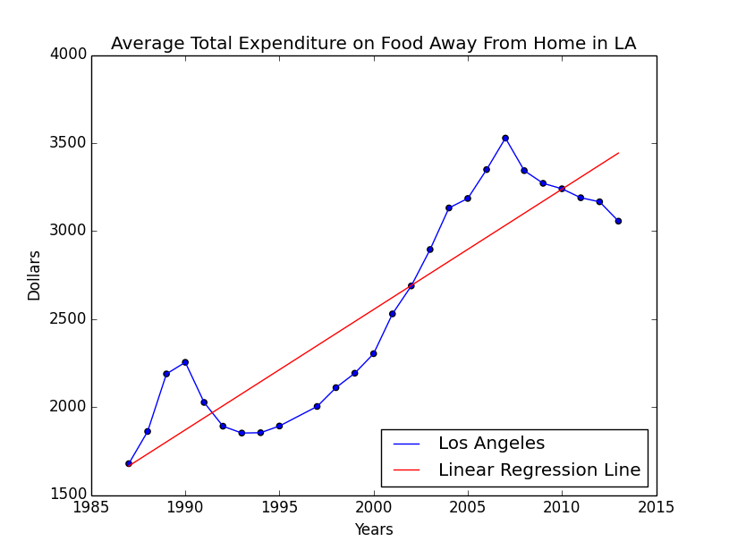
A More In-Depth Look at LA
This plot shows the average expenditure on food away from home and the regression line.
As mentioned before, this graph seems to indicate bad news for restaurant owners.
The regression line implies that the spending in 2014 will be $3511.17.
However, this estimate must be treated with caution as there is clearly a downward trend in the data while the regression line is strictly increasing.

Slide 10
A More In-Depth Look at LA
In an attempt to gauge how much longer there will be a downturn on food away from expenditure, the effects of the early 90s recession is considered.
The GDP contraction during the recession in the early 90s was 1.4%. This contraction of 1.4% resulted in three years of consecutively decreasing expenses away from home.
The GDP contraction due to the 08-09 financial crisis was 4.3%.
Assuming, a simplified linear relationship between the size of the recession and the period of time required for expenditure to start showing positive differences again, a decreasing period of around 9 years is implied.

Slide 11
A More In-Depth Look at LA
Having already seen 6 years of decline in expenditure, these results would imply the period of negative year-to-year differences will come to a close in the next 2-3 years.

Slide 12
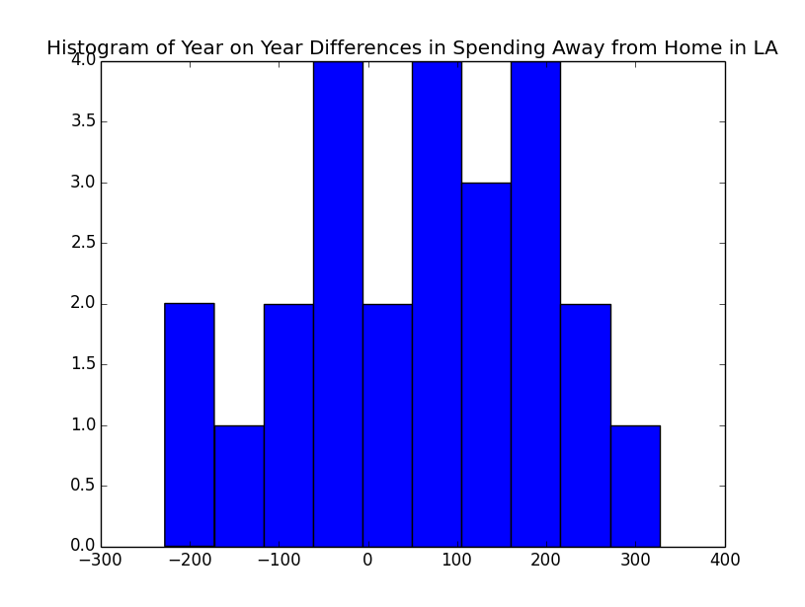
A More In-Depth Look at LA
This histogram shows the frequencies of year-on-year difference in the amount of money spent on food away from home in LA.
Using the Kolmogorov-Smirnov Test for goodness of fit(chi-squared test cannot be due to the small number of data points), the null hypothesis that this distribution is normal cannot be rejected.
The sample mean of this normal fitted distribution is $52.90 and the standard deviation is $137.68.

Slide 13
A More In-Depth Look at LA
Therefore, the expectation of the total amount of expenditure on food away from home in LA in 2014 will be the amount spent in 2013 + $52.90 = 3108.90 with a standard deviation of $137.68.

Slide 14
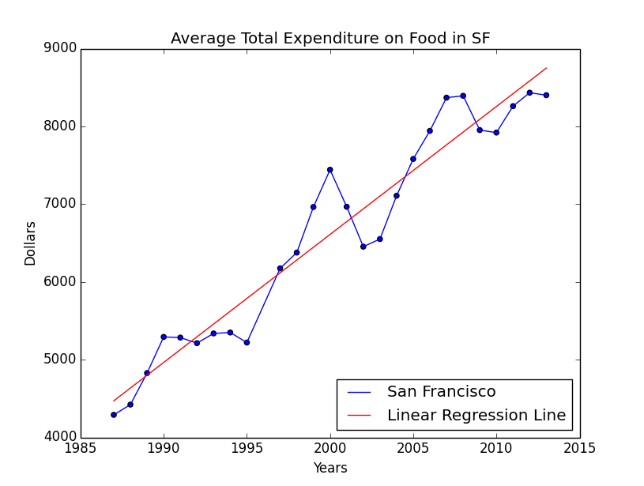
A More In-Depth Look at SF
This plot shows the linear regression line on total expenditure on food in SF.
Using this line, the expected expenditure on food in 2014 would be $8914.06.
The square root of the average squared error over the years, is $352.67.

Slide 15
A More In-Depth Look at SF
Overall, the error exceeds the average error in 7 out of 26 years.
Therefore, we can say that forecast shown previously will be within the average error with probability 0.731.
Interestingly, the average error in the last 5 years is $227.13, which is a positive trend and would give more confidence in the accuracy of the current forecast.

Slide 16
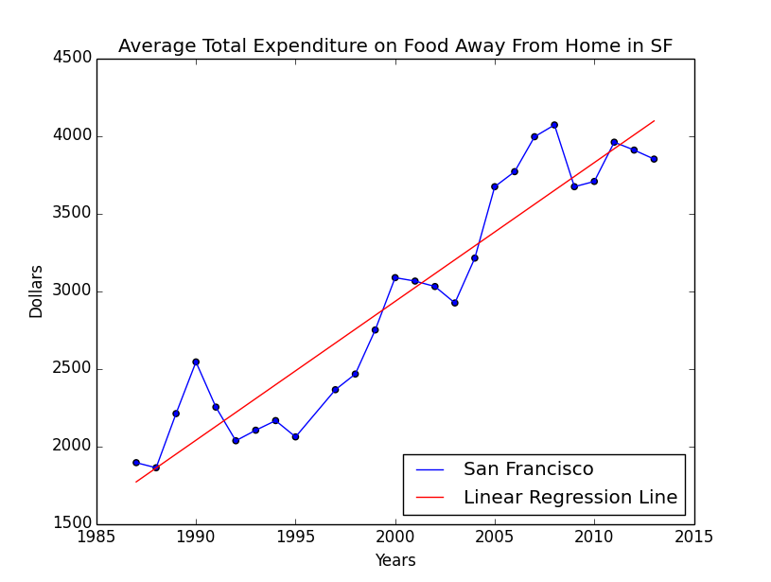
A More In-Depth Look at SF
This plot shows the average expenditure on food away from home and the regression line in SF.
As mentioned before, this graph seems to indicate bad news for restaurant owners.
This graph is slightly different from that of LA, where there was a decline in spending every year since the recession.
Here there are a couple of years of increase in the middle before the negative differences resume.

Slide 17
A More In-Depth Look at SF
The regression line implies average spending of $4185.19.
Once again, this estimate should be treated with caution as the data is currently trending away from the estimate.
Using the early 90s recession as a benchmark in a similar fashion as was done previously, one would expect the downward trends to end after about 6 – 7 years.

Slide 18
A More In-Depth Look at SF
Currently, there have been 5 years of overall decline in spending, however with a couple of years of moderate increases in spending, the relationship isn’t quite as clear as it was in LA.

Slide 19
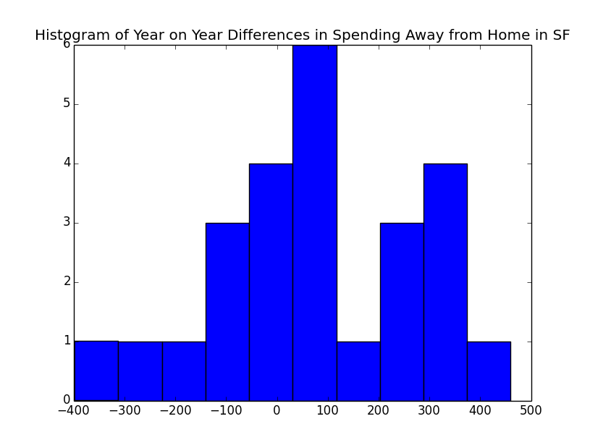
A More In-Depth Look at SF
This histogram shows the frequencies of year-on-year difference in the amount of money spent on food away from home in SF.
Using the Kolmogorov-Smirnov Test for goodness of fit(chi-squared test cannot be due to the small number of data points), the null hypothesis that this distribution is normal cannot be rejected.
The sample mean of this normal fitted distribution is $72.16 and the standard deviation is $208.40.

Slide 20
A More In-Depth Look at SF
Therefore, the expectation of the total amount of expenditure on food away from home in LA in 2014 will be the amount spent in 2013 + $72.16 = 3922.16 with a standard deviation of $208.40.

Slide 21
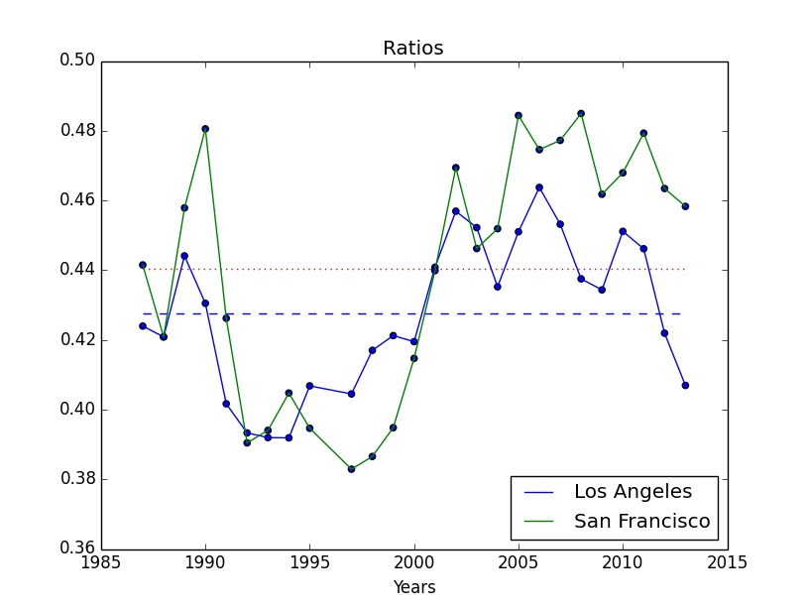
Ratios of Food Away From Home
This plot shows the fraction of total expenditure on food that was spent on food away from home in the two cities (the dashed lines indicate the average).
These plots give an indication of the culture of eating out in the two cities.
Almost throughout the period under analysis, there was a higher fraction of spending on food away from home in SF.

Slide 22
Ratios of Food Away From Home
In general, people in SF spent about 44% of their food expenditure on food away from home while that same number in LA was 42.7%.
Both lines have very similar characteristics, with one particularly interesting feature.
In the middle of each economic slowdown that occurred during this time period, this fraction spikes up before plunging in the aftermath of the slowdown.
This would imply that in the immediacy of an economic downturn, people begin to eat out more before cutting costs once the realities of the slowdown hit.

Slide 23
Summary
San Francisco and Los Angeles have both seen the average amount of money spent on food decline in the last few years since the recession.
This decline has also been seen in the amount of money spent in restaurants and other eateries.
In general, people in San Francisco spend a higher portion of their food budget away from home than people in Los Angeles.

Slide 24
Summary
A point that must be noted is that the population of Los Angeles is almost double that of San Francisco and so the gross values of LA could be greater than those of SF. This analysis has been undertaken on a per-capita basis.
Finally, these results show that spending on food is an indicator of the health of the economy which definitively proves that food can do anything!

