Slide 1





Training
Prediction
Buggy
Labeling data
Extracting features
Clean
Software History
Features
Classification Model
Extracting features
New Software
Features

Slide 2
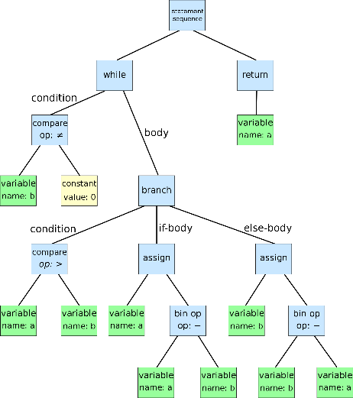

Parsing AST
Generating features
Features
Source Files

Slide 3


Input Layer
$$ℒ$$
Input Layer
….
Hidden Layer
………….
Features
….
Output
$$ℒ′$$
Encoder
Decoder

Slide 4

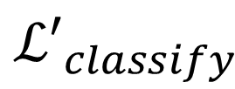
$$ℒ_{reconstruct}$$
Input Layer
Input Layer
Hidden Layer
$${ℒ′}_{classify}$$
Features
Output

Slide 5


Input Layer
$$ℒ$$
Input Layer
….
Hidden Layer
Parsing AST
Generating features
………….
Features
Source Files
….
Output
$$ℒ′$$
Encoder
Decoder

