Slide 1





Training
Prediction
Buggy
Labeling data
Extracting features
Clean
Software History
Features
Classification Model
Extracting features
New Software
Features

Slide 2
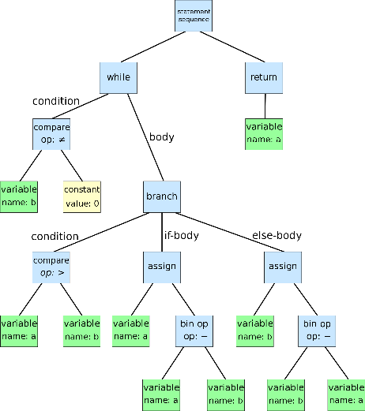

Parsing AST
Generating features
Features
Source Files

Slide 3


Input Layer
$$ℒ$$
Input Layer
….
Hidden Layer
………….
Features
….
Output
$$ℒ′$$
Encoder
Decoder

Slide 4
Input Layer
$$ℒ$$
Input Layer
Hidden Layer
Features
Output
$$ℒ′$$

Slide 5


Input Layer
$$ℒ$$
Input Layer
….
Hidden Layer
Parsing AST
Generating features
………….
Features
Source Files
….
Output
$$ℒ′$$
Encoder
Decoder

