Slide 1
commit message matrix
convolution feature map
max pooling
filter
embedding dimension

Slide 2
line of code matrix
CNN-2D
representation features
embedding dimension
…

Slide 3
commit message matrix
convolution feature map
max pooling
filter
embedding dimension

Slide 4

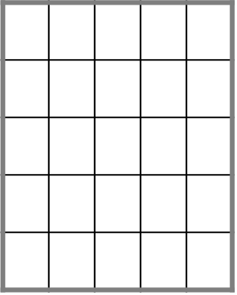
representation vector
CNN-2D
CNN-3D
……
……
……
……

Slide 5
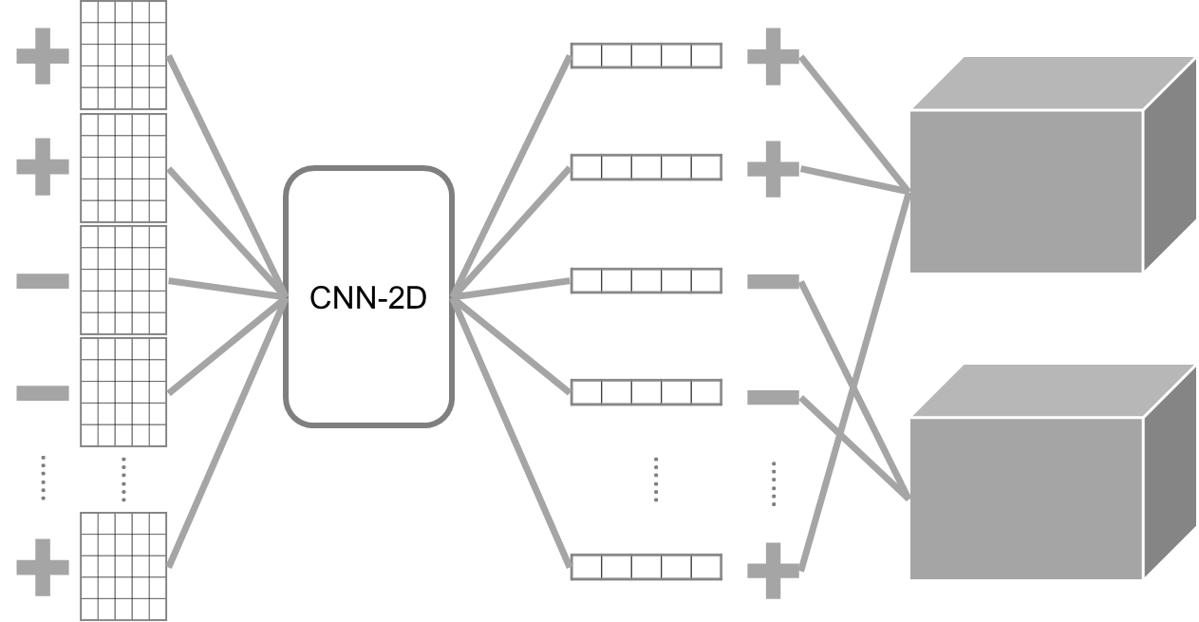
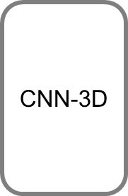

Slide 6
convolution feature map
representative vector
flatten
pooling
……

Slide 8
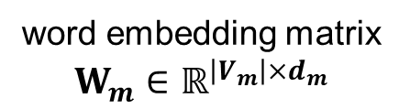
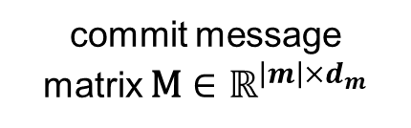

return
return
proper
$${\text{e}}_{m}$$
.
.
errono
a max pooling operation
.
proper
value
.
.
.
.
.
.
.
.
.
.
an embedding vector
.
.
value
word embedding matrix $W_{m}∈ℝ^{{\left|V_{m}\right|×d}_{m}}$
commit message
matrix $\text{M}∈ℝ^{{\left|m\right|×d}_{m}}$
a convolution layer with multiple filters + a ReLU activation function

Slide 9

return
return
proper
.
$${\text{e}}_{m}$$
.
errono
a max pooling operation
.
proper
value
.
.
.
.
.
.
.
.
an embedding vector
.
.
.
proper
value
word embedding matrix $W_{m}∈ℝ^{{\left|V_{m}\right|×d}_{m}}$
commit message
matrix $\text{M}∈ℝ^{{\left|m\right|×d}_{m}}$
a convolution layer with multiple filters + a ReLU activation function

Slide 11
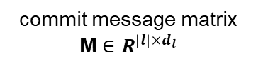
a convolution layer with multiple filters + a non-linear activation function
a max pooling operation
a vector representation
commit message matrix M $∈R^{{\left|l\right|×d}_{l}}$

Slide 12
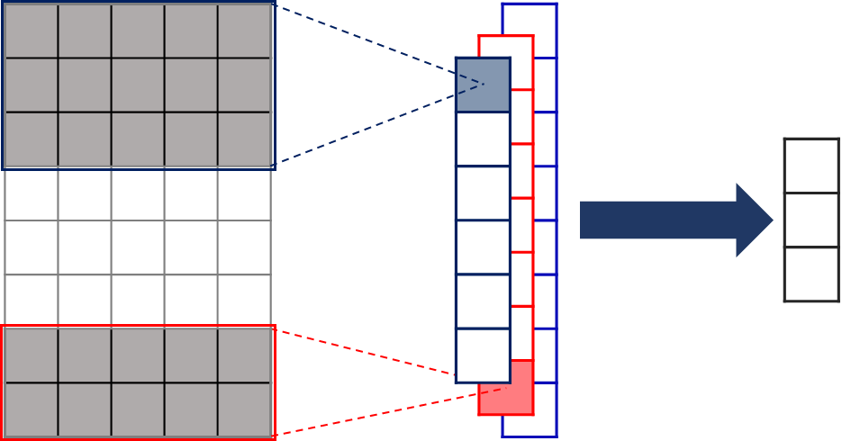
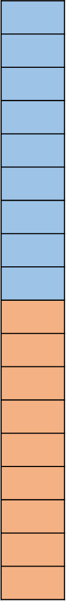
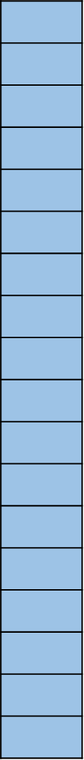




flatten
CNN-3D
$$…$$
flatten
CNN-3D
$$…$$
$$…$$
$$…$$
a CNN-3D includes a 3D convolutional layer, a non-linear activation function, and a 3D pooling layer
commit line model for each removed/added line in commit code

Slide 13
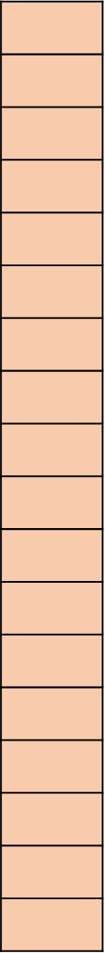


CNN-3D
$$…$$
$$…$$
CNN-3D
a CNN-3D for mapping removed or added code changes
an embedding vector
commit line module is used for each removed or added line

Slide 15
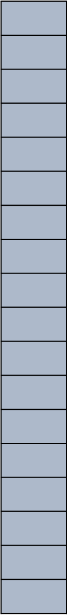



flatten
filters
$$…$$
$$…$$
$$…$$
a 3D convolution layer with multiple filters + a RELU activation function
a 3D max pooling layer
an embedding vector

Slide 16
flatten
$$…$$
flatten
$$…$$
$$…$$
$$…$$

Slide 17
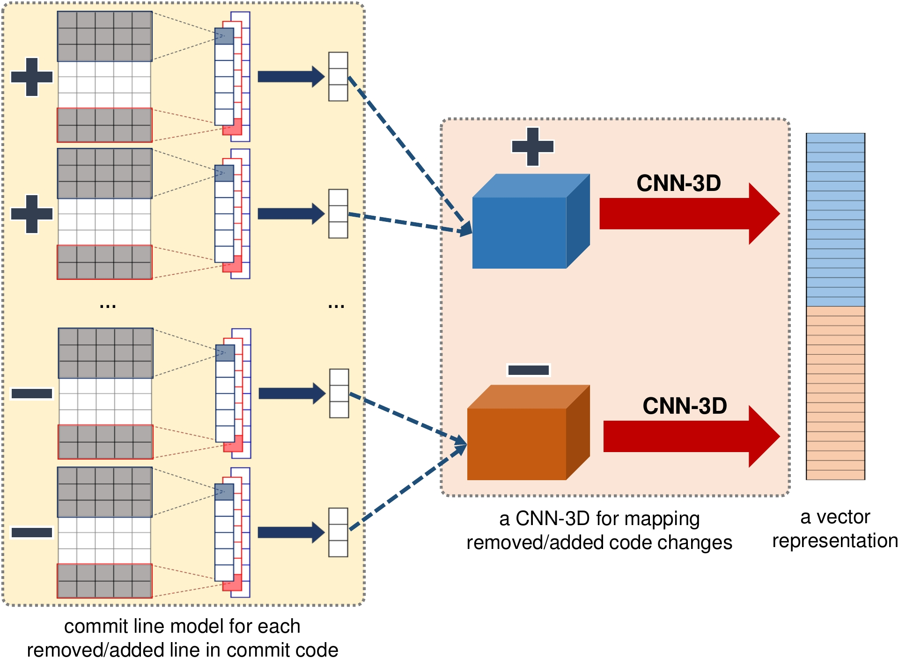


Slide 18
CNN-3D
$$…$$
$$…$$
CNN-3D

Slide 19
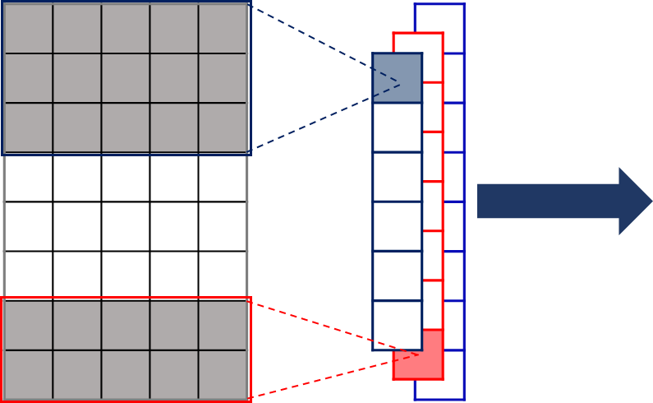
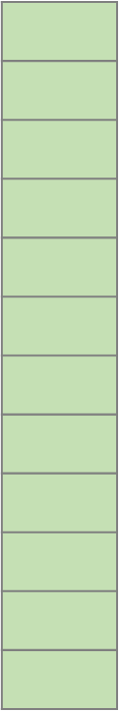

Slide 20
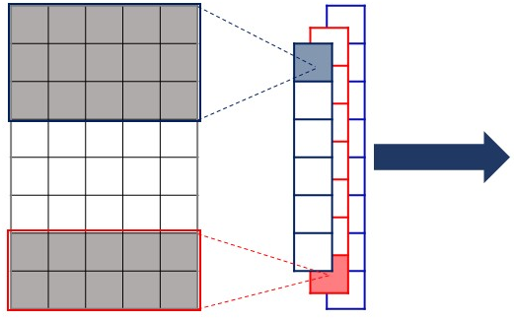
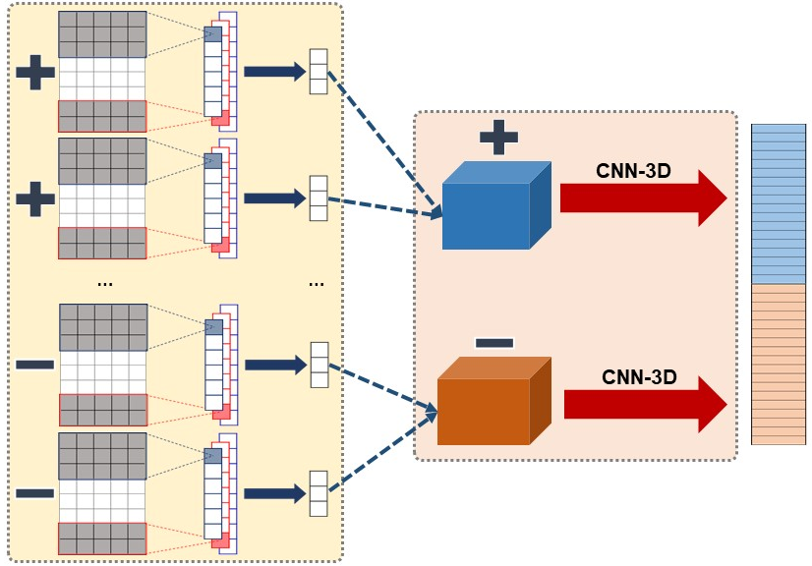
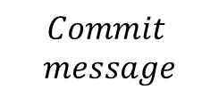



$$Commit$$
$$message$$
$${File}_{1}$$
$$…$$
$${File}_{u}$$

Slide 21
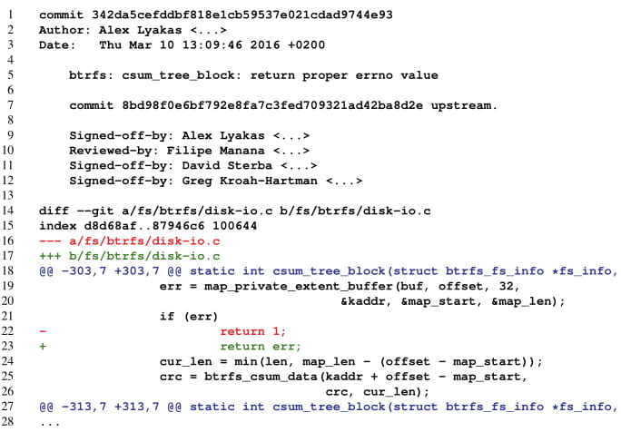
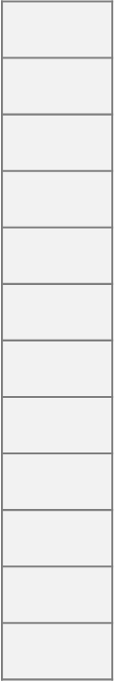
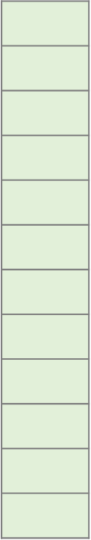



$${\text{e}}_{m}$$
FC
Commit message
module
Commit line module
output layer
Commit file module
a sample patch
Commit code module
$$\text{e}$$
a fully-connected layer
$$e_{c}$$
Classification module

Slide 22
$$e^{x}=1+\frac{x}{1!}+\frac{x^{2}}{2!}+\frac{x^{3}}{3!}+…, −∞<x<∞ \backslash mathcal\left(V\right)$$

Slide 23


$${\text{e}}_{m}$$
FC
Commit message
module
Commit line module
output layer
Commit file module
a sample patch
Commit code module
$$\text{x}$$
a fully-connected layer
$${\text{e}}_{c}$$
Classification module

Slide 24



$${\text{e}}_{m}$$
FC
output layer
$${\text{e}}_{c}$$
$$\text{e}$$
a fully-connected layer
Classification module

Slide 25



$${\text{e}}_{r}$$
extract removed module
extract added module
$${\text{e}}_{a}$$
an embedding vector
Commit file module

Slide 26



$${\text{e}}_{r}$$
$${\text{e}}_{f}$$
removed code module
added code module
Commit file module
$${\text{e}}_{a}$$
an embedding vector

Slide 27
$${\text{e}}_{r}$$
$${\text{e}}_{f}$$
removed code module
added code module
File module
$${\text{e}}_{a}$$
an embedding vector

Slide 28
$${\text{e}}_{m}$$
FC
Commit message
module
Commit line module
output layer
Commit file module
a sample patch
Commit code module
$$\text{e}$$
a fully-connected layer
$$e_{c}$$
Classification module

Slide 29




$${\text{e}}_{m}$$
FC
Commit message
module
Commit line module
a sample patch
output layer
Commit file module
Commit code module
$$\text{e}$$
a fully-connected layer
PatchNet
$${\text{e}}_{c}$$
Classification module

Slide 30
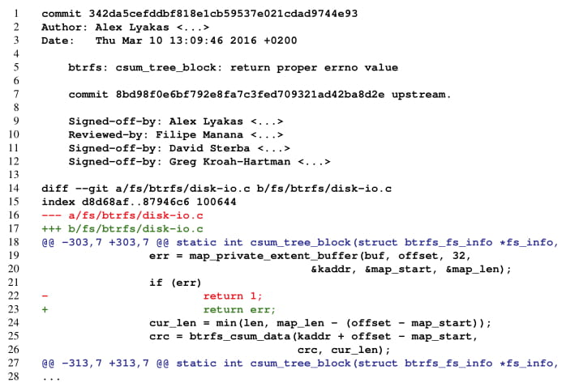



$${\text{e}}_{m}$$
FC
Commit message
module
Commit line module
output layer
Commit file module
Commit code module
$$\text{e}$$
a fully-connected layer
PatchNet
$${\text{e}}_{c}$$
Classification module
a sample patch

