Slide 1
Commit message
Code changes
Encoding
Encoding
Input layer
Convolutional network for natural language
Convolutional network for code changes
Feature extraction
Fully connected network for feature fusion
Feature combination
Output
Output layer

Slide 2
Long-period training data
Short-period training data
Period 1 | Period 2 | Period 3 | Period 4 | Period 5

Slide 3


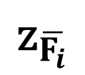
+class OVSBridge(BaseOVS):
+ super(OVSBridge, self)._init_(root_helper)
- self.root_helper = root_helper
- def run_vsctl(self, args):
…
…
$${\text{z}}_{\overline{F_{i}}}$$
$$\overline{F_{i}}$$
Convolutional layer + max pooling layer to out put the embedding vector of the code change
$$F_{i}∈ℝ^{{ 𝓝×𝓛×d}_{c}}$$
Convolutional layer + max pooling layer to out put the new representation of the code change

Slide 4


Commit message (${\text{z}}_{\text{m}}$)
Code changes (${\text{z}}_{C}$)
Feature fusion ($\text{z}$)
FULLY CONNTECTED LAYER
Output

Slide 5



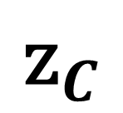
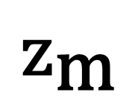

$${\text{z}}_{\text{m}}$$
FC
output layer
$$\text{e}$$
a fully-connected layer
$${\text{z}}_{C}$$
Classification module

Slide 6
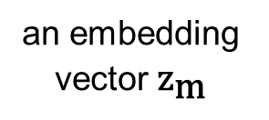
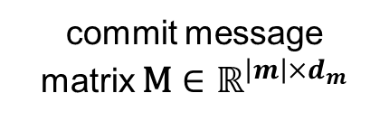
improve
packer-filter
test
a max pooling layer
coverage
an embedding vector ${\text{z}}_{\text{m}}$
commit message
matrix $\text{M}∈ℝ^{{\left|m\right|×d}_{m}}$
a convolution layer with multiple filters + a ReLU activation function

Slide 7
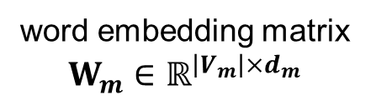
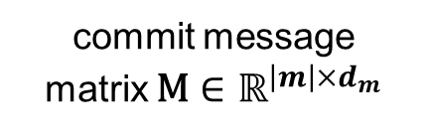

return
return
proper
$${\text{e}}_{m}$$
.
.
errono
a max pooling operation
.
proper
value
.
.
.
.
.
.
.
.
.
.
an embedding vector
.
.
value
word embedding matrix $W_{m}∈ℝ^{{\left|V_{m}\right|×d}_{m}}$
commit message
matrix $\text{M}∈ℝ^{{\left|m\right|×d}_{m}}$
a convolution layer with multiple filters + a ReLU activation function

Slide 8

INPUT
CONVOLUTIONAL + RELU
POOLING
FLATTEN
FULLY CONNECTED
OUTPUT

Slide 9


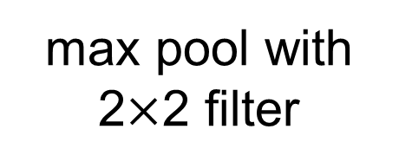
1 | 1 | 1 | 0 | 0
0 | 1 | 1 | 1 | 0
0 | 0 | 1 | 1 | 1
0 | 0 | 1 | 1 | 0
0 | 1 | 1 | 0 | 0
1 | 0 | 1
0 | 1 | 0
1 | 0 | 1
4 | 3 | 4
2 | 4 | 3
2 | 3 | 4
max pool with 2$×$2 filter
$$∗$$
$$=$$
4 | 4
4 | 4
INPUT
FILTER
ACTIVATION MAP

