Slide 1
Commit message
Code changes
Encoding
Encoding
Input layer
Convolutional network for natural language
Convolutional network for code changes
Feature extraction
Fully connected network for feature fusion
Feature combination
Output
Output layer

Slide 2
Long-period training data
Short-period training data
Period 1 | Period 2 | Period 3 | Period 4 | Period 5

Slide 3


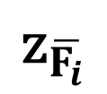
+class OVSBridge(BaseOVS):
+ super(OVSBridge, self)._init_(root_helper)
- self.root_helper = root_helper
- def run_vsctl(self, args):
$${\text{z}}_{\overline{F_{i}}}$$
$$\overline{F_{i}}$$
Convolutional layer + max pooling layer to out put the embedding vector of the code change
$$F_{i}∈ℝ^{{ 𝓝×𝓛×d}_{c}}$$
Convolutional layer + max pooling layer to out put the new representation of the code change

Slide 4


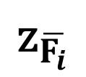
sa.Column('direction', ....
+ sa.Column('direction',
+ sa.Enum('ingress', 'egress',
$${\text{z}}_{\overline{F_{i}}}$$
$$\overline{F_{i}}$$
Convolutional layer + max pooling layer to out put the embedding vector of the code change
$$F_{i}∈ℝ^{{ 𝓝×𝓛×d}_{c}}$$
Convolutional layer + max pooling layer to out put the new representation of the code change

Slide 5


Commit message (${\text{z}}_{\text{m}}$)
Code changes (${\text{z}}_{C}$)
Feature fusion ($\text{z}$)
FULLY CONNECTED LAYER
Output

Slide 6




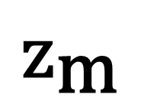

$${\text{z}}_{\text{m}}$$
FC
output layer
$$\text{e}$$
a fully-connected layer
$${\text{z}}_{C}$$
Classification module

Slide 7
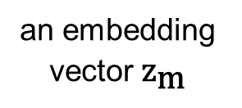
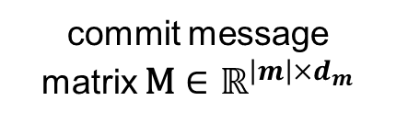
Name
the
security
a max pooling layer
group
an embedding vector ${\text{z}}_{\text{m}}$
commit message
matrix $\text{M}∈ℝ^{{\left|m\right|×d}_{m}}$
a convolution layer with multiple filters + a ReLU activation function

Slide 8
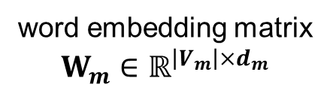
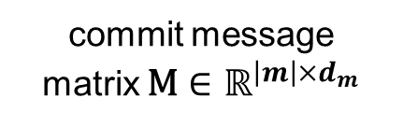

return
return
proper
$${\text{e}}_{m}$$
.
.
errono
a max pooling operation
.
proper
value
.
.
.
.
.
.
.
.
.
.
an embedding vector
.
.
value
word embedding matrix $W_{m}∈ℝ^{{\left|V_{m}\right|×d}_{m}}$
commit message
matrix $\text{M}∈ℝ^{{\left|m\right|×d}_{m}}$
a convolution layer with multiple filters + a ReLU activation function

Slide 9

INPUT
CONVOLUTIONAL + RELU
POOLING
FLATTEN
FULLY CONNECTED
OUTPUT
FEATURE LEARNING
CLASSIFICATION

Slide 10


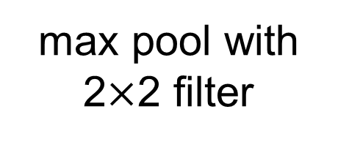
1 | 1 | 1 | 0 | 0
0 | 1 | 1 | 1 | 0
0 | 0 | 1 | 1 | 1
0 | 0 | 1 | 1 | 0
0 | 1 | 1 | 0 | 0
1 | 0 | 1
0 | 1 | 0
1 | 0 | 1
4 | 3 | 4
2 | 4 | 3
2 | 3 | 4
max pool with 2$×$2 filter
$$∗$$
$$=$$
4 | 4
4 | 4
INPUT
FILTER
ACTIVATION MAP

Slide 11
1 | 1 | 1 | 0 | 0
0 | 1 | 1 | 1 | 0
0 | 0 | 1 | 1 | 1
0 | 0 | 0 | 0 | 0
0 | 1 | 1 | 1 | 0
1 | 0 | 1
0 | 1 | 0
1 | 0 | 1
4 | 3 | 4
1 | 2 | 2
2 | 3 | 3
max pool with 2$×$2 filter
$$∗$$
$$=$$
4 | 4
3 | 3
INPUT
FILTER
ACTIVATION MAP

Slide 12
commit d60f6efd7f70efba1ccd007d55b1fa740fb98c76
Author: Dan Prince <email address hidden>
Date: Mon Jan 14 12:26:36 2013 -0500
Name the securitygrouprules.direction enum.
Updates to the SecurityGroupRule model and migration so that we
explicitly name the securitygrouprules.direction enum. This fixes
'Postgresql ENUM type requires a name.' errors.
Fixes LP Bug #1099267.
Change-Id: Ia46fe8d4b0793caaabbfc71b7fa5f0cbb8c6d24b
diff --git a/quantum/db/migration/alembic_migrations/versions/3cb5d900c5de_security_groups.py
index ff39de84a..cf565af0f 100644
--- a/quantum/db/migration/alembic_migrations/versions/3cb5d900c5de_security_groups.py
+++ b/quantum/db/migration/alembic_migrations/versions/3cb5d900c5de_security_groups.py
@@ -62,7 +62,10 @@ def upgrade(active_plugin=None, options=None):
- sa.Column('direction', sa.Enum('ingress', 'egress'), nullable=True),
+ sa.Column('direction',
+ sa.Enum('ingress', 'egress',
+ name='securitygrouprules_direction'),
+ nullable=True),
diff --git a/quantum/db/securitygroups_db.py b/quantum/db/securitygroups_db.py
index 9903a6493..5bd890bbe 100644
--- a/quantum/db/securitygroups_db.py
+++ b/quantum/db/securitygroups_db.py
@@ -62,7 +62,8 @@ class SecurityGroupRule(model_base.BASEV2, models_v2.HasId,
- direction = sa.Column(sa.Enum('ingress', 'egress'))
+ direction = sa.Column(sa.Enum('ingress', 'egress',
+ name='securitygrouprules_direction'))

Slide 13
commit d60f6efd7f70efba1ccd007d55b1fa740fb98c76
Author: Dan Prince <email address hidden>
Date: Mon Jan 14 12:26:36 2013 -0500
Name the securitygrouprules.direction enum.
Updates to the SecurityGroupRule model and migration so that we
explicitly name the securitygrouprules.direction enum. This fixes
'Postgresql ENUM type requires a name.' errors.
Fixes LP Bug #1099267.
Change-Id: Ia46fe8d4b0793caaabbfc71b7fa5f0cbb8c6d24b
diff --git a/quantum/db/migration/alembic_migrations/versions/3cb5d900c5de
_security_groups.py
index ff39de84a..cf565af0f 100644
--- a/quantum/db/migration/alembic_migrations/versions/3cb5d900c5de_
security_groups.py
+++ b/quantum/db/migration/alembic_migrations/versions/3cb5d900c5de_
security_groups.py
@@ -62,7 +62,10 @@ def upgrade(active_plugin=None, options=None):
- sa.Column('direction', sa.Enum('ingress', 'egress'), nullable=True),
+ sa.Column('direction',
+ sa.Enum('ingress', 'egress',
+ name='securitygrouprules_direction'),
+ nullable=True),
diff --git a/quantum/db/securitygroups_db.py b/quantum/db/securitygroups_db.py
index 9903a6493..5bd890bbe 100644
--- a/quantum/db/securitygroups_db.py
+++ b/quantum/db/securitygroups_db.py
@@ -62,7 +62,8 @@ class SecurityGroupRule(model_base.BASEV2, models_v2.HasId,
- direction = sa.Column(sa.Enum('ingress', 'egress'))
+ direction = sa.Column(sa.Enum('ingress', 'egress',
+ name='securitygrouprules_direction'))

