Slide 1

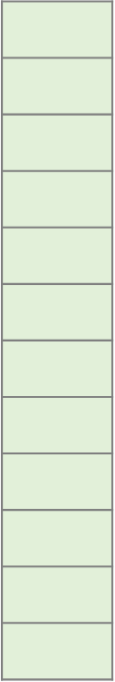


$${\text{e}}_{m}$$
Commit message
module
a sample patch (see Fig. 1)
Classification module
Commit line module
Commit file module
Commit code module
$${\text{e}}_{c}$$
PatchNet

Slide 2


$${\text{e}}_{m}$$
Commit message
module
a sample patch (see Fig. 1)
Classification module
Commit line module
Commit file module
Commit code module
PatchNet
$${\text{e}}_{c}$$

Slide 3
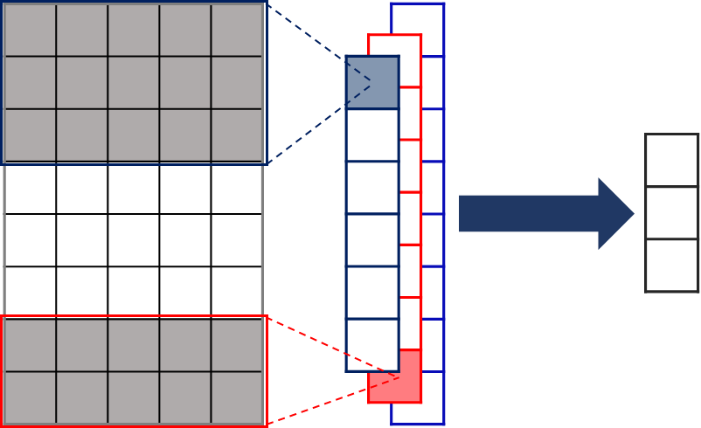





$${\text{e}}_{r}$$
filters
$$…$$
$$…$$
$$…$$
$$…$$
commit line module for each removed line in a file
a 3D convolution layer with multiple filters + a ReLU activation function
a 3D max pooling layer
flatten + concatenate
an embedding vector
CNN-3D
removed code module

Slide 4
$${\text{e}}_{r}$$
filters
$$…$$
$$…$$
$$…$$
$$…$$
commit line module for each removed line in a file
a 3D convolution layer with multiple filters + a ReLU activation function
a 3D max pooling layer
flatten + concatenate
an embedding vector
3D-CNN
removed code module

Slide 5
$${\text{e}}_{m}$$
Commit message
module
a sample patch
Classification module
Commit line module
Commit file module
Commit code module
PatchNet
$${\text{e}}_{c}$$

