Slide 1
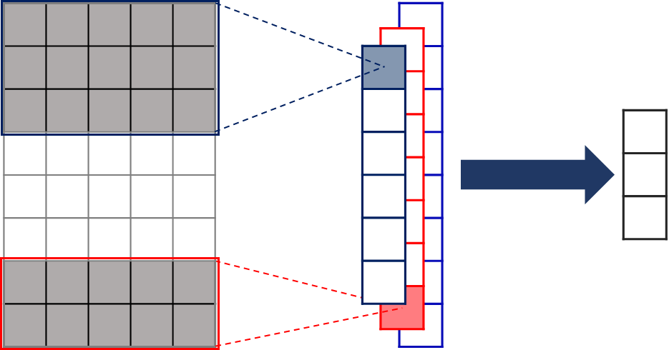
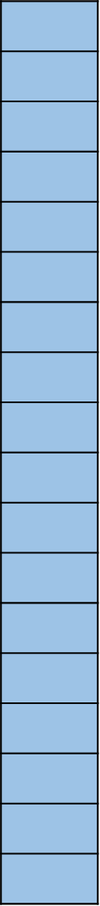


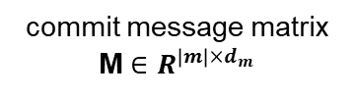

Commit message model
commit message matrix M $∈R^{{\left|m\right|×d}_{m}}$
a convolution layer with multiple filters + a non-linear activation function
FC
Soft-max
CNN-3D
$$…$$
$$…$$
CNN-3D
Commit code model
…
CNN-3D
$$…$$
$$…$$
CNN-3D

