Slide 1
commit message matrix
convolution feature map
max pooling
filter
embedding dimension

Slide 2
line of code matrix
CNN-2D
representation features
embedding dimension
…

Slide 3
commit message matrix
convolution feature map
max pooling
filter
embedding dimension

Slide 4

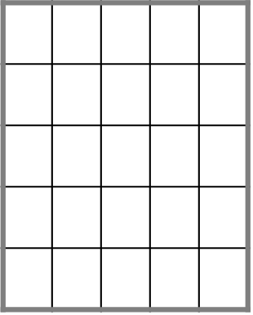
representation vector
CNN-2D
CNN-3D
……
……
……
……

Slide 5
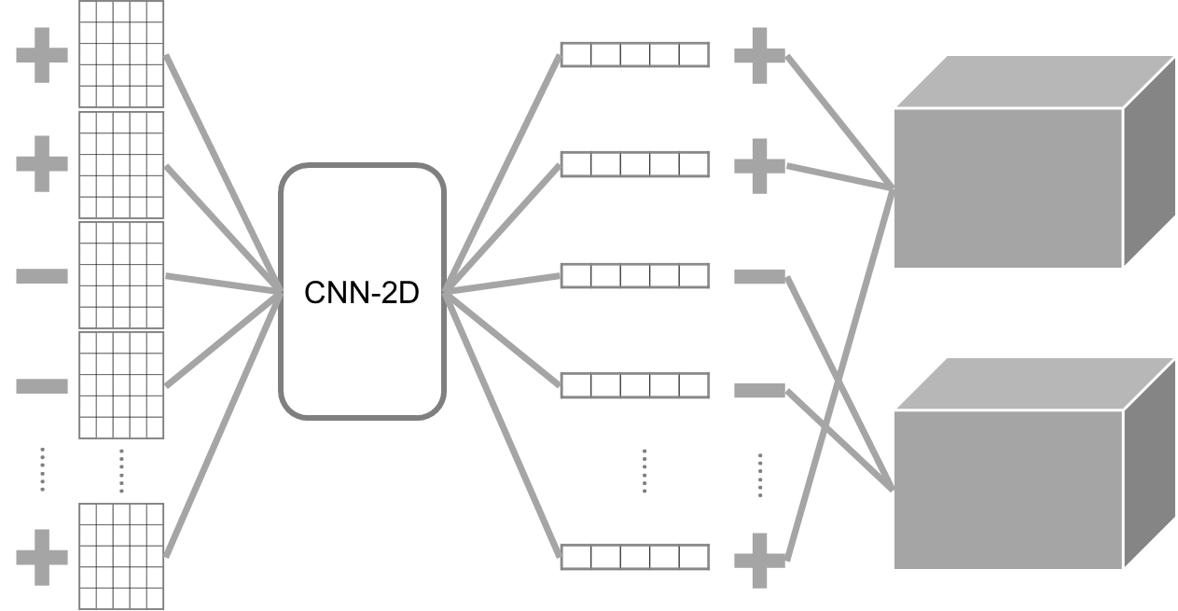
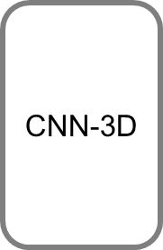

Slide 6
convolution feature map
representative vector
flatten
pooling
……

Slide 8
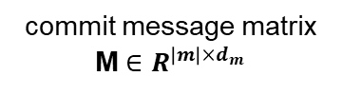
return
proper
value
a max pooling operation
errono
.
.
.
a vector representation
commit message matrix M $∈R^{{\left|m\right|×d}_{m}}$
a convolution layer with multiple filters + a non-linear activation function

Slide 9
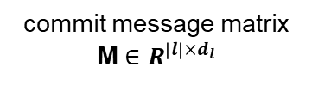
a convolution layer with multiple filters + a non-linear activation function
a max pooling operation
a vector representation
commit message matrix M $∈R^{{\left|l\right|×d}_{l}}$

Slide 10
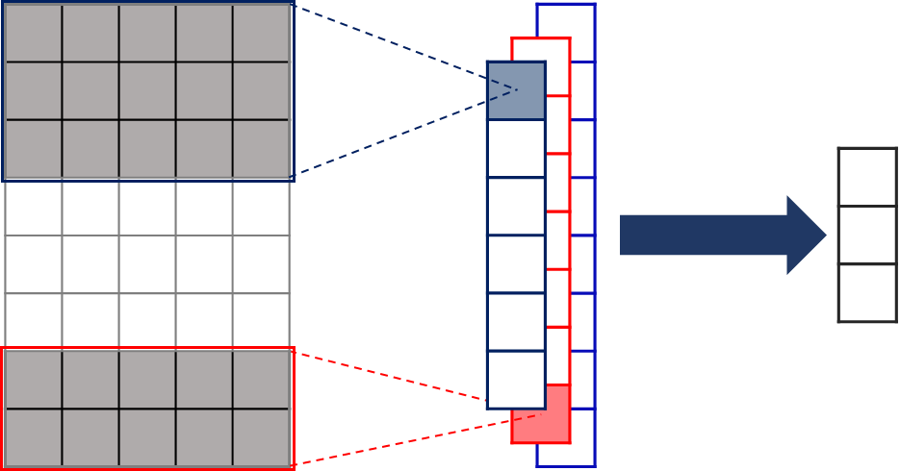
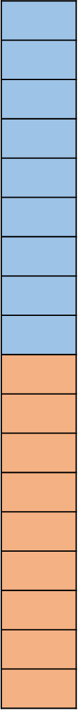
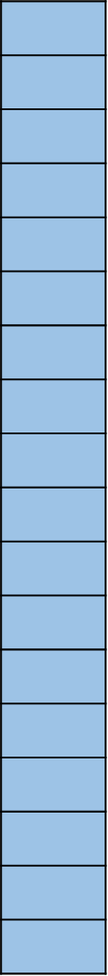




flatten
CNN-3D
$$…$$
flatten
CNN-3D
$$…$$
$$…$$
$$…$$
a CNN-3D includes a 3D convolutional layer, a non-linear activation function, and a 3D pooling layer
commit line model for each removed/added line in commit code

Slide 11
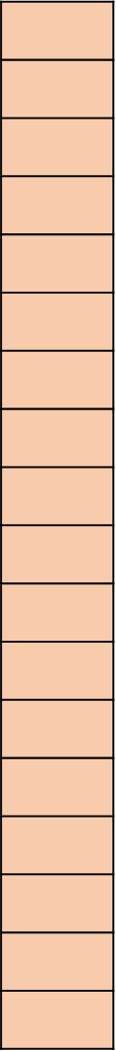


CNN-3D
$$…$$
$$…$$
CNN-3D
a CNN-3D for mapping removed/added code changes
a vector representation
commit line model for each removed/added line in commit code

Slide 13
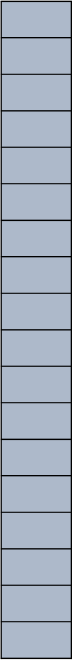



flatten
filters
$$…$$
$$…$$
$$…$$
a 3D convolution layer with multiple filters + a non-linear activation function
a 3D max pooling layer
a vector representation

Slide 14
flatten
$$…$$
flatten
$$…$$
$$…$$
$$…$$

Slide 15
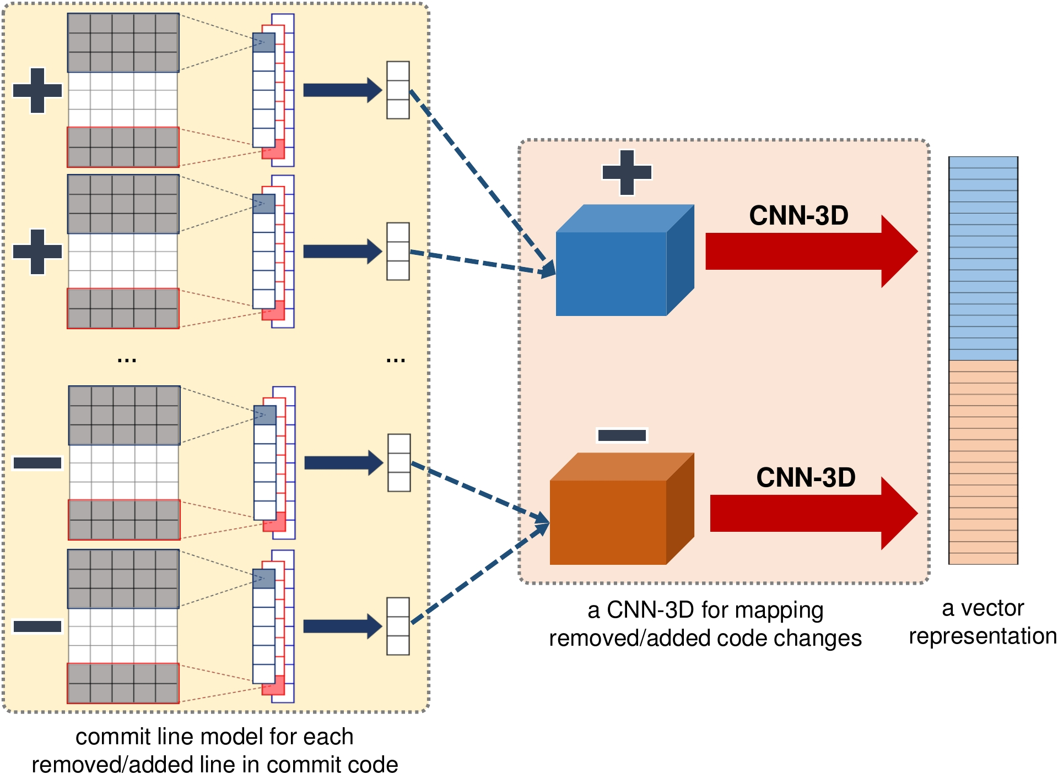
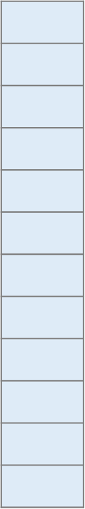

Slide 16
CNN-3D
$$…$$
$$…$$
CNN-3D

Slide 17
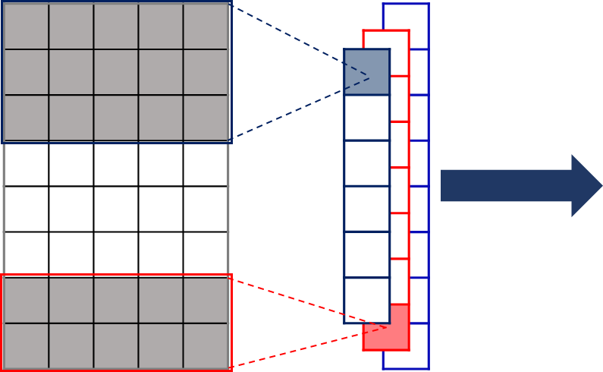
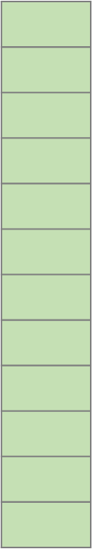

Slide 18
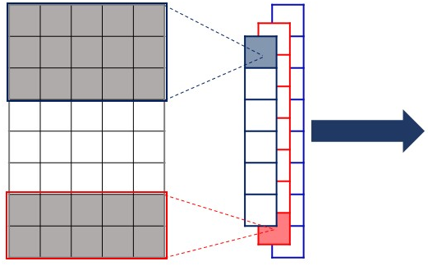
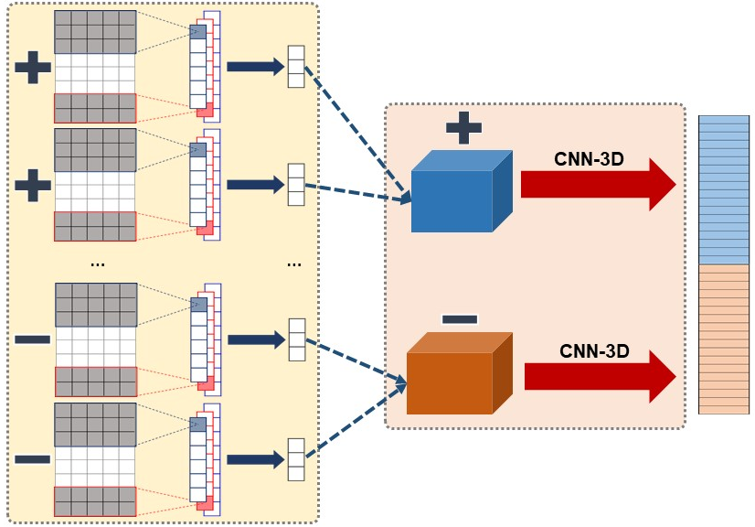
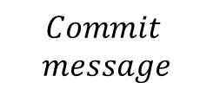



$$Commit$$
$$message$$
$${File}_{1}$$
$$…$$
$${File}_{u}$$

Slide 19
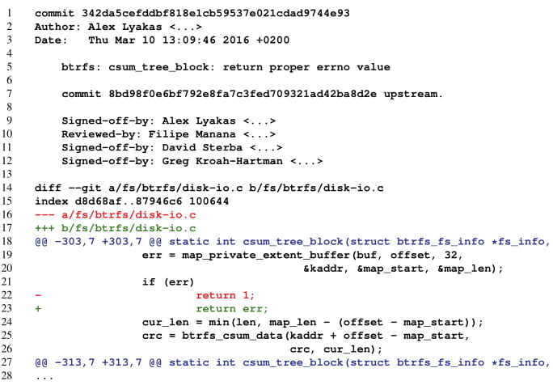
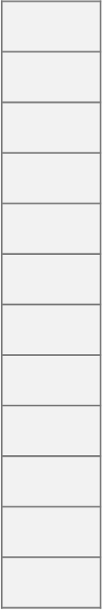
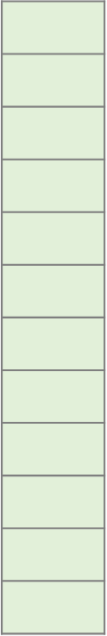



$${\text{x}}_{m}$$
FC
Commit message
module
Commit line module
output layer
Commit file module
a sample patch
Commit code module
$$\text{x}$$
a fully-connected layer
$${\text{x}}_{c}$$
Classification module

