Slide 1
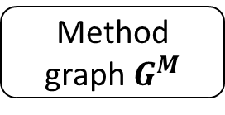
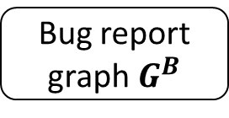
New bug report
NetML^{Text}
NetML Integrator
Historical bug reports
Feature extraction
NetML^{Spectra}
Program spectra
NetML^{SuspWord}
Ranked list of methods
Bug report graph$G^{B}$
Method corpus
Graph construction
Method graph$G^{M}$

Slide 2
Input bug report
Input program spectra
Historical bug reports
NetML^{Text}
NetML Integrator
Feature extraction
NetML^{Spectra}
Historical program spectra
NetML^{SuspWord}
Ranked list of methods
Bug report graph$G^{B}$
Method corpus
Graph construction
Method graph$G^{M}$

