Slide 1
How Marathons Have Changed Over the Past Five Decades

Slide 2
Background
What is it?
Inspiration:
Quotes in marathon training books about how these races have changed.
Predictions:
Overall, average finish times will be higher.
The number of races occurring will have increased significantly.
The average number of finishers will increase through the decades.
Data:
Previous study done by professor at University of Chicago

Slide 3
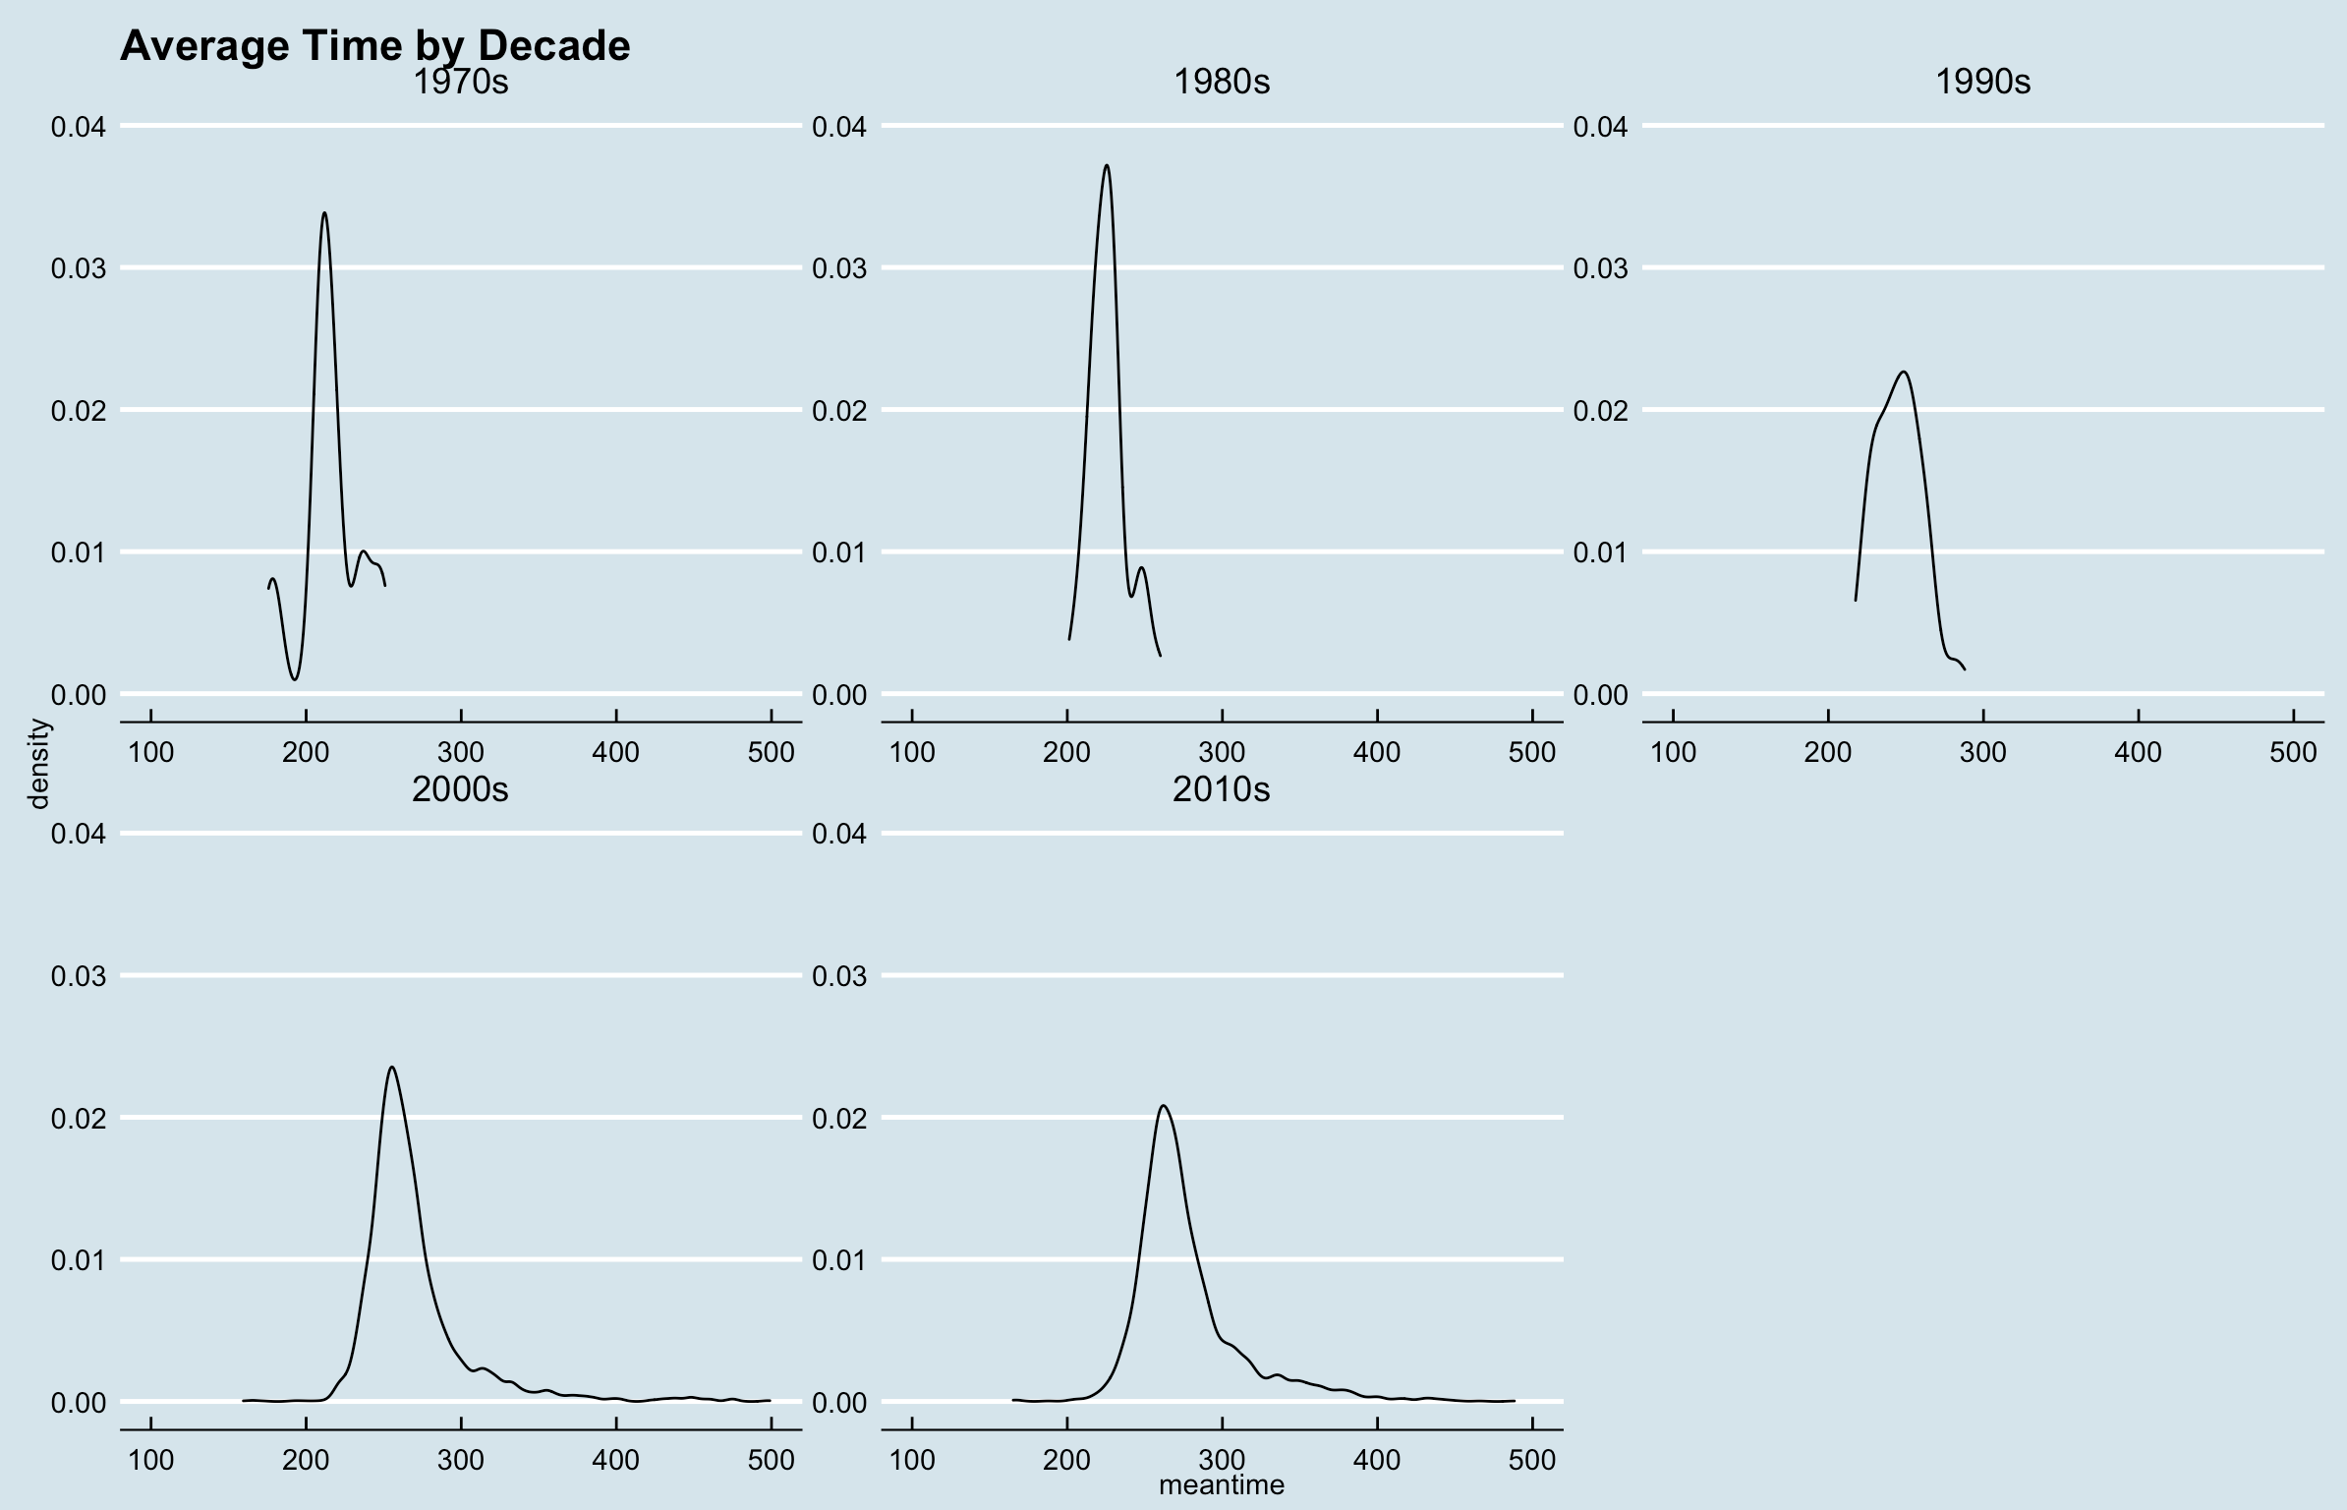

Slide 4
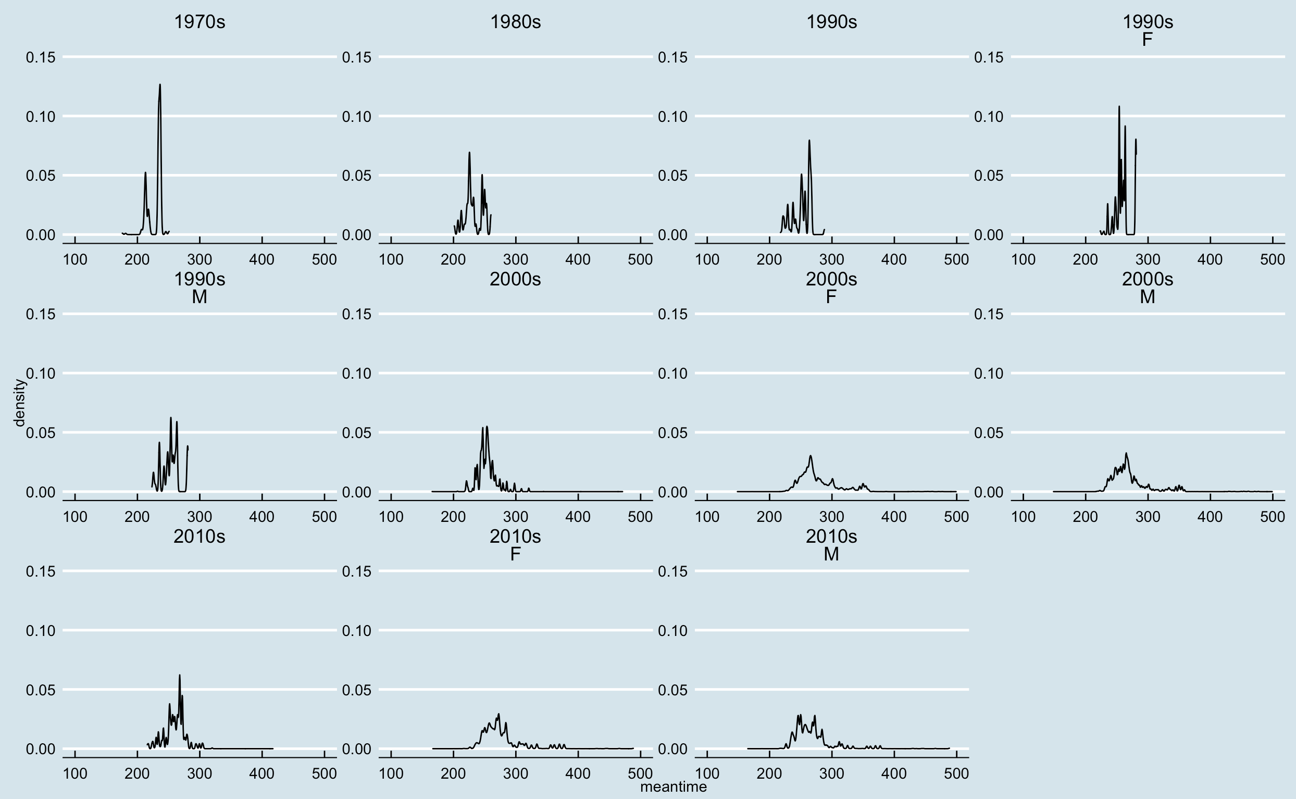
Chiptimes by Gender and Decade

Slide 5
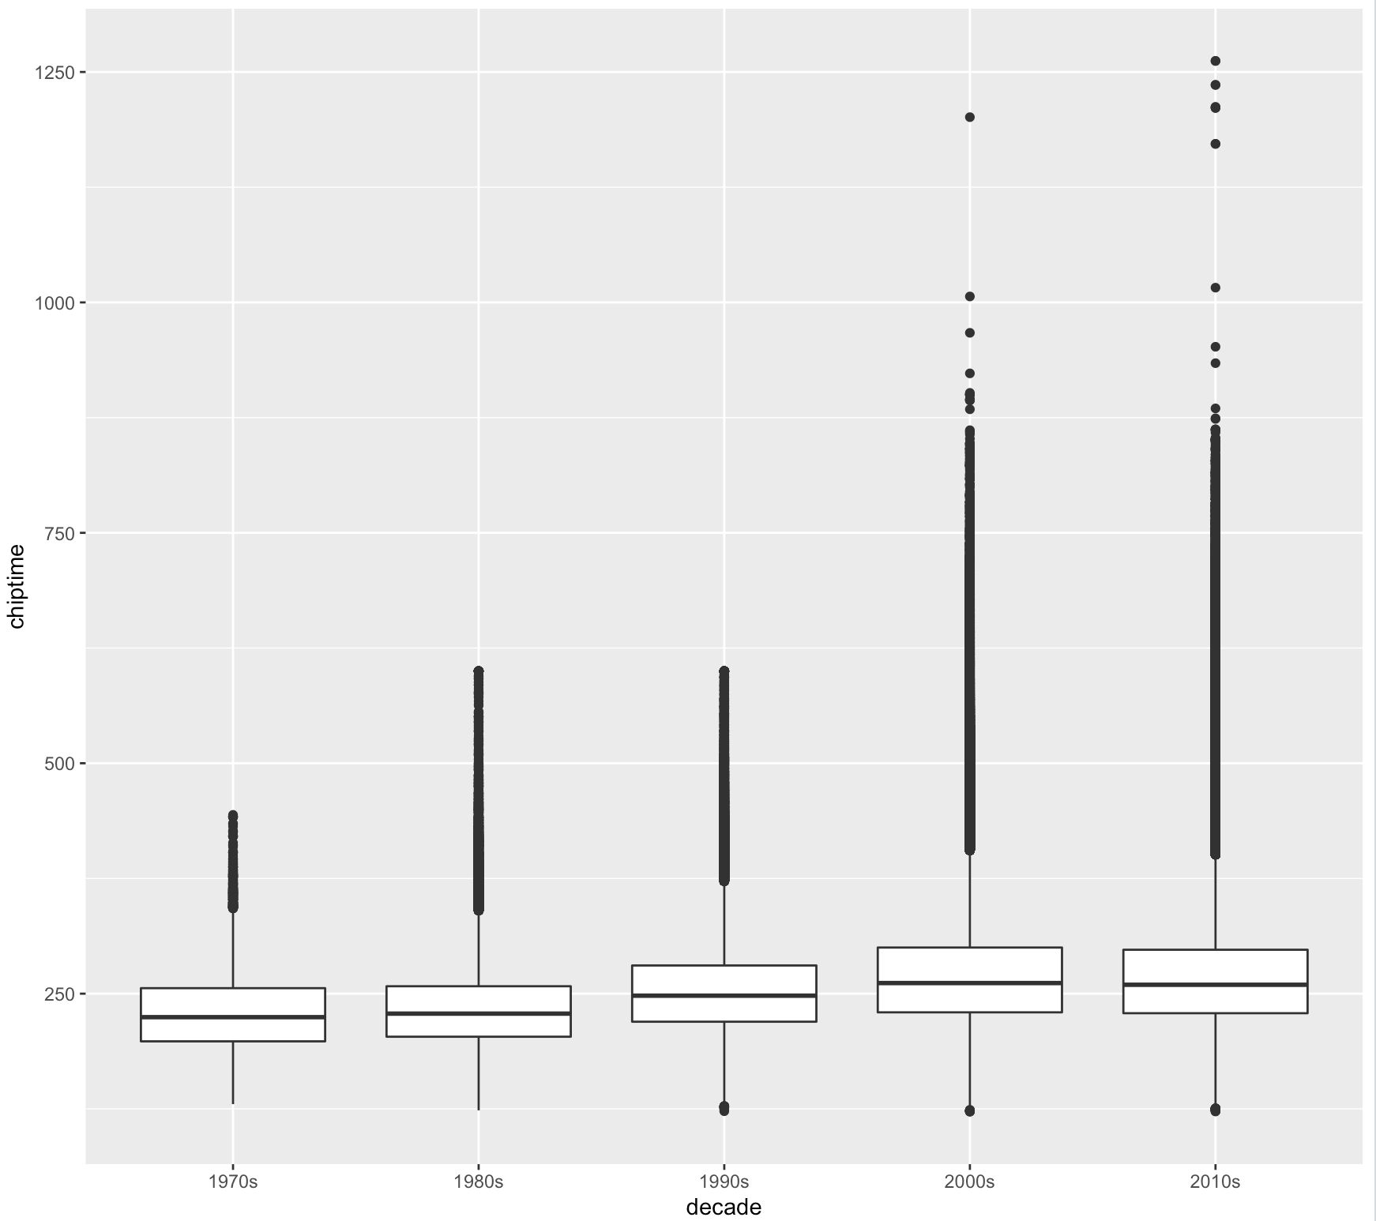
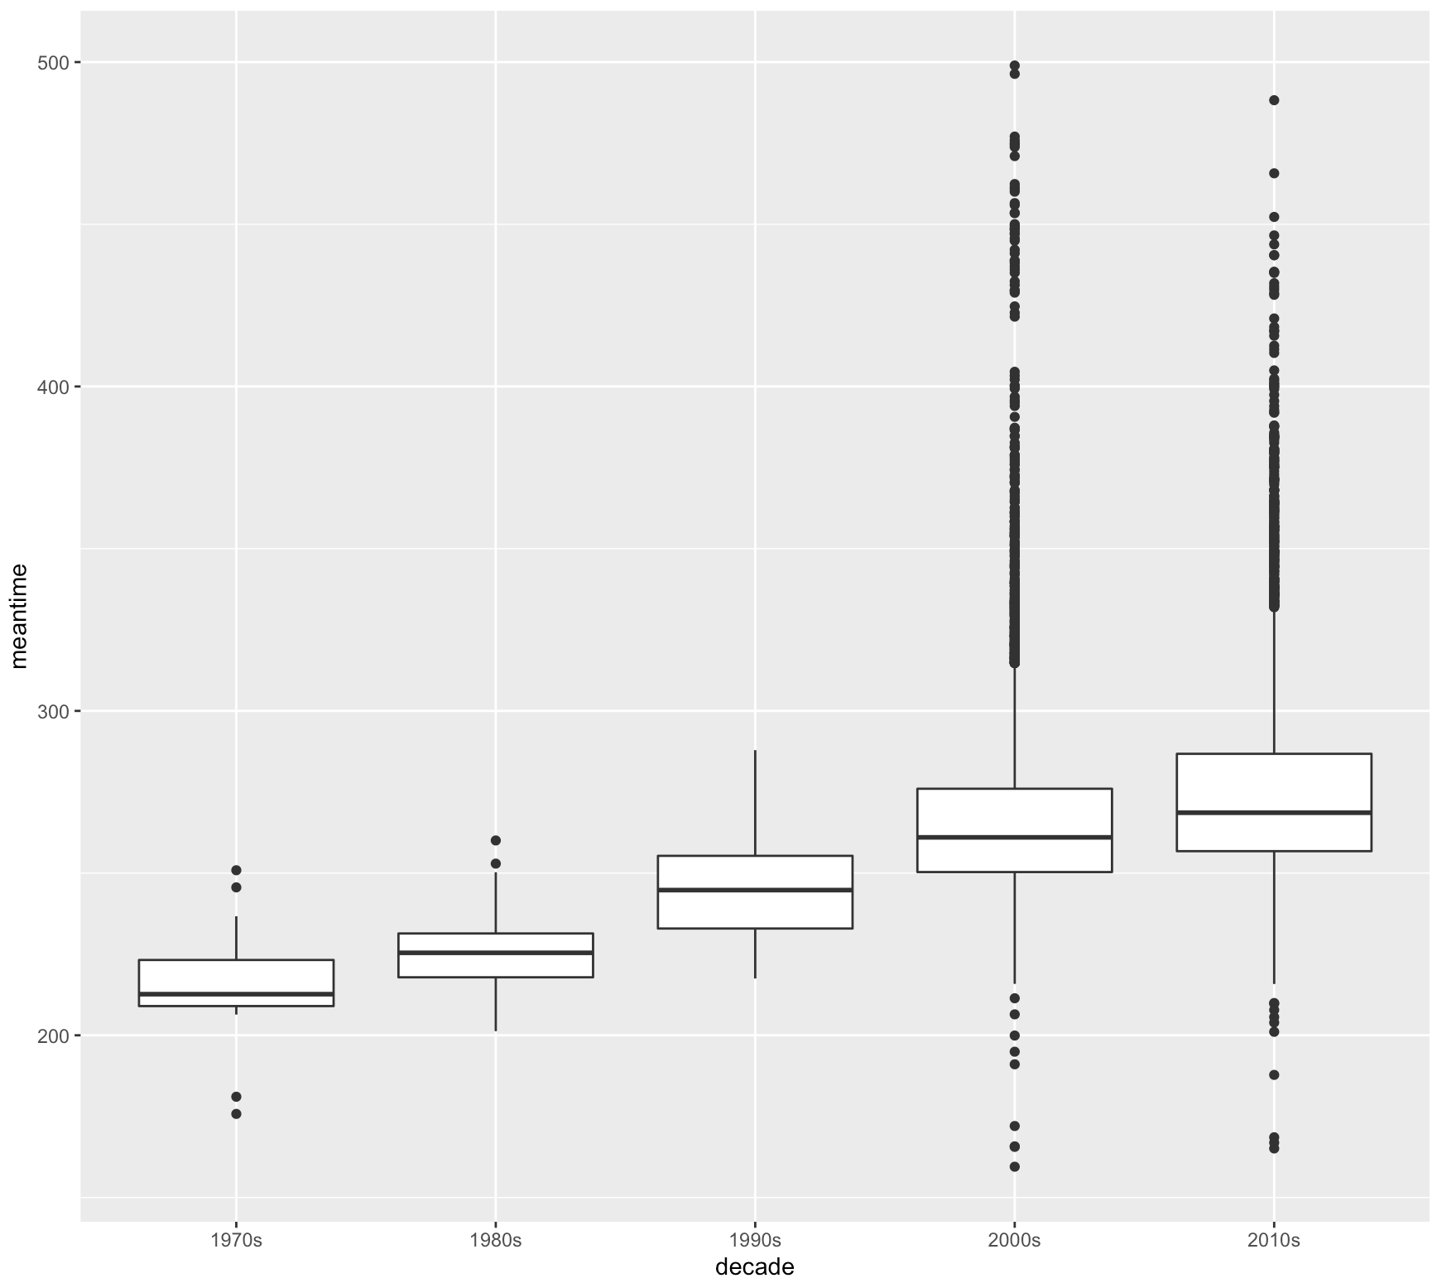
Mean Times by Decade
Chip Times by Decade

Slide 6
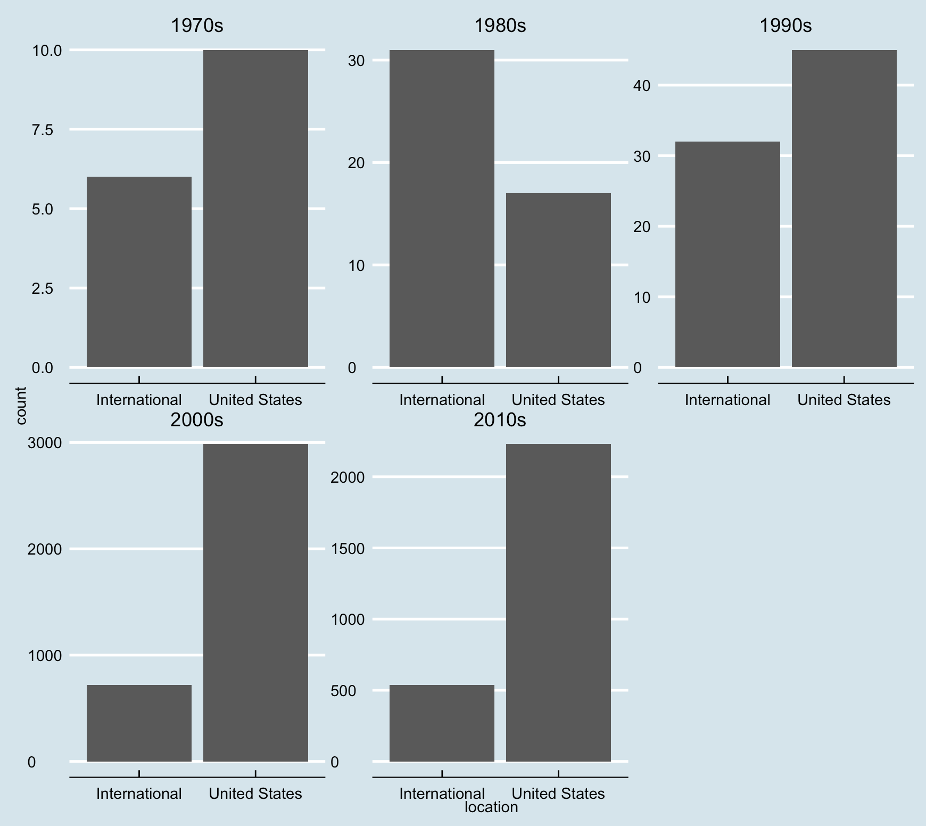
Races by Location

Slide 7
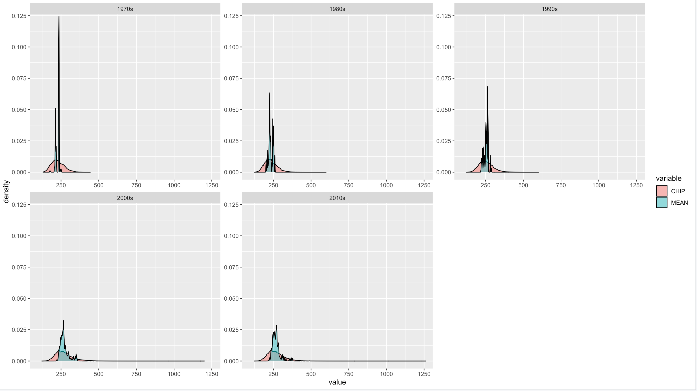
Chip Times vs Mean Times

Slide 8
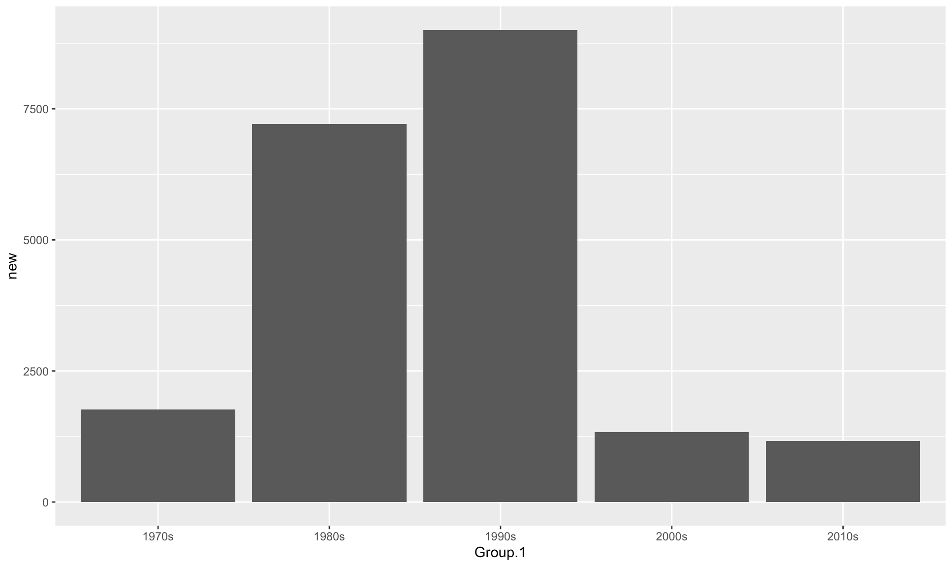
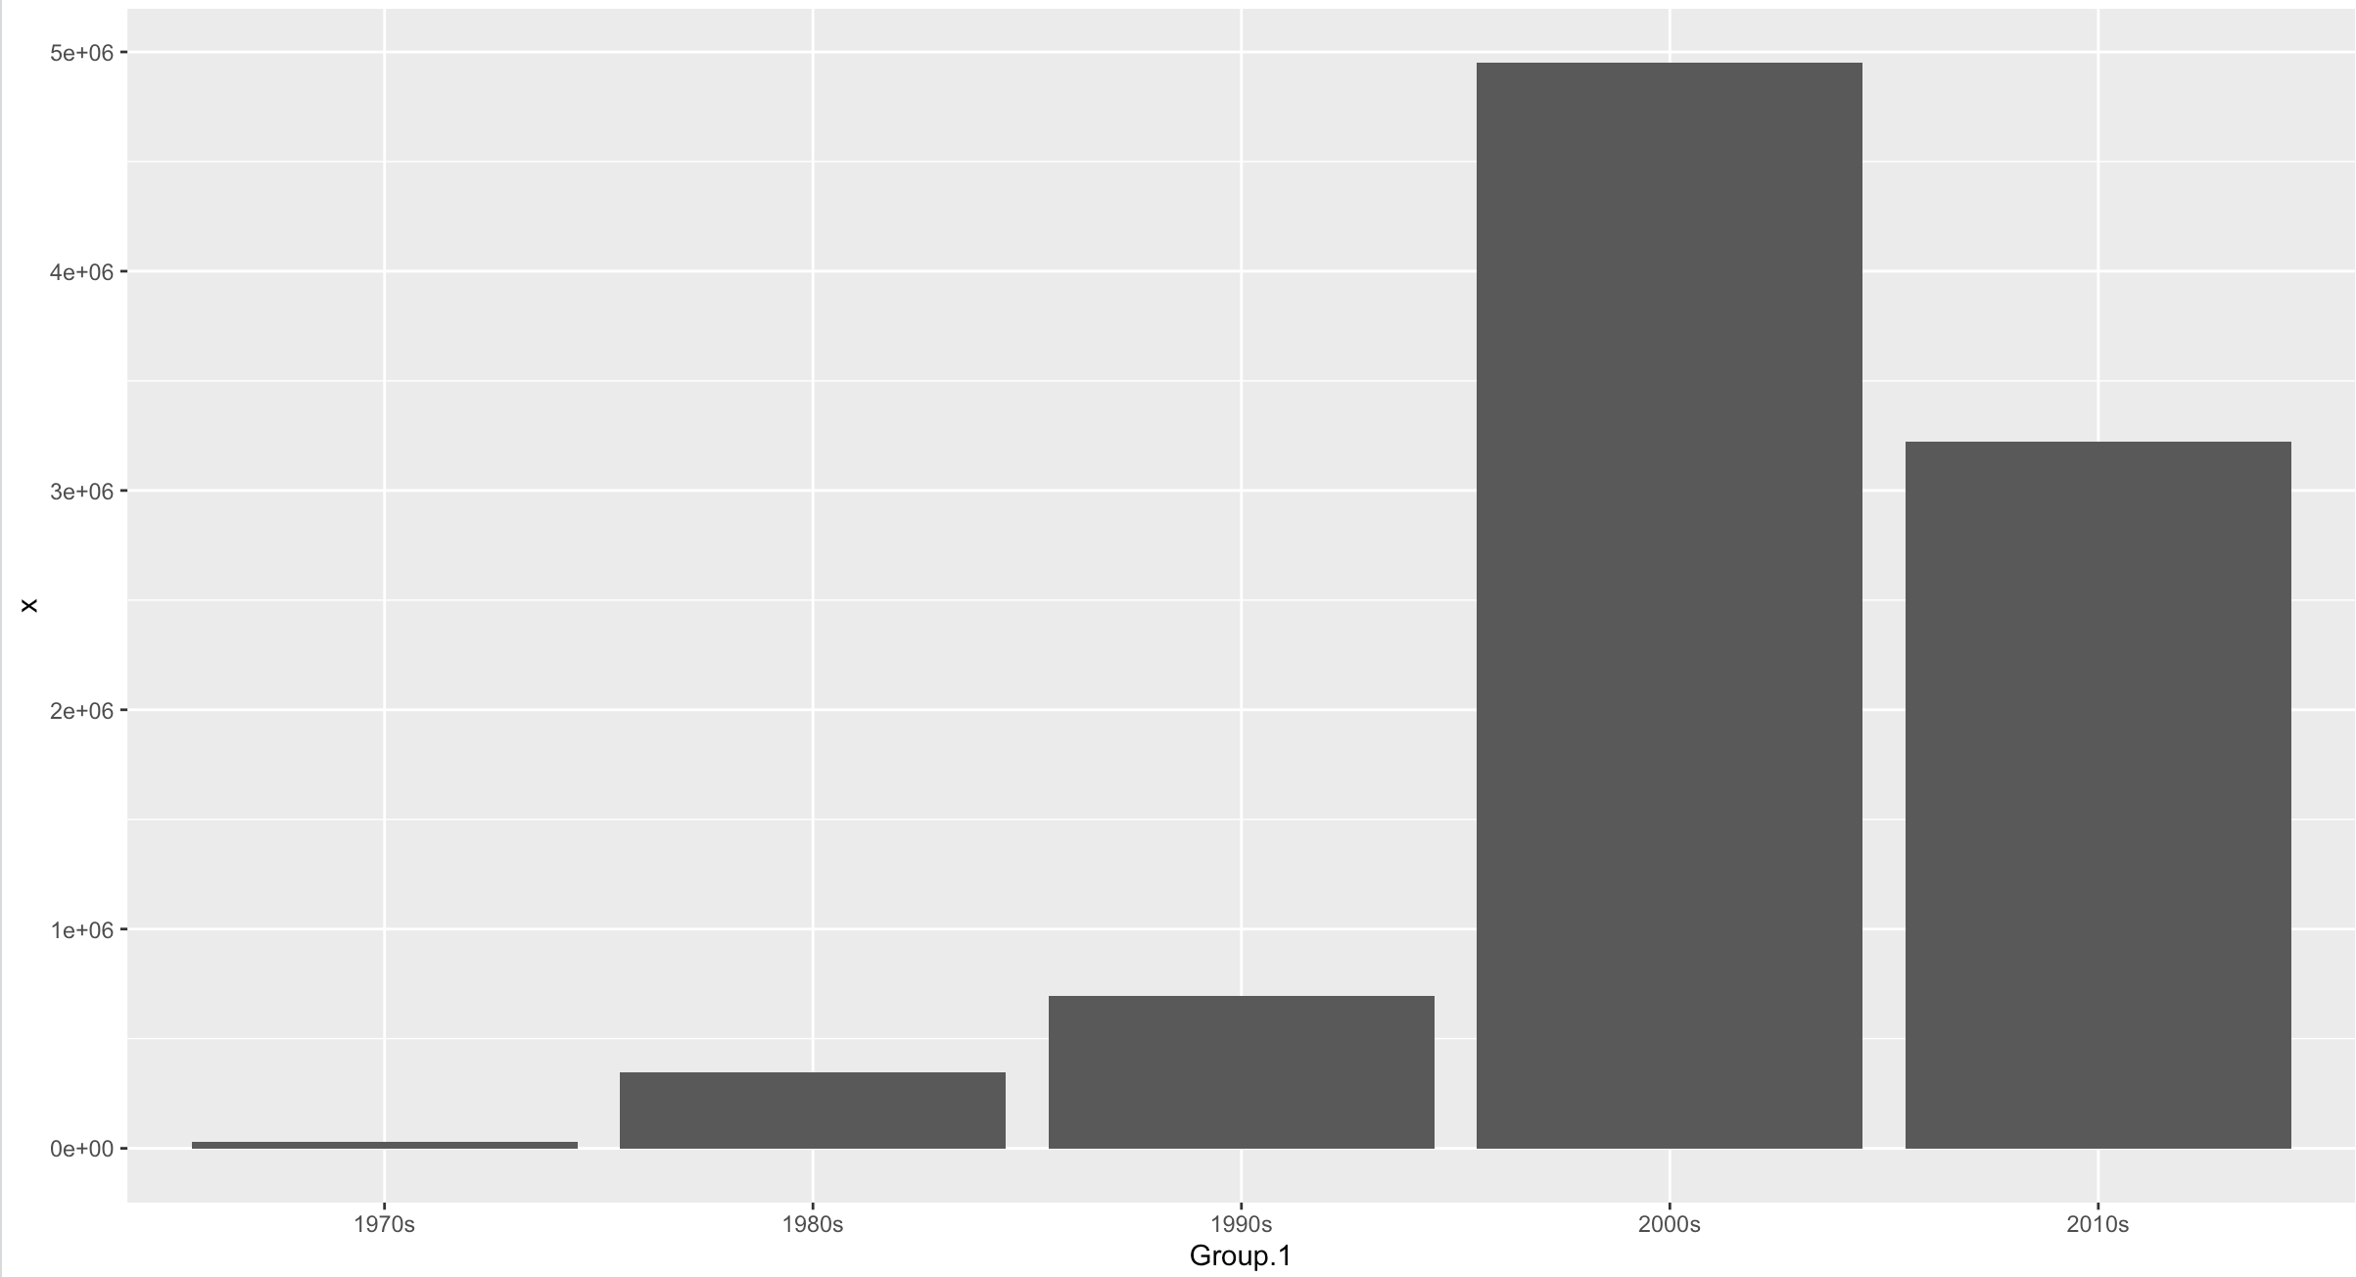
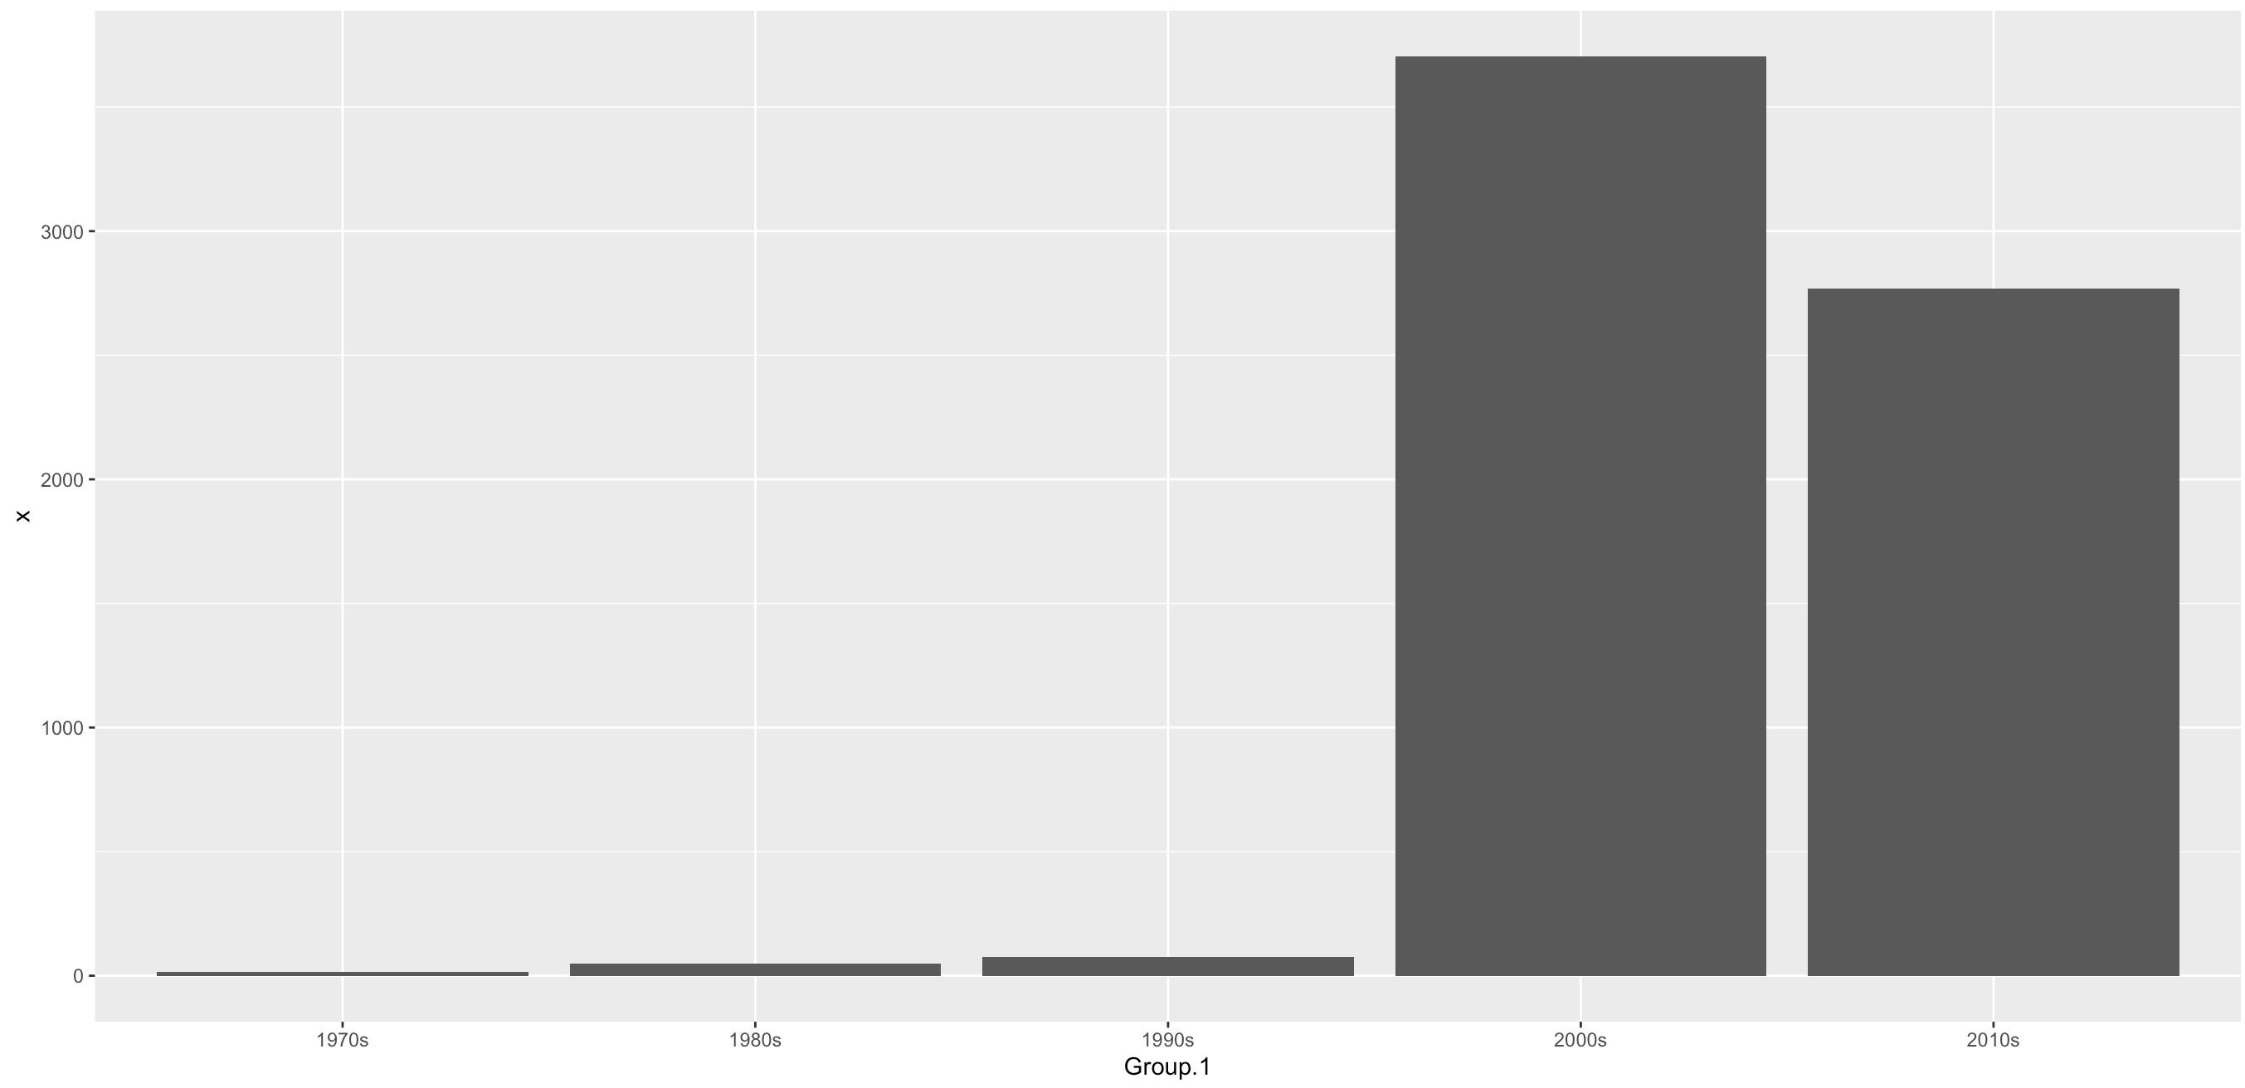
Average Number of Participants
Participants
Races

Slide 9
Summary
Top times have pretty much stayed the same.
A lot more people are participating with a much wider range of times.
The number of races has significantly increased.

