Slide 1
MyQuant
Real-Time Data reconstructed into Stock Option Probability Modeling
Derivatives Data meets Python Integrations
Hari Verma

Slide 2

What is MyQuant
“An advanced analytical tool designed to process live options data and generate a comprehensive "probability cloud" for any given trade thesis.”
The Thesis: Democratizing Quantitative Intelligence
Institutional Standard: Modern hedge funds rely on complex stochastic modeling to validate every investment thesis.
Engineering Accessibility: Developed a proprietary quantitative algorithm traditionally reserved for institutional desks to be completely optimized for the retail market.
Mathematical Validation: MyQuant serves as a rigorous filter, transforming subjective sentiment into objective, data-backed trade confirmations.

Slide 3
Model Strategy
Monte Carlo Simulation - Most retail tools give you a "Target Price" based on a single line. MyQuant recognizes that the future is a "probability cloud," not a single point.
Geometric Brownian Motion Formula Integration - Assuming a stocks return has two parts
Drift: Stead Average growth rate
Shock: Market Noise aka. Volatility
“By simulating 10,000 parallel "alternate universes" through a Monte Carlo engine, MyQuant moves beyond singular price targets to map every statistically probable outcome for a trade. This creates a high-fidelity frequency distribution at expiration, allowing us to mathematically calculate the "Probability of Profit" based on how many of those simulated paths exceed the breakeven threshold. This institutional approach replaces speculative guesswork with a concrete, data-driven edge”.
Live Greeks – A model is only as good as its fuel. Static models fail because market conditions change by the second.
Live Spot Price: The simulation anchor. We pull the exact last-traded price so the "starting line" of our 10,000 paths is accurate to the moment.
Implied Volatility (σ): IV isn't calculated by one person; it is dictated by the market. It represents the collective decisions of every trader in the world.
The API Advantage: By using the yfinance API, MyQuant captures "IV Crush" potential. If you are trading through an earnings report, the IV will be massive, and MyQuant will automatically show you that you need a much larger price move to break even, preventing "Volatility Trap“ in trades.
Lognormal Distributions - Why do we use a Lognormal distribution instead of a standard Bell Curve? Because of a fundamental rule in finance: A stock cannot go below $0.
The Standard Bell Curve: Assumes the stock of a company can go to Negative 50 Dollars which would literally never happen, hindering your probability calculation to begin with
Lognormal Curve: This model is superior as it assumes at hard floor of 0 dollars and implies unlimited upside to the right or positive direction of the Stock.
Institutional Importance: Major Wall Street Firms like Goldman or Barclays model risk similarly. For example, if a stock can only lose 100% of its value, there is a possibility of 1000% upside.

Slide 4

Risk Mitigation & Expected Value The Mathematics behind Long-Term Probability
$$EV=\left(P_{win}×Profit\right) −(P_{loss}×Risk Size ×Stop Loss)$$
EV (Expected Value) – Average expected to make per trade based on an unlimited amount of trades placed
$P_{win}$- Probability of the stock price reaching the Break Even or the Target Price (Depending on user selection)
Profit – Expected Profit
$P_{Loss}$- Probability of losing the maximum amount of Risk Amount
Risk Size – Amount of Risk/Premium paid for the contracts
Stop Loss (%) – Sets a limit of loss for the risk amount if the user is trading with a stop loss
Goal: MyQuant successfully proves mathematical support guiding a user to make a trade only when all variables are in favor of a positive direction

Slide 5
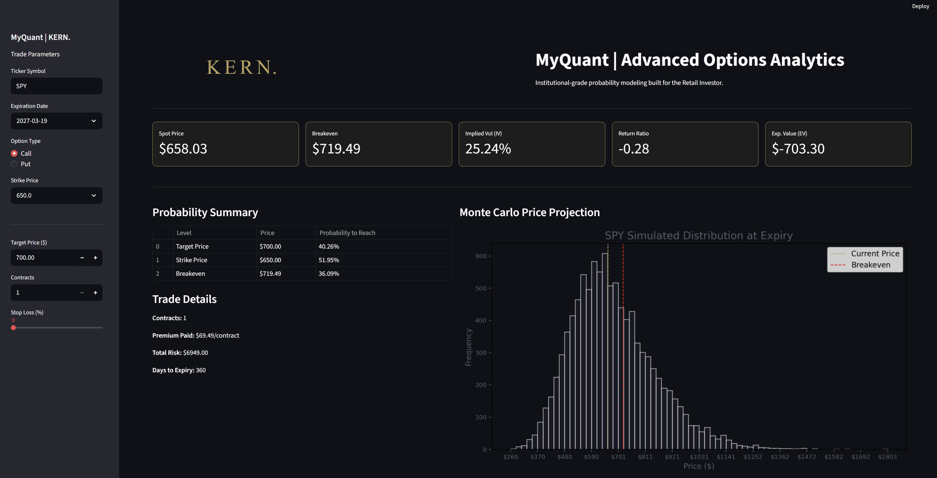
Trade 1: SPY Call, Exp. 9/18/2026, Strike: 650, Target: 700

Slide 6
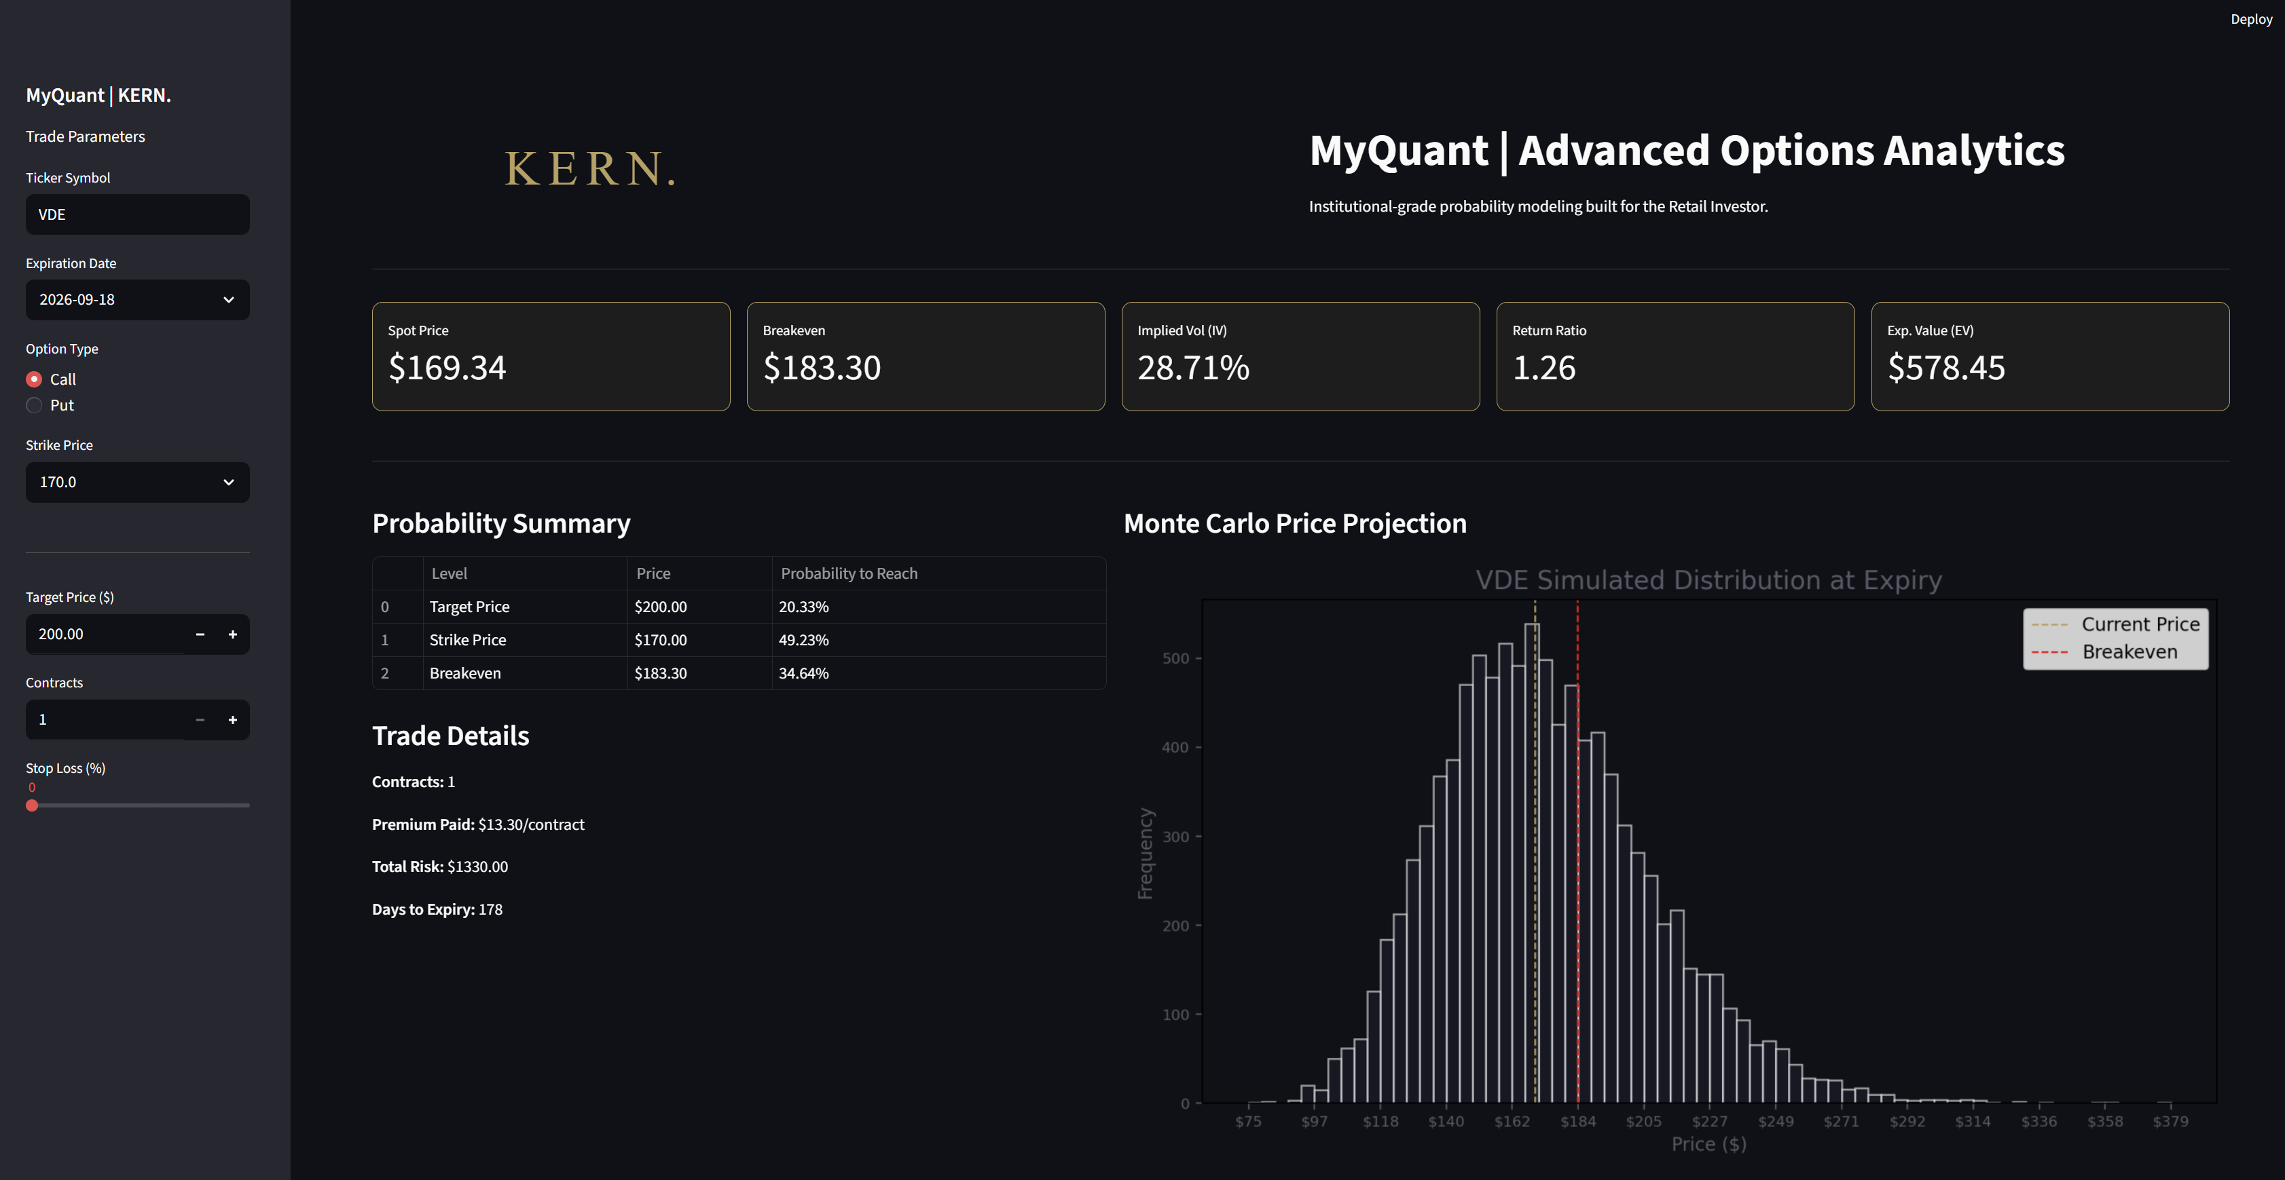
Trade 2: VDE Call, Exp. 9/18/2026, Strike: 170, Target: 200

Slide 7
Simulation: Trade 1 vs. Trade 2
Trade 1: SPY Call
SPY serves as the primary benchmark ETF for the S&P 500, offering broad-market exposure to the U.S. large-cap equity sector. This trade utilizes a long call strategy structured around a high-conviction price target of $700.
EV: -$703.30
Return Ratio: -0.28
Probabilities
Target Price: 40.26%
Strike Price: 51.95%
Break Even Price: 36.09%
Summary:
While the S&P 500 typically offers stable annualized returns, current macroeconomic trends and consensus suggest high risk for this specific entry. Our quantitative analysis confirms a heavily negative Expected Value (EV) and Return Ratio, signaling a high-conviction "no-trade" scenario.
Trade 2: VDE Call
VDE is a Vanguard ETF providing targeted exposure to U.S. energy sector leaders, primarily ExxonMobil and Chevron. This trade thesis is modeled on a target price objective of $200.
EV: $578.45
Return Ratio: 1.25
Probabilities
Target Price: 20.33%
Strike Price: 49.23%
Break Even Price: 34.64%
Summary:
Elevated VDE volume reflects geopolitical tension in the Strait of Hormuz. While EV modeling remains favorable, a low target price probability necessitates rigorous risk management to hedge against non-attainment.

Slide 8
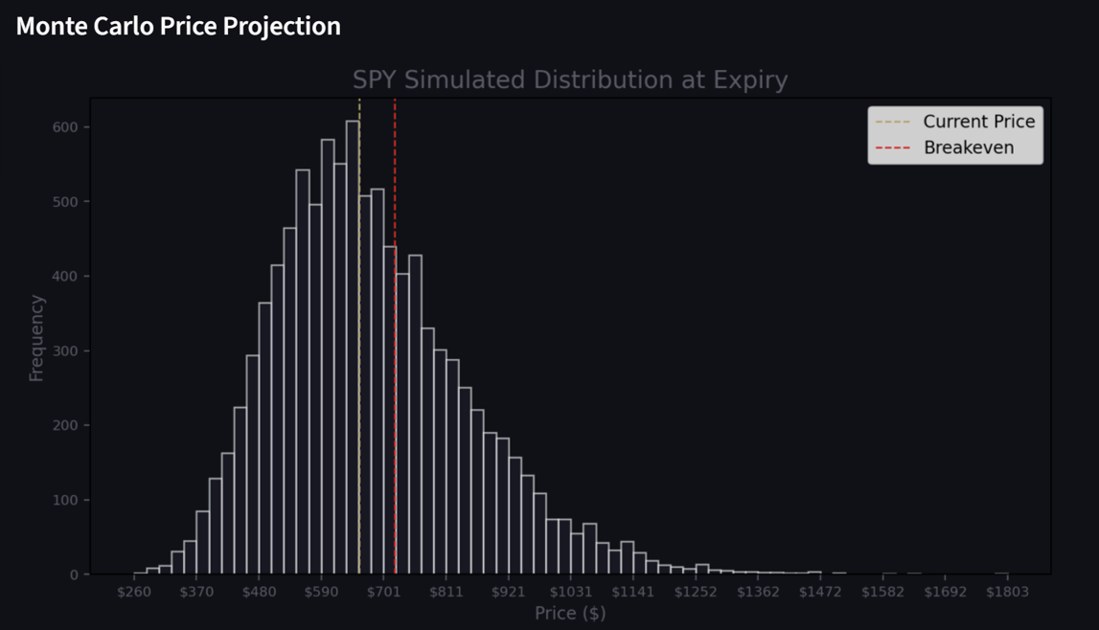
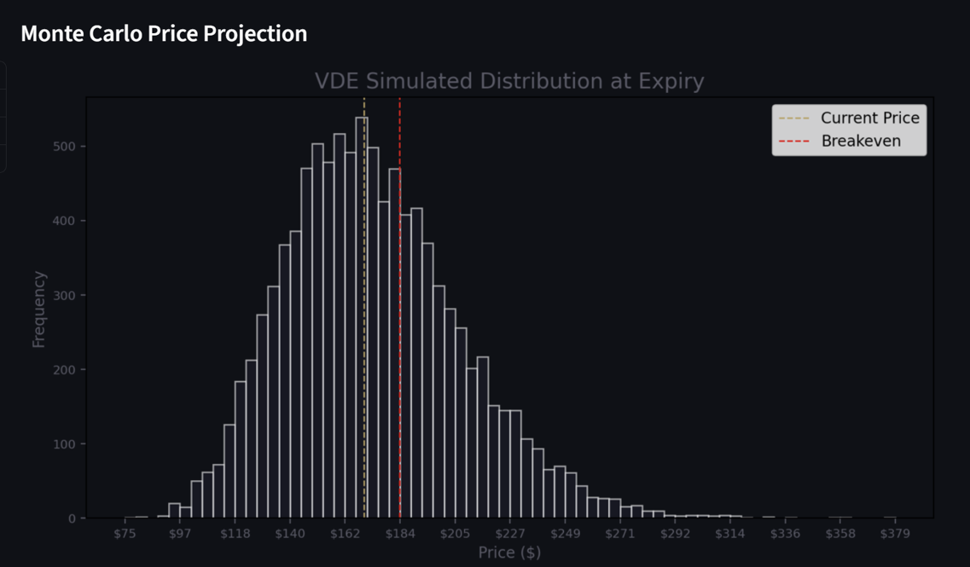
Monte-Carlo Simulations
Trade 1: SPY Call, Exp. 9/18/2026, Strike: 650, Target: 700
Trade 2: VDE Call, Exp. 9/18/2026, Strike: 170, Target: 200
“The comparative analysis between SPY and VDE confirms that while the broader market offers historical stability, the current mathematical Expected Value (EV) favors the energy sector. MyQuant’s Monte Carlo engine reveals that the SPY $700 call sits too far outside the high-probability "distribution meat," making it a low-conviction trade compared to the more centered VDE $200 projection. Ultimately, the data mandates a disciplined "Pass" on SPY in favor of VDE, where geopolitical catalysts and trading volume align more closely with a profitable statistical outcome. This rigorous filtering process ensures that Kern’s capital is allocated based on institutional-grade probability rather than speculative hope.”

