Slide 1
Capstone Project The Battle of Neighborhoods
Author: Himani Verma

Slide 2
Introduction
Below is the Introduction of Problem Statement for which we want a solution.
I live in in Toronto with family. My husband has been offered his dream job a thousand miles from home. While my job provides me the flexibility to work from a remote location, his new job doesn't have this facility. So we have decided to relocate somewhere near to his work location.
Along with the excitement that I have moving to a new city, I am a little anxious and nervous as well. I was born and raised in Toronto and I have never been away from my parents for a long time. All my friends are here, and my kid is also studying at a school here. All the things that we need are easily available nearby.
Both NYU and Toronto cities are very diverse and are the financial capitals of their respective countries. We would like to compare the neighborhoods of the two cities and determine how similar or dissimilar they are before we move there.

Slide 3
Audience:
Anyone who is moving to a new city they have never been to. It would help them with settling down in the new environment and exploring new life changing options.
When considering business development strategies, it is often helpful to examine downtown or business district relative to those in peer cities or cities that embody similar qualities. This comparison can help you discover business development opportunities that will strengthen economic vitality in your business district.
This Project will help to determine what kinds of retail or service business activities are supported in like places.
It will also provide real-life examples of districts that have defined themselves with a clear position in their market in terms of goods and services offered and of primary consumer segments served.

Slide 4
Objective
We will use Foursquare Data and Machine Learning segmentation and Clustering to study area classification in details.
The aim of this project is to segment areas of New York City and Toronto based on the most common places captured from Foursquare. Using segmentation and clustering, we hope we can determine:
The similarity or dissimilarity of both cities
Classification of area located inside the city whether it is residential, tourism places, or others

Slide 5
Data
We are going to use data from below Sources.
Toronto Dataset:
web url: "https://en.wikipedia.org/wiki/List_of_postal_codes_of_Canada:_M"
Geocoder_File: Geospatial_Coordinates.csv
New York Dataset:
Filename: nyu_2451_34572-geojson.json
The above files have been saved in local path for using in the notebook

Slide 6
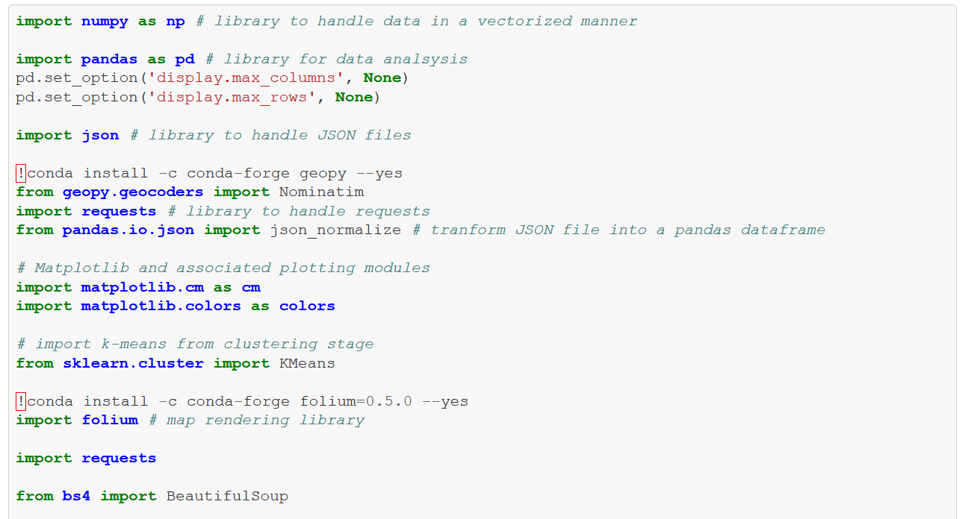
Required Libraries:
Python has a variety of libraries that we can use in this Project.

Slide 7
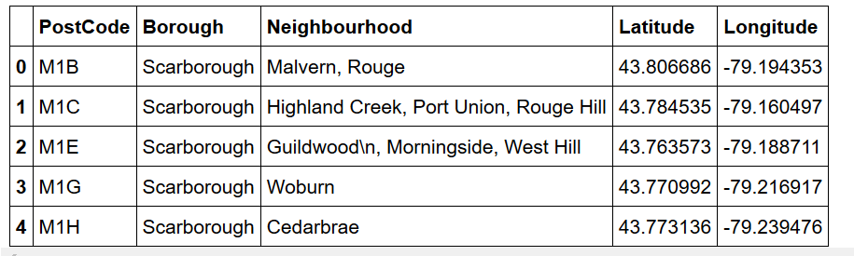
Let’s have a look at some sample data:
Toronto dataframe:

Slide 8
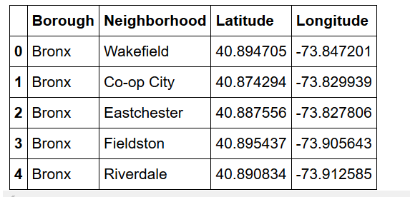
New York Dataframe:

Slide 9
Methodology
We are now going to use Basic Methodology
Foursquare API and Geopy to explore neighborhoods in both cities.
Machine Learning Algorithm K-means Cluster Classification
Folium is being used to explore neighborhoods of these cities.

Slide 10
Segment and form Clusters:
Toronto Segment: East Toronto
New York Segment: Manhattan
A grouped dataframe is obtained one for East Toronto and one for Manhattan using
Foursquare most common venue API.
And K-means clustering Algorithm is used to find clusters. Then is generated on these clusters using Folium.

Slide 11
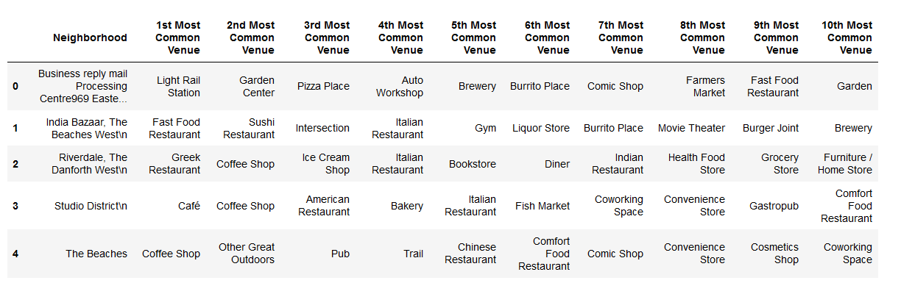
East Toronto Neighborhood Venues Dataframe:

Slide 12
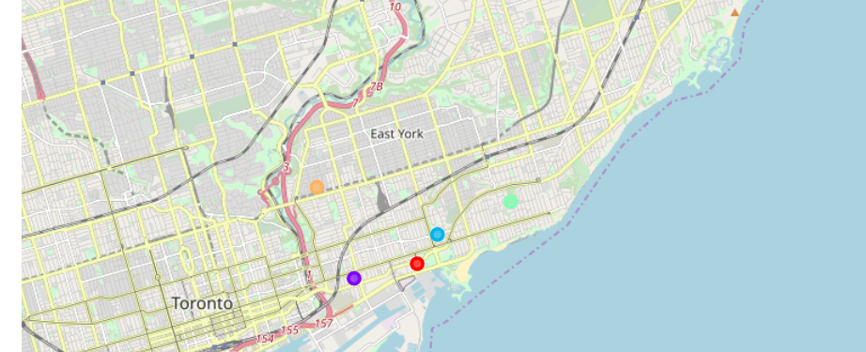
East Toronto Cluster Map:

Slide 13
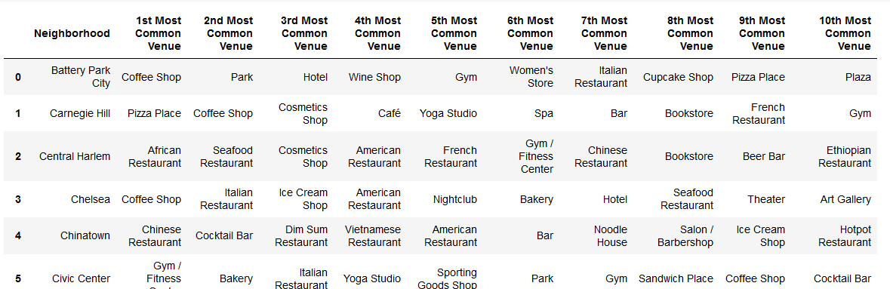
Manhattan Neighborhood Venues Dataframe:

Slide 14
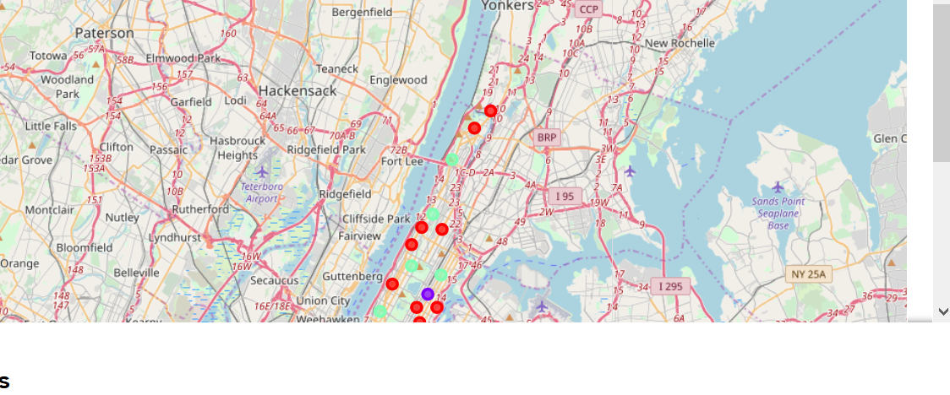
Manhattan Cluster map:

Slide 15
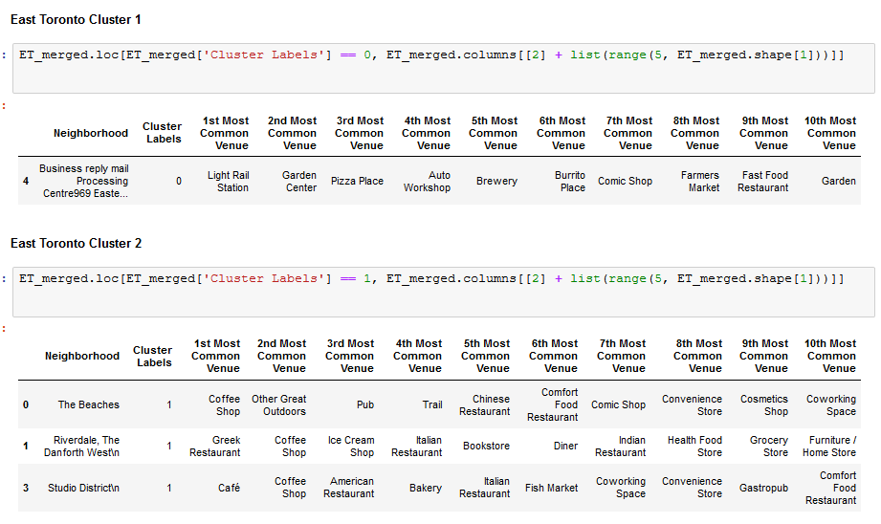
Results

Slide 16
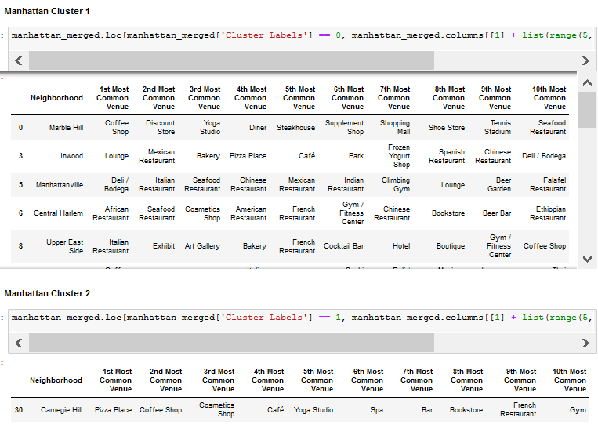

Slide 17
Discussion
The K-means algorithm is a technique to cluster n objects, on the basis of attributes, into k partitions, k < n.
Based on cluster for each cities above, we believe that classification for each cluster can be done better with calculation of venues categories (most common) in each cities. Refering to each cluster, we can't determine clearly what represent in each cluster by using Foursquare - Most Common Venue data.
However, for the sake of this project we assumed each cluster as follow:
Cluster 1: East Toronto: Residential
Cluster 2: East Toronto: Mix
Cluster 3: East Toronto: Health and Fitness
Cluster 1: Manhattan: Sports, Residential, Shopping
Cluster 2: Manhattan: Health and Fitness
Cluster 3: Manhattan: Residential

Slide 18
Discussion Contd..
What is lacking at this point is a systematic, quantitative way to identify and distinguish different district and to describe the correlation most common venues as recorded in Foursquare. The reality is however more complex: similar cities might have or might not have similar common venues. A further step in this classification would be to find a method to extract these common venues and integrate the spatial correlations between different of areas or district.
We believe that the classification we propose is an encouraging step towards a quantitative and systematic comparison of the different cities. Further studies are indeed needed in order to relate the data acquired, then observe it to more meaningful and objective results.

Slide 19
Conclusion
We can conclude that foursquare API's are useful in capturing data about various cities in the world. Using it, we refer back to our main objectives, which is to determine;
The similarity or dissimilarity of both cities
Classification of area located inside the city whether it is residential, tourism places, or others
In conclusion, both cities East Toronto and Manhattan are the two most popular cities. However, to declare both cities are similar or dissimilar base on common venues visited is quite difficult.
Both cities is similar in some venues also dissimilar in certain venues. And for classification based on common venues, again we must have more systematic or quantitative way to identify and declare this. Comparison can be made, but no such method or quantitative data to determine this. We hope in the future, a method to determine it can be establish and explore for references.
For this particular statement we can conclude that it might take little it of initial adjustment but we will live a comfortable life in New York City. Looking forward to relocate.

Slide 20
Thankyou

