Slide 1
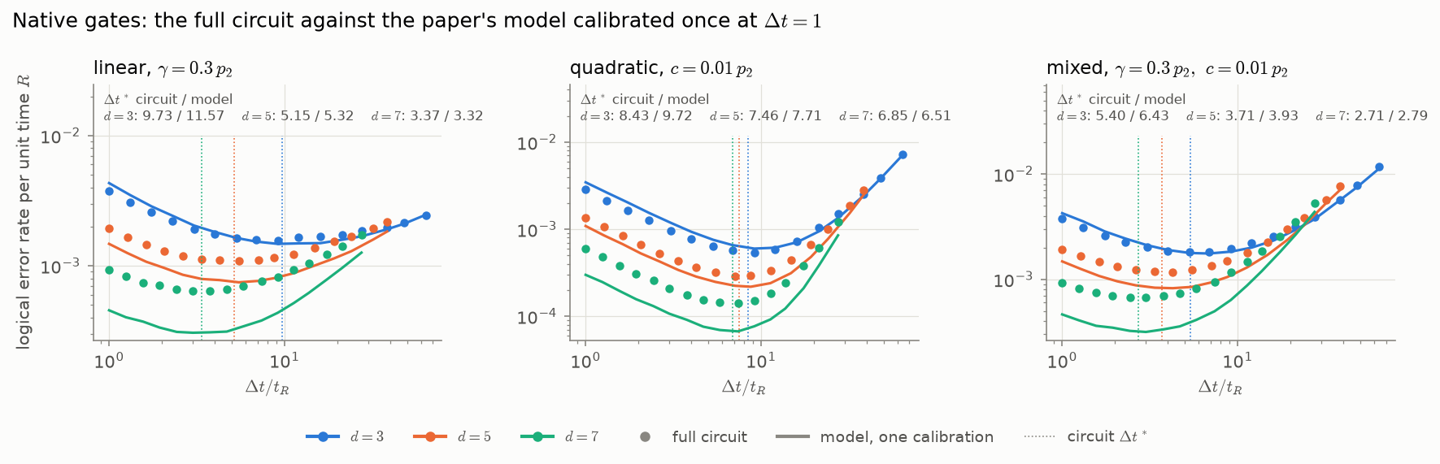
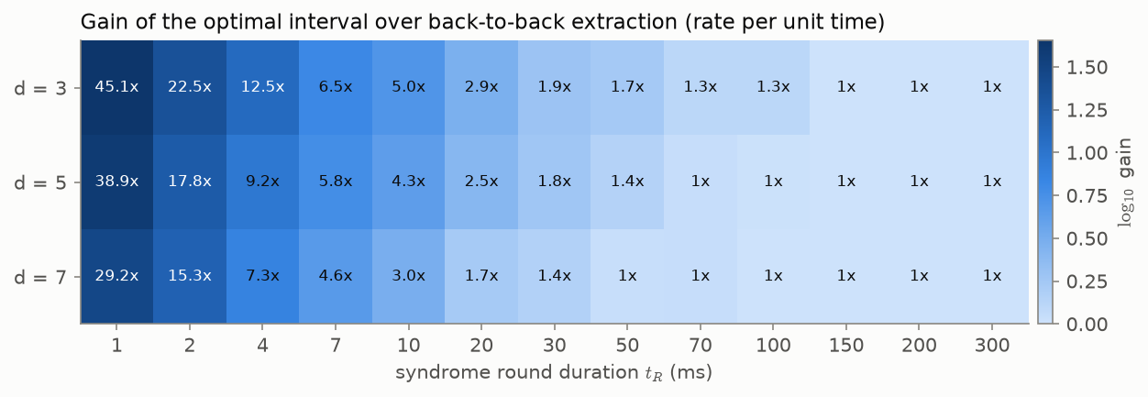
Optimal syndrome timing on trapped-ion hardware
14 Oct 2026 · Harshit Verma
Summary. An idle surface-code memory has a syndrome interval Δt* that minimises logical error per unit time due to the tradeoff between idling and noisy syndrome extraction. The project tests this tradeoff in three steps: (a) phenomenological simulation using artificial noise injection in Guppy; (b) a dephasing noise model (based on Quantinuum literature) along with gate noise, built in Selene and Stim-equivalent circuits; (c) relating physical parameters of a Quantinuum-like device, the physical QEC round time, to the tradeoff to identify the feasible region for a non-trivial syndrome extraction interval. We are now testing the programs on Quantinuum's full H2 emulators through aqora, which include sources of noise our Stim and Selene models leave out; all 16 programs have passed the H2-1SC syntax check.
Premise
each round, R times
Seed RNG
once per shot
Prepare
data in |+⟩
Z error
with probability p_data
Measure
each check
Flip record
with probability p_read
Read out
data in X
We inject the noise ourselves, inside the program. Each shot seeds one random-number generator. Before every round, each data qubit gets a Z error with probability p_data; after each check is measured, its recorded bit is flipped with probability p_read. The same program then runs on Selene, the emulator and the device.
Evidence
1
The paper's model reproduces, with noise injected in a device program.
Guppy and Stim agree at 18/18 settings (χ² p = 0.51). 1/Δt* = (0.385 ± 0.013) d − 0.92 for d = 5–11; paper: 0.402 (1.3σ).
2
The trade-off survives circuit noise.
With gate and readout errors and Z dephasing on every qubit, on textbook and native gates, 18/18 curves keep an interior optimum.
3
One calibration predicts the optimum.
The paper's model with p_data and p_read measured once from detection events at Δt = 1 gives Δt* within +15–20% (d = 3) and ±10% (d = 5, 7). It underestimates p_L (×0.5 at d = 7): use it for Δt*, not for p_L.
4
The parameters must be measured, not assumed.
A real extraction circuit has λ = 0.13–0.15 (paper 0.31) and a b_read floor of 1.2 (paper 1), lengthening Δt* 2.2–2.5× as Eq. 6 predicts. Per-qubit error varies 3×, 16% of it spreading from ancillas (native gates). Decoding with the paper's graph instead of the circuit's error model raises p_L up to 3.1× and moves Δt* threefold.
Fig. 1. Native gates. Points: full circuit. Lines: the paper's model calibrated once at Δt = 1. Dotted lines: the circuit's optimum.
Value on H2
The gain is set by the round duration t_R: ×15–45 at 1–2 ms, ×2–12 at 4–30 ms, none beyond 50–150 ms. Up to t_R = 2–4 ms, waiting at distance d beats back-to-back extraction at d + 2, saving 16–24 data qubits per logical qubit. A fitted ansatz, which predicts held-out mixed noise to within 4–6%, places H2's boundary at the same t_R. Sequential workloads idle most of their qubit-time (adder 84–87%, QFT 41–51%), so the interval acts on most of their space-time volume.
Open
Nothing has run on hardware yet (provider-side outage). t_R and the quadratic-dephasing convention (×4 on Δt*) are the deciding unknowns; the QIR programs, calibration experiments and fit that measure them are ready.
Fig. 2. Gain in logical error per unit time over back-to-back extraction, full circuit at H2-1E emulator rates.

