Slide 1
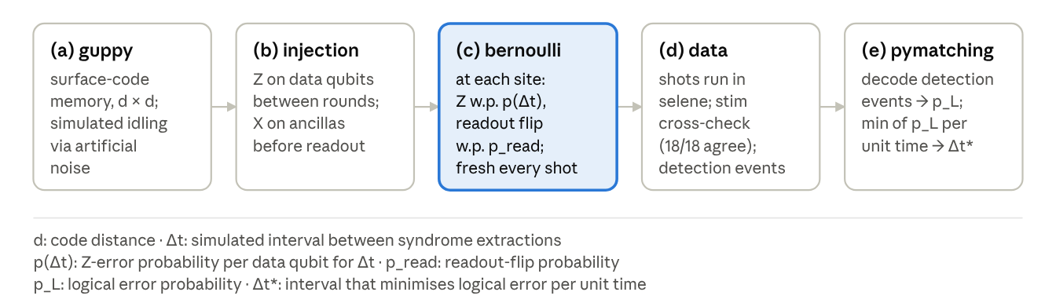
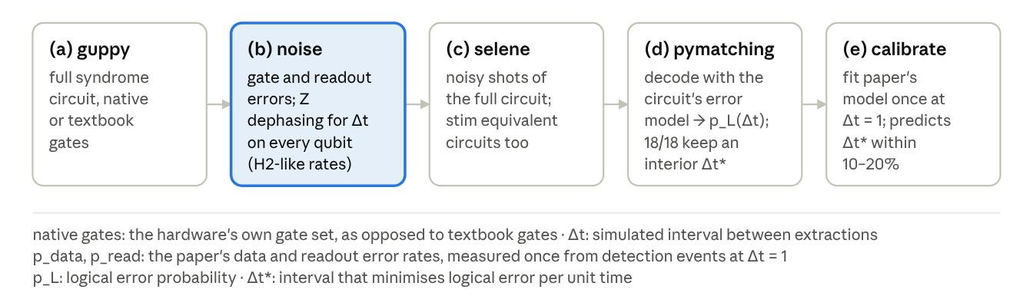
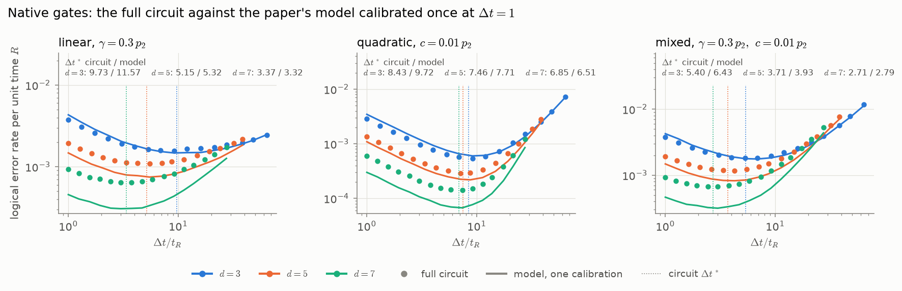
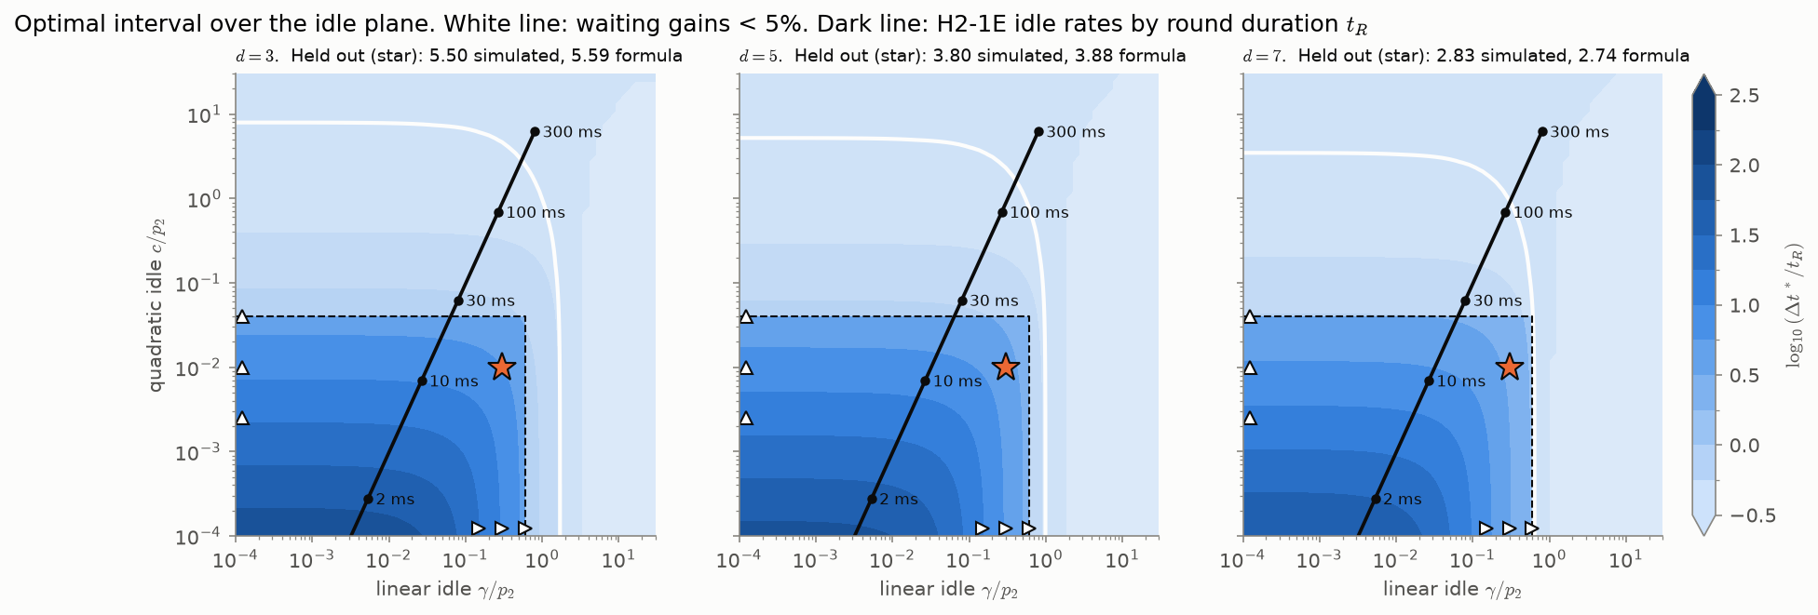
Optimal syndrome timing on trapped-ion hardware
14 Oct 2026 · Harshit Verma
Problem statement
An idle surface-code memory has a syndrome interval Δt* that minimises logical error per unit time due to the tradeoff between idling and noisy syndrome extraction. The project tests this tradeoff in three steps: (a) phenomenological simulation using artificial noise injection in guppy (b) dephasing noise model (based on quantinuum hardware characteristics reporteed) alongwith gate noise built in Selene and stim equivalent circuits. (c) relating physical parameters of a quantinuum-like device, the physical QEC round time, to the tradeoff; identify the feasible region for non-trivial syndrome extraction interval. We are now testing the programs on Quantinuum's full H2 emulators through aqora, which include sources of noise our Stim and Selene models leave out; all 16 programs have passed the H2-1SC syntax check.
Approach
1.
Phenomenological simulation using Guppy
Errors are drawn per shot by Bernoulli trials, then decoded by PyMatching. This approach leads to non-trivial syndrome extraction interval.
2.
Noisy Selene Simulation with native gates
The optimum survives full circuit noise in Selene
Dephasing applies Z to each data qubit over the simulated interval Δt under one of two idle models: Markovian at incoherent rate γ, or coherent phase drift at rate c. γ and c are free parameters fitted to the simulated detection events; their H2 values are unmeasured and set Δt*:
Evidence
A. The interior optimum survives full circuit noise i.e. approach 2. In Fig. 1 (native gates; idle models linear 0.3, quadratic 0.01 and mixed), the full-circuit logical error per unit time (points) falls and then rises with Δt at d = 3, 5 and 7, with the circuit's Δt* marked dotted. The paper's model, calibrated once from detection events at Δt = 1 (lines), predicts Δt* within +15–20% at d = 3 and ±10% at d = 5, 7.
B. Expected tradeoff on H2
Fig. 2 maps the optimal interval Δt*/t_R over the idle plane at d = 3, 5 and 7: linear idle strength γ/p₂ against quadratic idle strength c/p₂, both relative to the two-qubit gate error p₂. Beyond the white line, waiting gains less than 5% over Δt=1. The dark line places H2-1E idle rates by round duration t_R; it stays inside the gain region up to t_R ≈ 100–300 ms, where it crosses the white line.
Scientific impact
Algorithms leave most logical qubits idle: sequential workloads spend 84–87% (adder) and 41–51% (QFT) of their qubit-time waiting, so how an idle memory is protected governs most of a computation's space-time volume.
•
Time can stand in for space. For idling qubits a longer syndrome interval lowers logical error per unit time: waiting at distance d can beat back-to-back extraction at d + 2, saving 16–24 data qubits per logical qubit at short round durations. (see fig in saved)
•
Generalised across noise models. Δt* is mapped over linear and quadratic idle noise (γ, c) with gate noise, not one fixed phenomenological model.
•
Linked to hardware feasibility. Placing H2-1E idle rates on that map ties the gain to the round duration: waiting helps up to t_R ≈ 100–300 ms, and one calibration at Δt = 1 predicts Δt* within 10–20%.
•
Calibrating the outlook. Small-scale runs on the H2 emulators are under way to fix where H2 sits on the map.

