Slide 1

Effect of reservoir memory on learning options price
Harshit Verma

Slide 2
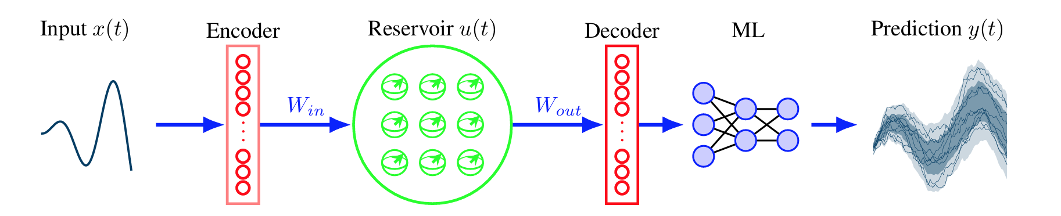
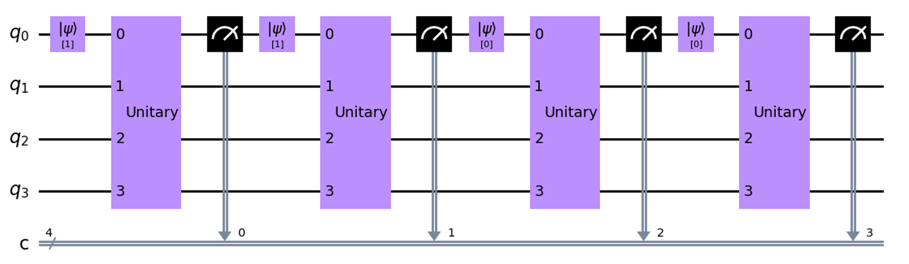
Predicting time series data
Reservoir computing schematic:
Considered architecture
Source: QuantumReservoirPy: A Software Package for Time Series Prediction

Slide 3
Predicting options price
Prepare data
Historical data from optiondata.org for major tickers from 2013.
Select liquid ticker such as AAPL, set baseline price using B-S formula
Create prediction dataset by defining windows on deviations from B-S
Create reservoir
Create reservoir with flexible input memory and washout
Add final classical layer for inference
Results using multiprocessing
Train and plot loss curves for different memory sizes, allowed local fields
Interactions modelled by Hamiltonians such as TFIM, Heisenberg model

Slide 4
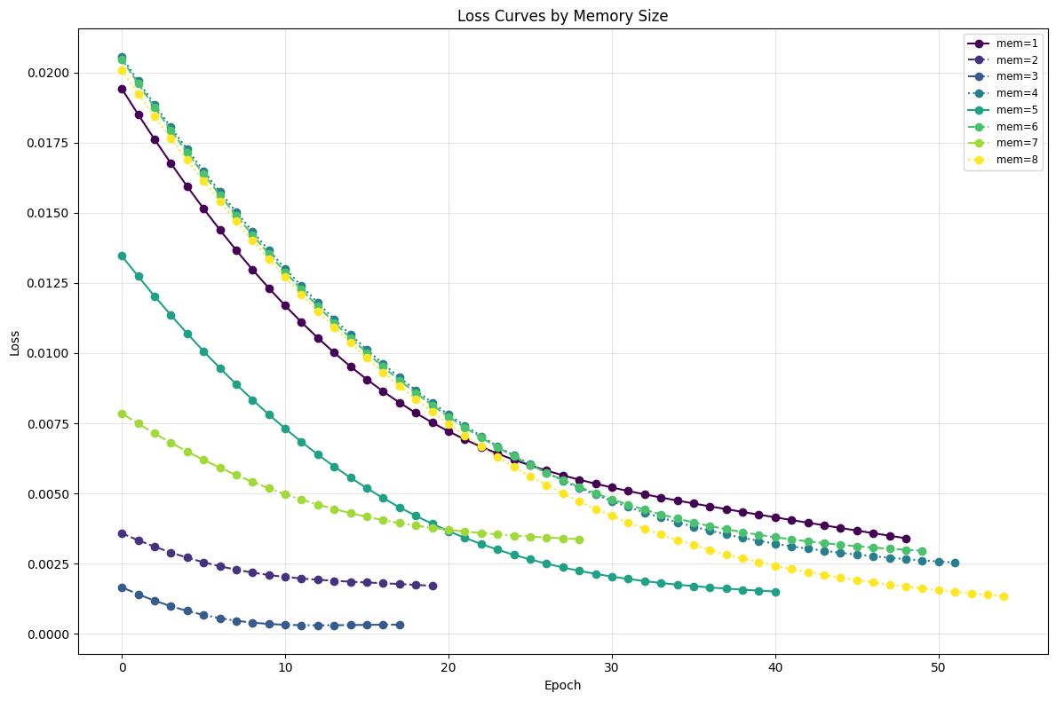
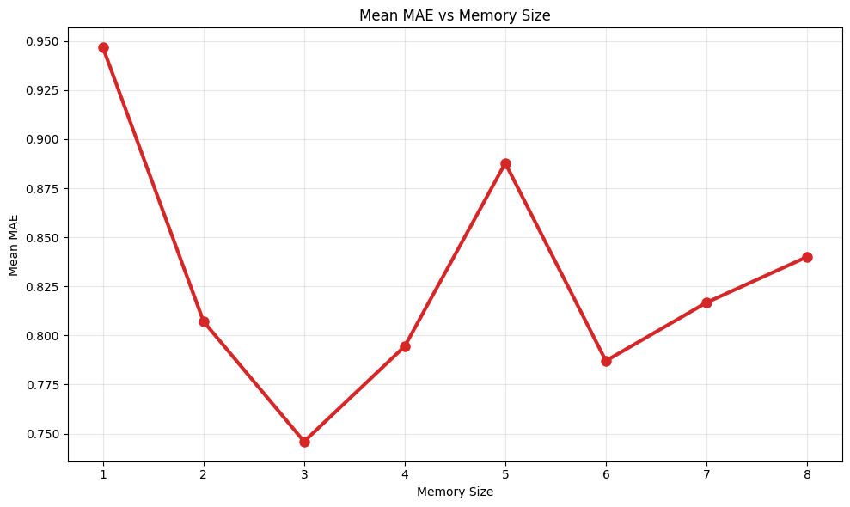
Results with varied memory – large random fields

Slide 5
Main task: imputing provided time series data for swapoptions
Tweak the prototype to allow access to given dataset
Tweak training data and window generation
Train reservoir+MLP on all available feature windows without NaN
Predict Nan values using reservoir+MLP
Generate imputed dataset

Slide 6
Future outlook
Explore behaviour on noisy circuits
Training over multiple greeks and macro-economic data in addition to time-series for inference
Data reuploading and injection, increasing data qubits or data persistence
Effect of chaotic vs integrable vs localized Hamiltonians in interaction phase
Conversion to popular SDKs such as qiskit and pennylane

