Slide 1
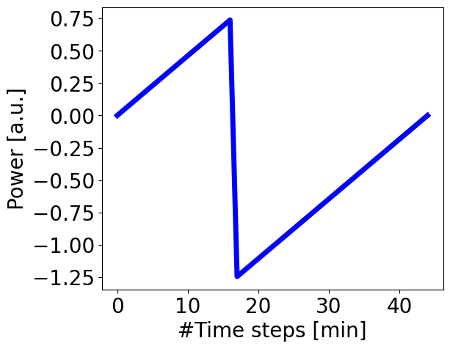
Slope
Activation
Width

