Slide 1
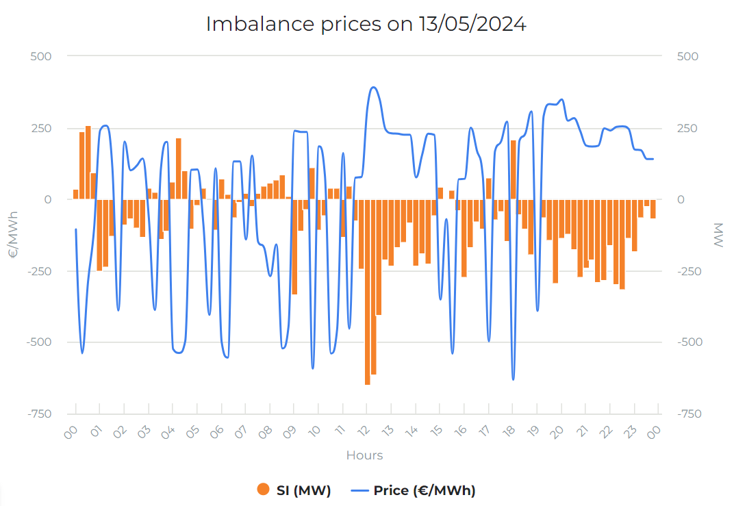
Participants get paid if they generate more than scheduled
Too much generation
Participants get paid if they generate less than scheduled
Not enough generation

