Slide 1


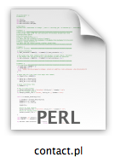
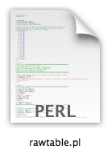


System:
>./coevolution.sh file.pdb ChainID
Launch
System:
>detailed_file_name
>contact_file_name
System:
>dssp calling
System:
>output

