Slide 1
Practice
Le Duc Bao – Le Quang Hoa

Slide 2
SuperNote - Requirement
SuperNote is note-taking app
Each note item includes title, content, created date, attached photo, location info, etc.,
SuperNote allows to create, edit, delete, and share note items

Slide 3
Application structure
Include two main activities:
Note list activity.
Note editor activity.

Slide 4
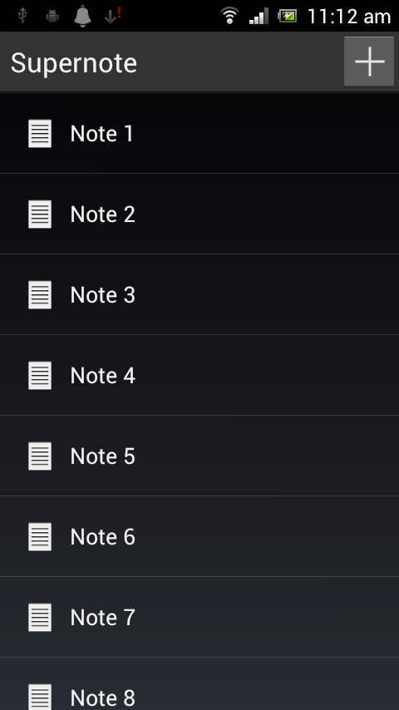
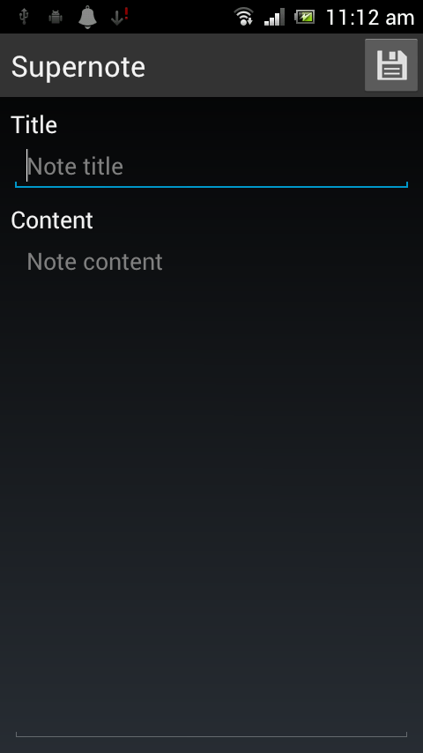
Application structure.
Click on note
Click “New” button
Press Back button
Click “Save” button

Slide 5
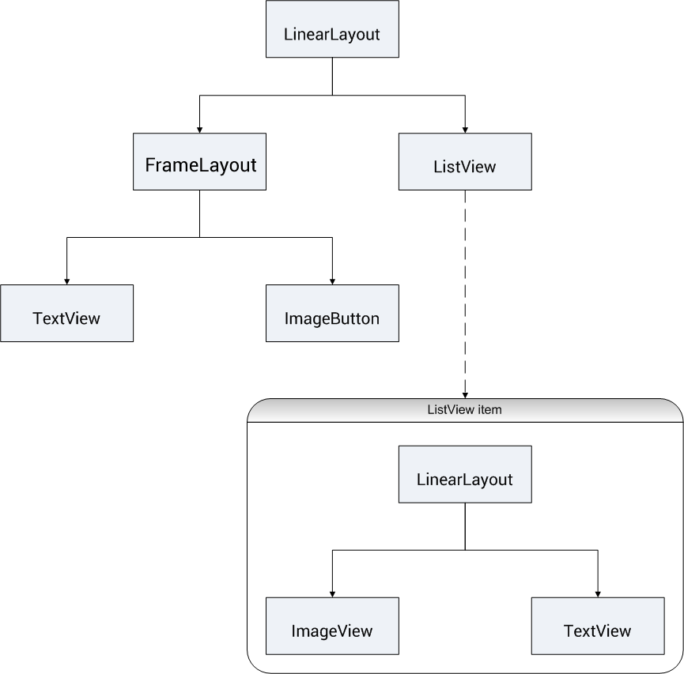
Application structure.
Back

Slide 6
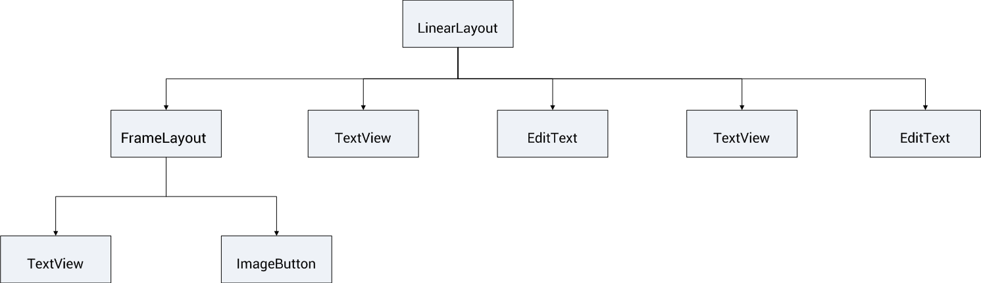
Application structure.
Back

Slide 7
Note object
private String mTitle;
private String mContent;
public String getTitle();
public void setTitle(String title) ;
public String getContent();
public void setContent(String content);
@Override
public String toString() {
return this.mTitle;
}

Slide 8
Adapter
The Adapter behaves as a middle-man between the data source and the AdapterView layout—the Adapter retreives the data (from a source such as an array or a database query) and converts each entry into a view that can be added into the AdapterView layout.

Slide 9
ArrayAdapter
ArrayAdapter creates a view for each array item by calling toString() on each item and placing the contents in a TextView.
Ex:
ArrayAdapter<Note> adapter = new ArrayAdapter<Note>(
this,
R.layout.listitem_note,
R.id.text_note_label,
notes);

Slide 10
Adapter
Note[] notes = Note.TEST();
ArrayAdapter<Note> adapter = new ArrayAdapter<Note>(this,
R.layout.listitem_note,
R.id.text_note_label, notes);
ListView noteList = (ListView) findViewById(R.id.list_note);
noteList.setAdapter(adapter);

Slide 11
Intent
An intent is an abstract description of an operation to be performed
Start another activity:
Intent intent = new Intent(this, NoteEditorActivity.class);
this.startActivity(intent);

Slide 12
Intent
Start another activity:
Intent intent = new Intent(this, NoteEditorActivity.class);
this.startActivity(intent);

Slide 13
Intent
Send extra information via Intent:
Intent intent = new Intent(this, NoteEditorActivity.class);
intent.putExtra(“EXTRA_TITLE”, note.getTitle());
intent.putExtra(“EXTRA_CONTENT”, note.getContent());
this.startActivity(intent);
Retrieve extra information:
String title = getIntent().getStringExtra(“EXTRA_TITLE”);
String content = getIntent().getStringExtra(“EXTRA_CONTENT”);

Slide 14
Backup

Slide 15
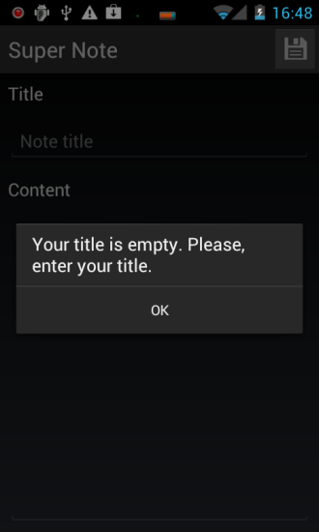
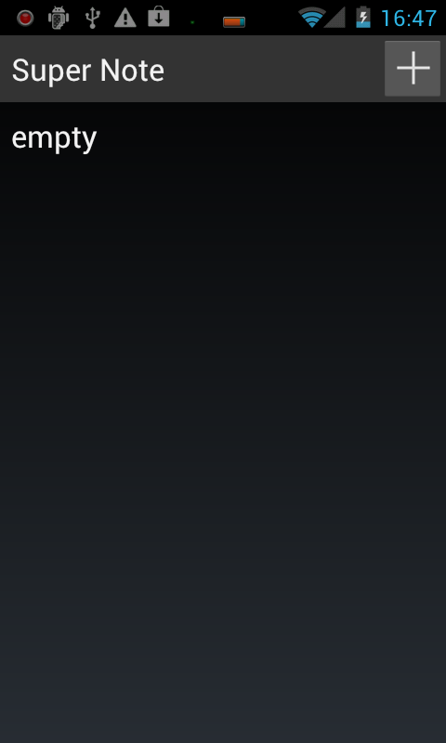
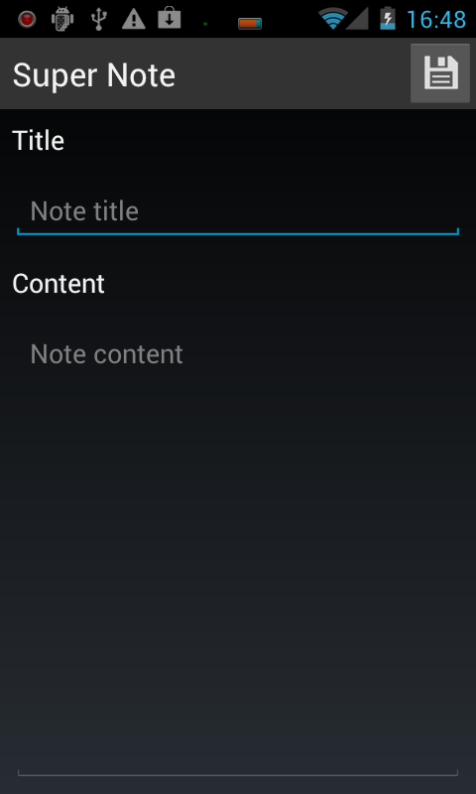
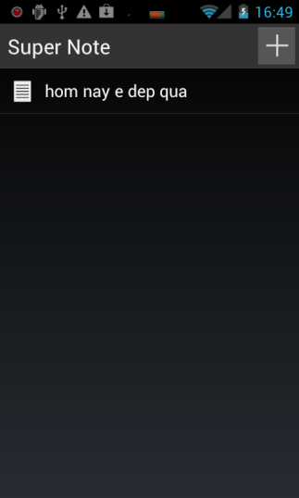
ADD ACTION
Click “New”
Click “Save”
Click “Back”

Slide 16
Check database function
NoteDBHelper Object
createNote(Note note) // insert note into Note table
updateNote(Note note, int id) // update note in Note table
deleteNote(Note note) // delete note from Note table
MainActivity
setListContent() // set all note in Note table to ListView

Slide 17
NoteDBHelper Object
public NoteDBHelper(Context context) {
super(context, DATABASE_NAME, null, DATABASE_VERSION);
}
public void onCreate(SQLiteDatabase db) { db.execSQL(Note.CREATE_NOTE_TABLE);
}
public void onUpgrade(SQLiteDatabase db, int oldVersion, int newVersion) {
// TODO upgrade database if possible.
}

Slide 18
NoteDBHelper Object
public void createNote(Note note);
public void updateNote(Note note, long id);
public void deleteNote(Note note);
public ArrayList<Note> readAllNote();

Slide 19
setListContent()
// create adapter
ArrayList<Note> notes = mDBHelper.readAllNote();
ArrayAdapter<Note> adapter = new ArrayAdapter<Note>(this, R.layout.listitem_note,
R.id.text_note_title, notes);
// update listView
this.mNoteList.setAdapter(adapter);

Slide 20
Create dialog
showDialog(int id) // call to show a dialog
onCreateDialog(int id)
dismissDialog(int id) // call to dismiss a dialog

Slide 21
onCreateDialog(int id)
AlertDialog.Builder builder = new AlertDialog.Builder(this);
builder.setMessage(R.string.dialog_title);
builder. setMessage(R.string.dialog_alter_empty_message);
builder. setPositiveButton(android.R.string.yes,
new DialogInterface.OnClickListener() {
@Override
public void onClick(DialogInterface dialog, int which) {
dismissDialog(ALTER_DIALOG);
}
});
builder.create();

Slide 22
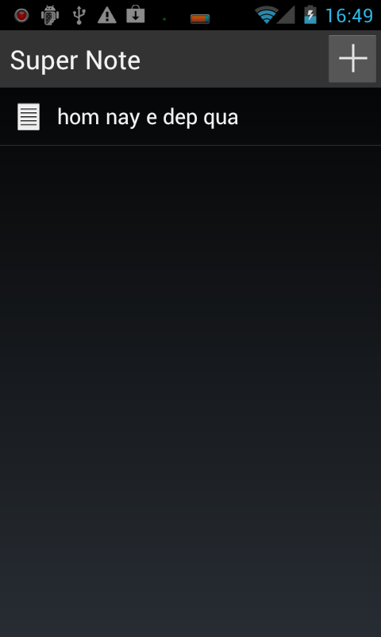
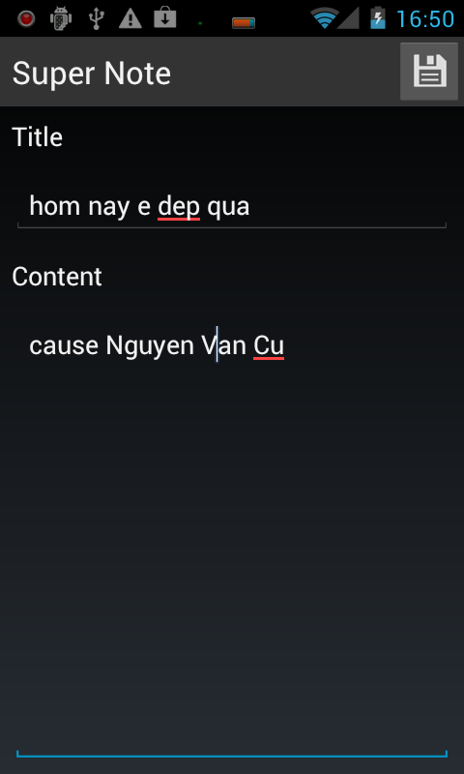
EDIT ACTION
Select Item
Click “Save”
Click “Back”

Slide 23
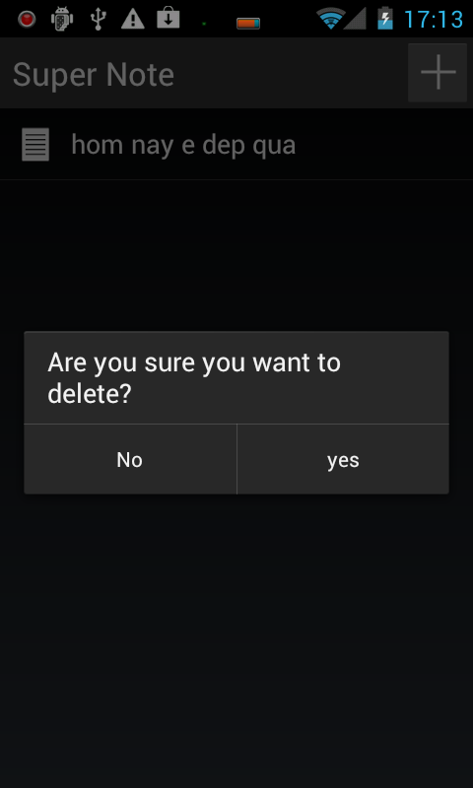
DELETE ACTION
Long Click
Click “Yes”
Click “No”

