Slide 1
Object Classification with Bag-of-Visual-Word
Student: Huynh Van Thong
Course: Computer Vision
Github: https://goo.gl/xYi2kR

Slide 2
Contents
Method
Implement
Result

Slide 3
Method
Input Image
SIFT extractor
List of Descriptor
Number of Keypoins x 128
Classifier
1000 features
Bag-of-Visual-Word
Type of object

Slide 4
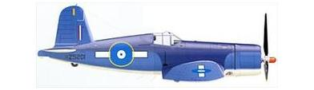
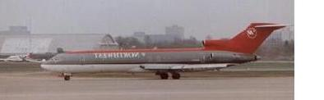
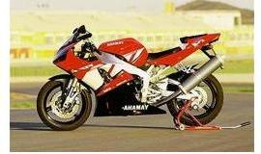
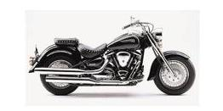
Method
Dataset: subset of two object in Caltech-256 Object Categories http://www.vision.caltech.edu/Image_Datasets/Caltech256/
Object | Number of images
Motorbike | 798
Airplane | 800

Slide 5
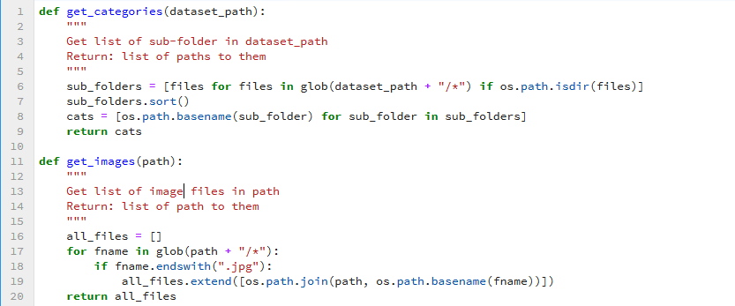
Implement
Get list of sub folder, images in a folder

Slide 6
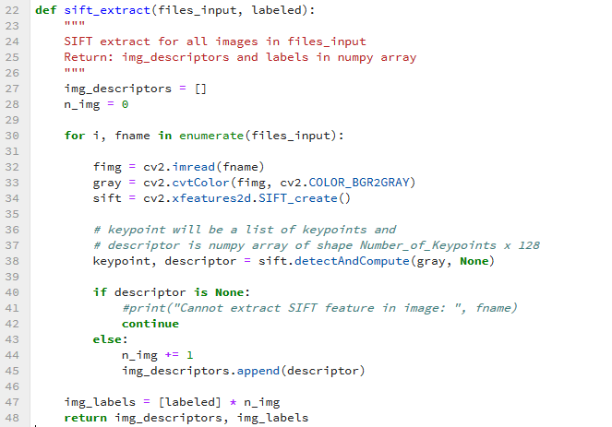
Implement
Extract SIFT descriptor with OpenCV

Slide 7
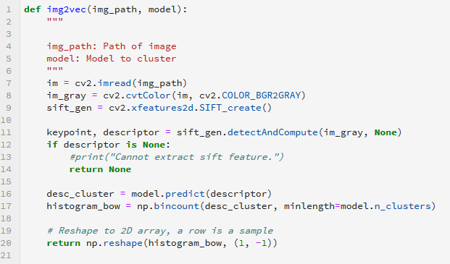
Implement
Convert image to a vector of features
model: K-mean model to cluster

Slide 8
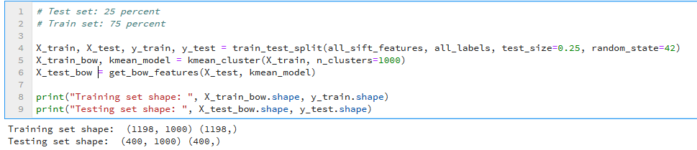
Implement
Split data to training and testing

Slide 9
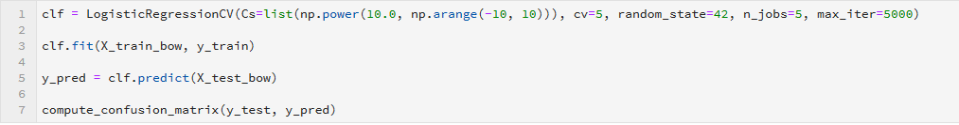
Implement
Training, predict with Logistic Regression using scikit-learn

Slide 10
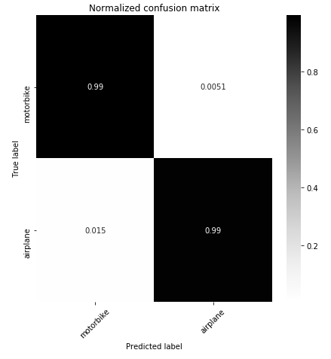
Result
Confusion matrix on testing set

Slide 11
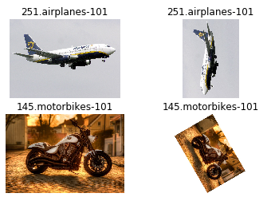
Result

