Slide 1
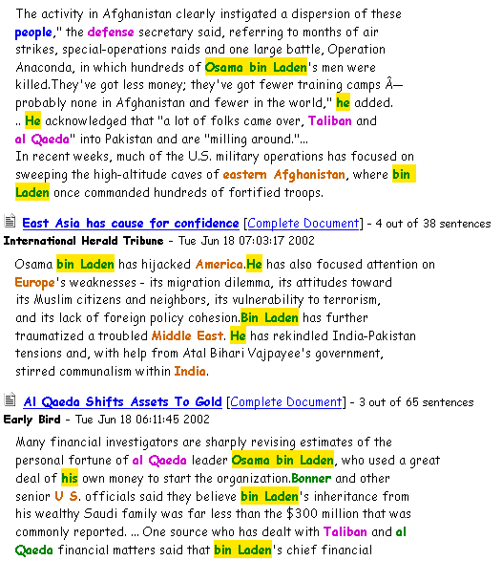
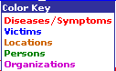
Osama bin Laden Tracker in MiTAP
Multi-document sentence extraction on bin Laden
Coreference: names, pronouns & aliases referring to same person
Color Key

