Slide 1
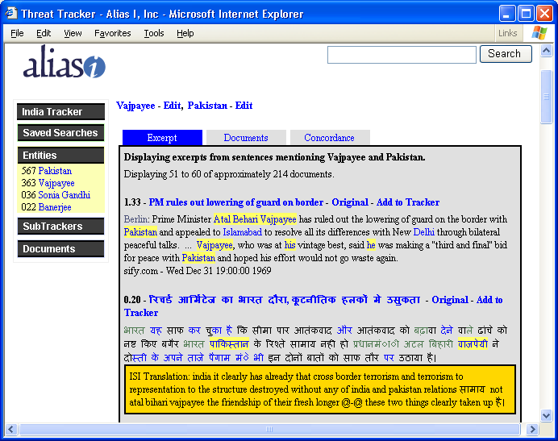
Translingual Entity Tracking
‘…’ indicates sentences have been removed because they don’t mention the Entity
Translation of Excerpt Summary
Mentions of Vajpayee and Pakistan found by ThreatTrackers

