Slide 1
WWW Programming (Advanced Web Programming with Java)
1. Web Application Architecture

Slide 2
Types of Software
Desktop Aplication: An application that runs stand-alone in a desktop or laptop computer.
A "Web-based application," which requires the Web browser to run.
Mobile applications will run in smartphones and tablets.
Server software is primarily built to interact with a server’s hardware infrastructure, including the processor, memory, storage, input/output (I/O) and other communication ports.

Slide 3
Types of Software (cont.)
Depending on the type or usage of the server, server software may be classified into various forms:
Web server software | Application server software
Database server software
Cloud computing server software
File server software
A plug-in is an element of a software program that can be added to provide support for specific features or functionality. Plug-ins are commonly used in Internet browsers but also can be utilized in numerous other types of applications.
Embedded software is computer software, written to control machines or devices that are not typically thought of as computers. It is typically specialized for the particular hardware that it runs on and has time and memory constraints.

Slide 4
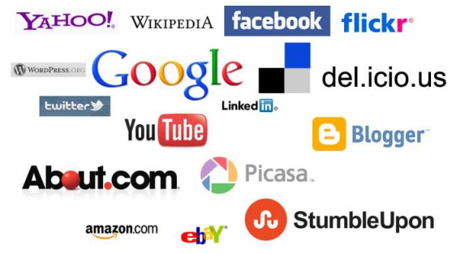
Popular Websites

Slide 5
Popular Web Applications
Facebook – the Social Network
Pixlr – Image Creation, Photo Editing & Effects
Zamzar – Online File Conversion
Yahoo mail/Gmail – Webmail Clients
bit.ly – Short URL Services
WolframAlpha – Computational Knowledge Engine

Slide 6
Components of a Website
Logo
Navigation
Search form
Content
Images & Multimedia
Gallery & Slideshows
Blog
Contact Form | Registration form
Members only area
Downloadable files
Shopping cart

Slide 7


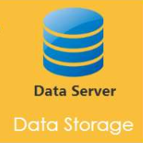
Architecture of a Web Application

Slide 8
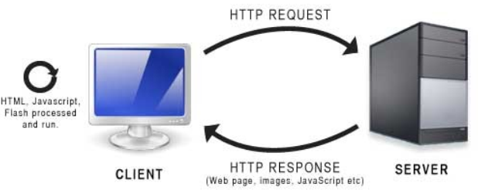
Http Request & Response

Slide 9
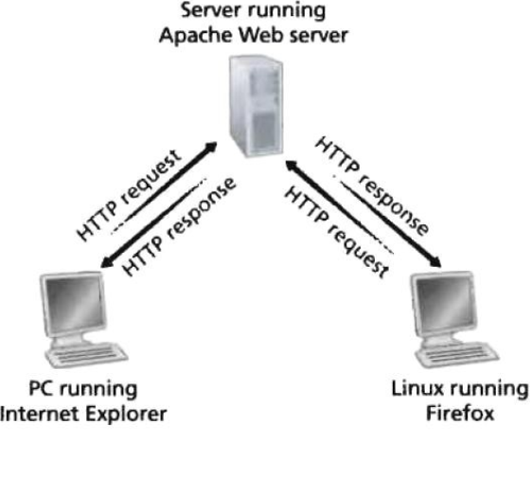
HyperText Transfer Protocol (HTTP)
Most popular application protocol used in the Internet (or The WEB)
An HTTP client sends a request message to an HTTP server
The server, in turn, returns a response message. In other words, HTTP is a pull protocol, the client pulls information from the server (instead of server pushes information down to the client).
HTTP is a stateless protocol. In other words, the current request does not know what has been done in the previous requests.

Slide 10
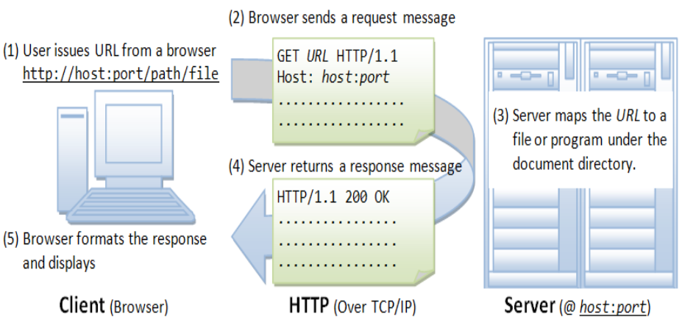
Browser

Slide 11
Uniform Resource Locator (URL)
A URL (Uniform Resource Locator) is used to uniquely identify a resource over the web. URL has the following syntax: protocol://hostname:port/path-and-file-name
Protocol: The application-level protocol used by the client and server, e.g., HTTP, FTP, and telnet.
Hostname: The DNS domain name (e.g., www.test101.com) or IP address (e.g., 192.128.1.2) of the server.
Port: The TCP port number that the server is listening for incoming requests from the clients.
Path-and-file-name: The name and location of the requested resource, under the server document base directory.

Slide 12
Uniform Resource Identifier (URI)
The Web is an information space. Human beings have a lot of mental machinery for manipulating, imagining, and finding their way in spaces. URIs are the points in that space.
Uniform Resource Identifiers (URIs) are short strings that identify resources in the Web: documents, images, downloadable files, services, electronic mailboxes, and other resources.
URIs make resources available under a variety of naming schemes and access methods such as HTTP, FTP, and Internet mail addressable in the same simple way.

Slide 13
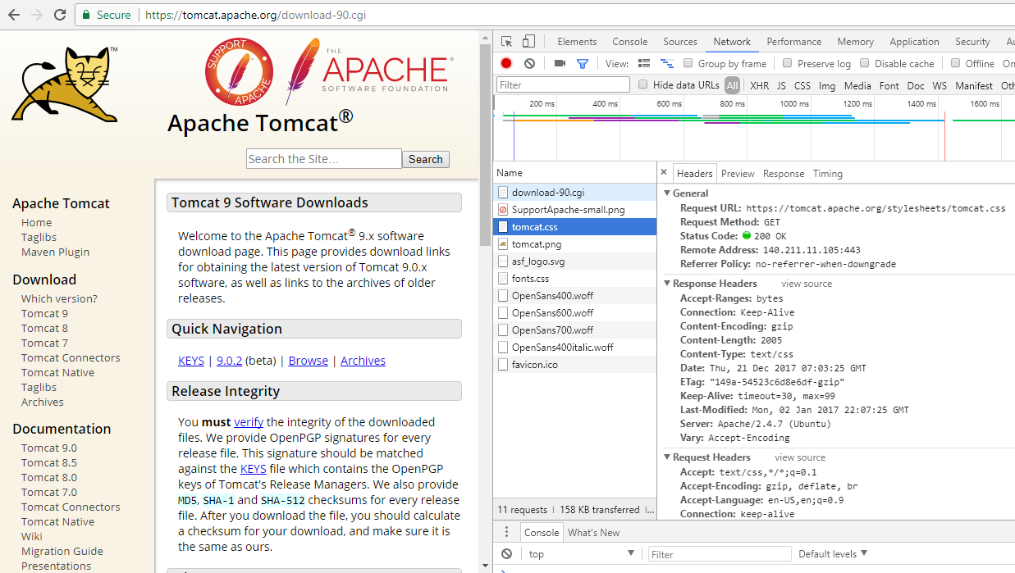
Http Request Message

Slide 14
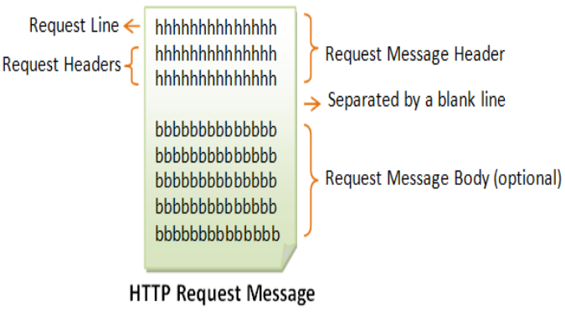
Http Request Message Format
The first line of the header is called the request line, followed by optional request headers. The request line syntax: request-method-name request-URI HTTP-version
request-method-name: HTTP protocol defines a set of request methods, e.g., GET, POST, HEAD, and OPTIONS.
request-URI: specifies the resource requested.
HTTP-version: 2 versions are currently in use: HTTP/1.0, HTTP/1.1.
Examples:
GET /test.html HTTP/1.1
HEAD /query.html
HTTP/1.0 POST /index.html HTTP/1.1

Slide 15
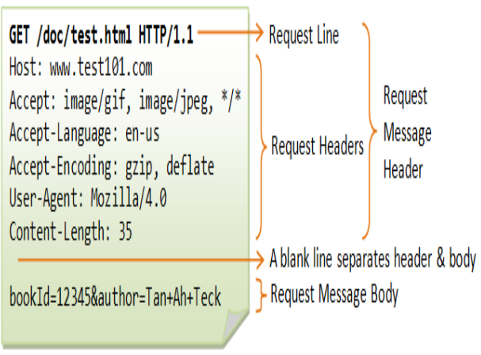
Http Request Message Format (cont.)
Request Headers
The request headers are in the form of name:value pairs. Multiple values, separated by commas, can be specified. request-header-name: request-header-value1, requestheader-value2, ...
Examples:
Host: www.xyz.com
Connection: Keep-Alive
Accept: image/gif, image/jpeg, */*
Accept-Language: us-en, fr, cn
username=vignesh&password=q

Slide 16
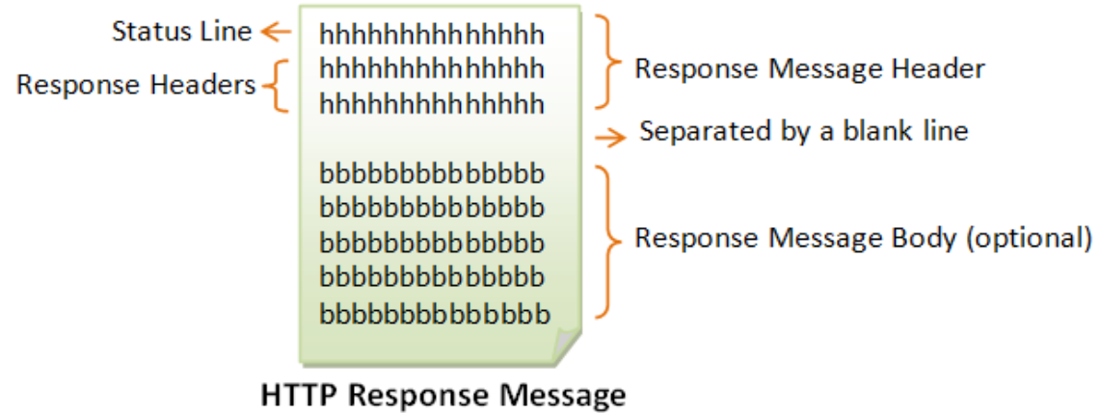
Http Response Message

Slide 17
Http Response Message (cont.)
The first line is called the status line, followed by optional response header(s).
The status line has the following syntax: HTTP-version status-code reason-phrase
HTTP-version: The HTTP version used in this session. Either HTTP/1.0 and HTTP/1.1.
status-code: a 3-digit number generated by the server to reflect the outcome of the request.
reason-phrase: gives a short explanation to the status code. Common status code and reason phrase are "200 OK", "404 Not Found", "403 Forbidden", "500 Internal Server Error".

Slide 18
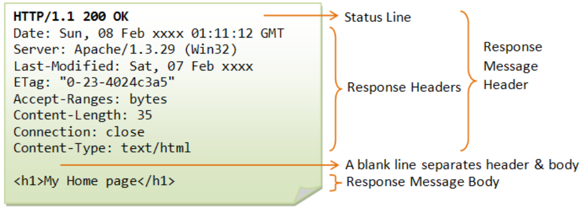
Http Response Message (cont.)

Slide 19
Http Response Status Code
100 Continue: The server received the request and in the process of giving the response.
200 OK: The request is fulfilled.
301 Move Permanently: The resource requested for has been permanently moved to a new location. The URL of the new location is given in the response header called Location. The client should issue a new request to the new location. Application should update all references to this new location.
400 Bad Request: Server could not interpret or understand the request, probably syntax error in the request message.
GET /index.html HTTTTTP/1.0
GET test.html HTTP/1.0

Slide 20
Http Response Status Code (cont.)
401 Authentication Required: The requested resource is protected, and require client’s credential (username/password). The client should re-submit the request with his credential (username/password).
403 Forbidden: Server refuses to supply the resource, regardless of identity of client.
404 Not Found: The requested resource cannot be found in the server. GET /t.html HTTP/1.0
405 Method Not Allowed: The request method used, e.g., POST, PUT, DELETE, is a valid method. However, the server does not allow that method for the resource requested.
408 Request Timeout.

Slide 21
Http Response Status Code (cont.)
500 Internal Server Error: Server is confused, often caused by an error in the server-side program responding to the request.
501 Method Not Implemented: The request method used is invalid (could be caused by a typing error, e.g., "GET" misspell as "Get"). get /test.html HTTP/1.0
502 Bad Gateway: Proxy or Gateway indicates that it receives a bad response from the upstream server.
503 Service Unavailable: Server cannot response due to overloading or maintenance. The client can try again later.
504 Gateway Timeout: Proxy or Gateway indicates that it receives a timeout from an upstream server.

Slide 22
Http Request Using HTML Form
<!DOCTYPE html> <head><title>Login</title></head> <body> <h2>LOGIN</h2> <form method="get/post/delete" action="/user/login"> Username:
<input type="text" name="user" size="25" /><br /> Password:
<input type="password" name="pw" size="10" /><br />
<br /> <input type="hidden" name="action" value="login" /> <input type="submit" value="SEND" /> </form> </body> </html>

Slide 23
Http Request Using HTML Form (cont.)
If GET request method is used, the URL-encoded query string will be appended behind the request-URI after a "?" character, i.e.,
GET request-URI?query-string HTTP-version
(other optional request headers)
(blank line)
(optional request body)
Using GET request to send the query string has the drawbacks:
The amount of data you could append behind request-URI is limited. If this amount exceed a server-specific threshold, the server would return an error "414 Request URI too Large".
The URL-encoded query string would appear on the address box of the browser.

Slide 24
Http Request Using HTML Form (cont.)
Case: <form method="get" action="/bin/login.html"...>
Request Data
GET /bin/login?user=Peter+Lee&pw=123456&action=login HTTP/1.1
Accept: image/gif, image/jpeg, */*
Referer: http://127.0.0.1:8000/bin/login.html
Accept-Language: en-us
Accept-Encoding: gzip, deflate
User-Agent: Mozilla/4.0 (compatible; MSIE 6.0; Windows NT 5.1)
Host: 127.0.0.1:8000
Connection: Keep-Alive
Address Bar
http://127.0.0.1:8000/bin/login.html?user=Peter+Lee&pw=123456&action=log

