Slide 1
WWW Programming (Advanced Web Programming with Java)
2. Java Servlets

Slide 2
Content
Servlet Introduction
Servlet Request & Response
Servlets and Servlet Context
Session Tracking
Filter
Securing Web Application

Slide 3
Definitions
A servlet is a Java class that can be loaded dynamically into and run by a special Web server.
This servlet-aware Web server, is known as servlet container.
Servlets interact with clients via a request-response model based on HTTP.
Therefore, a servlet container must support HTTP as the protocol for client requests and server responses.
A servlet container also can support similar protocols such as HTTPS (HTTP over SSL) for secure transactions

Slide 4
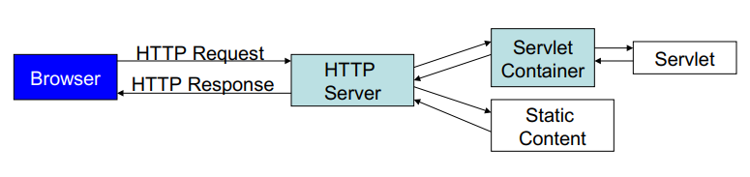
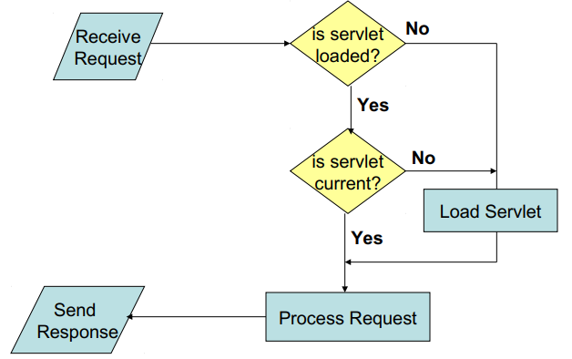
Servlet Container Architecture
How Servlets Work

Slide 5
Servlets Interfaces
Server implemented interfaces
ServletConfig
ServletContext
ServletRequest/ServletResponse
RequestDispatcher
FilterChain/FilterConfig
User implemented interfaces
Servlet
ServletContextListener
ServletContextAttributeListener
SingleThreadModel
Filter

Slide 6
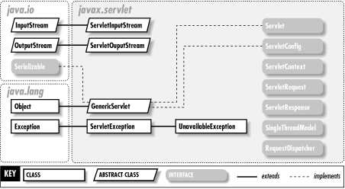
The javax.servlet package

Slide 7
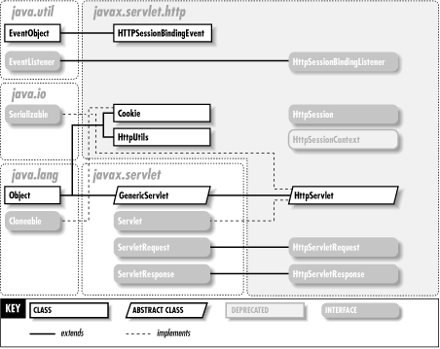
The javax.servlet.http Package

Slide 8
Servlet APIs
Every servlet must implement javax.servlet.Servlet interface
Most servlets implement the interface by extending one of these classes
javax.servlet.GenericServlet
javax.servlet.http.HttpServlet

Slide 9
Interface javax.servlet.Servlet
The Servlet interface defines methods
to initialize a servlet
to receive and respond to client requests
to destroy a servlet and its resources
to get any startup information
to return basic information about itself, such as its author, version and copyright.
Developers need to directly implement this interface only if their servlets cannot (or choose not to) inherit from GenericServlet or HttpServlet.

Slide 10
Generic Servlet & HTTP Servlet
GenericServlet - Methods
void init(ServletConfig config): Initializes the servlet.
void service(ServletRequest req, ServletResponse res): Carries out a single request from the client.
void destroy(): Cleans up whatever resources are being held (e.g., memory, file handles, threads) and makes sure that any persistent state is synchronized with the servlet's current in-memory state.
ServletConfig getServletConfig(): Returns a servlet config object, which contains any initialization parameters and startup configuration for this servlet.
String getServletInfo(): Returns a string containing information about the servlet, such as its author, version, and copyright.

Slide 11
HttpServlet - Methods
void doGet (HttpServletRequest request, HttpServletResponse response): handles GET requests
void doPost (HttpServletRequest request, HttpServletResponse response): handles POST requests
void doPut (HttpServletRequest request, HttpServletResponse response): handles PUT requests
void doDelete (HttpServletRequest request, HttpServletResponse response): handles DELETE requests

Slide 12
Main Concepts of Servlet Programming
Life Cycle
Client Interaction
Saving State
Servlet Communication
Calling Servlets
Request Attributes and Resources
Multithreading

Slide 13
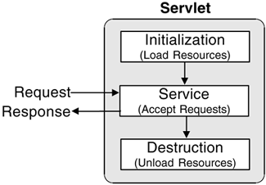
Life Cycle
Initialize
Servlet is created when servlet container receives a request from the client
Init() method is called only once
Service: Any requests will be forwarded to the service() method
doGet()/doPost()/doDelete()
doOptions()
doPut()
doTrace()
Destroy: destroy() method is called only once. Occurs when
Application is stopped
Servlet container shuts down
Allows resources to be freed

Slide 14
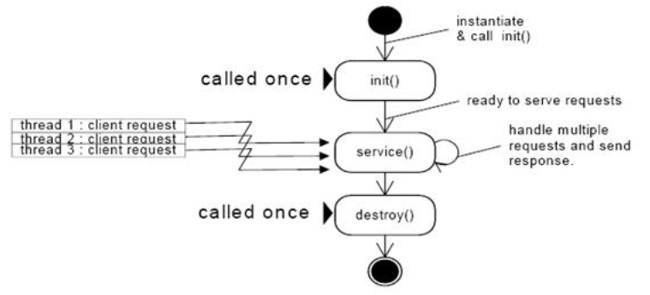
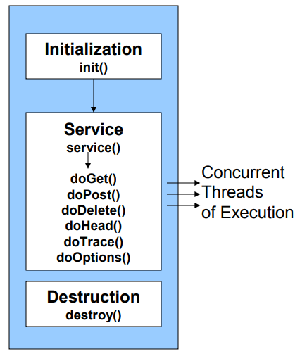
Life Cycle (cont.)

Slide 15
Life Cycle (cont.)
Servlet Container
Create Thread Pool
Thread
Thread
Instantiate servlet
Servlet
Call init ( ) method
Perform Initialization
HTTP Request 1
Call service ( ) method
Allocate request to thread
HTTP Request 2
Call service ( ) method
Allocate request to thread
Perform Service
Shutdown Initiated
Block all further requests Wait for active threads to end
Perform Service
HTTP Response 1
Terminate thread pool
HTTP Response 2
call destroy ( ) method
Perform cleanup
terminate servlet
Servlet destroyed & garbage collected
Container shutdown

Slide 16
Benefits of Java Servlets
Performance
The performance of servlets is superior to CGI because there is no process creation for each client request.
Each request is handled by the servlet container process.
After a servlet has completed processing a request, it stays resident in memory, waiting for another request.
Portability: Like other Java technologies, servlet applications are portable.
Rapid development cycle: As a Java technology, servlets have access to the rich Java library that will help speed up the development process.
Robustness
Servlets are managed by the Java Virtual Machine.
Don't need to worry about memory leak or garbage collection, which helps you write robust applications.
Widespread acceptance: Java is a widely accepted technology.

Slide 17
Servlet Request Objects
Provides client request information to a servlet.
The servlet container creates a servlet request object and passes it as an argument to the servlet's service method.
The ServletRequest interface define methods to retrieve data sent as client request:
parameter name and values
attributes
input stream
HTTPServletRequest extends the ServletRequest interface to provide request information for HTTP servlets

Slide 18
HttpServletRequest - Methods
Enumeration getParameterNames() an Enumeration of String objects, each String containing the name of a request parameter; or an empty Enumeration if the request has no parameters
java.lang.String[] getParameterValues (java.lang.String name) Returns an array of String objects containing all of the values the given request parameter has, or null if the parameter does not exist.
java.lang.String getParameter (java.lang.String name) Returns the value of a request parameter as a String, or null if the parameter does not exist.

Slide 19
HttpServletRequest – Methods (cont.)
Cookie[] getCookies() Returns an array containing all of the Cookie objects the client sent with this request.
java.lang.String getMethod() Returns the name of the HTTP method with which request was made, for example, GET, POST, or PUT.
java.lang.String getQueryString() Returns the query string that is contained in the request URL after the path.
HttpSession getSession() Returns the current session associated with this request, or if the request does not have a session, creates one.

Slide 20
Servlet Response Objects
Defines an object to assist a servlet in sending a response to the client.
The servlet container creates a ServletResponse object and passes it as an argument to the servlet's service method.
HttpServletResponse - Methods
java.io.PrintWriter getWriter() Returns a PrintWriter object that can send character text to the client
void setContentType (java.lang.String type) Sets the content type of the response being sent to the client. The content type may include the type of character encoding used, for example, text/html; charset=ISO-8859-4
int getBufferSize() Returns the actual buffer size used for the response

Slide 21
ServletContext
An object of ServletContext is created by the web container at time of deploying the project.
This object can be used to get configuration information from web.xml file.
There is only one ServletContext object per web application.
If any information is shared to many servlet, it is better to provide it from the web.xml file using the <context-param> element.
Syntax to provide the initialization parameter in Context scope
<web-app> ....
<context-param>
<param-name>parametername</param-name>
<param-value>parametervalue</param-value>
</context-param>
</web-app>

Slide 22
ServletContext (cont.)
Usage of ServletContext Interface. Some of them are as follows:
The object of ServletContext provides an interface between the container and servlet.
The ServletContext object can be used to get configuration information from the web.xml file.
The ServletContext object can be used to set, get or remove attribute from the web.xml file.
The ServletContext object can be used to provide inter-application communication.

Slide 23
ServletContext (cont.)
Commonly used methods of ServletContext interface
public String getInitParameter(String name):Returns the parameter value for the specified parameter name.
public Enumeration getInitParameterNames():Returns the names of the context's initialization parameters.
public void setAttribute(String name,Object object):sets the given object in the application scope.
public Object getAttribute(String name):Returns the attribute for the specified name.
public Enumeration getInitParameterNames():Returns the names of the context's initialization parameters as an Enumeration of String objects.
public void removeAttribute(String name):Removes the attribute with the given name from the servlet context.

Slide 24
Working with Form Data
The browser uses two methods to pass form’s information to web server: GET and POST Method.
The GET method sends the encoded user information appended to the page request. The page and the encoded information are separated by the ? question mark symbol
http://www.test.com/hello?key1 = value1&key2 = value2
This information is passed using QUERY_STRING header and will be accessible through QUERY_STRING environment variable and Servlet handles this type of requests using doGet() method.
A generally more reliable method of passing information to a backend program is the POST method.
Servlet handles this type of requests using doPost() method.

Slide 25
Working with Form Data (cont.)
Reading Form Data using Servlet
getParameter() − You call request.getParameter() method to get the value of a form parameter.
getParameterValues() − Call this method if the parameter appears more than once and returns multiple values, for example checkbox.
getParameterNames() − Call this method if you want a complete list of all parameters in the current request.

Slide 26
HttpServletRequest Methods to read HTTP Header
Cookie[] getCookies(): Returns an array containing all of the Cookie objects the client.
Enumeration getAttributeNames(): Returns an Enumeration containing the names of the attributes.
Enumeration getParameterNames(): Returns an Enumeration of String objects containing the names of the parameters.
HttpSession getSession(): Returns the current session associated with this request, or if the request does not have a session, creates one.
HttpSession getSession(boolean create): Returns the current HttpSession associated with this request or, if if there is no current session and value of create is true, returns a new session.
String getAuthType(): Returns the name of the authentication scheme used to protect the servlet, for example, "BASIC" or "SSL," or null if the JSP was not protected.

Slide 27
Writing Filters with Servlet
Servlet Filters are Java classes that can be used in Servlet Programming:
To intercept requests from a client before they access a resource.
To manipulate responses from server before they are sent back to the client.
There are various types of filters suggested by the specifications
Authentication Filters.
Data compression Filters.
Encryption Filters.
Filters that trigger resource access events.
Image Conversion Filters.
Logging and Auditing Filters.
MIME-TYPE Chain Filters.
Tokenizing Filters .
XSL/T Filters That Transform XML Content.

Slide 28
Writing Filters with Servlet (cont.)
Filters are deployed in the deployment descriptor file web.xml and then map to either servlet names or URL patterns in application's deployment descriptor.
A filter is simply a Java class that implements the javax.servlet.Filter interface. The javax.servlet.Filter interface defines methods:
public void doFilter (ServletRequest, ServletResponse, FilterChain): This method is called by the container each time a request/response pair is passed through the chain due to a client request for a resource at the end of the chain.
public void init(FilterConfig filterConfig): This method is called by the web container to indicate to a filter that it is being placed into service.
public void destroy(): This method is called by the web container to indicate to a filter that it is being taken out of service.

Slide 29
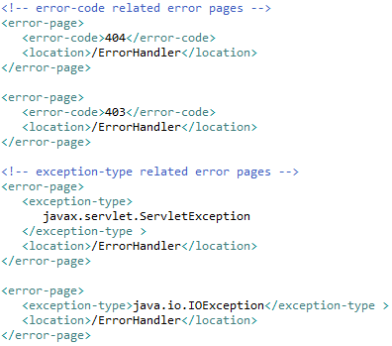
Exception Handling
If a servlet throws an exception, the web container searches the configurations in web.xml that use the exception-type element for a match with the thrown exception type.
Use the <error-page> element in web.xml to specify the invocation of servlets in response to certain exceptions or HTTP status codes.

Slide 30
Session Tracking
HTTP is a "stateless" protocol which means each time a client retrieves a Web page, the client opens a separate connection to the Web server and the server automatically does not keep any record of previous client request.
The HttpSession Object
Get HttpSession object by calling the public method getSession() of HttpServletRequest
HttpSession session = request.getSession();
Methods:
public Object getAttribute(String name)
public Enumeration getAttributeNames()

Slide 31
Session Tracking (cont.)
The HttpSession Object
Methods:
public Object getAttribute(String name)
public Enumeration getAttributeNames()
public long getCreationTime()
public String getId()
public boolean isNew()
public void removeAttribute(String name)
public void setAttribute(String name, Object value)
public void setMaxInactiveInterval(int interval)
public int getMaxInactiveInterval()
public long getLastAccessedTime()

Slide 32
Session Tracking (cont.)
Deleting Session Data:
Remove a particular attribute − call public void removeAttribute(String name) method to delete the value associated with a particular key.
Delete the whole session − call public void invalidate() method to discard an entire session.
Setting Session timeout − call public void setMaxInactiveInterval(int interval) method to set the timeout for a session individually.
Log the user out − The servers that support servlets 2.4, call logout to log the client out of the Web server and invalidate all sessions belonging to all the users.
web.xml Configuration − with Tomcat, can configure session time out in web.xml file.
<session-config> <session-timeout>15</session-timeout> </session-config>

Slide 33
Session Tracking (cont.)
Deleting Session Data:
The getMaxInactiveInterval( ) method in a servlet returns the timeout period for that session in seconds.
if session is configured in web.xml for 15 minutes, getMaxInactiveInterval( ) returns 900.

Slide 34
File Uploading
File Upload Form should be check the following important points:
The form method attribute should be set to POST method and GET method can not be used
The form enctype attribute should be set to multipart/form-data.
The form action attribute should be set to a servlet file which would handle file uploading at backend server.
To upload a single file you should use a single <input .../> tag with attribute type="file". To allow multiple files uploading, include more than one input tags with different values for the name attribute.

Slide 35
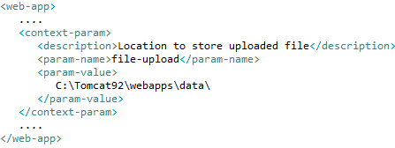
File Uploading (cont.)
Libraries for file uploading are:
commons-fileupload.x.x.jar
commons-io-x.x.jar
Set the max file size for uploaded files.
Create directories C:\temp and C:\apache-tomcat\webapps\data in advance. In web.xml file, we need the <context-param> tag to specify the location of upload folder.

Slide 36
Page Redirection
Page redirection is a technique where the client is sent to a new location other than requested.
Using method sendRedirect() of response object HttpResponse.
Syntax:
public void HttpServletResponse.sendRedirect(String location) throws IOException
Can also use setStatus() and setHeader() methods together.
response.setStatus(response.SC_MOVED_TEMPORARILY);
response.setHeader("Location", "http://www.newwebsitepage.com");

Slide 37
Sending Email
Sending email using JavaMail API and Java Activation Framework (JAF) : mail.jar and activation.jar files in the CLASSPATH.
javax.mail.Multipart
javax.mail.Part
javax.mail.Service
javax.mail.internet.InternetHeaders
javax.mail.internet.MimeBodyPart
javax.mail.internet.MimeMessage
javax.mail.internet.MimePart
javax.mail.internet.ParameterList

Slide 38
Servlets - Annotations
Servlet API 3.0 has introduced a new package called javax.servlet.annotation. It provides annotation types which can be used for annotating a servlet class.
If we use annotation, then the deployment descriptor (web.xml) is not required (only for Tomcat version 7 ↑)

Slide 39
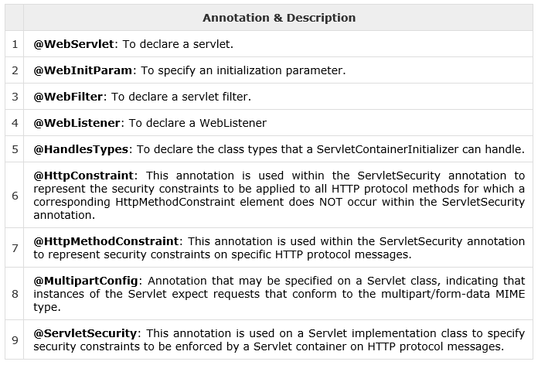
Servlets – Annotations (cont.)

