Slide 1
WWW Programming (Advanced Web Programming with Java)
5.1. Spring Framework

Slide 2
Complexity of Enterprise Application Development
J2EE Specification promised Scalability, Security and High Availability.
Enterprise JavaBeans (EJB), as part of the J2EE suite of specifications from Sun, were intended to be as reusable and portable as their non-enterprise counterparts, plain JavaBeans.
Problem with the Enterprise Java Beans (EJB)
Many interfaces and configuration files required to create an EJB were awkward, tedious, and prone to error.
The EJBs' marriage to the container made unit testing close to impossible.
Applications became heavy in the bulk of extra container features.

Slide 3
What you need is
Your components should run with or without a container.
Be testable with minimal to no intrusion from outside classes.
Components should have a life outside of the framework.
A framework to help you put into place some established best practices for your applications

Slide 4
What is Spring Framework?
Spring is the most popular application development framework for enterprise Java.
Open source Java platform since 2003.
Spring supports all major application servers and JEE standards.
Spring handles the infrastructure so you can focus on your application.
Spring is the most popular application development framework for enterprise Java.
Millions of developers around the world use Spring Framework to create high performing, easily testable, reusable code.

Slide 5
Spring version history
Version | Year | Note
 | 2002 | First version was written by Rob Johnson
1.0 | March 2004
2.0 | October 2006
2.5 | November 2017
3.0 | December 2009
3.1 | December 2011
4.0 | December 2013 | Support for Java SE (Standard Edition) 8, Groovy 2, some aspects of Java EE 7, and Web Socket
4.3 | June 2016
5.0 | March 2017 | 5.2.2 (December 2019)

Slide 6
Spring, Java and Java EE compatibility
Spring | Java Version | Java EE Version
1.x | Full Support for JDK 1.3, 1.4 | Java EE 1.3, 1.4 are fully supported.
2.0.x | Full Support for JDK 1.3, 1.4 and 1.5 | Java EE 1.3, 1.4 are fully supported.
2.5 | Full support for Java SE 1.4.2 or later, Early Support for Java SE 6. | Java EE 1.3, 1.4 are fully supported. Early support for Java EE 5.
3.x | Java SE 5 and 6 are fully supported | Java EE 1.4, 5 are fully supported. Early support for Java EE 6.
4.x | Java SE 6, 7 are fully supported. Early support for Java SE 8. | Java EE 6 is fully supported Early support for Java EE 7
5.x | Java SE 6, 7, 8 are fully supported Early Support for Java SE 9 | Java EE 6, 7 are fully supported

Slide 7
Spring – Evolution over Intelligent Design
The Dependency Inversion Principle
High level modules should not depend upon low level modules. Both should depend upon abstractions.
Abstractions should not depend upon details, details should depend upon abstractions.
Depend upon Abstractions, Do not depend upon Concrete Classes

Slide 8
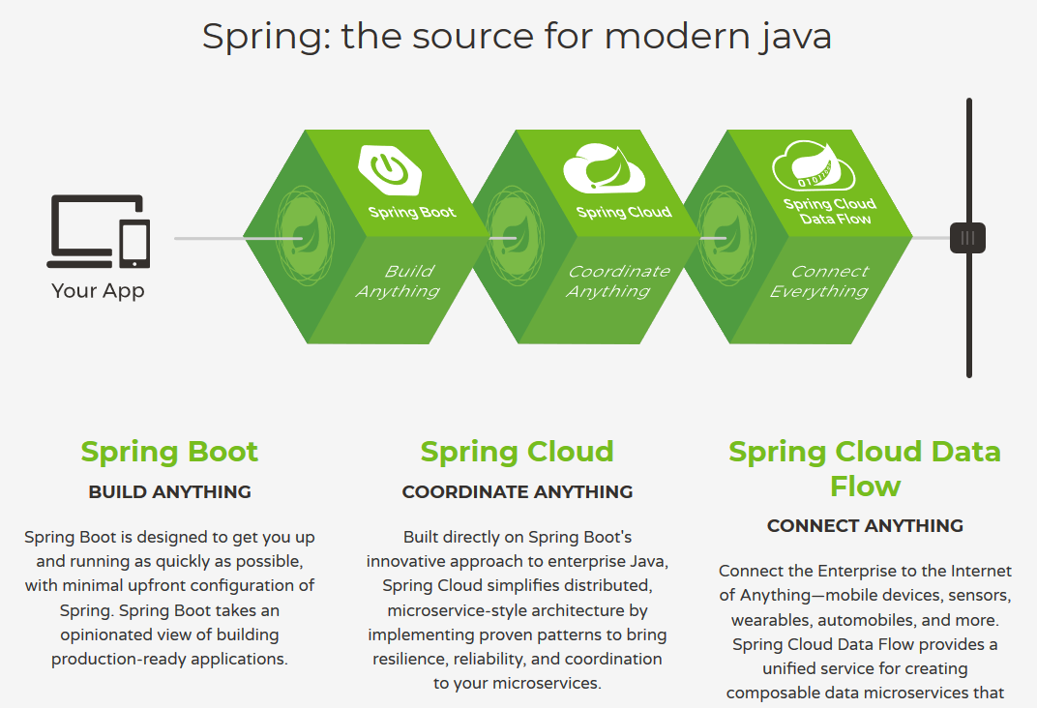

Slide 9
What is Spring all about?
As an IOC Container
Creates objects and makes them available to your application
As a Light-weight Framework for building Java Applications
Provides an infrastructure of classes that make it easier to accomplish tasks you can use Spring to build any application in Java (e.g., stand-alone, Web, JEE applications, etc.), unlike many other frameworks such as Apache Struts, which is limited to web applications.
Non Invasive & Portable
Fully modularized (High decoupling)
Considered as an alternative / replacement for the Enterprise JavaBean (EJB) Model
Open source Application Framework and no vendor lock-in.
Most business objects in Spring apps do not depend on the Spring framework.

Slide 10
What is Spring all about? (cont.)
A lightweight framework that addresses each tier in a Web application.
Presentation layer: An MVC framework that is most similar to Struts but is more powerful and easy to use.
Business layer: Lightweight IoC container and AOP support (including built in aspects)
Persistence layer
DAO template support for popular ORMs and JDBC
Simplifies persistence frameworks and JDBC
Complimentary: Not a replacement for a persistence framework

Slide 11
What is Spring all about? (cont.)
Well-Structured
Spring code base is proven to be well structured (possibly the best)
372 packages, 3500+ classes (as of 4.3.1 RELEASE)
Flexible & No dependency cycles
Programmers decide how to program
An open source framework created to address the complexity of enterprise application development.
Great documentation and community support

Slide 12
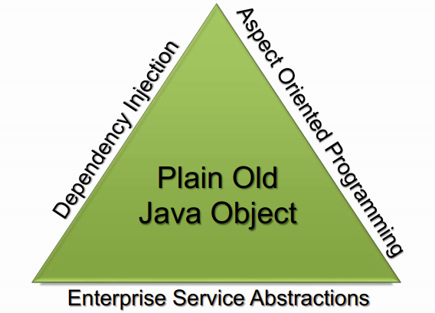
The Spring Triangle
What’s the purpose of Spring Framework ?
“Spring's main aim is to make J2EE easier to use and promote good programming practice. It does this by enabling a POJO-based programming model that is applicable in a wide range of environments.” – Rod Johnson

Slide 13
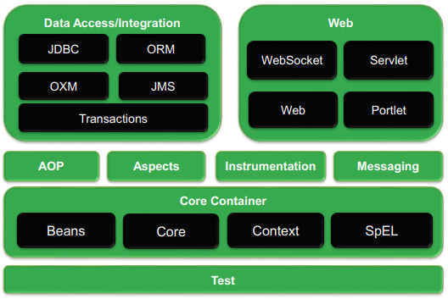
Architectural overview of Spring Framework

Slide 14
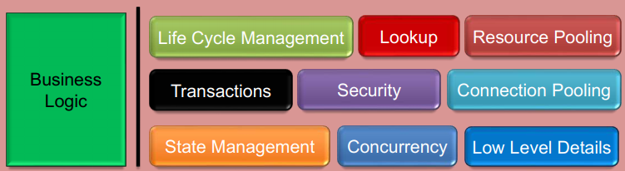
What is a Container?
Container, in the context of Java development, refers to a Software Application or Java Class that is responsible for managing the lifecycle of a given resource.
Because you do not have to develop these services yourself, you are free to concentrate on solving the business problem at hand instead.
Example Containers: Servlet Container, EJB Container, Applet Container, Spring Container
Built-in Spring Containers
BeanFactory Container
ApplicationContext Container

Slide 15
Core Container
The Core Container consists of the Core, Beans, Context, and Expression Language modules the details:
The Core module provides the fundamental parts of the framework, including the IoC and Dependency Injection features.
The Bean module provides BeanFactory, which is a sophisticated implementation of the factory pattern.
The Context module builds on the solid base provided by the Core and Beans modules and it is a medium to access any objects defined and configured. The ApplicationContext interface is the focal point of the Context module.
The SpEL module provides a powerful expression language for querying and manipulating an object graph at runtime.

Slide 16
Data Access/Integration
The Data Access/Integration layer consists of the JDBC, ORM, OXM, JMS and Transaction modules:
The JDBC module provides a JDBC-abstraction layer that removes the need for tedious JDBC related coding.
The ORM module provides integration layers for popular object-relational mapping APIs, including JPA, JDO, Hibernate, and iBatis.
The OXM module provides an abstraction layer that supports Object/XML mapping implementations for JAXB, Castor, XMLBeans, JiBX and XStream.
The Java Messaging Service JMS module contains features for producing and consuming messages.
The Transaction module supports programmatic and declarative transaction management for classes that implement special interfaces and for all your POJOs.

Slide 17
Web
The Web layer consists of the Web, Web-MVC, Web-Socket, and Web-Portlet modules:
The Web module provides basic web-oriented integration features such as multipart file-upload functionality and the initialization of the IoC container using servlet listeners and a web-oriented application context.
The Web-MVC module contains Spring's Model-View-Controller (MVC) implementation for web applications.
The Web-Socket module provides support for WebSocket-based, two-way communication between the client and the server in web applications.
The Web-Portlet module provides the MVC implementation to be used in a portlet environment and mirrors the functionality of Web-Servlet module.

Slide 18
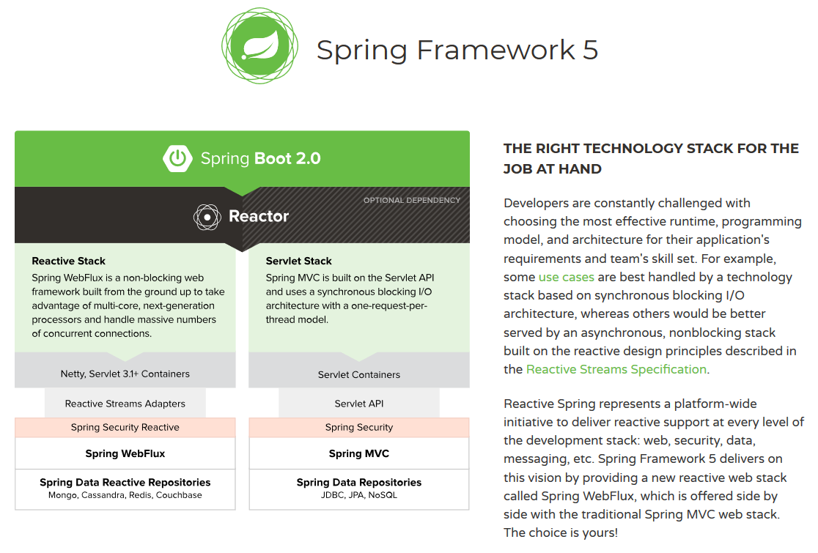
Spring Framework 5

Slide 19
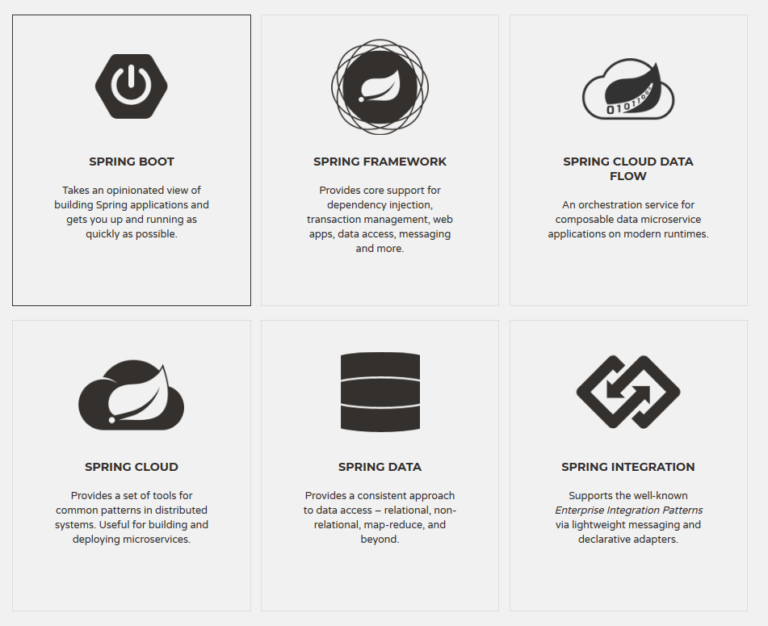

Slide 20
Advantages of using Spring Framework
Spring enables developers to develop enterprise-class applications using POJOs (Plain Old Java Objects).
Spring is organized in a modular fashion.
Spring does not reinvent the wheel instead, it truly makes use of some of the existing technologies.
Testing an application written with Spring is simple because environment-dependent code is moved into this framework.
Spring's web framework is a well-designed web MVC framework.
Lightweight IoC containers tend to be lightweight, especially when compared to EJB containers.
Spring provides a consistent transaction management.

