Slide 1
WWW Programming (Advanced Web Programming with Java)
5.2. IoC and Spring Dependency Injection

Slide 2
S.O.L.I.D Principles
SOLID there are five basic principles which help to create good (or solid) software architecture. SOLID is an acronym where:
S stands for SRP (Single responsibility principle)
O stands for OCP (Open closed principle)
L stands for LSP (Liskov substitution principle)
I stand for ISP ( Interface segregation principle)
D stands for DIP ( Dependency inversion principle)

Slide 3
Dependency injection (DI)
Dependency injection (DI) is a process whereby objects define their dependencies.
The container then injects those dependencies when it creates the bean
This process is fundamentally the inverse, hence the name Inversion of Control (IoC), of the bean itself controlling the instantiation or location of its dependencies on its own by using direct construction of classes, or the Service
Locator pattern.
Advantage
Code is cleaner with the DI principle and decoupling is more effective when objects are provided with their dependencies.

Slide 4
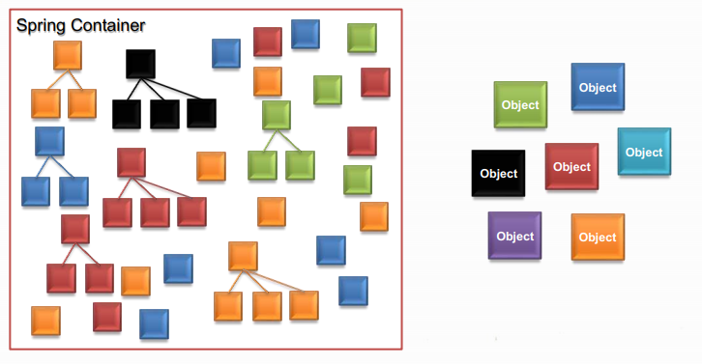
Spring Container
Built-in Spring Containers
BeanFactory Container
ApplicationContext Container

Slide 5
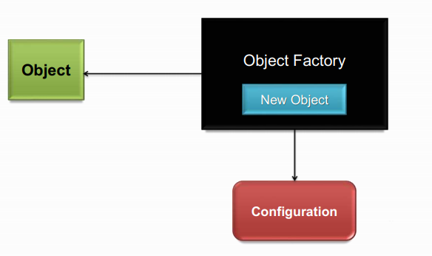
Factory Pattern

Slide 6
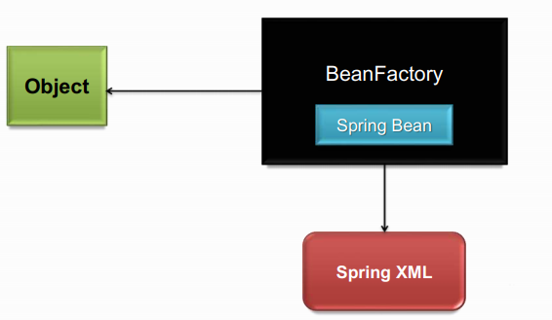
Spring Bean Factory

Slide 7
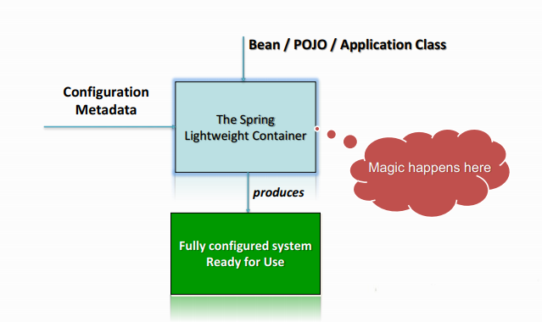
Spring IOC Container
What is Spring IOC container ?
The Spring IoC creates the objects, wire them together, configure them, and manage their complete lifecycle from creation till destruction. The Spring container uses dependency injection (DI) to manage the components that make up an application.

Slide 8
Spring IOC Container (cont.)
What is BeanFactory Container ?
A BeanFactory is an implementation of the factory pattern that applies Inversion of Control to separate the application’s configuration and dependencies from the actual application code. The most commonly used BeanFactory implementation is the XmlBeanFactory class.
This is the simplest container providing basic support for DI.The BeanFactory is usually preferred where the resources are limited like mobile devices or applet based applications

Slide 9
Spring IOC Container (cont.)
What is ApplicationContext Container ?
In addition to the capabilities of a BeanFactory Container, this container adds more enterprise-specific functionality such as the ability to resolve textual messages from a properties file and the ability to publish application events to interested event listeners.

Slide 10
Instantiating a Spring IOC Container
Packages that are basis for the Spring IOC Container
Spring BeanFactory Container
org.springframework.beans.factory.BeanFactory
The BeanFactory interface provides a configuration mechanism capable of managing any type of object
Spring ApplicationContext Container
org.springframework.context.ApplicationContext
ApplicationContext is a sub-interface of BeanFactory.
Provides enterprise-specific functionality.
It adds easier integration with:
Spring's AOP features
Message Resource handling (for use in i18n)
Event publication etc.

Slide 11
Instantiating a Spring IOC Container
You can instantiate a Spring IOC container using any one of the below two classes.
Spring Bean Factory Container org.springframework.beans.factory.BeanFactory
Spring ApplicationContext Container org.springframework.context.ApplicationContext

Slide 12
Spring ApplicationContext Container
Spring's more advanced container.
Similar to BeanFactory it can load bean definitions, wire beans together and dispense beans upon request.
Additionally it adds more enterprise-specific functionality such as the ability to resolve textual messages from a properties file and the ability to publish application events to interested event listeners.
Defined by the org.springframework.context.ApplicationContext interface.

Slide 13
Spring ApplicationContext
The most commonly used ApplicationContext implementations are:
ClassPathXmlApplicationContext
FileSystemXmlApplicationContext
XmlWebApplicationContext

Slide 14
Spring ApplicationContext
ClassPathXmlApplicationContext
This container loads the definitions of the beans from an XML file. Here you do not need to provide the full path of the XML file but you need to set CLASSPATH properly because this container will look bean configuration XML file in CLASSPATH.
FileSystemXmlApplicationContext
This container loads the definitions of the beans from an XML file. Here you need to provide the full path of the XML bean configuration file to the constructor.
XmlWebApplicationContext
This container loads the XML file with definitions of all beans from within a web application.

Slide 15
BeanFactory vs ApplicationContext
BeanFactory | ApplicationContext
The simplest factory, mainly for DI | The advanced and more complex factory
Saving Resources: Used when resources are limited, e.g., mobile, applets etc. | Used elsewhere and has the below features, 1> Enterprise aware functions 2> Publish application events to listeners 3> Wire and dispose beans on request
Package: org.springframework.beans.factory.BeanFactory | Package: org.springframework.context.ApplicationContext
Implementation: BeanFactory factory = new XmlBeanFactory (new ClassPathResource(“wildLife.xml")); | Implementation: ApplicationContext context = new ClassPathXmlApplicationContext(“wildLife.xml”);

Slide 16
BeanFactory vs ApplicationContext
ApplicationContext
Following are the additional features of Application Context: Provide a means for resolving text messages, including support for internationalization (i18N) of those messages, where as BeanFactory doesn’t support. provide a generic way to load file resources, such as images. publish events to beans that are registered as listeners. Certain operations on the container or beans in the container, which have to be handled in a programmatic fashion with a bean factory, can be handled declaratively in an application context. ApplicationContext provides integration with Spring AOP.
FINAL VERDICT: Since ApplicationContext has many advanced features along with all the features provided by BeanFactory, it is advisable to use ApplicationContext than BeanFactory. BeanFactory is good to use if we don’t want to use any of the additional features provided by ApplicationContext.

Slide 17
Which one to choose?
Bean Factory or Application Context
ApplicationContext container includes all functionality of the BeanFactory container, so it is generally recommended over the BeanFactory. If you are creating applications for an enterprise, choose Application Context.
BeanFactory can still be used for light weight applications like mobile devices or applet based applications where data volume and speed is significant.

Slide 18
Types of Dependency Injection
Dependency injection (DI) comes with two flavors
Constructor-based Dependency Injection
Accomplished by the container invoking a constructor with a number of arguments, each representing a dependency.
Calling a static factory method with specific arguments to construct the bean is nearly equivalent, and this discussion treats arguments to a constructor and to a static factory method similarly.
Setter-based Dependency Injection
Accomplished by the container calling setter methods on your beans after invoking a no-argument constructor or no-argument static factory method to instantiate your bean.

