Slide 1
WWW Programming (Advanced Web Programming with Java)
5.3. Spring Bean

Slide 2
Beans
The objects that form the backbone of your application and that are managed by the Spring IoC container are called beans.
A bean is an object that is instantiated, assembled, and otherwise managed by a Spring IoC container.
These beans are created with the configuration metadata that you supply to the container, for example, in the form of XML <bean/> definitions which you have already seen in previous chapters.

Slide 3
Beans- Definition
The bean definition contains the information called configuration metadata which is needed for the container to know the followings:
How to create a bean
Bean's lifecycle details
Bean's dependencies

Slide 4
Beans- Definition
Property | Description
class* | The bean class to be used to create the bean.
name | The unique bean identifier.
scope | The scope of the objects created from a particular bean definition.
autowiring mode | Used to specify autowire mode for a bean definition
lazy-initialization mode | Tells the IoC container to create a bean instance when it is first requested, rather
constructor-arg | Used to inject the dependencies into the class through a class constructor
properties | Used to inject the dependencies into the class through setter methods
initialization method | A callback to be called just after all necessary properties on the bean have been set by the container.
destruction method | A callback to be used when the container containing the bean is destroyed.

Slide 5
Beans - Scope
Scope | Description
singleton | This scopes the bean definition to a single instance per Spring IoC container (default).
prototype | This scopes a single bean definition to have any number of object instances.
request * | This scopes a bean definition to an HTTP request.
session * | This scopes a bean definition to an HTTP session.
global-session * | This scopes a bean definition to a global HTTP

Slide 6
Spring Configuration File
The various attributes passed to a <bean> tag in a Spring Configuration File
Tag Name | Description | Example
id | Unique Id | <bean id=“person” … />
name | Unique Name | <bean name=“lion” … />
class | Fully qualified Java class name | <bean class=“a.b.C” … />
scope | Bean object type | <bean scope=“singleton” … />
constructor-arg | Constructor injection | <constructor-arg value=“a” />
property | Setter injection | <property name=“a” … />
autowire | Automatic Bean referencing | <bean autowire=“byName” … />
lazy-init | Create a bean lazily (at its first request) | <bean lazy-init=“true” … />
init-method | A callback method just after bean creation | <bean init-method=“log” … />
destroy-method | A callback just before bean destruction | <bean destroy-method=“log” … />

Slide 7
Naming Spring Beans
Every bean has one or more identifiers.
Identifiers must be unique within the container that hosts the bean.
A bean usually has only one identifier, but if it requires more than one, the extra ones can be considered aliases.
The id attribute allows you to specify exactly one id.
If you want to introduce other aliases to the bean, you can specify them in the name attribute, separated by a comma (,), semicolon (;), or white space.
You are not required to supply a name or id for a bean. If no name or id is supplied explicitly, the container generates a unique name for that bean. However, if you want to refer to that bean by name you must provide a name.
Motivations for not supplying a name are related to using inner beans and autowiring collaborators.

Slide 8
Spring Configuration Metadata
Spring IoC container is totally decoupled from the format in which this configuration metadata is actually written.
Configuration Metadata can be provided to a Spring Container in the following ways
through an XML Based Configuration File
through an Annotation based Configuration
through a Java based configuration

Slide 9
Beans – Definition Inheritance
Spring Bean definition inheritance has nothing to do with Java class inheritance.
You can define a parent bean definition as a template and other child beans can inherit required configuration from the parent bean.
A child bean definition inherits configuration data from a parent definition. The child definition can override some values, or add others, as needed.
When you use XML-based configuration metadata, you indicate a child bean definition by using the parent attribute, specifying the parent bean as the value of this attribute.

Slide 10
Beans - Lifecycle
The life cycle of a Spring bean is easy to understand.
When a bean is instantiated, it may be required to perform some initialization to get it into a usable state.
When the bean is no longer required and is removed from the container, some cleanup may be required.

Slide 11
Beans – Lifecycle – Initialization
The org.springframework.beans.factory.InitializingBean interface specifies a single method:
void afterPropertiesSet() throws Exception;
public class ExampleBean implements InitializingBean {
public void afterPropertiesSet() {
// do some initialization work
}
}

Slide 12
Beans – Lifecycle – Initialization (cont.)
In the XML-based configuration metadata, you can use the init-method attribute to specify the name of the method that has a void no-argument signature.
<bean id="..." class="..." init-method="init"/>
<bean id = "exampleBean" class = "examples.ExampleBean" init-method = "init"/>
public class ExampleBean {
public void init() {
// do some initialization work
}
}

Slide 13
Beans – Lifecycle – Initialization (cont.)
Annotate the method with @PostConstruct
@PostConstruct
public void init() {
...
}
A PostConstruct interceptor method must not throw application exceptions, but it may be declared to throw checked exceptions including the java.lang.Exception if the same interceptor method interposes on business or timeout methods in addition to lifecycle events.
If a PostConstruct interceptor method returns a value, it is ignored by the container.

Slide 14
Beans – Lifecycle - Destruction
The org.springframework.beans.factory.DisposableBean interface specifies a single method:
void destroy() throws Exception;
Can simply implement the above interface and finalization work can be done inside destroy() method as follows
public class ExampleBean implements DisposableBean {
public void destroy() {
// do some destruction work
}
}

Slide 15
Beans – Lifecycle – Destruction (cont.)
In the XML-based configuration metadata, you can use the destroy-method attribute to specify the name of the method that has a void no-argument signature.
<bean id="..." class="..." destroy-method="destroy"/>
Example
<bean id = "exampleBean" class = "examples.ExampleBean" destroy-method = "destroy"/>
public class ExampleBean {
public void destroy() {
// do some destruction work
}
}

Slide 16
Beans – Lifecycle – Destruction (cont.)
Annotate the method with @PreDestroy
@PreDestroy
public void destroy() {
...
}

Slide 17
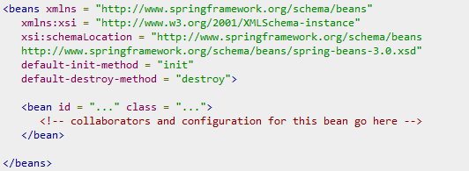
Default initialization and destroy methods
If you have too many beans having initialization and/or destroy methods with the same name, you don't need to declare init-method and destroy-method on each individual bean.
Instead, the framework provides the flexibility to configure such situation using default-init-method and default-destroy-method attributes on the <beans> element as follows

Slide 18
Beans – Multiple Lifecycle Mechanisms
Multiple lifecycle mechanisms configured for the same bean are called in the following order:
Initialization: Methods annotated with @PostConstruct
afterPropertiesSet() as defined by the InitializingBean callback interface
A custom configured init() method
Destruction: Methods annotated with @PreDestroy
destroy() as defined by the DisposableBean callback interface
A custom configured destroy() method

Slide 19
Instantiating Beans
Instantiating with a Constructor <bean id="exampleBean" class="examples.ExampleBean" /> <bean name="anotherExample" class="examples.ExampleBeanTwo" />
Instantiating with a Static Factory Method
<bean id="clientService“ class="examples.ClientService“ factory-method="createInstance"/>
public class ClientService { private static ClientService clientService = new ClientService();
private ClientService() {} public static ClientService createInstance() { return clientService; }

Slide 20
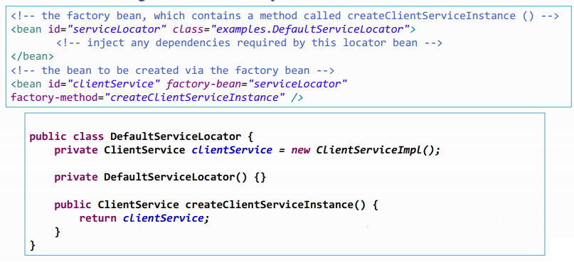
Instantiating Beans (cont.)
Instantiation using an instance factory method

Slide 21
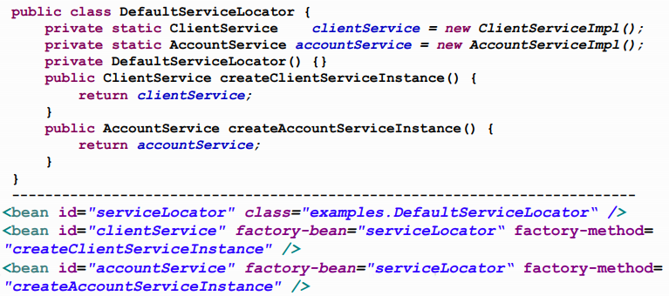
Instantiating Beans (cont.)
Instantiating more than one instance factory methods

Slide 22
Bean Aliasing
In a bean definition, you can supply more than one name for the bean
by using a combination of up to one name specified by the id attribute, and any number of other names in the name attribute. <bean id=“employee" name= “emp1, emp2, emp3" ... />
These names can be equivalent aliases to the same bean, and are useful for some situations, such as allowing each component in an application to refer to a common dependency by using a bean name that is specific to that component itself. <alias name="fromName" alias="toName"/>
This is useful in case we need to use beans that exist in a different sub-system.

Slide 23
Spring - Bean Definition Inheritance
A child bean definition inherits configuration data from a parent definition. The child definition can override some values, or add others, as needed.
<?xml version = "1.0" encoding = "UTF-8"?>
<beans xmlns = "http://www.springframework.org/schema/beans"
xmlns:xsi = "http://www.w3.org/2001/XMLSchema-instance"
xsi:schemaLocation = "http://www.springframework.org/schema/beans
http://www.springframework.org/schema/beans/spring-beans-3.0.xsd">
<bean id = "helloWorld" class = "com.HelloWorld">
<property name = "message1" value = "Hello 1"/>
<property name = "message2" value = "Hello 2"/>
</bean>
<bean id = "helloWorld2" class = "com.HelloWorld2" parent = "helloWorld">
<property name = "message1" value = "Hello 1 from HelloWorld2"/>
<property name = "message3" value = "Hello 3 from HelloWorld2"/>
</bean>
</beans>

