Slide 1
WWW Programming (Advanced Web Programming with Java)
5.4. Spring Web MVC

Slide 2
Content
Spring MVC Basics
Spring MVC Framework
Controller/Model/View
Spring Interceptor
Spring Validator

Slide 3
The MVC pattern
MVC pattern breaks an application into three parts:
Model: The domain object model / service layer
View: Template code / markup
Controller: Presentation logic / action classes
MVC defines interaction between components to promote separation of concerns and loose coupling
Each file has one responsibility
Enables division of labor between programmers and designers
Facilitates unit testing
Easier to understand, change and debug

Slide 4
Advantages of MVC Pattern
Separation of application logic and web design through the MVC pattern
Integration with template languages
Some MVC frameworks provide built-in components
Other advantages include:
Form validation
Error handling
Request parameter type conversion
Internationalization
IDE integration

Slide 5
Exploring Spring's Web MVC Framework
The Spring Web MVC framework is built on generic Servlet known as a DispatcherServlet class (Front Controller).
The DispatcherServlet class sends the request to the handlers with configurable handler mappings, theme resolution, locale and view resolution along with file uploading.
The handleRequest(request, response) method is given by the default handler called Controller interface.
The application controller implementation classes of the controller interface are as follows:
AbstractController
AbstractCommandController
SimpleFormController.

Slide 6
Spring MVC Features
Powerful configuration of both framework and application classes.
Separation of roles.
Flexibility in choosing subclasses.
Model transfer flexibility.
No need of duplication of code.
Specific validation and binding.
Specific local and theme resolution.
Facility of JSP form tag library.

Slide 7
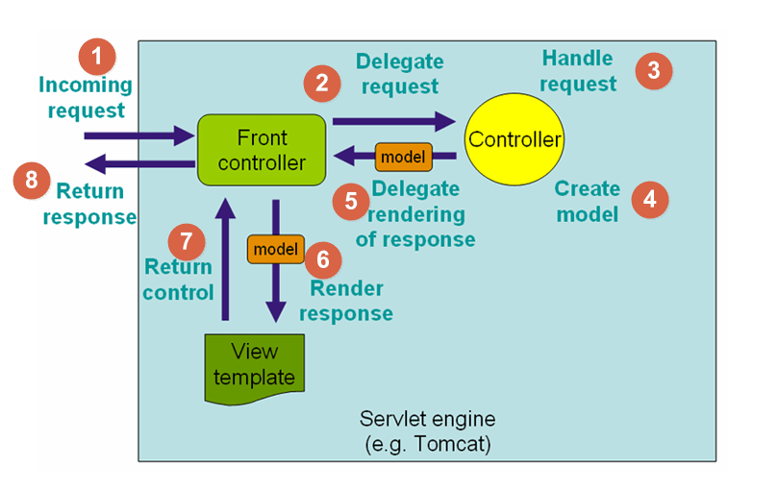
Flow of Spring MVC

Slide 8
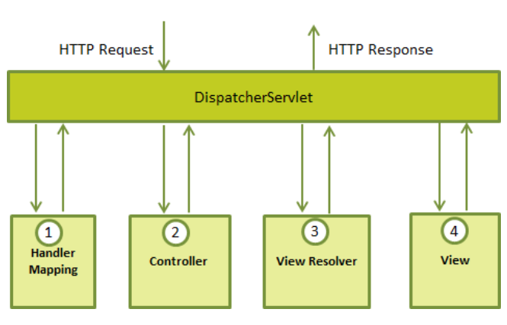
DispatcherServlet

Slide 9
DispatcherServlet (cont.)
Following is the sequence of events corresponding to an incoming HTTP request to DispatcherServlet
After receiving an HTTP request, DispatcherServlet consults the HandlerMapping to call the appropriate Controller.
The Controller takes the request and calls the appropriate service methods based on used GET or POST method. The service method will set model data based on defined business logic and returns view name to the DispatcherServlet.
The DispatcherServlet will take help from ViewResolver to pickup the defined view for the request.
Once view is finalized, The DispatcherServlet passes the model data to the view which is finally rendered on the browser.

Slide 10
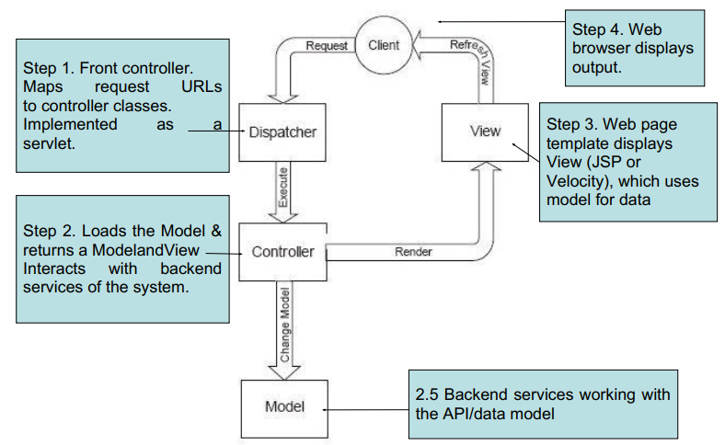
DispatcherServlet (cont.)
HandlerMapping, Controller, and ViewResolver are parts of WebApplicationContext which is an extension of the plain ApplicationContext with some extra features necessary for Web applications.

Slide 11
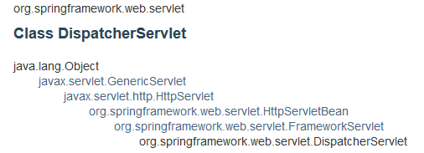
DispatcherServlet (cont.)
The DispatcherServlet class is important part of spring Web MVC framework.
It is used for dispatching the request to application controllers.
The DispatcherServlet class is configured in web.xml file of a web application.
Map the request using Uniform Resource Locator (URL) mapping in the same web.xml file to handle any request

Slide 12
HadlerMapping/Controller/ViewResolver
Handler mapping: Manages the execution of controllers, provided they match the specified criteria.
Controller: It handles the client's request.
View resolver: Resolves view names to view used by the DispatcherServlet.
The mapping between the Logical name and the Physical View Location is taken care by the View Resolver object.
Spring comes with a set of Built-In Spring Resolvers.
We can write Custom View Resolvers by implementing the org.springframework.web.servlet.ViewResolver interface

Slide 13
View Resolver
BeanNameViewResolver
FreeMarkerViewResolver
InternalResourceViewResolver
JasperReportsViewResolver
ResourceBundleViewResolver
UrlBasedViewResolver
VelocityLayoutViewResolver
VelocityViewResolver
XmlViewResolver
XsltViewResolver

Slide 14
View Resolver (cont.)
InternalResourceViewResolver
Controller returns - new ModelAndView("myView1")
<bean id="viewResolver“ class="org.springframework.web.servlet.view.InternalResourceViewResolver">
<property name="prefix"><value>/WEB-INF/view/</value></property>
<property name="suffix"><value>.jsp</value></property>
</bean>
the prefix + the logical View Name + the suffix
/WEB-INF/view/myView.jsp

Slide 15
View Resolver (cont.)
BeanNameViewResolver
One of the disadvantage of using InternalResourceViewResolver is that the name of the View file (jsp or pdf) must be present in the Web Application Context.
Dynamically generated View files may not be possible.
In such a case, we may use the BeanNameViewResolver which will dynamically generate View in Pdf or Excel Formats.

Slide 16
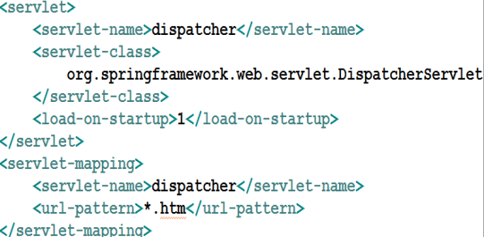
Configure DispatcherServlet in web.xml
Spring application context file, dispatcher-servlet.xml, will automatically be searched for and loaded by Spring for us.

Slide 17
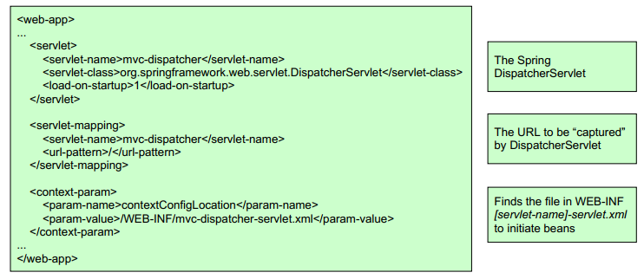
Create Spring’s Application Context XML File
Web applications define servlets in web.xml
Maps URL patterns to servlets
WebApplicationContext is an extension of ApplicationContext for features of Servlets and themes

Slide 18
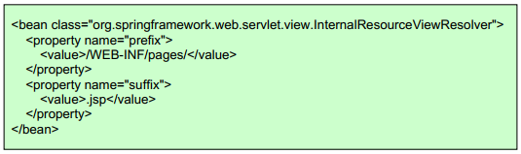
Overriding DispatcherServlet defaults
DispatcherServlet initiates with default configuration. Overidding it through the [servlet-name]-servlet.xml bean
Configuring ViewResolver is basic step
Different types of ViewResolver. Following 2 basic ones:
InternalResourceViewResolver (for jsp, css, images etc)
ContentNegotiatingViewResolver (for ContentType response, useful for REST APIs)
If the Controller returns “index”, InternalResourceViewResolver tries to find file as view /WEBINF/pages/index.jsp

Slide 19
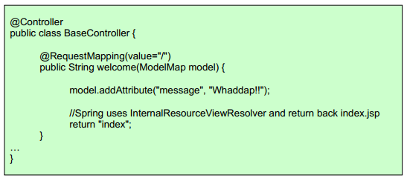
Controllers
The Controllers are central components of MVC
Simply add @Controller annotation to a class
Use @RequestMapping to map methods to url
<beans…> <context:component-scan
base-package=“se.iuh.spingmvc.controllers"/> ... </beans>
Get all the @Controller
annotated classes accessible
as beans

Slide 20
Controllers (cont.)
Controller Annotation
The @Controller annotation defines the class as a Spring MVC controller.
The @RequestMapping annotation is used to map URLs like '/hello' onto an entire class or a particular handler method.
@RequestMapping(method = RequestMethod.GET) is used to declare the printHello() method as the controller's default service method to handle HTTP GET request.

Slide 21
Controller arguments
@RequestParam, @PathVariable
POJO – arbitrary java object that gets populated with request values
@Valid – to enforce validation of the POJO
BindingResult – to access the results of binding and validation
Model, ModelMap, Map<String, ?> - acces to the model object
Raw HttpServletRequest, response, session
Locale, @RequestHeader, @RequestBody,...

Slide 22
Controllers – return types
String, View, ModelAndView – use a “view“
@ResponseBody – any object
@Controller @RequestMapping("/users") public class UserController { @Inject private UserService service; @RequestMapping(value="/ajaxView“ consumes="application/json") @ResponseBody public User view(@RequestParam String username){ User u = service.find(username); return u; } }

Slide 23
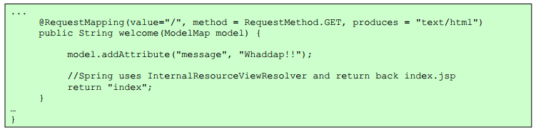
More detailed Url Mapping
@RequestMapping also accepts the following parameters:
method (GET/POST/PUT/DELETE...)
produces (mimeType)
consumes (mimeType)
params
headers

Slide 24
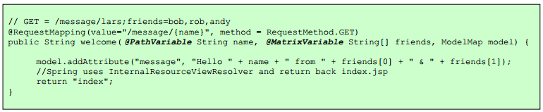
Url Templates in Controllers
@PathVariable - to map variables in URL paths
path variables can also be Regular Expressions
You can also do as follows /message/*/user/{name}
You can also use comma-separated URL parameters (also called Matrix-Variables)
To do this, make setRemoveSemicolonContent=false for RequestMappingHandlerMapping

Slide 25
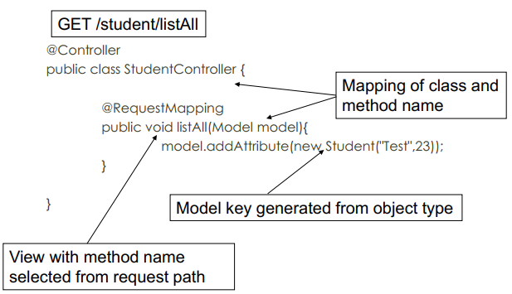
Convention over Configuration

Slide 26
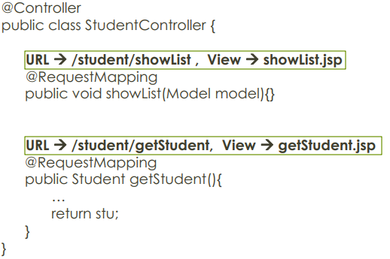
Convention over Configuration (cont.)
Mapping By Convention

Slide 27
Spring Framework: @RestController vs. @Controller
Spring MVC REST Workflow
The client sends a request to a web service in URI form.
The request is intercepted by the DispatcherServlet which looks for Handler Mappings and its type.
The Handler Mappings section defined in the application context file tells DispatcherServlet which strategy to use to find controllers based on the incoming request.
Spring MVC supports three different types of mapping request URIs to controllers: annotation, name conventions, and explicit mappings.
Requests are processed by the Controller and the response is returned to the DispatcherServlet which then dispatches to the view.

Slide 28
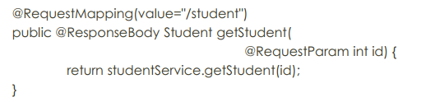
Spring Framework: @RestController vs. @Controller (cont.)
Using the @ResponseBody Annotation
When you use the @ResponseBody annotation on a method, Spring converts the return value and writes it to the http response automatically. Each method in the Controller class must be annotated with @ResponseBody.
@ResponseBody annotation instructs Spring MVC to serialize the Student to the client.
Spring MVC automatically serializes to JSON because the client accepts that content type

Slide 29
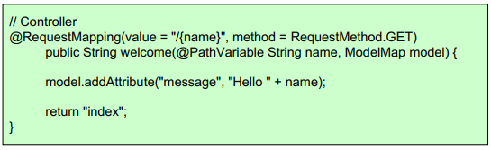
Model
Controllers and view share a Java object referred as model, (‘M’ in MVC)
A model can be of the type Model or can be a Map that can represent the model.
The view uses this to display dynamic data that has been given by the controller
In View:
<html> body><h1>${message}</h1></body> </html>

Slide 30
ModelAndView object in Spring MVC
ModelAndView is an object that holds both the model and view. The handler returns the ModelAndView object and DispatcherServlet resolves the view using View Resolvers and View.
The View is an object which contains view name in the form of the String and model is a map to add multiple objects.
ModelAndView model = new ModelAndView("employeeDetails");
model.addObject("employeeObj", new EmployeeBean(123));
model.addObject("msg", "Employee information.");
return model;

Slide 31
@ModelAttribute from Controller
You can also use @ModelAttribute in controller to directly load URL value into the model
A Model can represent objects that can be retrieved from database or files as well
Model should not have logic, rather the controller should get the model and “transform” the model based on the request, while sending it to the View

Slide 32
View
Spring MVC integrates with many view technologies:
JSP
Velocity
Freemarker
JasperReports
Values sent to controller with POST or GET as usual
Values made available to the view by the controller

Slide 33
Spring’s form tag library
Binding-aware JSP tags for handling form elements
Integrated with Spring MVC to give the tags access to the model object and reference data
Comes from spring-webmvc.jar
Add the following to make the tags available:
<%@ taglib prefix="form" uri="http://www.springframework.org/tags/form" %>

Slide 34
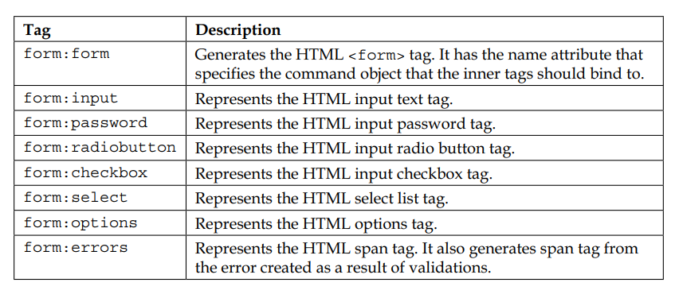
Spring’s form tag library (cont.)
<%@ taglib prefix="form" uri="http://www.springframework.org/tags/form" %>

Slide 35
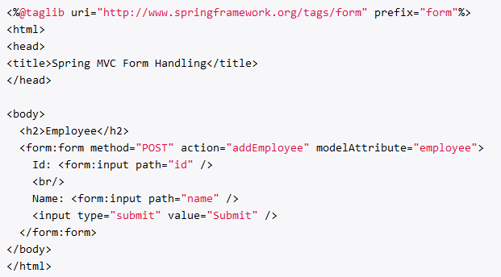
The attributes: path & modelAttribute/commandName
commandName/modelAttribute: name of a variable in the request scope or session scope that contaims the information about this form, it should be a been.
path: name of a bean property that should be accessed in order to pass the information to from and to the controller.

Slide 36
The form tag
Renders a form tag and exposes the binding to inner tags
You can specify any HTML attributes that are valid for an HTML form
You can also tell it what the form backing object is (it uses ‘command’ by default).
@RequestMapping("/person/add")
public String addPerson(Model model) {
Person person = new Person();
model.addAttribute(person);
return "addPerson";
}
<form:form method=”get” commandName=”person”>
<form:input path=”name” />
</form:form>
<form method=”get”>
<input type=”text” name=”name” />
</form>

Slide 37
The input tag
Renders an HTML input tag with a type of ‘text’
You can specify any HTML attributes valid for an HTML input
You bind it to your model object by specifying the path relative to the backing object
@RequestMapping("/person/add")
public String addPerson(Model model) {
Person person = new Person();
person.setName(”Spencer”);
model.addAttribute(person);
return "addPerson";
}
<form:form method=”get” commandName=”person”>
<form:input path=”name” />
</form:form>
<form method=”get”>
<input type=”text” name=”name” value=”Spencer” />
</form>

Slide 38
The checkbox tag
Renders an HTML input tag with a type of ‘checkbox’
public class Person {
private boolean admin;
private String[] languages;
}
<form:form commandName=”person”>
<form:checkbox path=”admin” />
<form:checkbox path=“languages” value=“Java” />
<form:checkbox path=“languages” value=“Scala” />
</form:form>
<form>
<input type=”checkbox” name=”admin” value=”true” />
<input type=”checkbox” name=”languages” value=”Java” />
<input type=”checkbox” name=”languages” value=”Scala” />
</form>

Slide 39
The checkboxes tag
Similar to checkbox tag, but creates multiple checkboxes instead of one
public class Person {
private boolean admin;
private String[] favoriteLanguages;
private List<String> allLanguages;
}
<form:form commandName=”person”>
<form:checkbox path=”admin” />
<form:checkboxes path=”favoriteLanguages” items=”${allLanguages}” />
</form:form>
<form>
<input type=”checkbox” name=”admin” value=”true” />
<input type=”checkbox” name=” favoriteLanguages” value=”Java” />
<input type=”checkbox” name=” favoriteLanguages” value=”Scala” />
</form>

Slide 40
The password tag
Renders an HTML input tag with a type of ‘password’
<form:form>
<form:input path=”username” />
<form:password path=”password” />
</form:form>
<form>
<input type=”text” name=”username” />
<input type=”password” name=”password” />
</form>

Slide 41
The select tag
Renders an HTML select tag
It can figure out whether multiple selections should be allowed
You can bind options using this tag, as well as by nesting option and options tags
<form:select path=”favoriteLanguage” items=”${allLanguages}” />
<select name=”favoriteLanguage”>
<option value=”Java”>Java</option>
<option value=”Scala”>Scala</option>
</form>

Slide 42
The option/options tags
Renders an HTML option (or multiple options)
Nested within a select tag
Renders ‘selected’ based on the value bound to the select tag
<form:select path=”favoriteLanguage”>
<form:option value=”3” label=”.NET” />
<form:options items=”${languages}” itemValue=”id” itemLabel=”name” />
</form:select>
<select name=”favoriteLanguage”>
<option value=”.NET”>.NET</option>
<option value=”Java”>Java</option>
<option value=”Scala”>Scala</option>
</form>

Slide 43
The errors tag
Renders an HTML span tag, containing errors for given fields
You specify which fields to show errors for by specifying a path
path=“name” – Would display errors for name field.
path=“*” – Would display all errors
<form:errors path=”*” cssClass=”errorBox” />
<form:errors path=”name” cssClass=”specificErrorBox” />
<span name=”*.errors” class=”errorBox”>Name is required.</span>
<span name=“name.errors” class=“specificErrorBox”>Name is required.</span>

Slide 44
Spring Exception
@ExceptionHandler only handles exception getting raised from the controller where it is defined.
It will not handle exceptions getting raised from other controllers. @ControllerAdvice annotation solves this problem.
@ControllerAdvice annotation is used to define @ExceptionHandler,@InitBinder, and @ModelAttribute methods that apply to all @RequestMapping methods.

Slide 45
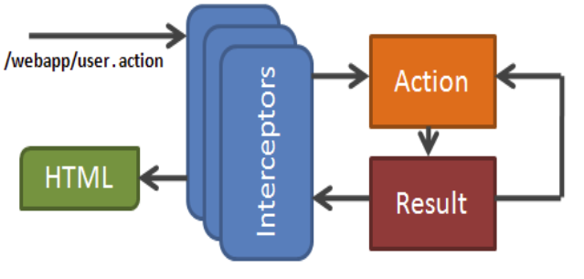
Spring Interceptor
Notes:
Spring Interceptor ~ Servlet Filter. Spring Interceptor chỉ áp dụng đối với các request đang được gửi đến một Controller.

Slide 46
Spring Interceptor (cont.)
Spring MVC provides a powerful mechanism to intercept an http request
Each interceptor you define must implement org.springframework.web.servlet.HandlerInterceptor interface.
HandlerInterceptor – an interface, which must be implemented by the Spring interceptor classes, has the following three methods.
preHandle(...) – called just before the controller
postHandle(...) – called immediately after the controller
afterCompletion(...) – called just before sending response to view
HandlerInterceptorAdaptor – an implementation class of HandlerInterceptor interface provided by Spring as a convenient class. By extending this we can override only the necessary methods out of the three.

Slide 47
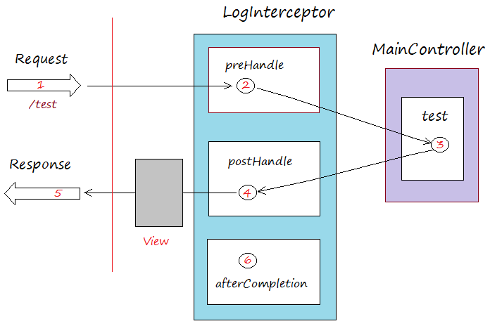
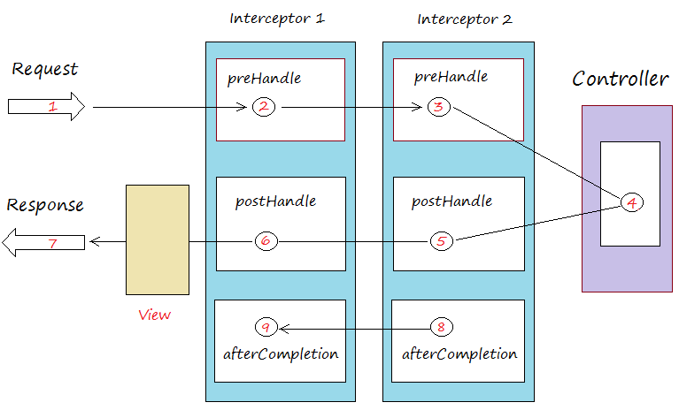
Spring Interceptor (cont.)

Slide 48
Locales
LocaleResolver
AcceptHeaderLocaleResolver
CookieLocaleResolver
SessionLocaleResolver
LocaleChangeInterceptor
<bean id="localeChangeInterceptor" class="org.springframework.web.servlet.i18n.LocaleChangeInterceptor"> <property name="paramName" value="lang"/> </bean>
http://localhost:8080/carbase/?lang=ru

Slide 49
File upload
MultipartResolver
<bean id="multipartResolver“ class="org.springframework.web.multipart.commons.CommonsMultipartResolver> <!-- one of the properties; the maximum file size in bytes --> <property name="maxUploadSize" value="100000"/> </bean>
MultipartFile
@RequestMapping(method = RequestMethod.POST) public String upload (@RequestParam("file") MultipartFile file)
{...}

Slide 50
Spring Validation
Spring provides a simplified set of APIs and supporting classes for validating domain objects.
Spring features a Validator interface that you can use to validate objects. The Validator interface works using an Errors object so that while validating, validators can report validation failures to the Errors object.

Slide 51
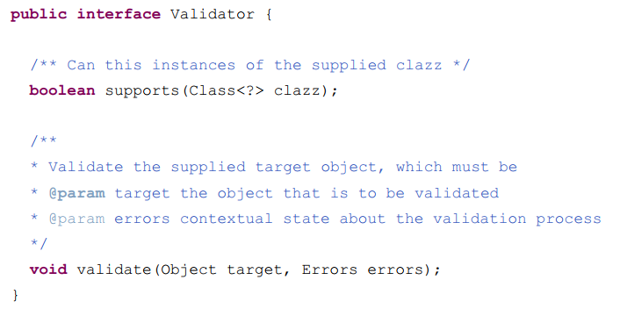
Spring Validation (cont.)
Validation using Spring’s Validator interface

Slide 52
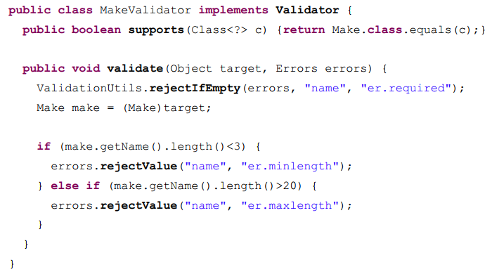
Spring Validation (cont.)
Validation using Spring’s Validator interface (cont.)

Slide 53
Spring Validation (cont.)
Validation using Spring’s Validator interface (cont.)
Auxiliary classes
Errors
reject
rejectValue
ValidationUtils
rejectIfEmpty
rejectIfEmptyOrWhitespace
invokeValidator

Slide 54
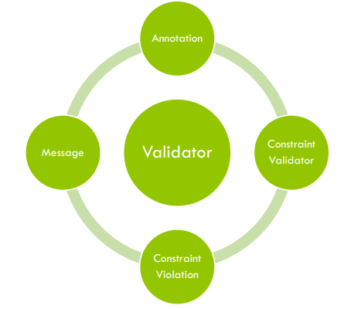
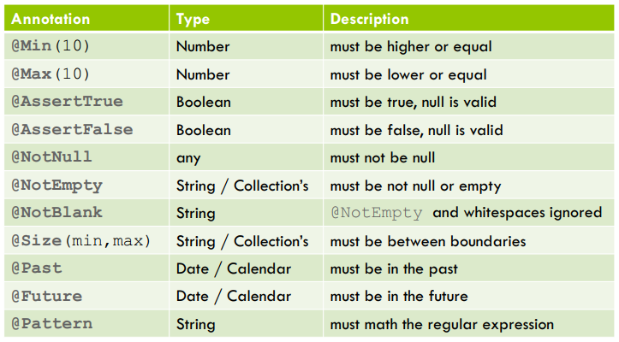
Spring Validation (cont.)
Bean Validation
Standard Constraints

Slide 55
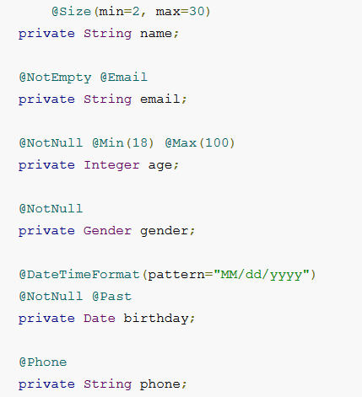
Spring Validation (cont.)
Bean Validation (cont.)
import javax.validation.constraints.Max;
import javax.validation.constraints.Min;
import javax.validation.constraints.NotNull;
import javax.validation.constraints.Past;
import javax.validation.constraints.Size;
import org.hibernate.validator.constraints.Email;
import org.hibernate.validator.constraints.NotEmpty;
import org.springframework.format.annotation.DateTimeFormat;
@Phone: defined custom validator.

Slide 56
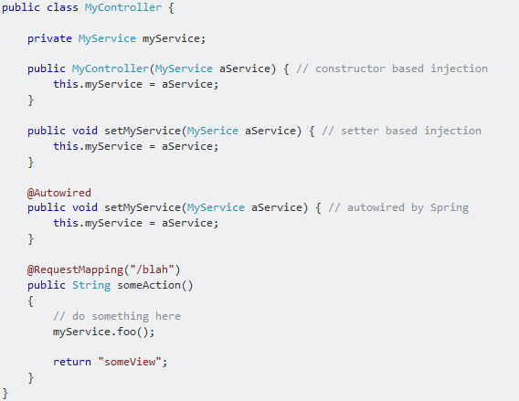
@Autowired
@Autowired on Setter Methods
@Autowired on Properties
@Autowired on Constructors
@Autowired on Constructors

Slide 57
Magic tags
<mvc:annotation-driven>
<mvc:interceptors>
<mvc:view-controller>
<mvc:resources>
<mvc:default-servlet-handler>
<context:component-scan>

Slide 58
Magic tags (cont.)
<mvc:annotation-driven>
registers necessary beans
support formatting
Number fields using the @NumberFormat
Date, Calendar, Long fields using the @DateTimeFormat
support for reading and writing
XML, if JAXB is present in classpath
JSON, if Jackson is present in classpath
support validating with @Valid

Slide 59
Magic tags (cont.)
<mvc:interceptors>
<!-- register "global" interceptor beans to apply to all registered HandlerMappings --> <mvc:interceptors> <!–- applied to all URL paths --> <bean class="org.springframework.web.servlet.theme.ThemeChangeInterceptor"/> <!–- applied to a specific URL path --> <mvc:interceptor> <mvc:mapping path="/secure/*"/> <bean class="org.example.MyInterceptor" /> </mvc:interceptor> </mvc:interceptors>

Slide 60
Magic tags (cont.)
<mvc:view-controller>: immediately forwards to a view when invoked
<mvc:view-controller path="/" view-name="index"/> <mvc:view-controller path="/resourceNotFound"/>
<mvc:resources>: handles HTTP GET requests for /resources/** by efficiently serving up static resources <mvc:resources location="/, classpath:/META-INF/web-resources/“ mapping="/resources/**"/>
<mvc:default-servlet-handler>: allows for mapping the DispatcherServlet to "/" by forwarding static resource requests to the container's default Servlet <mvc:default-servlet-handler/

Slide 61
Magic tags (cont.)
<context:component-scan>: activates the annotations and scans the packages to find and register beans within the application context (will be use to activate Spring MVC annotation scanning capability which allows to make use of annotations like @Controller and @RequestMapping etc.)

Slide 62
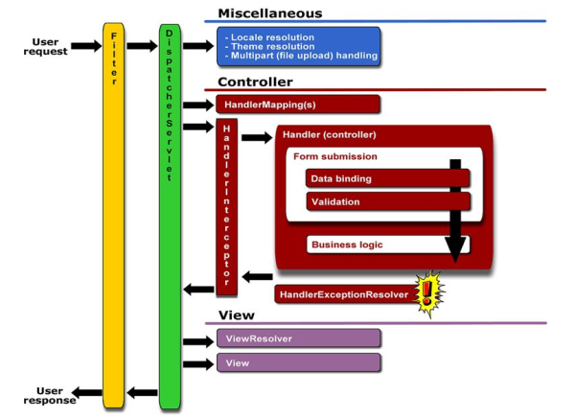
Spring MVC request life cycle

