Slide 1
WWW Programming (Advanced Web Programming with Java)
5.5. Spring Boot

Slide 2

Content
Spring Boot introduction
Create Spring Boot project
Spring Boot main components
Spring Boot, Spring Beans and DI

Slide 3
Spring Boot
Spring Boot is an open source Java-based framework used to create a micro Service.
It is developed by Pivotal Team and is used to build stand-alone and production ready Spring applications.

Slide 4
What is Micro Service?
Micro Service is an architecture that allows the developers to develop and deploy services independently.
Each service running has its own process and this achieves the lightweight model to support business applications.
Micro services offers the following advantages to its developers: Easy deployment
Simple scalability
Compatible with Containers
Minimum configuration
Lesser production time

Slide 5
Spring Boot advantages
Spring Boot offers the following advantages to its developers:
Easy to understand and develop spring applications
Increases productivity
Reduces the development time
Spring Boot is designed with the following goals:
To avoid complex XML configuration in Spring
To develop a production ready Spring applications in an easier way
To reduce the development time and run the application independently
Offer an easier way of getting started with the application

Slide 6




Spring Boot
Opinionated view of building production-ready Spring applications
Tomcat
pom.xml
Spring Boot
Auto configuration

Slide 7
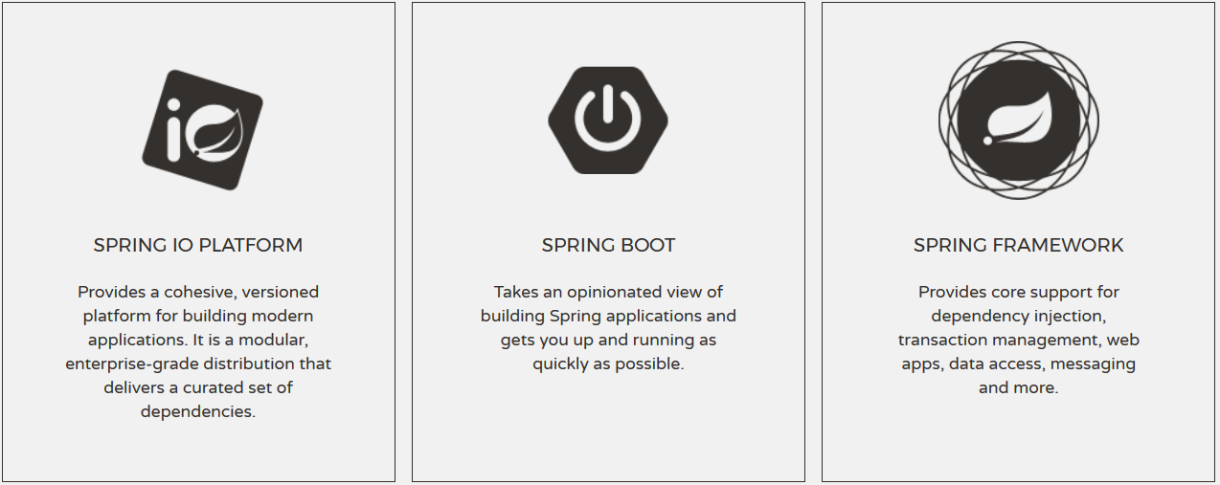
Spring Boot
Spring Boot

Slide 8
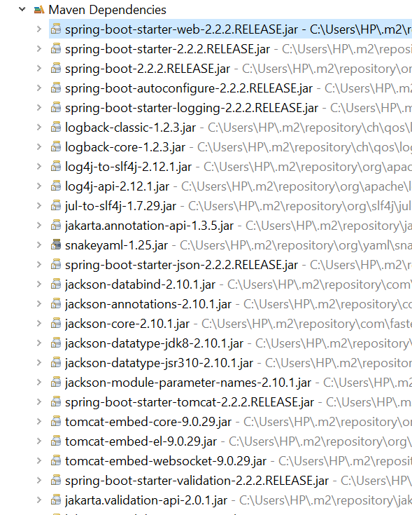
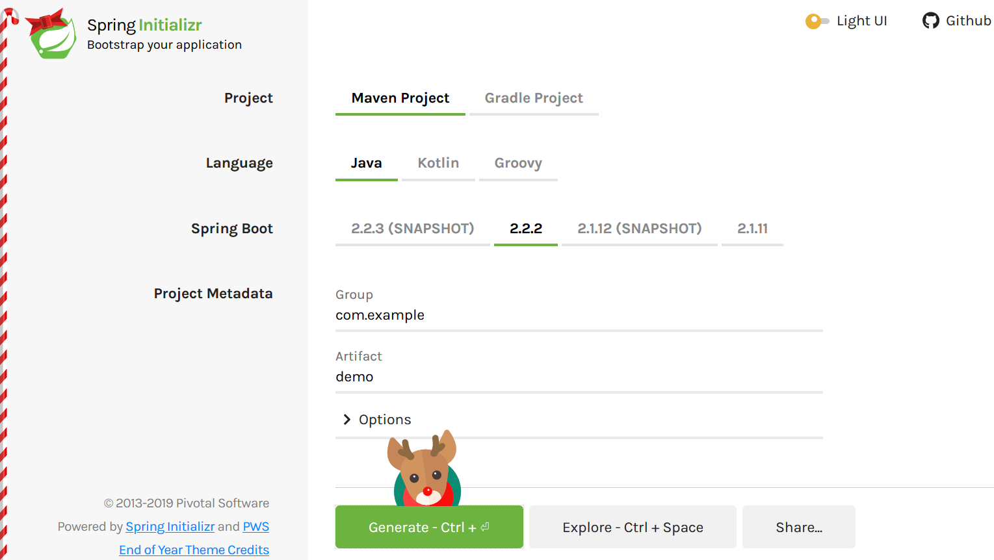
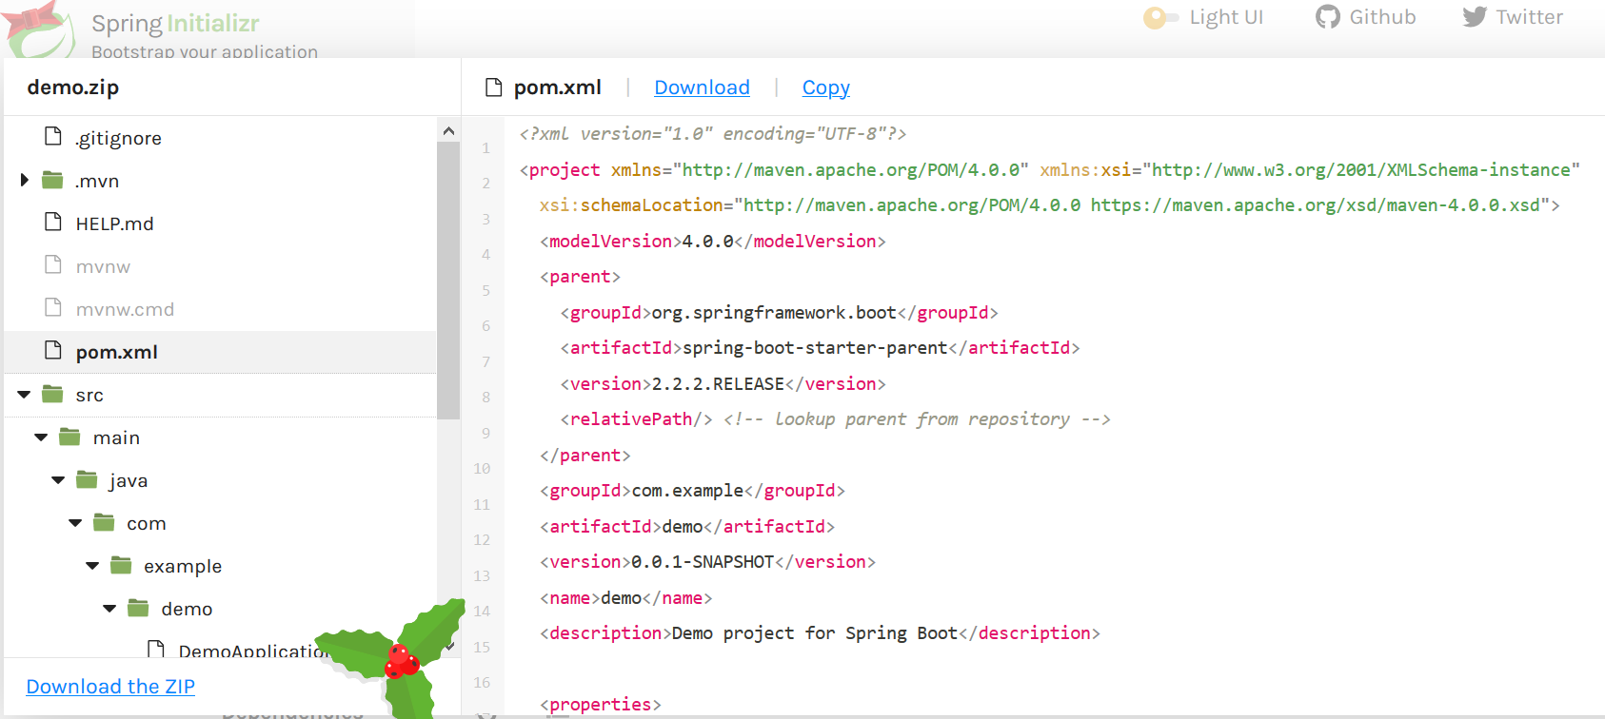
Creating Spring Boot Project
Just go to https://start.spring.io/

Slide 9
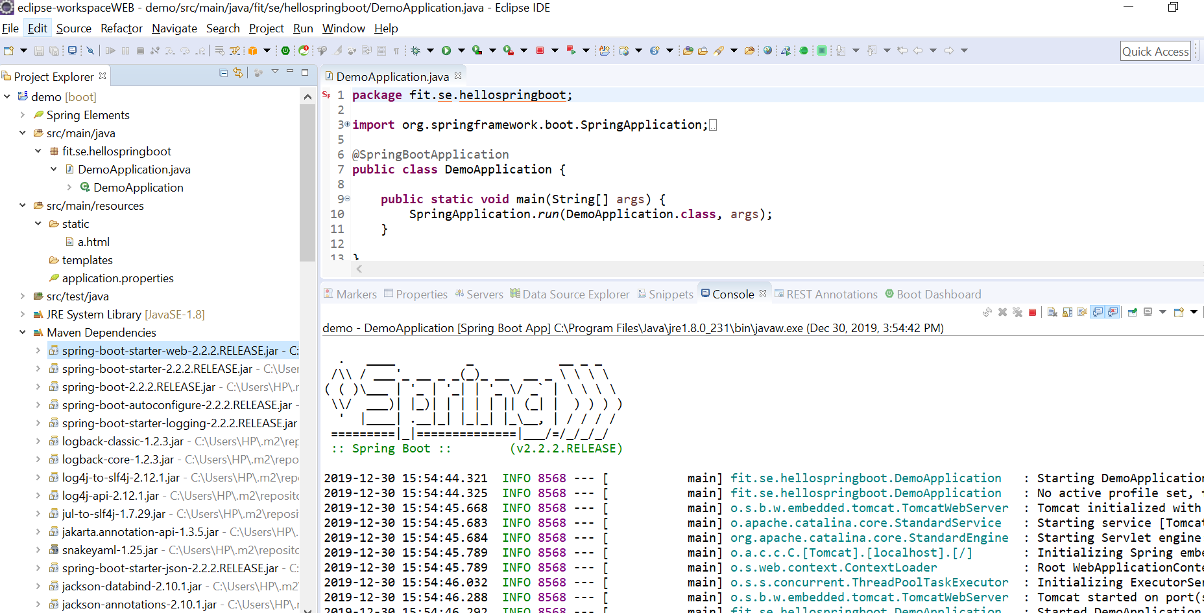
Creating Spring Boot Project

Slide 10
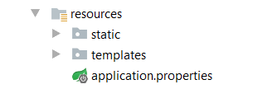
Spring Resources
HTML, CSS, JS
Thymeleaf
App properties

Slide 11
Spring Boot Main Components
Four main components:
Spring Boot Starters - combine a group of common or related dependencies into single dependency
Spring Boot AutoConfigurator - reduce the Spring Configuration
Spring Boot CLI - run and test Spring Boot applications from command prompt
Spring Boot Actuator – provides EndPoints and Metrics

Slide 12
Spring Boot Starters
spring-boot-starter-web
spring-boot-starter-tomcat
spring-web
spring-boot-starter
spring-web-mvc
spring-boot
tomcat-embed-logging-juli
spring-boot-autoconfigure
tomcat-embed-core
spring-boot-starter-logging

Slide 13
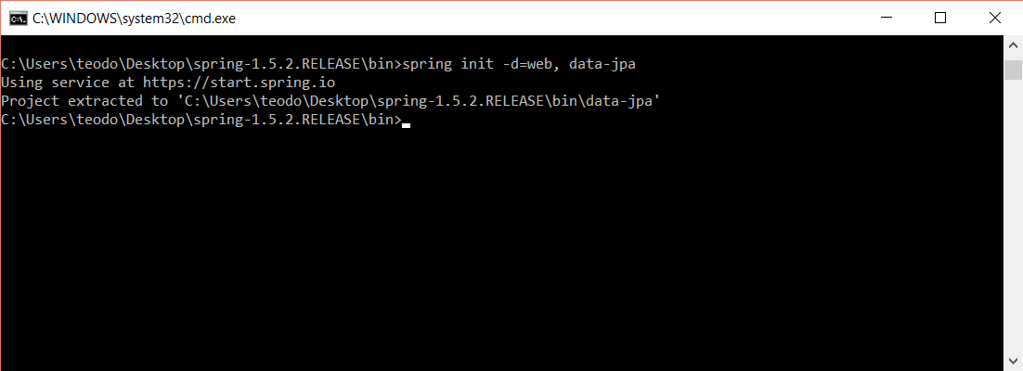
Spring Boot CLI
Command Line Interface - Spring Boot software to run and test Spring Boot applications

Slide 14
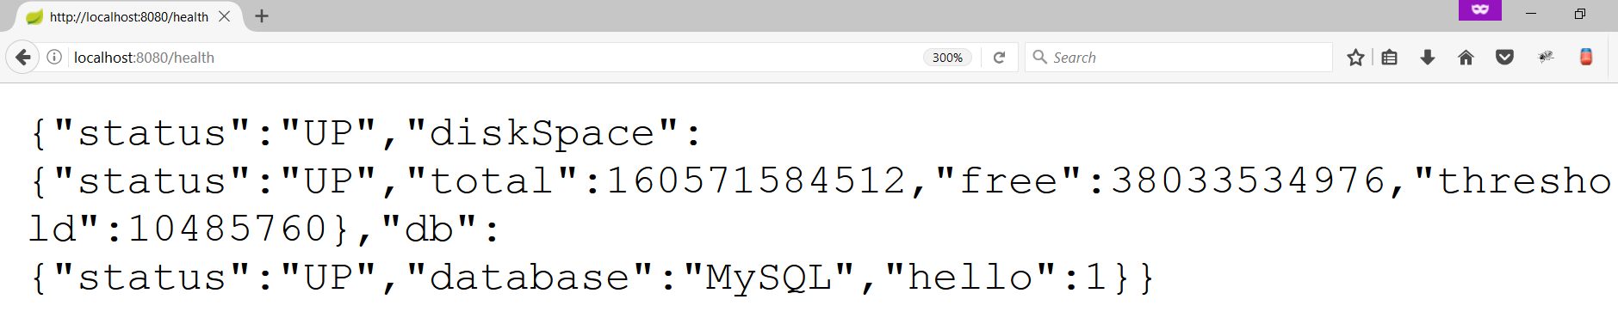
Spring Boot Actuator
Expose different types of information about the running application
pom.xml
<dependency>
<groupId>org.springframework.boot</groupId>
<artifactId>spring-boot-starter-actuator</artifactId>
</dependency>

Slide 15
Spring Boot Requirements
Setting up and running Spring Boot applications requires the following:
Java 8+
Spring Framework 5.0.1.RELEASE or above
Servlet 3.0+ container (in case you don’t make use of the embedded servers).

Slide 16
Spring BootApplication
The entry point of the Spring Boot Application is the class contains
@SpringBootApplication annotation. This class should have the main method to run the
Spring Boot application. @SpringBootApplication annotation includes AutoConfiguration, Component Scan, and Spring Boot Configuration.
If you added @SpringBootApplication annotation to the class, you do not need to add the @EnableAutoConfiguration, @ComponentScan and @SpringBootConfiguration annotation.
The @SpringBootApplication annotation includes all other annotations.

Slide 17
Spring Boot – Spring Beans and Dependency Injection
In Spring Boot, we can use Spring Framework to define our beans and their dependency injection.
The @ComponentScan annotation is used to find beans and the corresponding injected with @Autowired annotation.
If you followed the Spring Boot typical layout, no need to specify any arguments for @ComponentScan annotation. All component class files are automatically registered with Spring Beans.

