Slide 1
WWW Programming (Advanced Web Programming with Java)
5.6. Spring Data

Slide 2
Content
Spring Data introduction
Spring Data features
Main modules
Accessing data with MongoDB
Accessing data with JPA

Slide 3
Spring Data
Spring Data’s mission is to provide a familiar and consistent, Spring-based programming model for data access while still retaining the special traits of the underlying data store.
It makes it easy to use data access technologies, relational and non-relational databases, map-reduce frameworks, and cloud-based data services.

Slide 4
Spring Data Features
Powerful repository and custom object-mapping abstractions
Dynamic query derivation from repository method names
Implementation domain base classes providing basic properties
Support for transparent auditing (created, last changed)
Possibility to integrate custom repository code
Easy Spring integration via JavaConfig and custom XML namespaces
Advanced integration with Spring MVC controllers
Experimental support for cross-store persistence

Slide 5
Spring Data main modules
Spring Data Commons - Core Spring concepts underpinning every Spring Data module.
Spring Data JDBC - Spring Data repository support for JDBC.
Spring Data JPA - Spring Data repository support for JPA.
Spring Data MongoDB - Spring based, object-document support and repositories for MongoDB.
Spring Data Redis - Easy configuration and access to Redis from Spring applications.
Spring Data REST - Exports Spring Data repositories as hypermedia-driven RESTful resources.
…

Slide 6
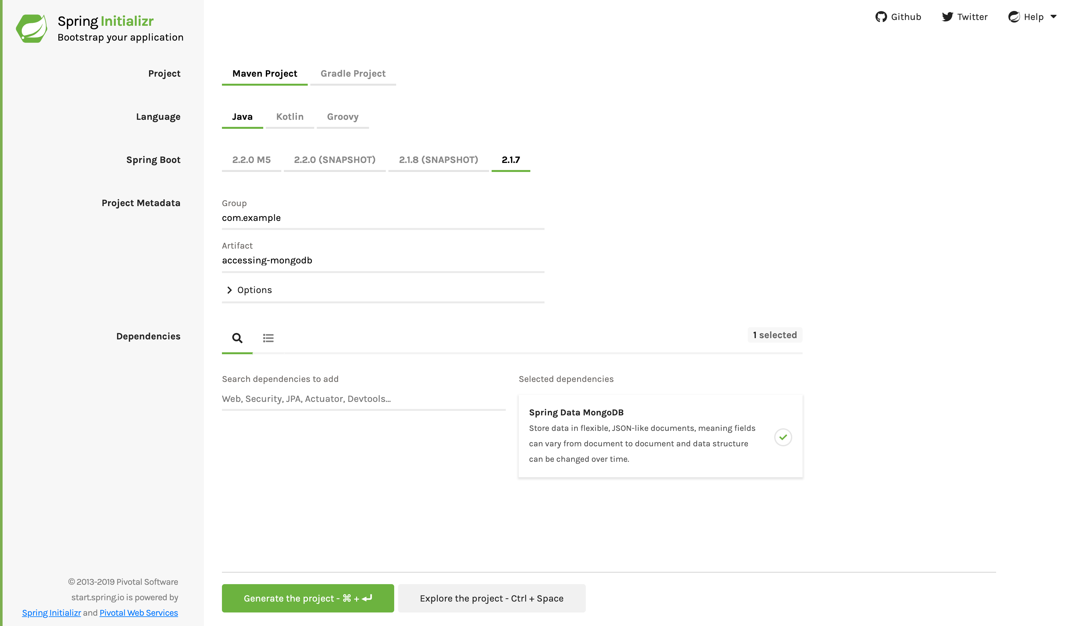
Accessing Data with MongoDB
Starting with Spring Initializr
Notes:
https://spring.io/guides/gs/accessing-data-mongodb/

Slide 7
Accessing Data with MongoDB (cont.)
<dependencies>
<dependency>
<groupId>org.springframework.boot</groupId>
<artifactId>spring-boot-starter-data-mongodb</artifactId>
</dependency>
<dependency>
<groupId>org.springframework.boot</groupId>
<artifactId>spring-boot-starter-test</artifactId>
<scope>test</scope>
</dependency>
</dependencies>
Notes:
https://spring.io/guides/gs/accessing-data-mongodb/

Slide 8
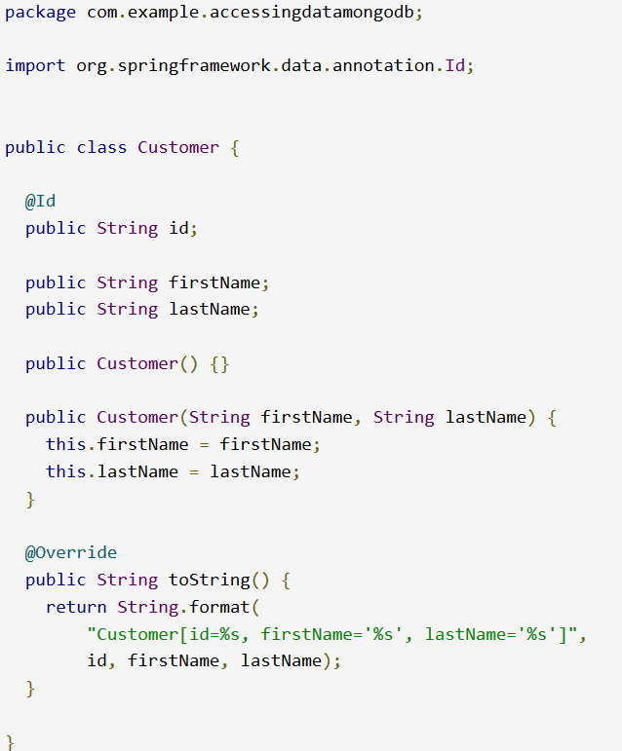
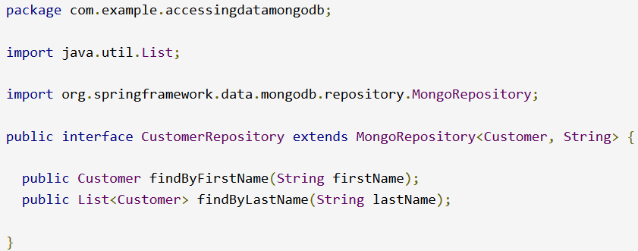
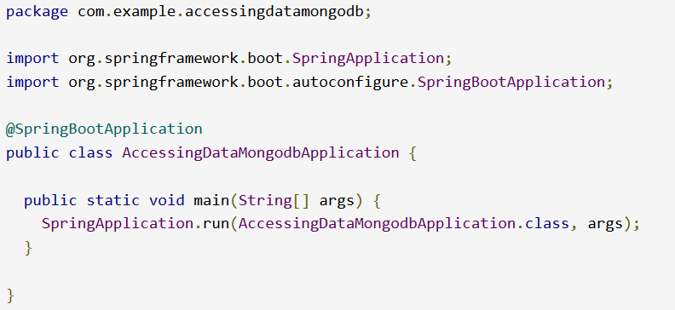
Accessing Data with MongoDB (cont.)
Notes:
https://spring.io/guides/gs/accessing-data-mongodb/

Slide 9
Accessing Data with MongoDB (cont.)
@SpringBootApplication is a convenience annotation that adds all of the following:
@Configuration: Tags the class as a source of bean definitions for the application context.
@EnableAutoConfiguration: Tells Spring Boot to start adding beans based on classpath settings, other beans, and various property settings. For example, if spring-webmvc is on the classpath, this annotation flags the application as a web application and activates key behaviors, such as setting up a DispatcherServlet.
@ComponentScan: Tells Spring to look for other components, configurations, and services in the com/example package, letting it find the controllers.
Notes:
https://spring.io/guides/gs/accessing-data-mongodb/

Slide 10
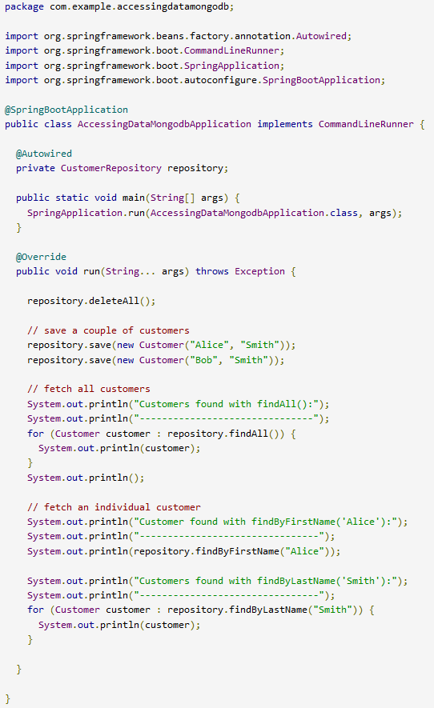
Accessing Data with MongoDB (cont.)
Can run the application by using ./mvnw spring-boot:run.
Or can build the JAR file with ./mvnw clean package and then run the JAR file, as follows:
      java -jar target/gs-accessing-data-mongodb-0.1.0.jar
Notes:
https://spring.io/guides/gs/accessing-data-mongodb/

Slide 11
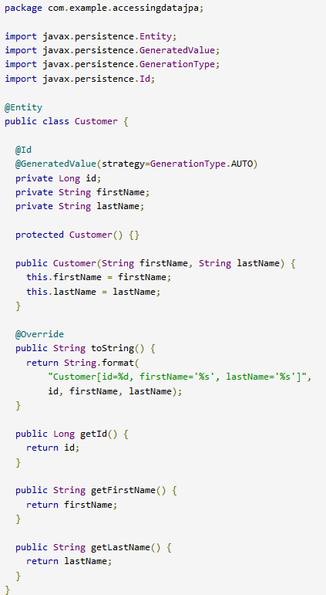
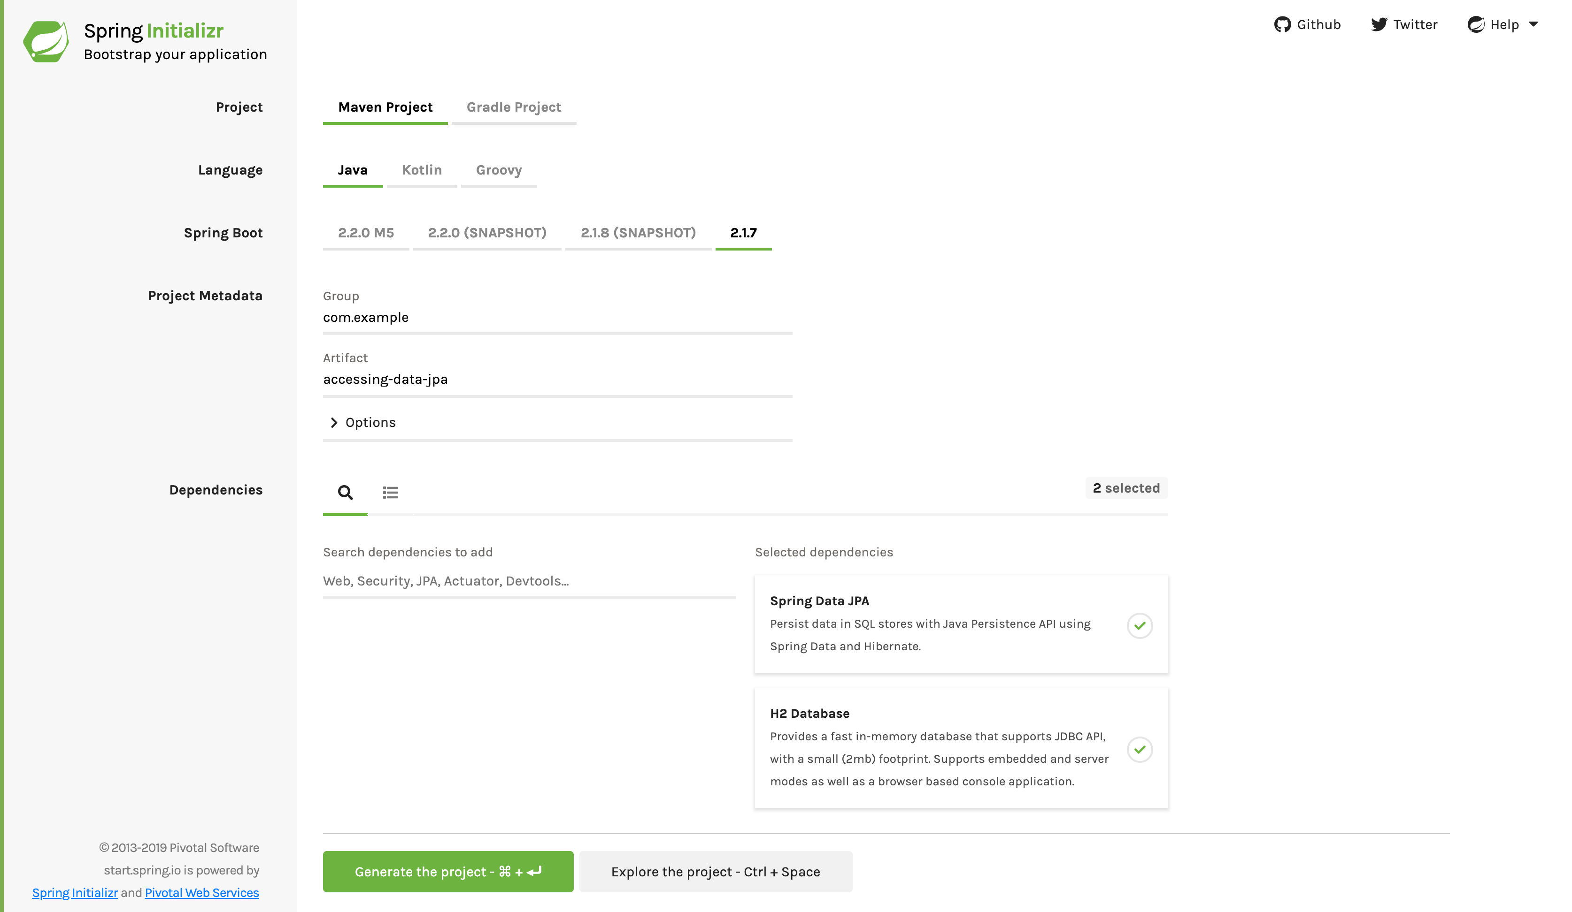
Accessing Data with JPA

Slide 12
Accessing Data with JPA (cont.)
<dependencies>
<dependency>
<groupId>org.springframework.boot</groupId>
<artifactId>spring-boot-starter-data-jpa</artifactId>
</dependency>
<dependency>
<groupId>com.h2database</groupId>
<artifactId>h2</artifactId>
<scope>runtime</scope>
</dependency>
<dependency>
<groupId>org.springframework.boot</groupId>
<artifactId>spring-boot-starter-test</artifactId>
<scope>test</scope>
</dependency>
</dependencies>

Slide 13
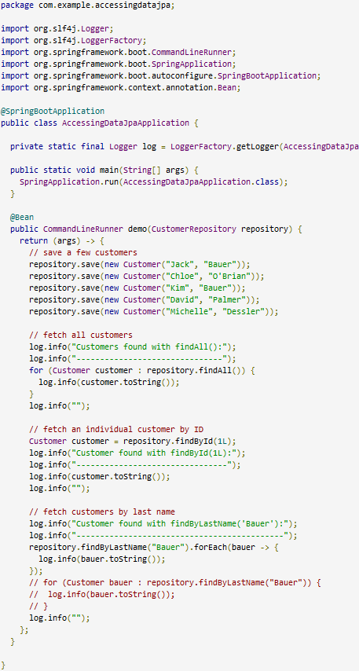
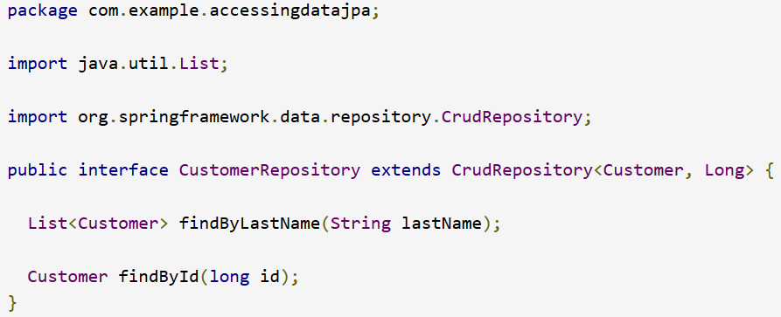
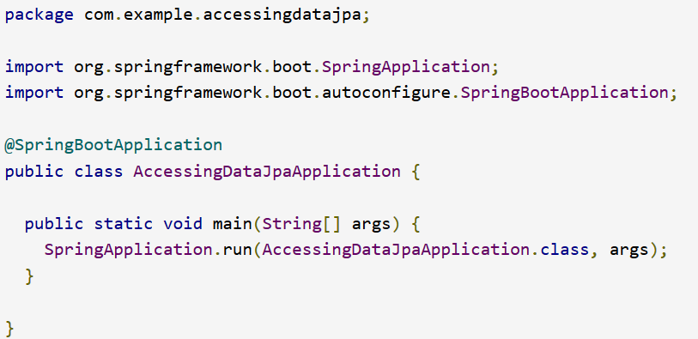
Accessing Data with JPA (cont.)

Slide 14
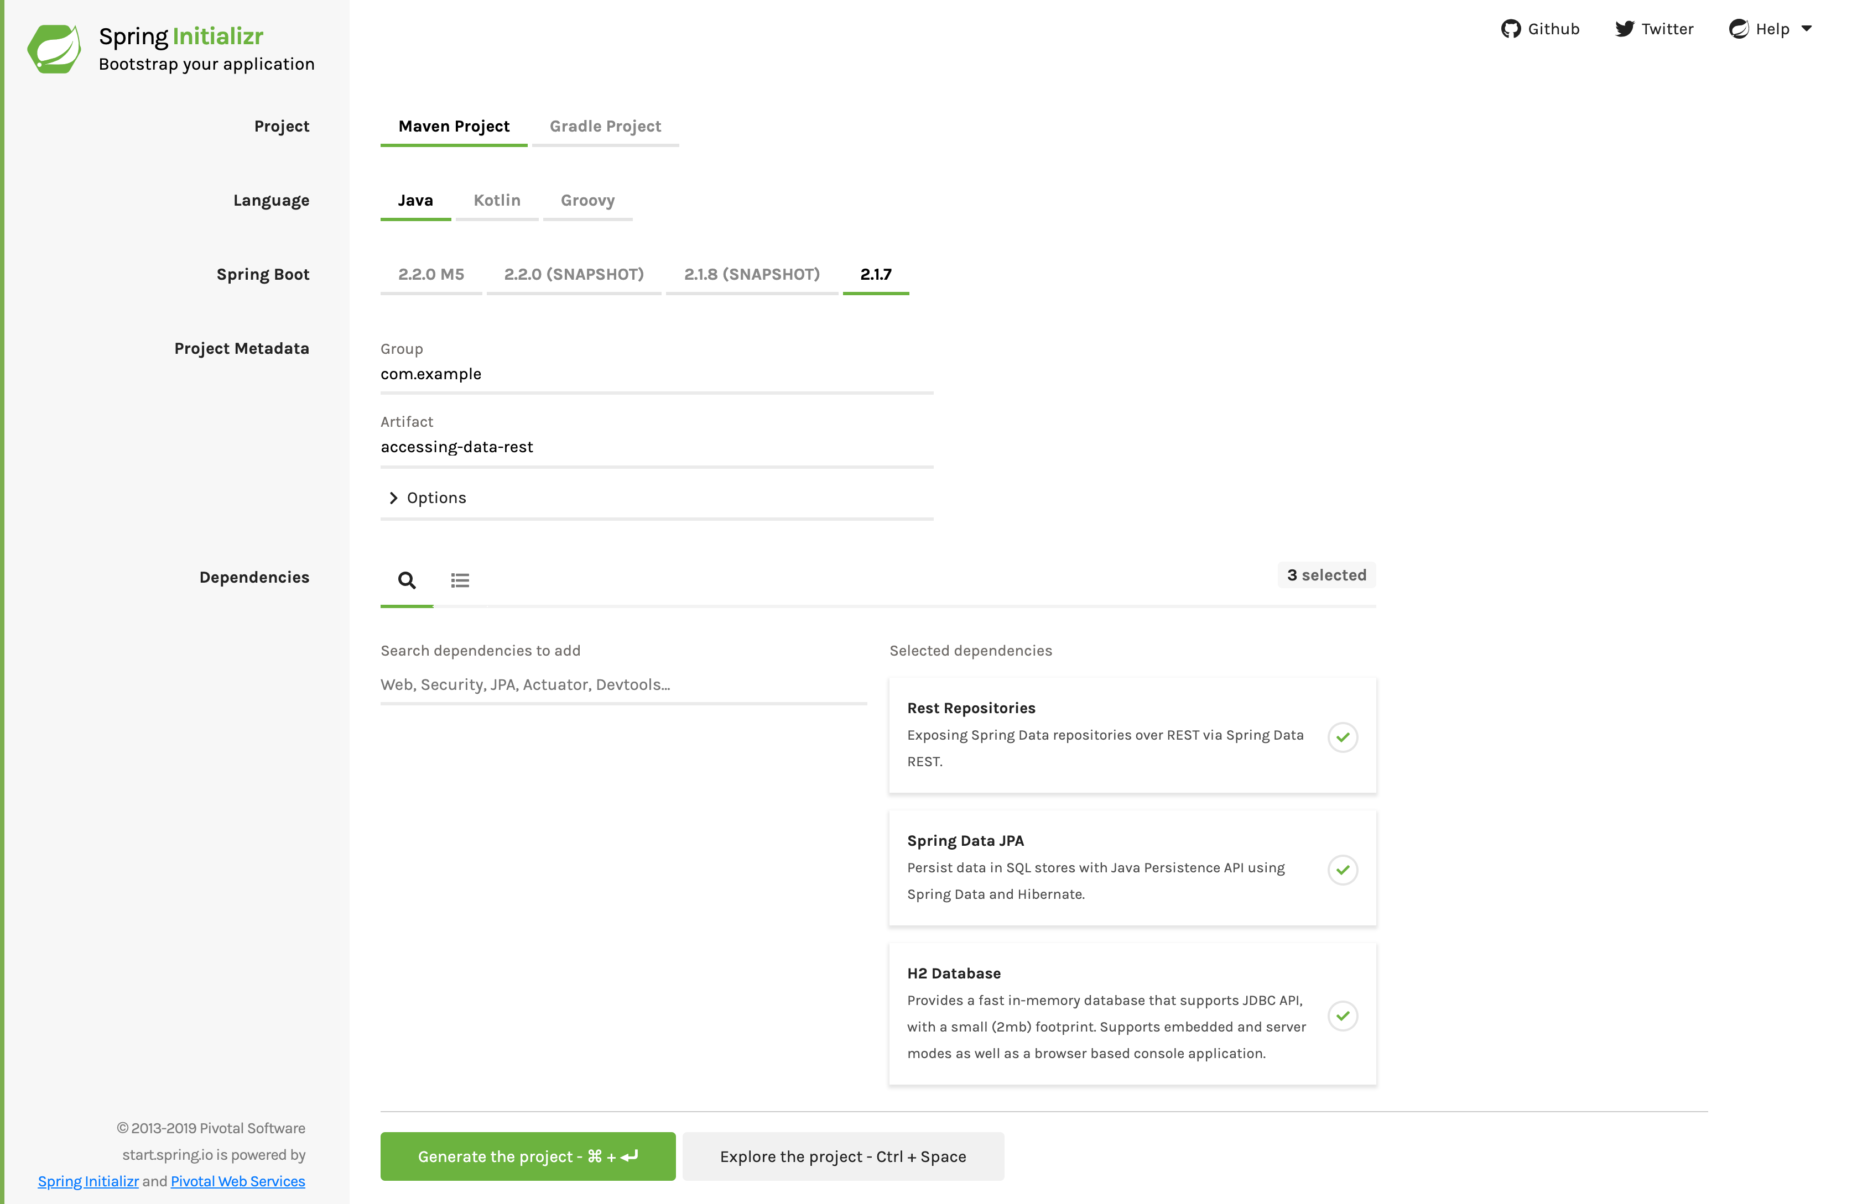
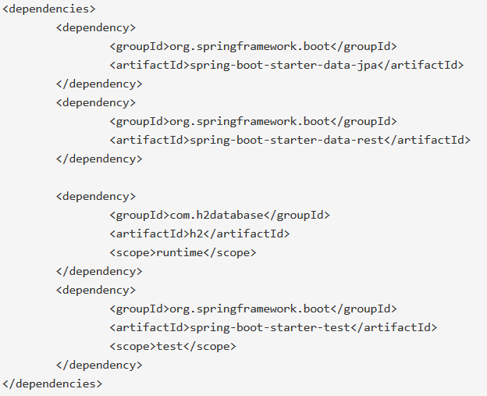
Accessing JPA Data with REST

Slide 15
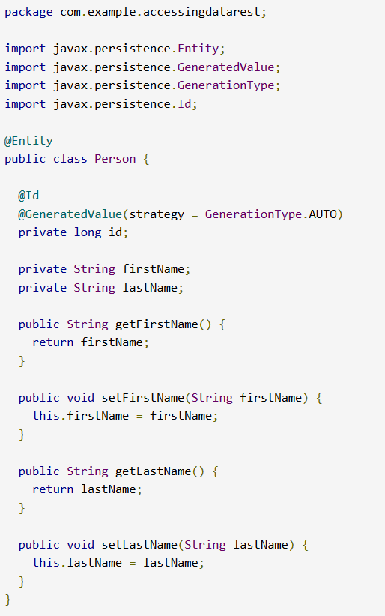
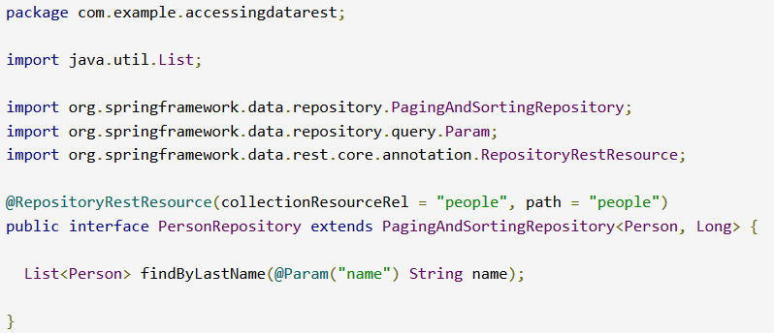
Accessing JPA Data with REST (cont.)

Slide 16
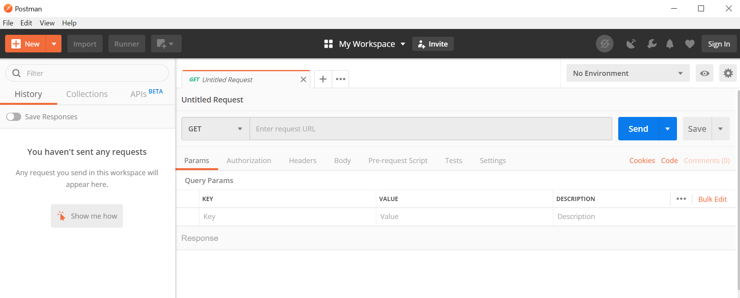
Accessing JPA Data with REST (cont.)
Using Postman to test the application

