Slide 1
Software Architecture and Design
01. Introduction to Software Architecture

Slide 2
Content
What is software architecture?
Definitions of software architecture
Architecture addresses nonfunctional requirements
What does a software architect do? (Functions)
Architectures and technologies
A Software Architecture Process
Process Outline
Architecture Design
Validation
Software quality attributes

Slide 3
Terminologies
Architecture
Old art and ancient engineering discipline
Software
The industry begun in late 40s
Software architecture
Much less mature than computer hardware architecture
Common excuses
Software industry is young and unique

Slide 4
What does SA address?
Complexity of software systems increased
Developing software: hundreds/ thousands person-years
Many software systems: complex as skyscrapers
Designing software
Beyond algorithms/ data structures of the computation
New kind of problem: overall system structure

Slide 5
Producing software systems
Criteria have changed
Computer hardware improved, affordable
Need for software applications exploded
How to specify requirements for new products and implement the software quickly, cheaply
Earliest software product on market
Quality?
New criterion: does it have a good SA, understood by stakeholders and developers?

Slide 6
Definition
Defintions - ANSI/IEEE Std 1471-2000
“Architecture is the fundamental organization of a system, embodied in its components, their relationships to each other and the environment, and the principles governing its design and evolution.”
Definitions - SEI
“The software architecture of a program or computing system is the structure or structures of the system, which comprise software elements, the externally visible properties of those elements, and the relationships among them.”

Slide 7
Definition (cont.)
Definitions – Garlan and Shaw
“[Software architecture goes] beyond the algorithms and data structures of the computation; designing and specifying the overall system structure emerges as a new kind of problem. Structural issues include gross organization and global control structure; protocols for communication, synchronization, and data access; assignment of functionality to design elements; physical distribution; composition of design elements; scaling and performance; and selection among design alternatives.”

Slide 8
Software architecture
Provides a design plan of a system
Blueprint
Implies purpose
Is an abstraction that helps in managing the complexity of a system
Software architects limited by
Lack of standardized ways to represent architecture
Lack of analysis methods to predict whether an architecture will result in an implementation that meets the requirements

Slide 9
SA as a design plan
Structural plan that describes
The elements of a system
How they fit together
How they work together to fulfill requirements
Used as blueprint during development process
Used to negotiate system requirements
Used to set expectations with
Customers
Marketing/management personnel

Slide 10
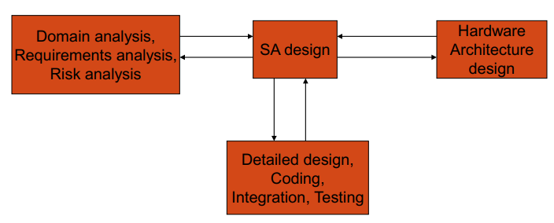
SA as design plan
Project manager uses the design plan as input to the project plan

Slide 11
Architecture Defines Structure
Decomposition of system in to components/modules/subsystems
Architecture defines:
Component interfaces
What a component can do
Component communications and dependencies
How components communicate
Component responsibilities
Precisely what a component will do when you ask it

Slide 12
Structure and Dependencies
Excessive component dependencies are bad!
Key architecture issue
Identifying components that may change
Reduce direct dependencies on these components
Creates more modifiable systems
C1
C2
C3
C4
C1
C2
C3
C4
AL
Third Party
Component
Third Party
Component
Four components are directly dependent on a third party component. If the third party component is replaced with a new component with a different interface, changes to each component are likely.
Diagram Key
Component
Dependency
Only the AL (abstraction layer) component is directly dependent on the third party component. If the third party component is replaced, changes are restricted to the AL component only
C

Slide 13
Architecture addresses NFRs
Non-functional requirements (NFRs) define ‘how’ a system works
NFRs rarely captured in functional requirements
Aka. architecture requirements
Must be elicited by architect
NFRs include:
Technical constraints
Business constraints
Quality attributes

Slide 14
SA as an abstraction
SA not a comprehensive decomposition of a system
Implementation details abstracted away, encapsulated into elements of the SA
SA should describe elements at a coarse level of granularity
How elements fulfill the requirements
Element interactions
Element dependencies on execution platform
Architecture provides an abstract view of a design
Hides complexity of design
May or may not be a direct mapping between architecture elements and software elements

Slide 15
SA goal
One should strive for a good architecture
When system is implemented according to the architecture, it meets its requirements and resource budget
It is possible to implement system according to architecture
Not good enough when
Not explicit or not comprehensive or not consistent or not understandable

Slide 16
Decomposition
Hierarchical decomposition is a powerful abstraction mechanism
Partitions design
Allocate components to development teams
Why isn’t the Client component decomposed?
Top Level Architecture Description
Diagram Key
Component
Dependency
C
Client
Broker
Server
Message Handler
Security
Server
Directory Server
Request Handler
Data
Store

Slide 17
Architecture Views
A software architecture represents a complex design artifact
Many possible ‘views’ of the architecture
Cf. with buildings – floor plan, external, electrical, plumbing, air-conditioning

Slide 18
Philippe Krutchen - 4+1 View Model
Logical view: describes architecturally significant elements of the architecture and the relationships between them.
Process view: describes the concurrency and communications elements of an architecture.
Physical view: depicts how the major processes and components are mapped on to the applications hardware.
Development view: captures the internal organization of the software components as held in e.g. a configuration management tool.
Architecture use cases: capture the requirements for the architecture; related to more than one particular view

Slide 19
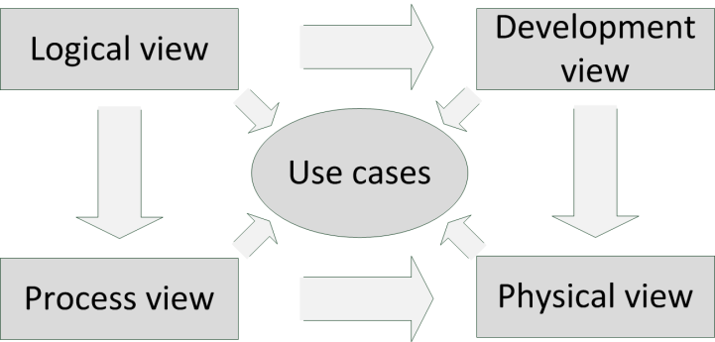
Philippe Krutchen - 4+1 View Model

Slide 20
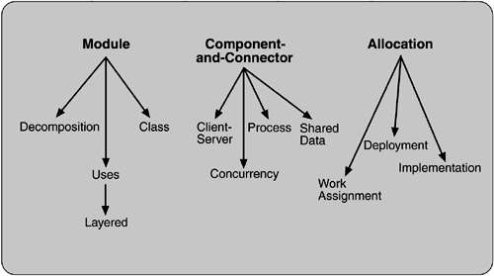
SEI – Views and Beyond
Module: structural view of the architecture, comprising the code modules such as classes, packages and subsystems
Component and Connector: describes the behavioral aspects of the architecture. Components are objects, threads or processes, and connectors describe how components interact.
Allocation: shows how the processes are mapped to hardware and gives a view of the source code in the configuration management systems.
Notes:
Software Engineering Institute https://www.sei.cmu.edu/

Slide 21
SA terminology
1. Architectural style/pattern
Defines element types and how they interact
Sometimes defines a mapping of functionality to architectural elements
2. Reference/domain specific architecture
Defines element types and how they interact
They apply to a particular domain
They define how the domain functionality is mapped to architectural elements

Slide 22
SA terminology (cont.)
3. Product-line architecture
Applies to a set of products within a company
Defines element types, how they interact, how the product functionality is mapped to them
May also define some of the instances of the architectural elements.
E.g., error-reporting components would be common to many products of the product line

Slide 23
SA terminology (cont.)
4. Software architecture
Applies to one system
Describes element types, how they interact, how the product functionality is mapped to them
Describes the instances that exist in the system
Level of specificity needed to design a system

Slide 24
SA terminology (cont.)
5. ADL (architectural description language)
Gives notation for architectural elements
As types and instances, also interconnecting instances to form configurations
Mostly in research communities
In theory: architects can use an ADL to describe any of the 1-4 terms
In practice: not all ADLs support all the 1-4 terms
Some ADLs have accompanying tools

Slide 25
Software Architecture Process
Regardless of the main focus of the method (artifacts, use cases, attributes, or domain), the architectural design process includes the following aspects
Analysis of architecture requirements, identifying concerns, and providing context for decision making through the process
Documentation of the desirable characteristics and supporting principles of the system and its evolution, to facilitate communicating them with the system’s stakeholders
Evaluation and comparison of architecture alternatives in a consistent manner
Verification of compliance of the actual system implementation with its architectural description
Management of the evolution of the architecture.

Slide 26
Software Architecture Process (cont.)
Architects must be versatile:
Work with the requirements team: The architect plays an important role in requirements gathering by understanding the overall systems needs and ensuring that the appropriate quality attributes are explicit and understood.
Work with various application stakeholders: Architects play a pivotal liaison role by making sure all the application’s stakeholder needs are understood and incorporated into the design.
Lead the technical design team: Defining the application architecture is a design activity.
Work with the project management: Planning, estimates, budgets, schedules

Slide 27
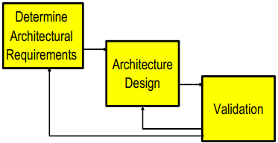
An Architecture Process
Highly iterative
Can scale to small/large projects

Slide 28
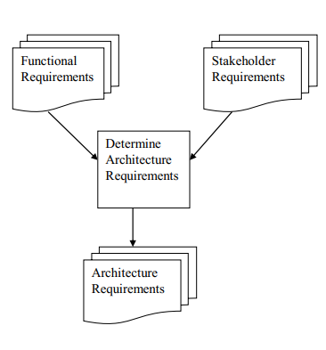
Determine Architectural Requirements
Sometime called:
architecturally significant requirements
architecture use cases
essentially the quality and non-functional requirements for a system.

Slide 29
Example
A typical architecture requirement :
“Communications between components must be guaranteed to succeed with no message loss”
Some architecture requirements are constraints:
“The system must use the existing IIS-based web server and use Active Server Page to process Web requests”
Constraints impose restrictions on the architecture and are (almost always) nonnegotiable.
They limit the range of design choices an architect can make.

Slide 30
Architecture and quality attributes
What are Quality Attributes
Scalability
Reliability
Availability
Modifiability
Performance
Security
Testability
Usability
Other Quality Attributes
Part of a system’s NFRs
“how” the system achieves its functional requirements

Slide 31
Quality attributes - Scalability
“How well a solution to some problem will work when the size of the problem increases.”
4 common scalability issues in IT systems:
Request load
Connections
Data size
Deployments

Slide 32
Quality attributes – Scalability (cont.)
Request Load
How does an 100 tps application behave when simultaneous request load grows? E.g.
From 100 to 1000 requests per second?
Ideal solution, without additional hardware capacity:
as the load increases, throughput remains constant (i.e. 100 tps), and response time per request increases only linearly (i.e. 10 seconds)

Slide 33
Quality attributes – Scalability (cont.)
Add more hardware
Scale-up:
Single application instance is executed on a multiprocessor machine
Application
Scale-out: Application replicated on different machines
Application
CPU
Application
Application
Application

Slide 34
Quality attributes – Scalability (cont.)
Adding more hard ware should improve performance:
scalability must be achieved without modifications to application architecture
Reality as always is different!
Applications will exhibit a decrease in throughput and a subsequent exponential increase in response time.
increased load causes increased contention for resources such as CPU, network and memory
each request consumes some additional resource (buffer space, locks, and so on) in the application, and eventually these are exhausted

Slide 35
Quality attributes – Scalability (cont.)
Scalability – J2EE example
I.Gorton, A Liu, Performance Evaluation of Alternative Component
Architectures for Enterprise JavaBean Applications, in IEEE Internet
Computing, vol.7, no. 3, pages 18-23, 2003.

Slide 36
Quality attributes - Availability
Availability is concerned with system failure and its associated consequences.
Availability - Key requirement for most IT applications
Measured by the proportion of the required time it is useable. E.g.
100% available during business hours
No more than 2 hours scheduled downtime per week
24x7x52 (100% availability)
Related to an application’s reliability
Unreliable applications suffer poor availability

Slide 37
Quality attributes – Availability (cont.)
Period of loss of availability determined by:
Time to detect failure
Time to correct failure
Time to restart application
Strategies for high availability:
Eliminate single points of failure
Replication and failover
Automatic detection and restart
Recoverability (e.g. a database)
the capability to reestablish performance levels and recover affected data after an application or system failure

Slide 38
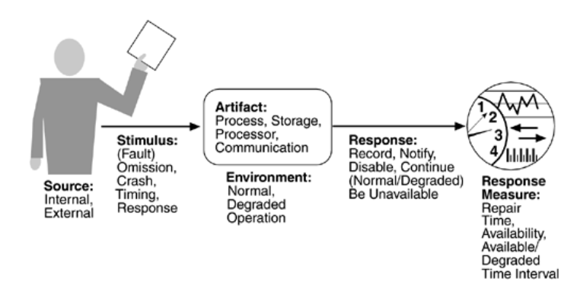
Quality attributes – Availability (cont.)
Availability general scenarios

Slide 39
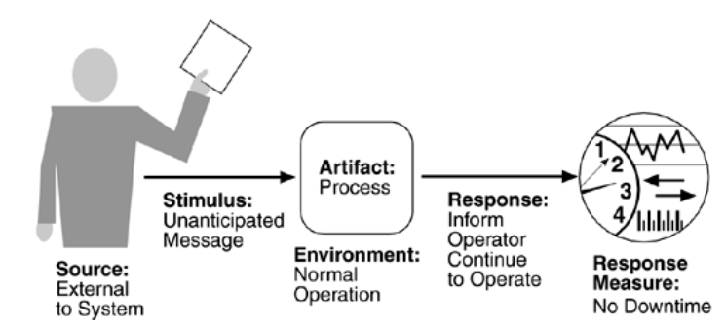
Quality attributes – Availability (cont.)
Sample availability scenario

Slide 40
Quality attributes - Modifiability
Modifications to a software system during its lifetime are a fact of life.
Modifiable systems are easier to change/evolve
Modifiability should be assessed in context of how a system is likely to change
No need to facilitate changes that are highly unlikely to occur
Over-engineering!

Slide 41
Quality attributes - Modifiability (cont.)
Modifiability measures how easy it may be to change an application to cater for new (non-) functional requirements.
‘may’ – nearly always impossible to be certain
Must estimate cost/effort
Modifiability measures are only relevant in the context of a given architectural solution.
Components
Relationships
Responsibilities

Slide 42
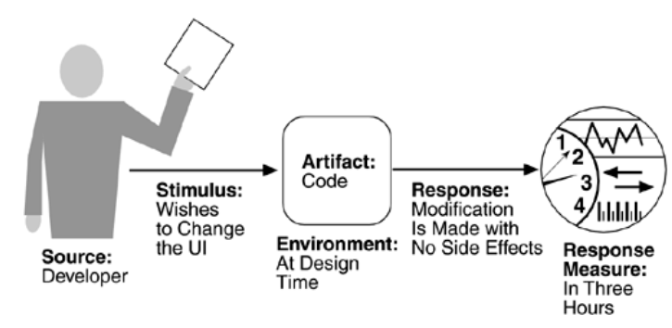
Quality attributes - Modifiability (cont.)
Sample modifiability scenario

Slide 43
Quality attributes - Performance
Performance is about timing.
Events (interrupts, messages, requests from users, or the passage of time) occur, and the system must respond to them.
There are a variety of characterizations of event arrival and the response but basically performance is concerned with how long it takes the system to respond when an event occurs.

Slide 44
Quality attributes - Performance (cont.)
The response of the system to a stimulus can be characterized by
latency (the time between the arrival of the stimulus and the system's response to it),
deadlines in processing (in the engine controller, for example, the fuel should ignite when the cylinder is in a particular position, thus introducing a processing deadline),
the throughput of the system (e.g., the number of transactions the system can process in a second),
the jitter of the response (the variation in latency),
the number of events not processed because the system was too busy to respond, and the data that was lost because the system was too busy.

Slide 45
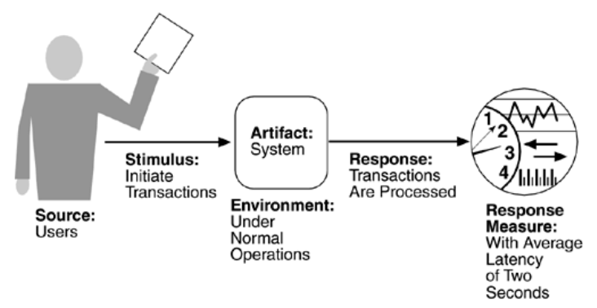
Quality attributes - Performance (cont.)
Sample performance scenario

Slide 46
Quality attributes - Security
Difficult, specialized quality attribute:
Lots of technology available
Requires deep knowledge of approaches and solutions
Security is a multi-faceted quality

Slide 47
Quality attributes - Security (cont.)
Authentication: Applications can verify the identity of their users and other applications with which they communicate.
Authorization: Authenticated users and applications have defined access rights to the resources of the system.
Encryption: The messages sent to/from the application are encrypted.
Integrity: This ensures the contents of a message are not altered in transit.
Non-repudiation: The sender of a message has proof of delivery and the receiver is assured of the sender’s identity. This means neither can subsequently refute their participation in the message exchange.

Slide 48
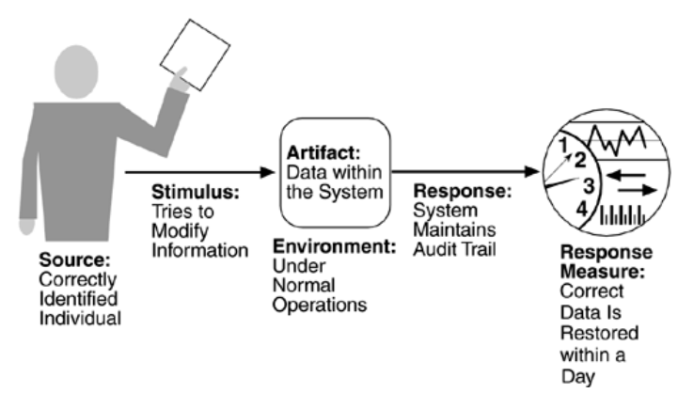
Quality attributes - Security (cont.)
Sample security scenario

Slide 49
Quality attributes - Software testability
Software testability refers to the ease with which software can be made to demonstrate its faults through (typically execution-based) testing.
At least 40% of the cost of developing well-engineered systems is taken up by testing. If the software architect can reduce this cost, the payoff is large.
In particular, testability refers to the probability, assuming that the software has at least one fault, that it will fail on its next test execution.

Slide 50
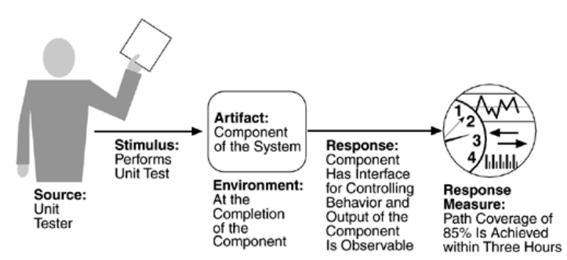
Quality attributes - Software testability
Testability scenario concerning the performance of a unit test: A unit tester performs a unit test on a completed system component that provides an interface for controlling its behavior and observing its output; 85% path coverage is achieved within three hours.

Slide 51
Quality attributes - Usability
Usability is concerned with how easy it is for the user to accomplish a desired task and the kind of user support the system provides.
Learning system features. If the user is unfamiliar with a particular system or a particular aspect of it, what can the system do to make the task of learning easier?
Using a system efficiently. What can the system do to make the user more efficient in its operation?
Minimizing the impact of errors. What can the system do so that a user error has minimal impact?
Adapting the system to user needs. How can the user (or the system itself) adapt to make the user's task easier?
Increasing confidence and satisfaction. What does the system do to give the user confidence that the correct action is being taken?

Slide 52
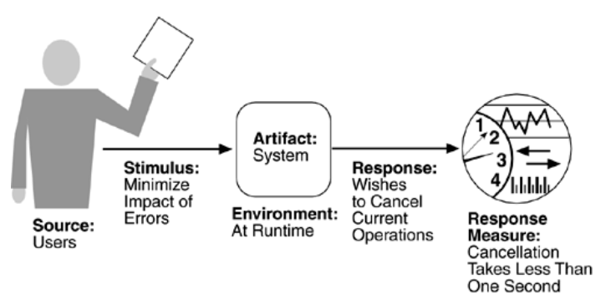
Quality attributes - Usability (cont.)
Sample usability scenario

