Slide 1
Software Architecture and Design
02. Architecture Styles

Slide 2
Introduction
Middleware is the plumbing or wiring of IT applications
Provides applications with fundamental services for distributed computing
Insulates applications from underlying platform (OS, DBMS, etc) APIs
Lots of middleware exists
Different purposes
Different vendors
Different standards and proprietary technologies

Slide 3
Middleware Classification
Business Process Orchestrators
BizTalk, TIBCO StaffWare, ActiveBPEL
Message Brokers
BizTalk, WebSphere Message Broker, SonicMQ
Application Servers
J2EE, CCM, .NET
Transport
Message-Oriented Middleware, Distributed Objects Systems

Slide 4
Common Architectural Design
Category | Architectural Design | Description
Communication | Message bus | Prescribes use of a software system that can receive and send messages using one or more communication channels.
 | Service–Oriented Architecture (SOA) | Defines the applications that expose and consume functionality as a service using contracts and messages.
Deployment | Client/server | Separate the system into two applications, where the client makes requests to the server.
 | 3-tier or N-tier | Separates the functionality into separate segments with each segment being a tier located on a physically separate computer.

Slide 5
Common Architectural Design (cont.)
Category | Architectural Design | Description
Domain | Domain Driven Design | Focused on modeling a business domain and defining business objects based on entities within the business domain.
Structure | Component Based | Breakdown the application design into reusable functional or logical components that expose well-defined communication interfaces.
 | Layered | Divide the concerns of the application into stacked groups (layers).
 | Object oriented | Based on the division of responsibilities of an application or system into objects, each containing the data and the behavior relevant to the object.

Slide 6
Software Architectures and Technologies
Message-Oriented Architecture (Message-Oriented Middleware MOM)
Multi-tier Architecture
Java EE Specifications (J2EE Architecture)
.NET N-tier
Services Oriented Architecture (SOA)

Slide 7
Message-Oriented Architecture (Message-Oriented Middleware MOM)

Slide 8
Types of Middleware
Remote procedure calls
Message-oriented middleware
Distributed objects
Database-oriented middleware
Transaction-oriented middleware
Message brokers

Slide 9
Middleware (cont.)
Middleware can be grouped into the following categories:
Remote Procedure Call or RPC-based middleware, which allows procedures in one application to call procedures in remote applications as if they were local calls. The middleware implements a linking mechanism that locates remote procedures and makes these transparently available to a caller. Traditionally, this type of middleware handled procedure-based programs; it now also includes object-based components.
Object Request Broker or ORB-based middleware, which enables an application’s objects to be distributed and shared across heterogeneous networks.
Message Oriented Middleware or MOM-based middleware, which allows distributed applications to communicate and exchange data by sending and receiving messages.

Slide 10
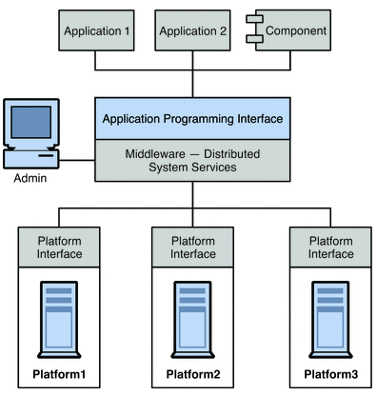
Middleware (cont.)
Middleware allows software components (applications, enterprise java beans, servlets, and other components) that have been developed independently and that run on different networked platforms to interact with one another.

Slide 11
Basic Messaging
Send (queue, message)
Put message onto queue
Receive (queue, message)
Get message from queue
No dependency on state of receiving application on message send
send
receive
queue

Slide 12
Persistence
queue
Receipt of message at queue implies message is written to disk log
Removal of message from queue deletes message from disk log
Trade-off performance versus reliability
send
receive

Slide 13
Message Oriented Middleware
Message Oriented Middleware is a concept that involves the passing of data between applications using a communication channel that carries self-contained units of information (messages).
In a MOM-based communication environment, messages are usually sent and received asynchronously.
Using message-based communications, applications are abstractly decoupled; senders and receivers are never aware of each other.

Slide 14
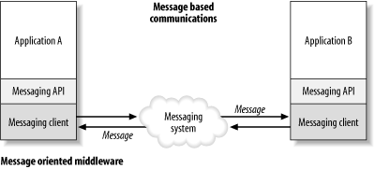
Message Oriented Middleware (cont.)
In a messaging system, an application uses an API to communicate through a messaging client that is provided by the MOM vendor.
The messaging client sends and receives messages through a messaging system

Slide 15
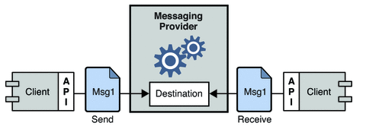
MOM-Based System
MOM Server
MOM Server
Senders
Receivers
Sending
Applications
Sending
Applications
Message
Handler Thread Pool

Slide 16
MOM Transactions

Slide 17
MOM Transactions
Sender and receiver do *not* share a transaction
Rollback on receiver does not affect the sender (already committed)
‘Synchronous’ operations are not atomic
Request/response is 3 transactions not 1
Put to request queue
Get from request queue, put to response queue
Get from response queue
Request queue
send
receive
receive
send

Slide 18
Scaling MOM
MOM Server
ApplicationQ
Senders
Receivers
MOM Server
ApplicationQ

Slide 19
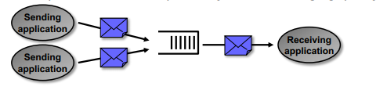
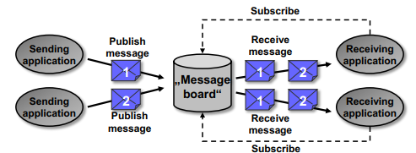
Messaging models
P2P - Point to Point
1 queue per receiver (application).
One-to-one (1 sender, 1 receiver) or many-to-one messaging (many senders, 1 receiver).
Publish - Subscribe
One-to-many or many-to-many distribution of messages (same message may be received by multiple receivers if these are subscribed).
Similar to a message board

Slide 20
Publish-Subscribe Messaging
Extension of MOM to provide 1-to-N, N-to-1, and N-to-N communications
Messages are ‘published’ to logical subjects or topics
Subscribers receive all messages from subjects they subscribe to
Sub
Create/
Publish
Pub
Subject
Register/
Subscribe
Sub
Sub

Slide 21
Publish-Subscribe with Multicast
Based on
TIBCO
Rendezvous

Slide 22
Multi-tier Architecture - Application Servers

Slide 23
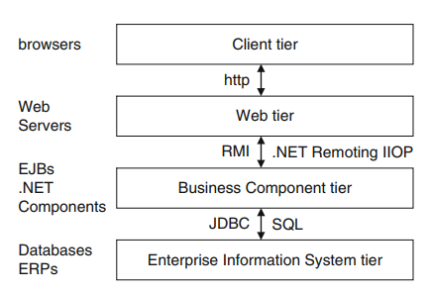
Application Servers
An application server is a component-based server technology that resides in the middle-tier of an N-tier architecture, and provides distributed communications, security, transactions and persistence.
Application servers are widely used to build internet-facing applications.
N-Tier architecture for Web applications

Slide 24
Application Servers (cont.)
Client Tier:
In a Web application, the client tier typically comprises an Internet browser that submits HTTP requests and downloads HTML pages from a web server.
This is commodity technology, not an element of the application server.

Slide 25
Application Servers (cont.)
Web Tier:
The Web tier runs a Web server to handle client requests. When a request arrives, the Web server invokes Web server-hosted components such as servlets, Java Server Pages (JSPs) or Active Server Pages (ASPs) depending on the flavor of Web server being used.
The incoming request identifies the exact Web component to call.
This component processes the request parameters, and uses these to call the business logic tier to get the required information to satisfy the request.
The Web component then formats the results for return to the user as HTML via the Web server.

Slide 26
Application Servers (cont.)
Business Component Tier:
The business components comprise the core business logic for the application.
The business components are realized by for example Enterprise JavaBeans (EJB) in JEE, .NET components or CORBA objects.
The incoming request identifies the exact Web component to call.
This component processes the request parameters, and uses these to call the business logic tier to get the required information to satisfy the request.
The Web component then formats the results for return to the user as HTML via the Web server.

Slide 27
Application Servers (cont.)
Business Component Tier:
The business components comprise the core business logic for the application. The business components are realized by for example Enterprise JavaBeans (EJB) in JEE, .NET components or CORBA objects.
The business components receive requests from the Web tier, and satisfy requests usually by accessing one or more databases, returning the results to the Web tier.
A run-time environment known as a container accommodates the components. The container supplies a number of services to the components it hosts.
These varying depending on the container type (e.g., EJB, .NET, CORBA), but include transaction and component lifecycle management, state management; security, multithreading and resource pooling.

Slide 28
Application Servers (cont.)
Enterprise Information Systems Tier:
This typically consists of one or more databases and back-end applications like mainframes and other legacy systems.
The business components must query and interact with these data stores to process requests.

Slide 29
J2EE architecture
The Java™ 2 Platform, Enterprise Edition (J2EE) provides a standard for developing multitier, enterprise applications

Slide 30
J2EE Application Server
In J2EE, the application server container provides the execution environment for the J2EE-specific components
EJBs
Message-driven beans
Connectors
Container provides additional services for hosted components
Transactions
Security
Directory
Threading
Connection pooling

Slide 31
Java EE introduction
Java EE is designed to support applications that implement enterprise services for customers, employees, suppliers, partners, and others who make demands on or contributions to the enterprise.
Such applications are inherently complex, potentially accessing data from a variety of sources and distributing applications to a variety of clients.

Slide 32
Java EE introduction (cont.)
The Java EE application model defines an architecture for implementing services as multitier applications that deliver the scalability, accessibility, and manageability needed by enterprise-level applications. This model partitions the work needed to implement a multitier service into the following parts:
The business and presentation logic to be implemented by the developer
The standard system services provided by the Java EE platform

Slide 33
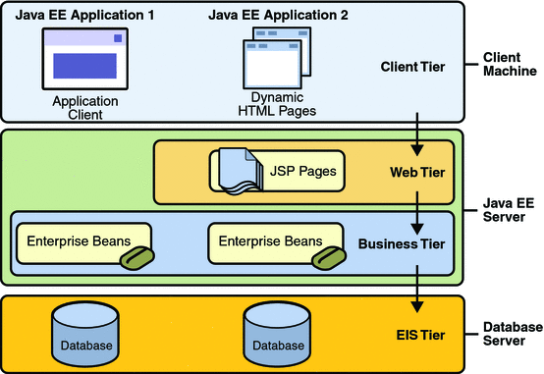
Distributed Multitiered Applications

Slide 34
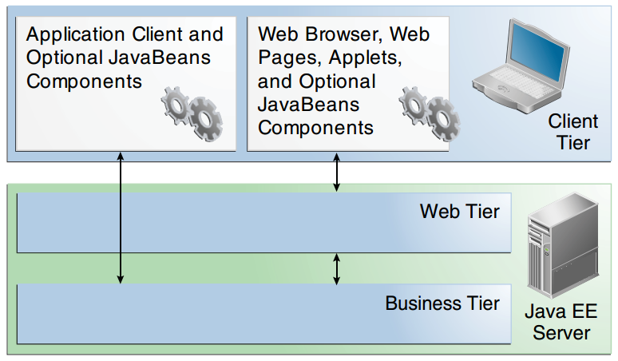
Server communication

Slide 35
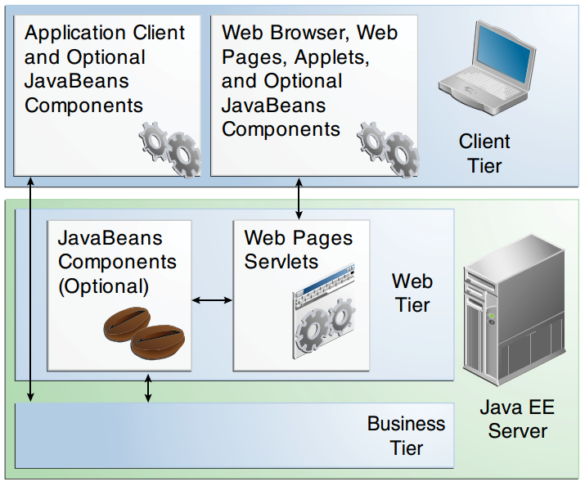
Web Tier and Java EE Applications

Slide 36
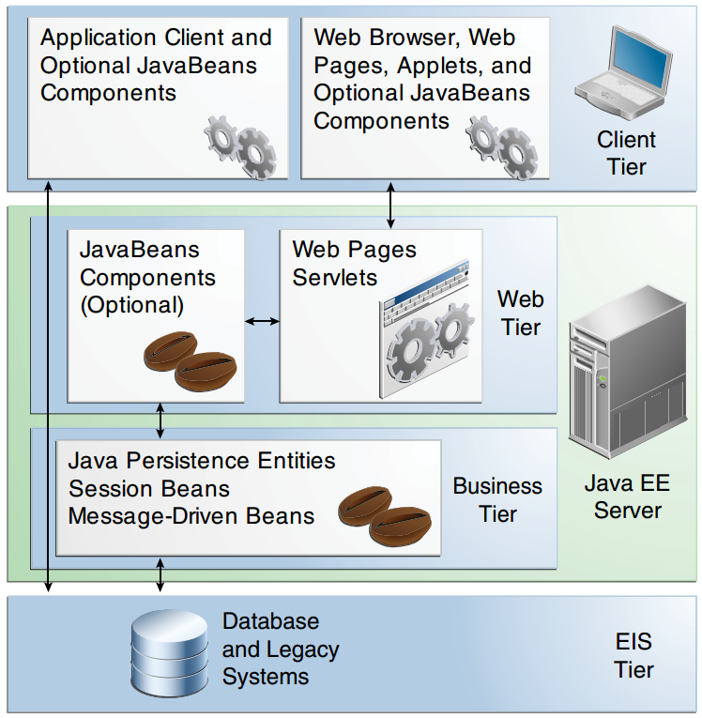
Business and EIS Tiers

Slide 37
Java EE Server and Containers
Notes:
Enterprise Information System Tier

Slide 38
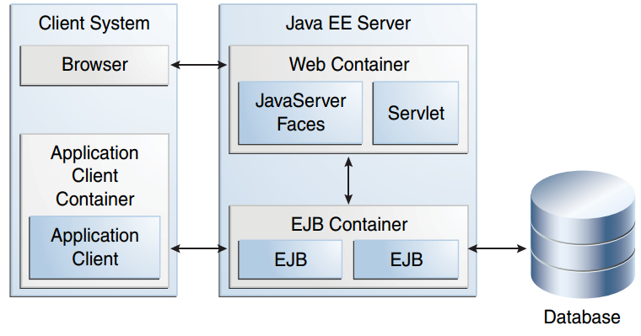
Java EE Containers

Slide 39
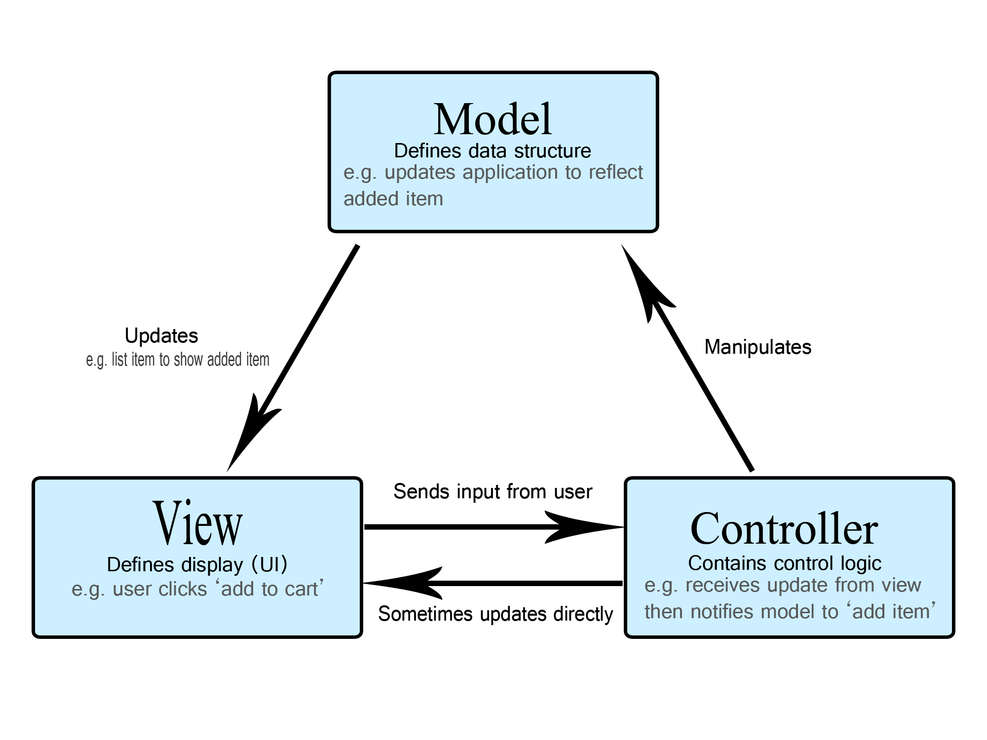
MVC architecture
Model View Controller (MVC) is a software architecture pattern, commonly used to implement user interfaces: it is therefore a popular choice for architecting Web applications.
In general, it separates out the application logic into three separate parts, promoting modularity and ease of collaboration and reuse. It also makes applications more flexible and welcoming to iterations.

Slide 40
MVC architecture (cont.)
Model
The model defines what data the application should contain. If the state of this data changes, then the model will usually notify the view (so the display can change as needed) and sometimes the controller (if different logic is needed to control the updated view).
Going back to our shopping list app, the model would specify what data the list items should contain — item, price, etc. — and what list items are already present.
View
The view defines how the app's data should be displayed.
In our shopping list app, the view would define how the list is presented to the user, and receive the data to display from the model.

Slide 41
MVC architecture (cont.)
Controller
The controller contains logic that updates the model and/or view in response to input from the users of the application.
So for example, our shopping list could have input forms and buttons that allow us to add or delete items. These actions require the model to be updated, so the input is sent to the controller, which then manipulates the model as appropriate, which then sends updated data to the view.

Slide 42
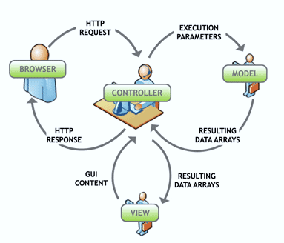
MVC architecture (cont.)
Execution Process
Controller – Mediates input and commands for the model or view
Model – Application data, business rules, logic, and functions.
View – Output and representation of data

Slide 43
MVC framework
PHP: CakePHP, CodeIgniter, Laravel
Java: Spring Web MVC, JavaServer Faces (JSFs)
Perl: Catalyst, Dancer
Python: Django, Flask, Grok
Ruby: Ruby on Rails, Camping, Nitro, Sinatra
JavaScript: AngularJS, JavaScriptMVC, Spine
ASP.NET MVC (.NET Framework)

Slide 44
MVC architecture (cont.)
ASP.NET MVC
Runs on top of ASP.NET
Not a replacement for Web Forms
Leverage the benefits of ASP.NET
Embrace the Web
SEO-friendly URLs, HTML 5, SPA
Adopt REST concepts
Uses MVC pattern
Conventions and Guidance
Separation of concerns

Slide 45
MVC framework (cont.)
ASP.NET MVC (cont.)
HTTP Request
Web server
ASP.NET MVC Routing engine
/Users/Ivo/
Select controller and invoke action (method)
User
Controller
(C# class)
HTTP Response
(HTML, File, JSON, …)
CRUD model
Select view & pass data (model)
View engine
(Razor)
Model (POCO)
Use model data

Slide 46

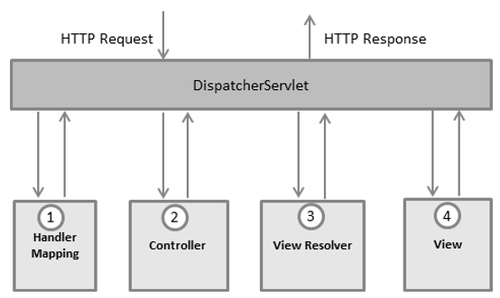
MVC framework (cont.)
Spring Web MVC

Slide 47
Services Oriented Architectures and Technologies

Slide 48
Introduction
Service-oriented architectures and Web services are the latest step in the development of application integration middleware.
They attempt to fix the interoperability problems of the past and provide a foundation for future Internet-scale distributed applications.
They also attempt, and to some extent succeed, to mark the end of the “middleware wars” with all major vendors finally agreeing on a single rich set of technology standards for application integration and distributed computing.

Slide 49
Service-Oriented Systems
Web services are really just another application integration technology, conceptually little different from CORBA, JEE, DCOM, or any of their competitors.
All of these technologies are much alike: client applications can discover servers, find out what services they are offering, and invoke the functions they provide.
What is different about service-oriented systems and their supporting Web services technologies is that these applications and servers are now expected to be accessed by outside organizations and individuals over the public Internet.
The result of this shift in focus is a set of standards and architectural principles that emphasize interoperability by making the fewest possible assumptions about how service providers and consumers work internally and what implementation details they have in common.

Slide 50
Service
What is a Service?
A service is a reusable component that can be used as a building block to form larger, more complex business-application functionality.
A service may be as simple as “get me some person data,” or as complex as “process a disbursement.”
A service provides a discrete business function that operates on data. Its job is to ensure that the business functionality is applied consistently, returns predictable results, and operates within the quality of service required.

Slide 51
Service (cont.)
What is a Service? (cont.)
How the service is implemented, and how a user of the service accesses it, are limited only by the SOA infrastructure choices of the enterprise.
From a theory point of view, it really doesn’t matter how a service is implemented.
Service contains
Contract - message type def, constraint, description (comment)
Interface - set of operations
Implementation - Logic and data

Slide 52
Service (cont.)
Characteristics of a Service
Supports open standards for integration: Although proprietary integration mechanisms may be offered by the SOA infrastructure, SOA’s should be based on open standards. Open standards ensure the broadest integration compatibility opportunities.
Loose coupling: The consumer of the service is required to provide only the stated data on the interface definition, and to expect only the specified results on the interface definition. The service is capable of handling all processing (including exception processing).

Slide 53
Service (cont.)
Characteristics of a Service
Stateless: The service does not maintain state between invocations. It takes the parameters provided, performs the defined function, and returns the expected result. If a transaction is involved, the transaction is committed and the data is saved to the database.
Location agnostic: Users of the service do not need to worry about the implementation details for accessing the service. The SOA infrastructure will provide standardized access mechanisms with service-level agreements.

Slide 54
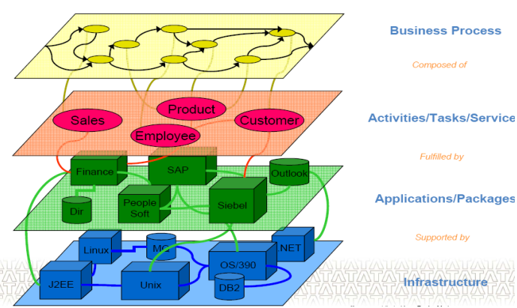
Type of Services
Type of Services
Examples of a Service
Creating a Purchase Order inside a mainframe application
Requesting and reserving a room in a hotel
Applying for a loan by filling out a loan request form
Search books/music based on key

Slide 55
Services Oriented Architecture (SOA)
What is Service-Oriented Architecture?
Service-Oriented Architecture (SOA) is an architectural style. Applications built using an SOA style deliver functionality as services that can be used or reused when building applications or integrating within the enterprise or trading partners.
Uses open standards to integrate software assets as services
Standardizes interactions of services
Services become building blocks that form business flows
Services can be reused by other applications

Slide 56
SOA
What is SOA?
A set of components which can be invoked, and whose interface description can be published and discovered (W3C).
Service-oriented architecture is a client/server design approach in which an application consists of software services and software service consumers (also known as clients or service requesters). SOA differs from the more general client/server model in its definitive emphasis on loose coupling between software components, and in its use of separately standing interfaces (Gartner).

Slide 57
SOA (cont.)
What is SOA? (cont.)
Service-Oriented Architecture is a business-driven IT architecture approach that supports integrating your business as linked, repeatable business tasks, or services. SOA helps today’s business innovate by ensuring that IT systems can adapt quickly, easily and economically to support rapidly changing business needs. SOA helps customers increase the flexibility of their business processes, strengthen their underlying IT infrastructure and reuse their existing IT investments by creating connections among disparate applications and information sources. (IBM)

Slide 58
SOA (cont.)
Legacy Business Process

Slide 59
SOA (cont.)
SOA Business Process

Slide 60
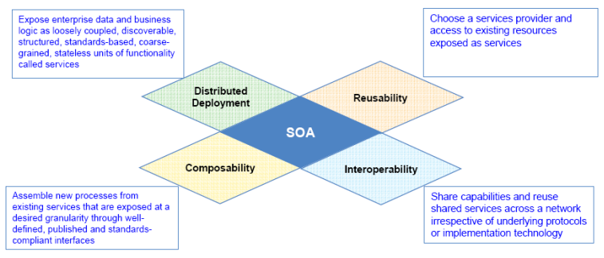
SOA (cont.)
Definition of SOA
SOA is an architectural approach that allows to:

Slide 61
SOA Characteristics
Based on open standards
Foster inherent reusability
Foster intrinsic interoperability
Emphasizes extensibility
Fundamentally autonomous
Promotes dynamic discovery
Promotes architectural composability
Promotes loose coupling throughout the enterprise
Supports incremental implementation

Slide 62
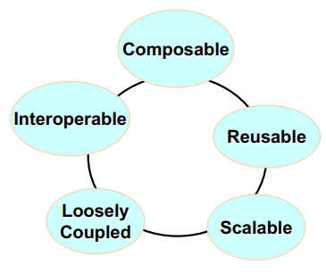
SOA Characteristics (cont.)
Services are platform independent, self describing interfaces (XML)
Messages are formally defined
Services can be discovered
Services have quality of service characteristics defined in policies
Services can be provided on any platform
Can be governed

Slide 63
Core SOA Definitions
XML – Extensible Markup Language
SOAP – Simple Object Access Protocol
WSDL – Web Services Description Language
UDDI - Universal Description, Discovery and Integration
ESB – Enterprise Service Bus
Key Concepts
Network Transparency
Virtualized endpoint
Self-describing software
Universally discoverable software
Universally understood software
Machine to machine interaction

Slide 64
SOA Usage & Supporting Platforms
SOA Usage
B2B
Enterprise Application Integration (EAI)
Application to Application
Government
Major Players in SOA Space
IBM: WebSphere SOA Product Suite
BEA: Aqualogic (WebLogic)
Oracle: Fusion Middleware
Microsoft: .NET
SAP: NetWeaver

Slide 65
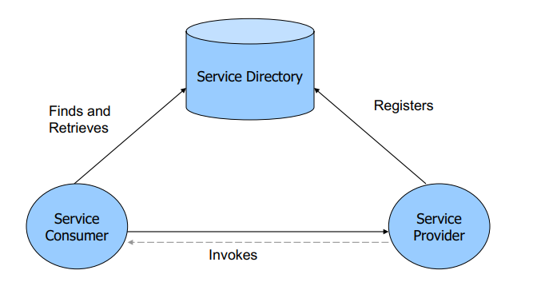
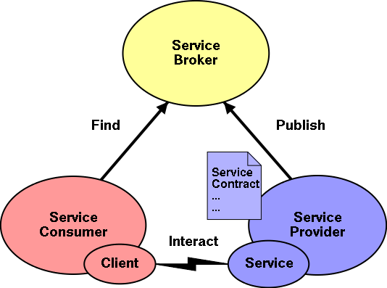
SOA architecture

Slide 66
7 Steps to SOA
Create/Expose Services
Register Services
Secure Services
Manage (monitor) Services
Mediate and Virtualize Services
Govern the SOA
Integrate Services

Slide 67
7 Steps to SOA (cont.)
1. Create & Expose Services
Three primary choices
Rebuild existing applications using SOA paradigm
Expose existing application logic as a set of services
A combination of rebuild and expose
Enterprises typically use a combination of rebuild & expose
Solutions exist that facilitate migration of mainframe applications such as CICS to Web Services
Granularity is a key criterion for Web Service
Functionality must be sufficiently coarse-grained
If coarse-grained, potential to be useful to different applications

Slide 68
7 Steps to SOA (cont.)
2. Register Services
Application architects & developers need to know that a service exists
Use a registry
UDDI compatibility important
Search and Browse capability
Facilitate quick and accurate discovery of services
Some vendors have extended registries to repositories

Slide 69
7 Steps to SOA (cont.)
3. Secure Services
May have inadvertently created gaping security holes
My have exposed sensitive information
5 principles of security
Authentication
Basic HTTP authentication, SAML, X.509 signature
Authorization
Leverage solutions such as CA SiteMinder, IBM TAM
Privacy
XML-Encryption
Key & certificate management & distribution capabilities
Non-Repudiation
Requestor & Sender cannot deny activities
Auditing
Accurate accounting of requests & responses

Slide 70
7 Steps to SOA (cont.)
4. Manage Services
Look for potential disaster
Too many applications consuming a service?
Is the load reasonable
Is there a degradation in performance?
Need to be able to monitor for
Basic Availability
Performance
Throughput
SLA agreement

Slide 71
7 Steps to SOA (cont.)
5. Mediate & Virtualize Services
As SOA matures may need to:
Introduce new versions
Increase capacity by running multiple instances
Provision applications to use specific instances of services
Solution is Virtualization
Virtual service is a new service
Own WSDL, network address, transport parameters
Doesn’t implement business logic
Acts as proxy to one or more physical services
Routes, load-balances, transforms, mediates
XML transformation can be used to allow consumers to use an old version of service that no longer exists
Request & response transformed

Slide 72
7 Steps to SOA (cont.)
5. Mediate & Virtualize Services (cont.)
Consumers can select specific operations from multiple different services & combine them into a single functional WSDL
Consumers can provide different policy requirements for different classes of users
Transport bridging can be provided
E.g. HTTP and JMS
Meditation between different standards implementation or versions of standards
Mediation between different messaging styles
RSS, SOAP, REST, Plain old XML (POX)
Content-or-context-based routing to deliver advanced load-balancing and high-availability capabilities

Slide 73
7 Steps to SOA (cont.)
6. Govern the SOA
Use a governance framework
Design Time Issues
What types of services can be published?
Who can publish them?
What types of schema and messages services can accept?
What are the rules for the services?
Run Time Issues
Security
Reliability
Performance
Compliance with policies

Slide 74
7 Steps to SOA (cont.)
6. Govern the SOA (cont.)
Tools needed for active participants
Service Developer needs tools to:
Publish, categorize, define meta-data, virtualize
Choose policy, participate in capacity planning & access workflow
Service Consumer needs tools to:
Facilitate service discovery, selection & access workflow
Operations Staff need to:
Monitor service performance
Troubleshoot problems, monitor dependencies
Version services, virtualization & proxy management

Slide 75
7 Steps to SOA (cont.)
6. Govern the SOA (cont.)
Security Staff needs tools to:
Manage policy, report policy, check compliance, audit security
Enterprise Architect needs tools to:
Monitor application, manage relationships
Define & validate design policy
Assign services to proxy
Virtualize services
Enterprise IT Management
Manage reuse metrics
Gather service reuse statistics
Gather SOA statistics

Slide 76
Traditional Architecture Vs SOA
Traditional Architecture | Service Oriented Architecture
Components are tightly couple Interface between subsystems is explicitly defined in terms a stack of protocols Known implementation Components are not independent of implementation attributes Tends to be closed architecture - Difficult to replace, or reuse components from one system to another Commonly, functions are accessible with the help of point-point connections over the network Tends to be confined to a single organization Based on standard set of layer - presentation, business, data access, Database | Loose coupling by means of services with standardized interfaces Application components communicate only through services and can be plugged in to any infrastructure that implements the standardized service Uses abstraction and is based on XML over SOAP Largely independent of implementation attributes Loosely coupling between interaction software components - leads to re-use of software components Designed to follow publically accessible models for consumption Meant for enabling participation of multiple organizations Requires additional layers Business layer → Service and business modelcomponents Service Bus/Service Façade BPM

Slide 77
Traditional Architecture Vs SOA (cont.)
Traditional Architecture | Service Oriented Architecture
Standards Involves only traditional J2EE and Web related standards Uses only HTTP Uses HTTPS for security More or less stable set of standards Usage Process centric Known context of usage | Standards Includes standards related to Web Service Builds a messaging layer above HTTP using SOAP Prefer WS-Security for end-to-end security Implementations must deal with evolving set of standards Usage Workflow centric To a large extent, future context of usage unknown at the time of design i.e unknown users and usage platforms

Slide 78
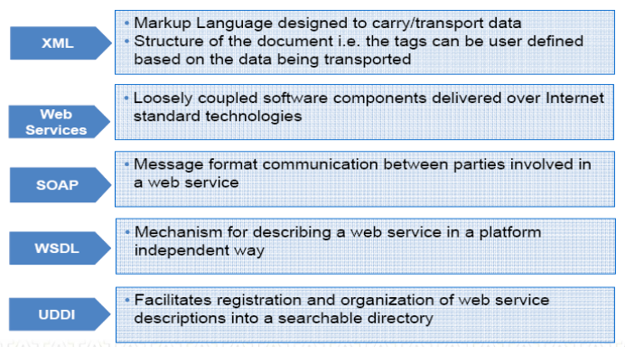
Key Standards of and Technology of SOA

