Slide 1
Software Architecture and Design
03. Architecture View Model

Slide 2
Introduction
A software architecture design must conform to the major functionality and performance requirements of the system, as well as satisfy the non-functional requirements such as reliability, scalability, portability, and availability.
A software architecture must describe its group of components, their connections, interactions among them and deployment configuration of all components.
A software architecture can be defined in many ways
UML (Unified Modeling Language) − UML is one of object-oriented solutions used in software modeling and design.
Architecture View Model (4+1 view model) − Architecture view model represents the functional and non-functional requirements of software application.
ADL (Architecture Description Language) − ADL defines the software architecture formally and semantically.

Slide 3
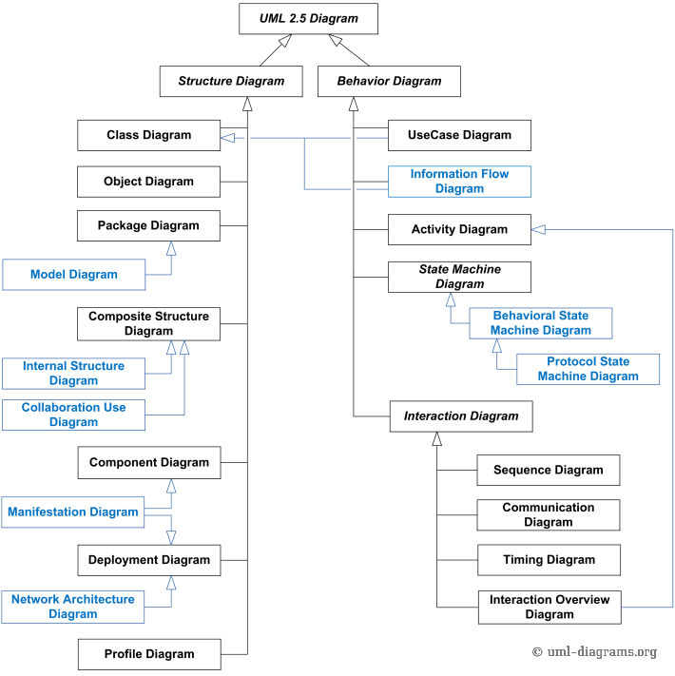
UML 2.5 Diagrams Overview
Note, items in blue are not part of official taxonomy of UML 2.5 diagrams.

Slide 4
UML
Nonproprietary standard for modeling systems
Current Version: UML 2.5
Information at the OMG portal http://www.uml.org/
Commercial tools:
Rational (IBM),Together (Borland), Visual Architect (Visual Paradigm), Enterprise Architect (Sparx Systems)
Open Source tools http://www.sourceforge.net/

Slide 5
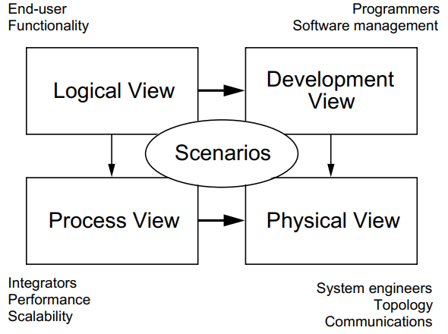
Architecture View Model
4+1 view model

Slide 6
Architecture View Model (cont.)
Logical view:
The logical view is concerned with the functionality that the system provides to end-users.
UML diagrams used to represent the logical view include, class diagrams, and state diagrams.
Process view:
The process view deals with the dynamic aspects of the system, explains the system processes and how they communicate, and focuses on the runtime behavior of the system.
The process view addresses concurrency, distribution, integrators, performance, and scalability, etc. UML diagrams to represent process view include the activity diagram.

Slide 7
Architecture View Model (cont.)
Development view:
The development view illustrates a system from a programmer's perspective and is concerned with software management.
This view is also known as the implementation view.
It uses the UML component diagram to describe system components. UML Diagrams used to represent the development view include the package diagram.
Physical view:
The physical view depicts the system from a system engineer's point of view.
It is concerned with the topology of software components on the physical layer as well as the physical connections between these components.
This view is also known as the deployment view.
UML diagrams used to represent the physical view include the deployment diagram.

Slide 8
Architecture View Model (cont.)
Scenarios:
The description of an architecture is illustrated using a small set of use cases, or scenarios, which become a fifth view.
The scenarios describe sequences of interactions between objects and between processes.
They are used to identify architectural elements and to illustrate and validate the architecture design.
They also serve as a starting point for tests of an architecture prototype. This view is also known as the use case view.

Slide 9
Architecture View Model
Each view is described by a blueprint using its own particular notation.
For each view also, the architects can pick a certain architectural style, hence allowing the coexistence of multiple styles in one system

Slide 10
Scenerios

Slide 11
UML Use Case Diagrams
Used during requirements elicitation and analysis to represent external behavior (“visible from the outside of the system”)
An Actor represents a role, that is, a type of user of the system
A use case represents a class of functionality provided by the system
Use case model:
The set of all use cases that completely describe the functionality of the system.
Passenger
PurchaseTicket

Slide 12
Actors
An actor is a model for an external entity which interacts (communicates) with the system:
User
External system (Another system)
Physical environment (e.g. Weather)
An actor has a unique name and an optional description
Examples:
Passenger: A person in the train
GPS satellite: An external system that provides the system with GPS coordinates.
Passenger
Optional Description
Name

Slide 13
Use Case
A use case represents a class of functionality provided by the system
• Use cases can be described textually, with a focus on the event flow between actor and system
• The textual use case description consists of at least 6 parts:
Unique name
Participating actors
Entry conditions
Exit conditions
Flow of events
Special requirements.
PurchaseTicket

Slide 14
Textual Use Case Description Example
1. Name: Purchase ticket
2. Participating actor: Passenger
3. Entry condition:
Passenger stands in front of ticket distributor
Passenger has sufficient money to purchase ticket
4. Exit condition:
Passenger has ticket
5. Flow of events:
PurchaseTicket
Passenger

Slide 15
Textual Use Case Description Example
5. Flow of events:
1. Passenger selects the number of zones to be traveled
2. Ticket Distributor displays the amount due
3. Passenger inserts money, at least the amount due
2a. Ticket Distributor returns change
2b. Ticket Distributor issues ticket
4. Passenger takes ticket
5. Ticket Distributor ready for next Passenger
6. Special requirements: None.
Passenger
PurchaseTicket

Slide 16
Uses Cases can be related
Extends Relationship
To represent seldom invoked use cases or exceptional functionality - one use case extending another use case by adding that use cases’ events
Includes Relationship
To represent functional behavior common to more than one use case - i.e. create one use case to describe the common behavior, and then include it in all other use cases that may need such behavior

Slide 17
The <<extends>> Relationship
<<extends>> relationships model exceptional or seldom invoked cases
The exceptional event flows are factored out of the main event flow for clarity
The direction of an <<extends>> relationship is to the extended use case
Use cases representing exceptional flows can extend more than one use case.
Passenger
PurchaseTicket
<<extends>>
<<extends>>
<<extends>>
OutOfOrder
<<extends>>
TimeOut
Cancel
NoChange

Slide 18
The <<include>> Relationship
<<include>> relationship represents common functionality needed in more than one use case
<<include>> behavior is factored out for reuse, not because it is an exception
The direction of a <<include>> relationship is to the using use case (unlike the direction of the <<extends>> relationship).
Passenger
PurchaseMultiCard
PurchaseSingleTicket
<<include>>
<<include>>
CollectMoney

Slide 19
Logical view

Slide 20
Class diagram
Class diagram is UML structure diagram which shows structure of the designed system at the level of classes and interfaces, shows their features, constraints and relationships - associations, generalizations, dependencies, etc.
Some common types of class diagrams are:
domain model diagram,
diagram of implementation classes.
Object diagram could be considered as instance level class diagram which shows instance specifications of classes and interfaces (objects), slots with value specifications, and links (instances of association).

Slide 21
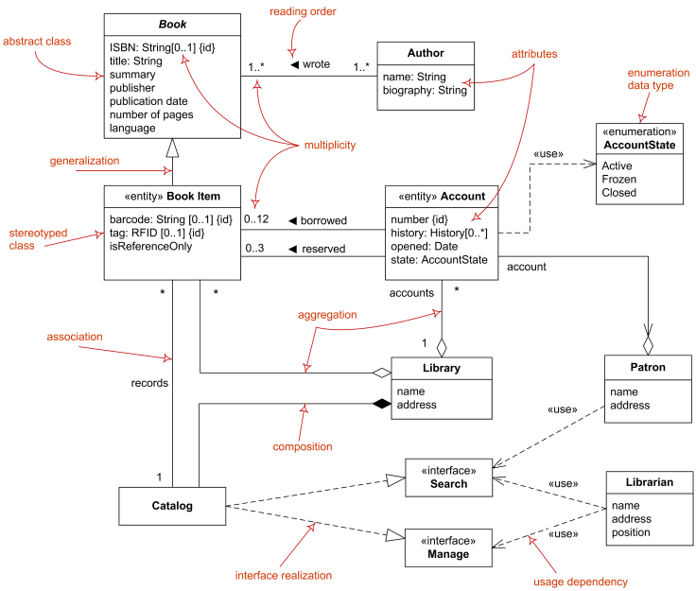
Class diagram (cont.)
Example of Domain Model Diagram
Domain diagram overview - classes, interfaces, associations, usage, realization, multiplicity.

Slide 22
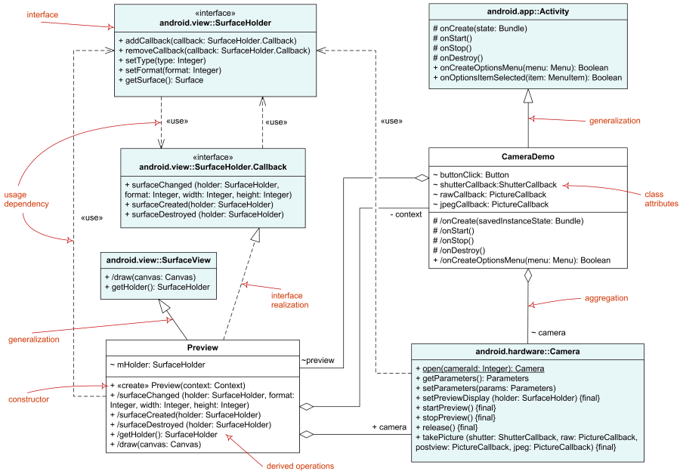
Class diagram (cont.)
Diagram of Implementation Classes
Elements of implementation class diagram - classes, interfaces, associations, usage, realization.

Slide 23
Class diagram (cont.)
Classes: A template for creating objects and implementing behavior in a system. In UML, a class represents an object or a set of objects that share a common structure and behavior. They're represented by a rectangle that includes rows of the class name, its attributes, and its operations.
Name: The first row in a class shape.
Attributes: The second row in a class shape. Each attribute of the class is displayed on a separate line.
Methods: The third row in a class shape. Also known as operations, methods are displayed in list format with each operation on its own line.
Signals: Symbols that represent one-way, asynchronous communications between active objects.

Slide 24
Class diagram (cont.)
Data types: Classifiers that define data values. Data types can model both primitive types and enumerations.
Packages: Shapes designed to organize related classifiers in a diagram. They are symbolized with a large tabbed rectangle shape.
Interfaces: A collection of operation signatures and/or attribute definitions that define a cohesive set of behaviors. Interfaces are similar to classes, except that a class can have an instance of its type, and an interface must have at least one class to implement it.

Slide 25
Class diagram (cont.)
Enumerations: Representations of user-defined data types. An enumeration includes groups of identifiers that represent values of the enumeration.
Objects: Instances of a class or classes. Objects can be added to a class diagram to represent either concrete or prototypical instances.
Artifacts: Model elements that represent the concrete entities in a software system, such as documents, databases, executable files, software components, etc.

Slide 26
Classes
A class represents a concept
A class encapsulates state (attributes) and behavior (operations)
Each attribute has a type
Each operation has a signature
Type
TarifSchedule
Table zone2price
Enumeration getZones()
Price getPrice(Zone)
Name
TarifSchedule
Attributes
Signature
zone2price
getZones()
getPrice()
Operations
TarifSchedule

Slide 27
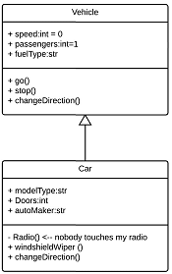
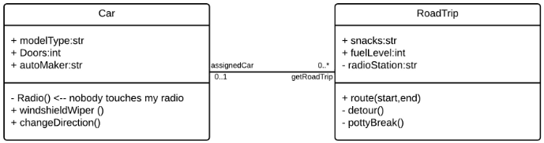
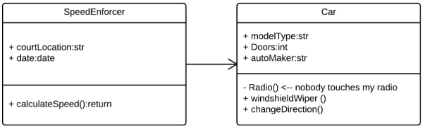
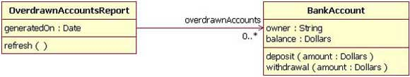
Class diagram (cont.)
Interactions
Inheritance
Bidirectional association
Unidirectional association

Slide 28


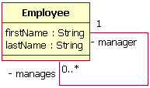
Association
Basic aggregation
Composition aggregation
Reflexive associations

Slide 29
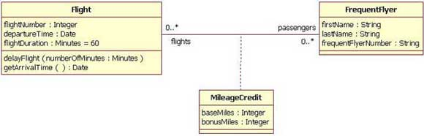
Association class
The association between the Flight class and the FrequentFlyer class results in an association class called MileageCredit.
This means that when an instance of a Flight class is associated with an instance of a FrequentFlyer class, there will also be an instance of a MileageCredit class.

Slide 30
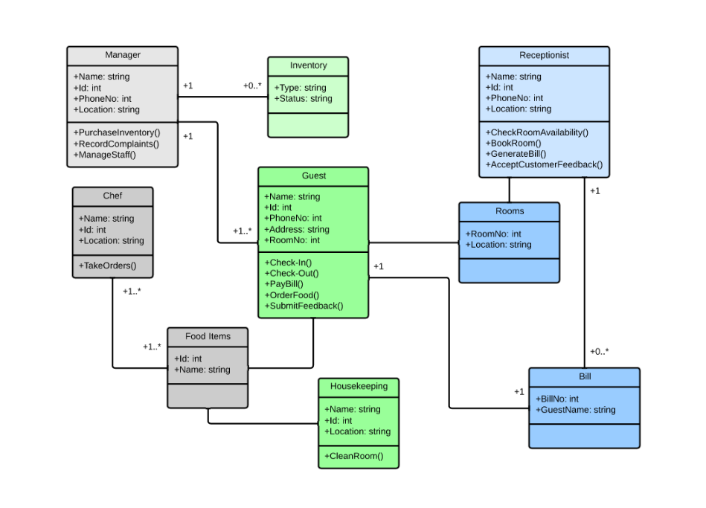
Example
Class diagram for a hotel management system

Slide 31
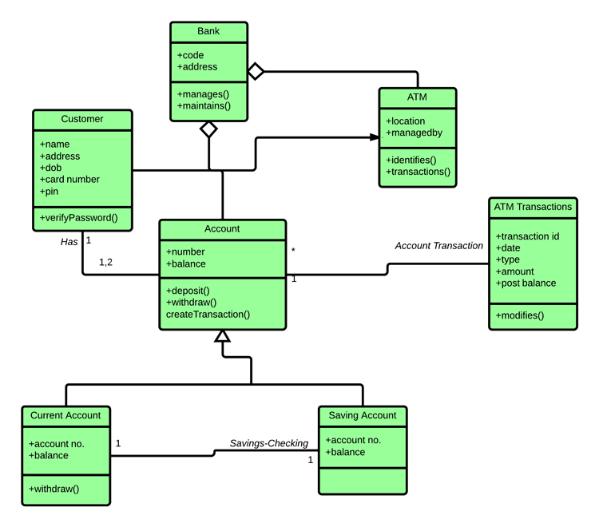
Example (cont.)
Class diagram for an ATM system

Slide 32
Process view

Slide 33
Process view
Activity diagrams, along with use case and state machine diagrams, are considered behavior diagrams because they describe what must happen in the system being modeled.
Benefits of activity diagrams
Activity diagrams present a number of benefits to users. Consider creating an activity diagram to:
Demonstrate the logic of an algorithm.
Describe the steps performed in a UML use case.
Illustrate a business process or workflow between users and the system.
Simplify and improve any process by clarifying complicated use cases.
Model software architecture elements, such as method, function, and operation.

Slide 34
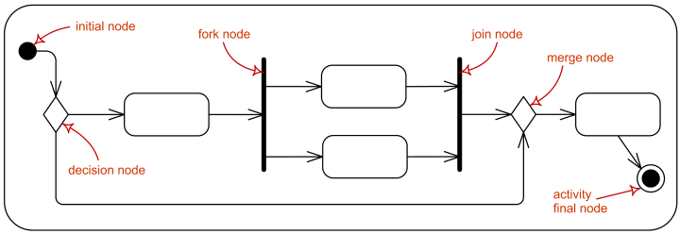
Basic components of an activity diagram
Control node is an activity node used to coordinate the flows between other nodes. It includes:
initial node
flow final node
activity final node
decision node
merge node
fork node
join node

Slide 35
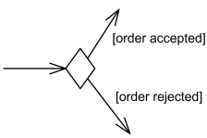
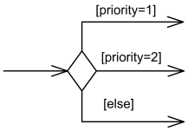
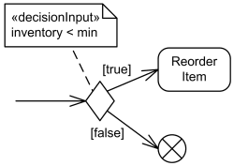
Decision nodes
Decision node with two outgoing edges with guards.
Decision node with three outgoing edges and [else] guard.
Decision node with decision input behavior.

Slide 36
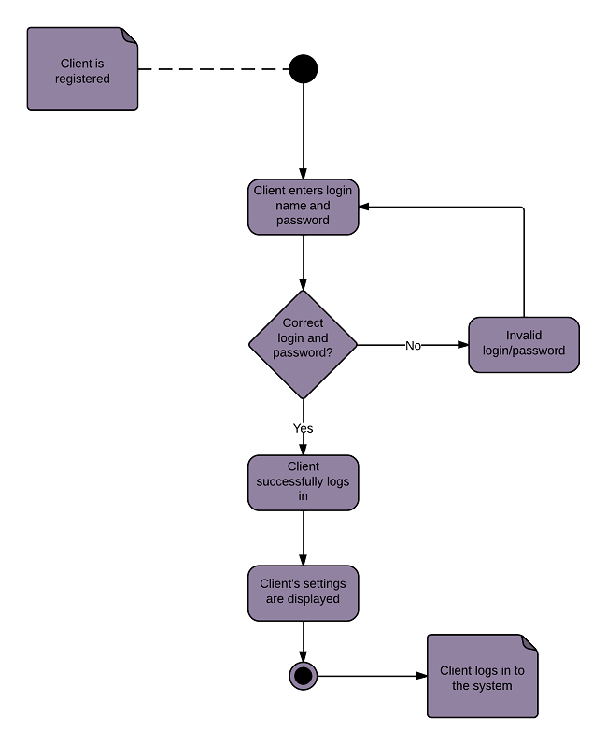
Example
Login activity diagram example

Slide 37
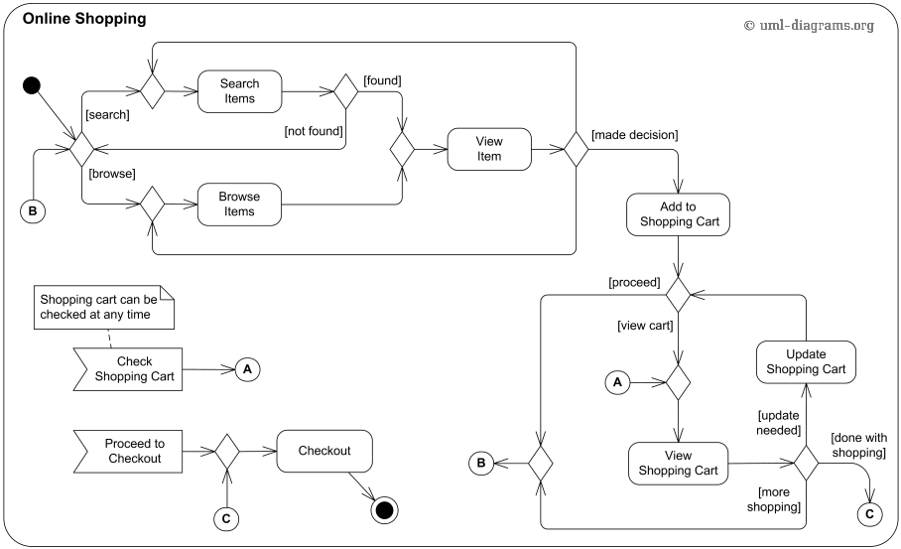
Example (cont.)
An example of UML activity diagram for online shopping

Slide 38
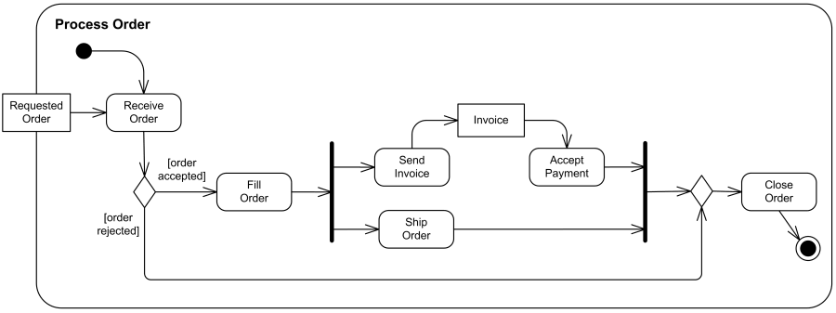
Example (cont.)
An example of business flow activity to process purchase order.

Slide 39
Deployment view

Slide 40
Deployment view
The component diagram's main purpose is to show the structural relationships between the components of a system.
In UML 2, components are considered autonomous, encapsulated units within a system or subsystem that provide one or more interfaces.

Slide 41
UML component diagrams
UML component diagrams describe software components and their dependencies to each others
A component is an autonomous unit within a system
The components can be used to define software systems of arbitrary size and complexity
UML component diagrams enable to model the high-level software components, and the interfaces to those components
Important for component-based development (CBD)
Component and subsystems can be flexibly REUSED and REPLACED
A dependency exists between two elements if changes to the definition of one element may cause changes to the other

Slide 42
UML component diagrams (cont.)
Modular unit with well-defined interfaces that is replaceable within its environment
Autonomous unit within a system
Has one or more provided and required interfaces
Its internals are hidden and inaccessible
A component is encapsulated
Its dependencies are designed such that it can be treated as independently as possible

Slide 43

Deployment view (cont.)
A component is shown as a rectangle with
A keyword <<component>>
Optionally, in the right hand corner a component icon can be displayed
A component icon is a rectangle with two smaller rectangles jutting out from the left-hand side
This symbol is a visual stereotype
The component name
Components can be labelled with a stereotype
there are a number of standard stereotypes ex: <<entity>>, <<subsystem>>
The different ways to draw a component's name compartment

Slide 44
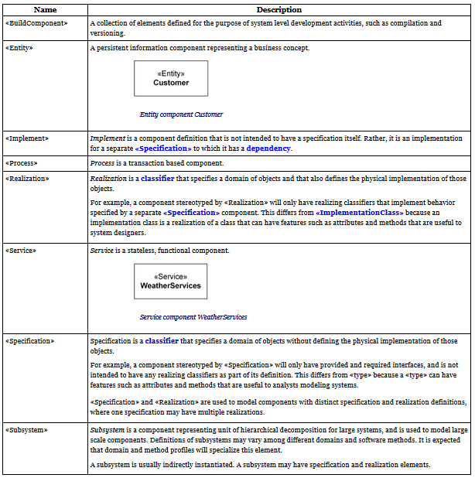
Deployment view (cont.)
Standard UML component stereotypes

Slide 45
Deployment view (cont.)
A component can have
Interfaces
An interface represents a declaration of a set of operations and obligations
Usage dependencies
A usage dependency is relationship which one element requires another element for its full implementation
Ports
Port represents an interaction point between a component and its environment
Connectors
Connect two components
Connect the external contract of a component to the internal structure

Slide 46
Interface
A component defines its behaviour in terms of provided and required interfaces
An interface
Is the definition of a collection of one or more operations
Provides only the operations but not the implementation
Implementation is normally provided by a class/ component
In complex systems, the physical implementation is provided by a group of classes rather than a single class

Slide 47
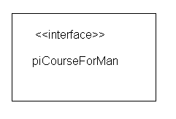
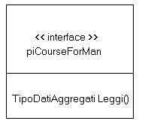
Interface (cont.)
May be shown using a rectangle symbol with a keyword <<interface>> preceding the name
For displaying the full signature, the interface rectangle can be expanded to show details
Can be
Provided
Required

Slide 48
Interface (cont.)
A provided interface
Characterize services that the component offers to its environment
Is modeled using a ball, labelled with the name, attached by a solid line to the component
A required interface
Characterize services that the component expects from its environment
Is modeled using a socket, labelled with the name, attached by a solid line to the component
In UML 1.x were modeled using a dashed arrow

Slide 49


Interface (cont.)
Where two components/classes provide and require the same interface, these two notations may be combined
The ball-and-socket notation hint at that interface in question serves to mediate interactions between the two components
If an interface is shown using the rectangle symbol, we can use an alternative notation, using dependency arrows

Slide 50
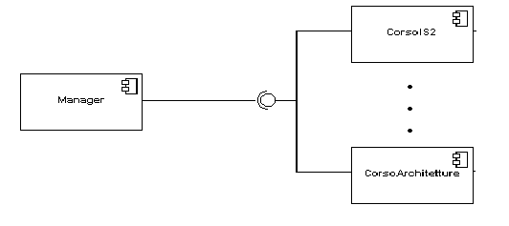
Interface (cont.)
In a system context where there are multiple components that require or provide a particular interface, a notation abstraction can be used that combines by joining the interfaces
A component
Specifies a CONTRACT of the services that it provides to its clients and that it requires from others components in terms of its provided and required interfaces
Can be replaced
The system can be extended

Slide 51

Dependencies
Components can be connected by usage dependencies
Usage Dependency
A usage dependency is relationship which one element requires another element for its full implementation
Is a dependency in which the client requires the presence of the supplier
Is shown as dashed arrow with a <<use>> keyword
The arrowhead point from the dependent component to the one of which it is dependent

Slide 52
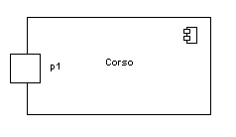
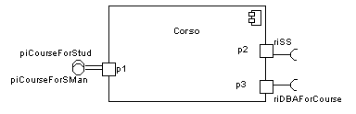
Port
Specifies a distinct interaction point
Between that component and its environment
Between that component and its internal parts
Is shown as a small square symbol
Ports can be named, and the name is placed near the square symbol
Is associated with the interfaces that specify the nature of the interactions that may occur over a port

Slide 53

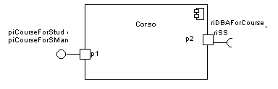
Port (cont.)
Ports can support unidirectional communication or bi-directional communication
If there are multiple interfaces associated with a port, these interfaces may be listed with the interface icon, separated by a commas

Slide 54
Port (cont.)
All interactions of a component with its environment are achieved through a port
The internals are fully isolated from the environment
This allows such a component to be used in any context that satisfies the constraints specified by its ports
Ports are not defined in UML 1.x

Slide 55

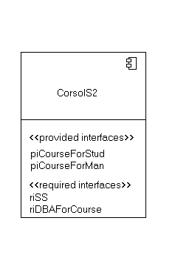
External view
A component have an external view and an internal view
An external view (or black box view) shows publicly visible properties and operations
An external view of a component is by means of interface symbols sticking out of the component box
The interface can be listed in the compartment of a component box

Slide 56
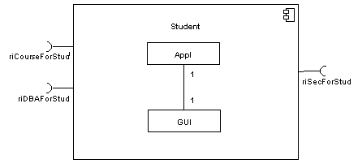
Internal view
An internal, or white box view of a component is where the realizing classes/components are nested within the component shape
Realization is a relationship between two set of model elements
One represents a specification
The other represent an implementation of the latter

Slide 57
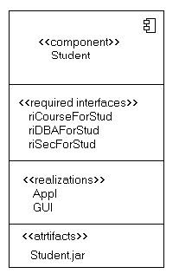
Internal view (cont.)
The internal class that realize the behavior of a component may be displayed in an additional compartment
Compartments can also be used to display parts, connectors or implementation artifacts
An artifact is the specification of a phisycal piece of information

Slide 58
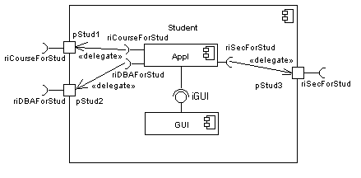
Internal view (cont.)
Components can be built recursively

Slide 59

Assembly
Two kinds of connectors:
Delegation
Assembly
Assembly connector
A connector between 2 components defines that one component provides the services that another component requires
He must only be defined from a required interface to a provided interface
An assembly connector is notated by a “ball-and-socket” connection
This notation allows for succint graficalwiring of components

Slide 60
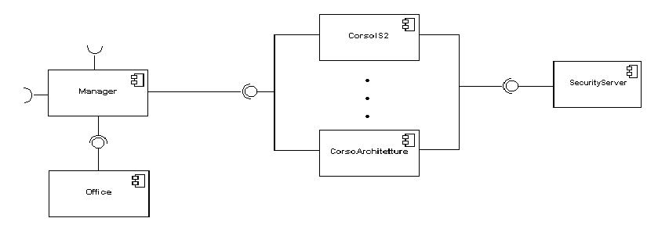
Semantics
The semantics for an assembly connector :
Are that signals travel along an instance of a connector originating in a required port and delivered to a provided port
The interfaces provided and required must be compatible
The interface compatibility between provided and required ports that are connected enables an existing component in a system to be replaced

Slide 61
Delegation connector
Links the external contract of a component to the internal realization
Represents the forwarding of signals
He must only be defined between used interfaces or ports of the same kind

Slide 62
Deployment view (cont.)
The target interface must support a signature compatible with a subset of operations of the source interface
A port may delegate to a set of ports on subordinate components
The union of the target interfaces must be signature compatible with the source interface
Semantics:
Is a declaration that behaviour that is available on a component instance is not realized by that component itself, but by another instance that has compatible capabilities
Is used to model the hierarchical decomposition
Message and signal flow will occur between the connected ports
Notes:
UML 2.0 Superstructure Specification
August 2, 2003
UML 2 Superstructure Final Adopted Specification
www.omg.org/cgi-bin/doc?ptc/2003-08-02
The Diagrams of UML 2.0
by Scott W. Ambler, 2003-2004
www.agilemodeling.com/essays/umlDiagrams.htm
UML overview
By Mandar Chitnis, Pravin Tiwari, & Lakshmi Ananthamurthy
http://www.developer.com/design/article.php/1553851

Slide 63
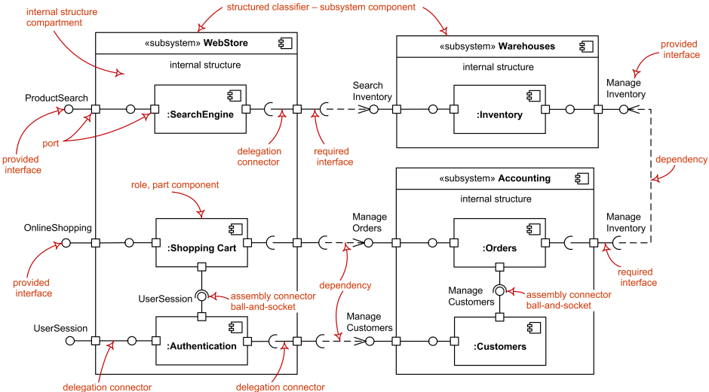
Deployment view (cont.)
The major elements of UML component diagram - component, provided interface, required interface, port, connectors.

Slide 64
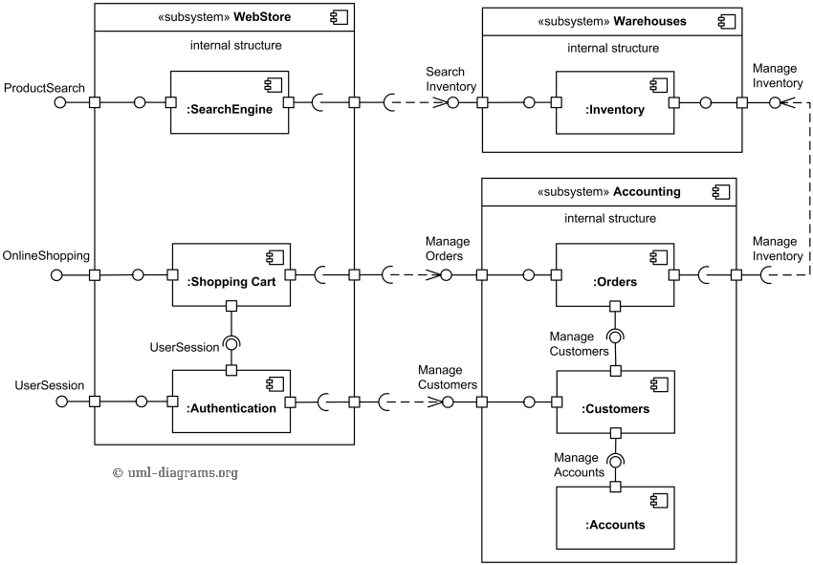
Deployment view (cont.)
An example of UML 2.5 component diagram for online shopping. The diagram shows "white-box" view of the internal structure of three related subsystems - WebStore, Warehouses, and Accounting.
In UML «subsystem» is a standard component stereotype for larger components, usually containing some smaller components.
Notes:
https://www.uml-diagrams.org/examples/online-shopping-uml-component-diagram-example.html?context=cmp-examples

Slide 65
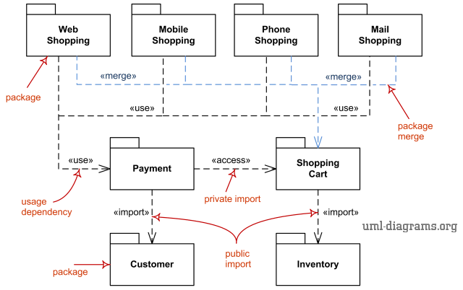
Deployment view (cont.)
Package Diagram
Some major elements of the package diagram are shown on the drawing below. Web Shopping, Mobile Shopping, Phone Shopping, and Mail Shopping packages merge Shopping Cart package.
The same 4 packages use Payment package. Both Payment and Shopping Cart packages import other packages.

Slide 66
Physical view

Slide 67
Physical view
The deployment diagram describes the physical deployment of information generated by the software program on hardware components.
You can use deployment diagram to:
Show which software elements are deployed by which hardware elements.
Illustrate the runtime processing for hardware.
Provide a view of the hardware system’s topology.

Slide 68
Deployment diagram elements (cont.)
Artifact: A product developed by the software, symbolized by a rectangle with the name and the word “artifact” enclosed by double arrows.
Association: A line that indicates a message or other type of communication between nodes.
Component: A rectangle with two tabs that indicates a software element.
Dependency: A dashed line that ends in an arrow, which indicates that one node or component is dependent on another.
Interface: A circle that indicates a contractual relationship. Those objects that realize the interface must complete some sort of obligation.

Slide 69
Deployment diagram elements (cont.)
Node: A hardware or software object, shown by a three-dimensional box.
Node as container: A node that contains another node inside of it—such as in the example below, where the nodes contain components.
Stereotype: A device contained within the node, presented at the top of the node, with the name bracketed by double arrows.

Slide 70
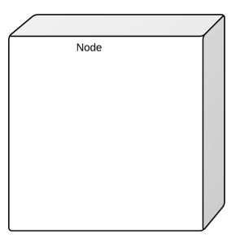
Physical view (cont.)
Nodes
There are two types of nodes in a deployment diagram: device nodes and execution environment nodes.
Device nodes are computing resources with processing capabilities and the ability to execute programs. Some examples of device nodes include PCs, laptops, and mobile phones.
An execution environment node is any computer system that resides within a device node. It could be an operating system, a JVM, or another servlet container.

Slide 71
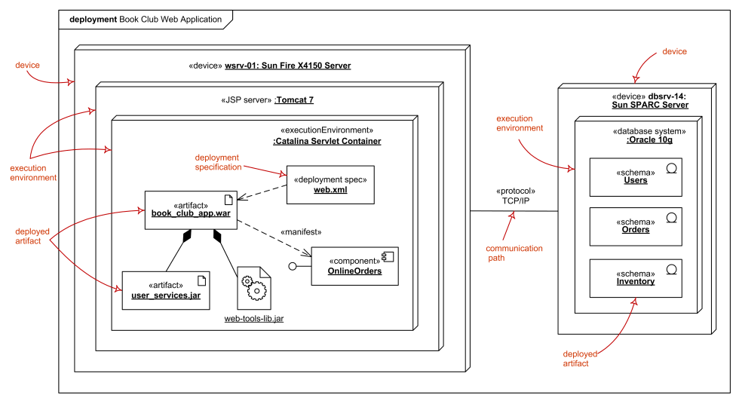
Deployment diagram - Examples

Slide 72
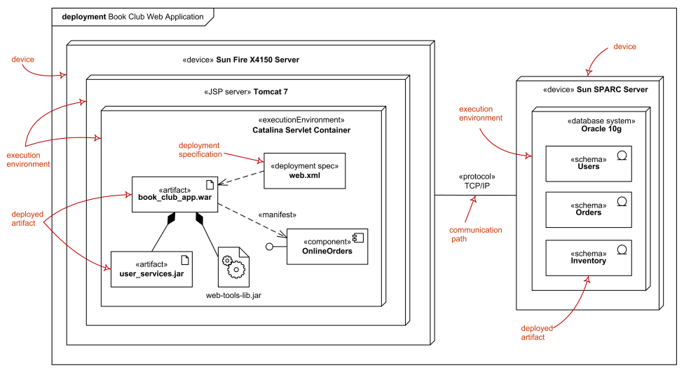
Physical view (cont.)
Specification level deployment diagram - Web application deployed to Tomcat JSP server and database schemas - to database system.
Online shopping Web application UML deployment diagram

Slide 73
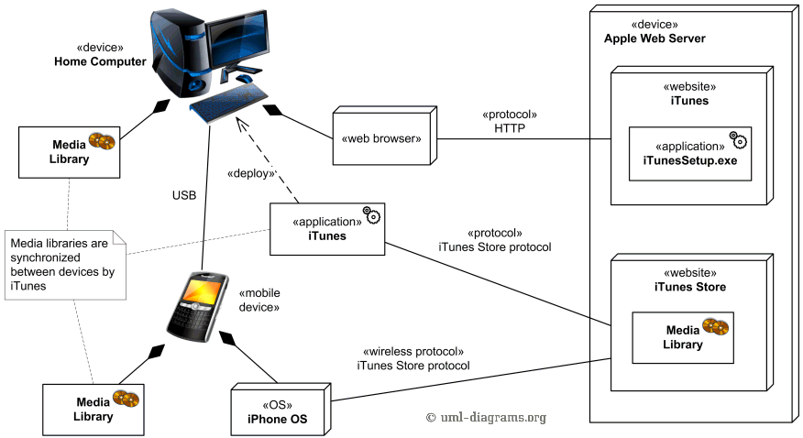
Example - Deployment diagram
An example of UML deployment diagram for Apple iTunes
Notes:
https://www.uml-diagrams.org/apple-itunes-uml-deployment-diagram-example.html

Slide 74
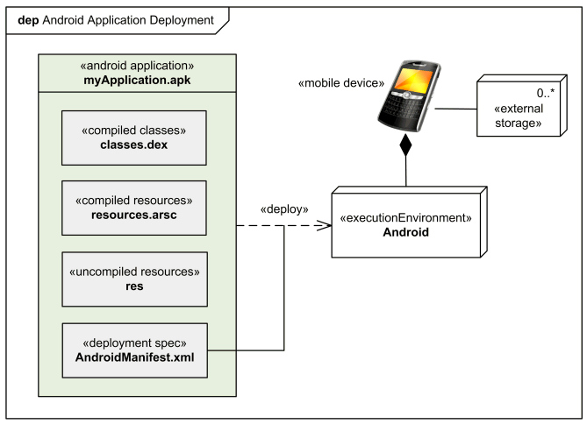
Example - Deployment diagram (cont.)
Android applications are written in Java.
Android SDK tools compile and package the code along with any required data and resource files into Android application archive file having .apk suffix.
The .apk file represents one Android application to be deployed to the Android-enabled mobile devices.

