Slide 1
Software Architecture and Design
04. Implementation for Architectural Styles

Slide 2
Content
Message Oriented Architecture
Point-2-Point.
Publish-Subcrible
Java EE Specifications
JavaEE
.NET Framework
Windows Communication Foundation
Services Oriented Architecture
SOAP
REST
Microframework (Node.js, Spark)

Slide 3
Implementation
Message Oriented Architecture

Slide 4
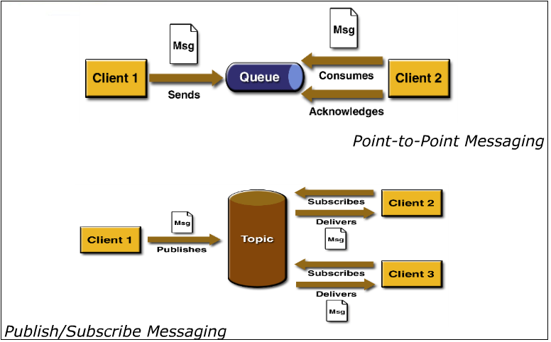

Slide 5
JMS Architecture
Main components of JMS are:
JMS Provider: A messaging system that implements the JMS interfaces and provides administrative and control features
Clients: Java applications that send or receive JMS messages. A message sender is called the Producer, and the recipient is called a Consumer
Messages: Objects that communicate information between JMS clients
Administered objects: Preconfigured JMS objects created by an administrator for the use of clients.

Slide 6
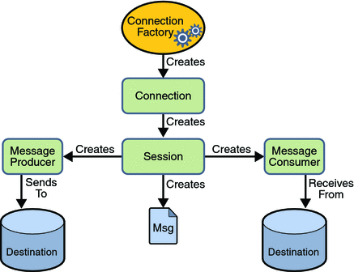
JMS Architecture (cont.)

Slide 7

Point to point messaging model
Producer sends the message to a specified queue within JMS provider and the only one of the consumers who listening to that queue receives that message.

Slide 8
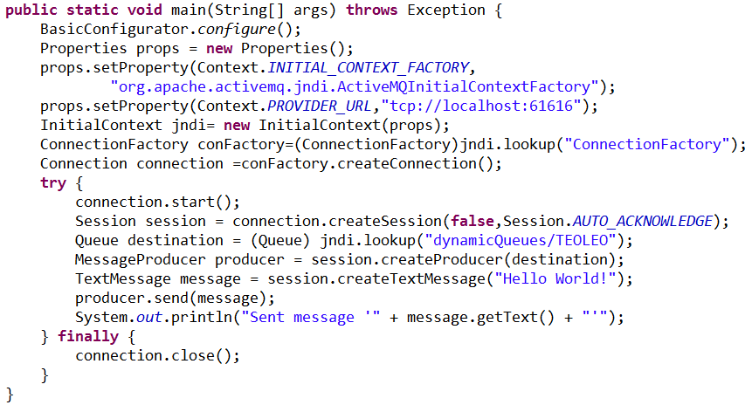
Queue sender with Java

Slide 9
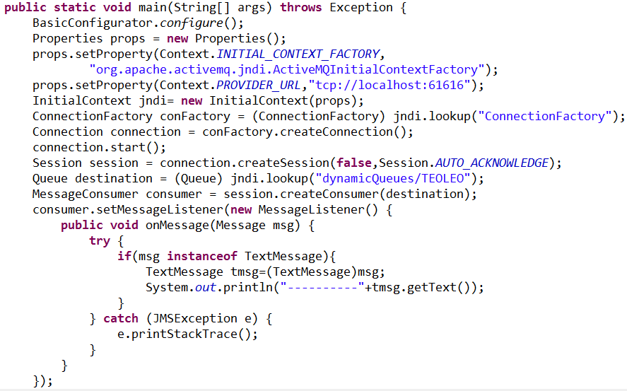
Queue receiver with Java

Slide 10
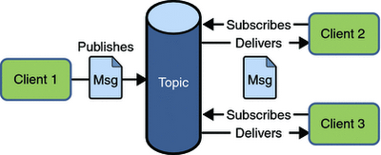
Publisher Subscriber Model
Publisher publishes the message to a specified topic within JMS provider and all the subscribers who subscribed for that topic receive the message.
Note that only the active subscribers receive the message.

Slide 11
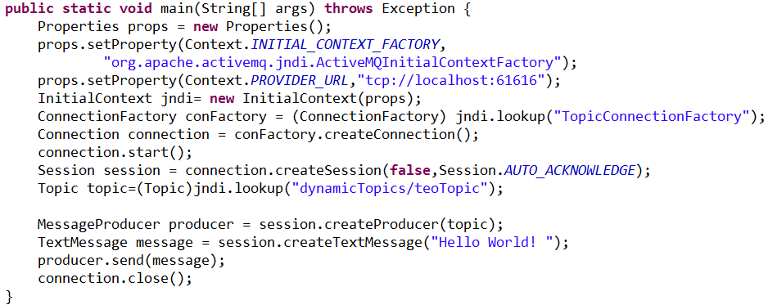
Publisher Subscriber Sender with Java

Slide 12
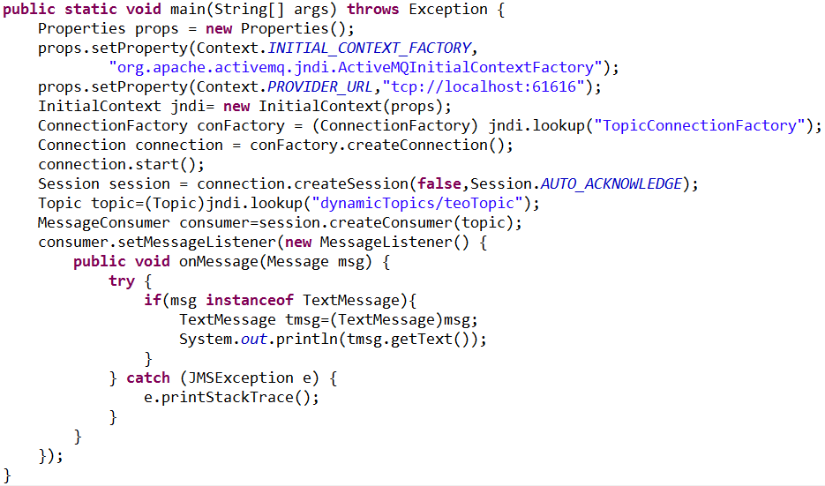
Publisher Subscriber Receiver with asynchronous Java

