Slide 1
Software Architecture and Design
05. Software Design Patterns

Slide 2
What is a software design pattern?
A software design pattern is a reusable solution to a reoccurring design problem.
The purpose of the design process is to determine how the eventual code will be structured or organized into modules.
The output of the design process is an abstract solution model typically expressed using a symbolic modeling language such as UML.

Slide 3
Design patterns as problem
Conceptually, a design pattern provides a mapping from a specific design problem to a generic solution
Knowledge of design patterns simplifies software design by reducing the number of design problems that have to be solved from first principles.
Design problems that match documented design patterns, have ready-made solutions.
The remaining problems that don't match documented design patterns must be solved from first principles.

Slide 4
Design Pattern Catalog
Design Patterns are generally broken into three groups:
Creational Patterns deal with object creation at run-time
Structural Patterns deal with the composition of objects and classes
Behavioral Patterns deal with the way in which classes or objects interact and distribute responsibility

Slide 5
Design Pattern Catalog (cont.)
Creational Patterns
Abstract Factory
Builder
Factory Method
Prototype
Singleton
Behavioral Patterns
Chain of Responsibility
Command
Interpreter
Iterator
Mediator
Memento
Multiple Dispatch
Observer
State
Strategy
Template Method
Visitor
Structural Patterns
Adapter
Bridge
Composite
Container
Decorator
Façade
Flyweight
Proxy

Slide 6
Creational design patterns
These design patterns are all about class instantiation. This pattern can be further divided into class-creation patterns and object-creational patterns.
While class-creation patterns use inheritance effectively in the instantiation process, object-creation patterns use delegation effectively to get the job done.

Slide 7
Creational design patterns (cont.)
Abstract Factory
Creates an instance of several families of classes
Builder
Separates object construction from its representation
Factory Method
Creates an instance of several derived classes
Object Pool
Avoid expensive acquisition and release of resources by recycling objects that are no longer in use
Prototype
A fully initialized instance to be copied or cloned
Singleton
A class of which only a single instance can exist

Slide 8
Creational design patterns (cont.)
Singleton Design Pattern
Problem
Application needs one, and only one, instance of an object. Additionally, lazy initialization and global access are necessary.
Intent
Ensure a class has only one instance, and provide a global point of access to it.
Encapsulated “just-in-time initialization” or "initialization on first use".

Slide 9
Creational design patterns (cont.)
Singleton Design Pattern (cont.)
Singleton should be considered only if all three of the following criteria are satisfied:
Ownership of the single instance cannot be reasonably assigned
Lazy initialization is desirable
Global access is not otherwise provided for

Slide 10
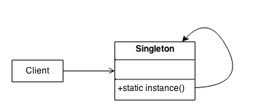
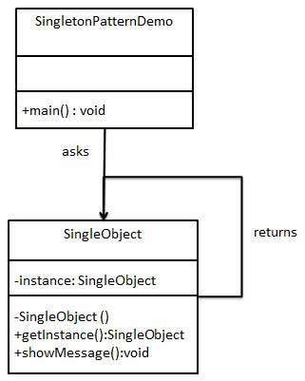
Creational design patterns (cont.)
Singleton Design Pattern (cont.)
Structure

Slide 11
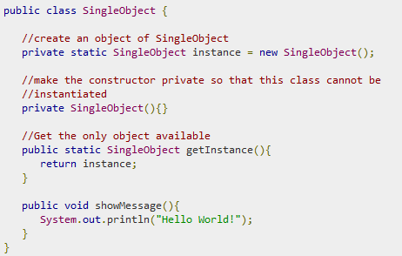
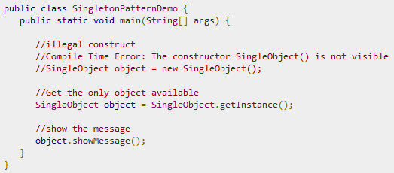
Creational design patterns (cont.)
Singleton Design Pattern (cont.)

Slide 12
Creational design patterns (cont.)
Prototype Design Pattern
Problem
Application “hard wires” the class of object to create in each “new” expression.
Intent
Specify the kinds of objects to create using a prototypical instance, and create new objects by copying this prototype.
Co-opt one instance of a class for use as a breeder of all future instances.
The new operator considered harmful.

Slide 13
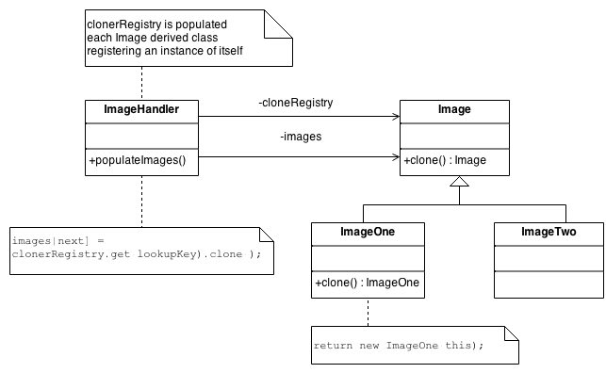
Creational design patterns (cont.)
Prototype Design Pattern (cont.)
Struture
The Factory knows how to find the correct Prototype, and each Product knows how to spawn new instances of itself.

Slide 14
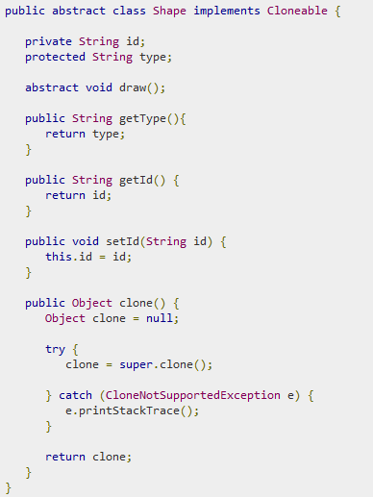
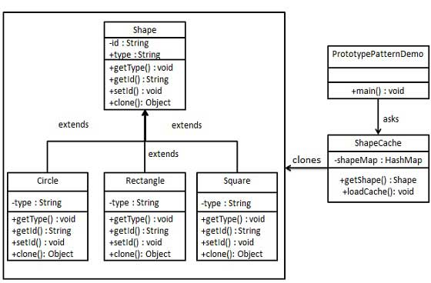
Creational design patterns (cont.)
Prototype Design Pattern (cont.)
1

Slide 15
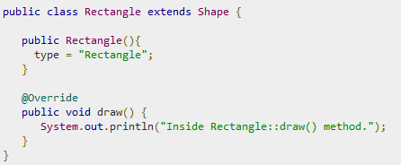
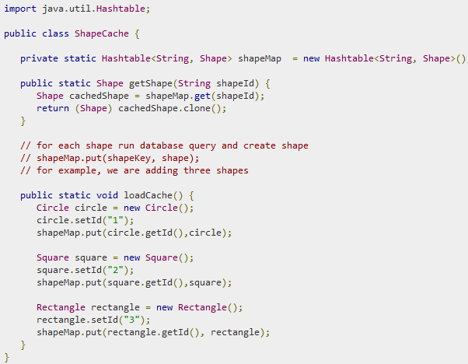
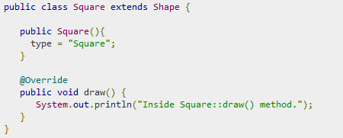
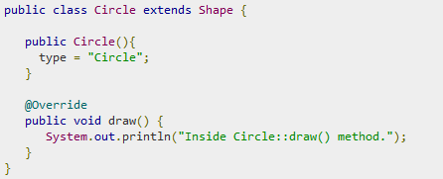
Creational design patterns (cont.)
Prototype Design Pattern (cont.)
Create a class to get concrete classes from database and store them in a Hashtable.
2
3

Slide 16
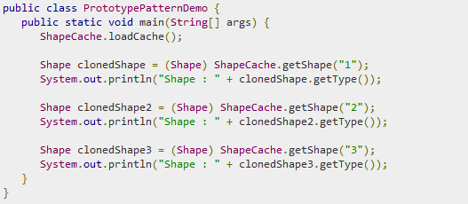
Creational design patterns (cont.)
Prototype Design Pattern (cont.)
PrototypePatternDemo uses ShapeCache class to get clones of shapes stored in a Hashtable.
4

Slide 17
Creational design patterns (cont.)
Factory Method Pattern
A framework needs to standardize the architectural model for a range of applications, but allow for individual applications to define their own domain objects and provide for their instantiation.
Intent
Define an interface for creating an object, but let subclasses decide which class to instantiate. Factory Method lets a class defer instantiation to subclasses.
Defining a “virtual” constructor.
The new operator considered harmful.

Slide 18
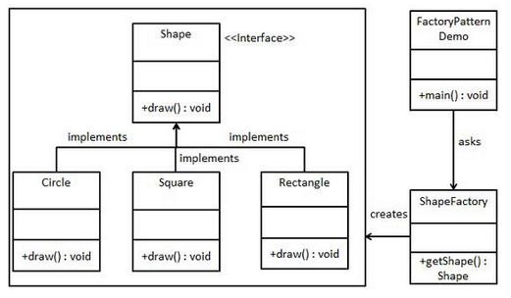
Creational design patterns (cont.)
Factory Method Pattern (cont.)
Implementation

Slide 19

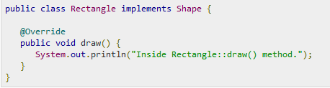
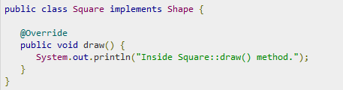
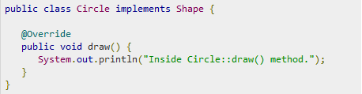
Creational design patterns (cont.)
Factory Method Pattern (cont.)
Create an interface for Shapes.
Create concrete classes implementing the same interface.
1
2

Slide 20
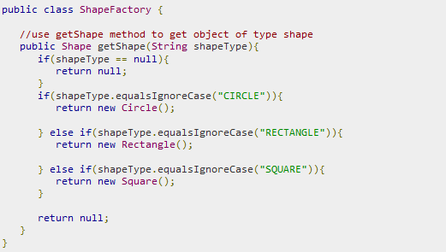
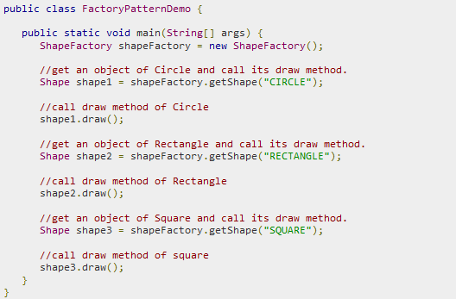
Creational design patterns (cont.)
Factory Method Pattern (cont.)
Create a Factory to generate object of concrete class based on given information.
3
4
Use the Factory to get object of concrete class by passing an information such as type.

Slide 21
Creational design patterns (cont.)
Abstract Factory Design Pattern
If an application is to be portable, it needs to encapsulate platform dependencies. These “platforms” might include: windowing system, operating system, database, etc. Too often, this encapsulation is not engineered in advance, and lots of #ifdef case statements with options for all currently supported platforms begin to procreate like rabbits throughout the code.
Intent
Provide an interface for creating families of related or dependent objects without specifying their concrete classes.
A hierarchy that encapsulates: many possible “platforms”, and the construction of a suite of “products”.
The new operator considered harmful.

Slide 22
Creational design patterns (cont.)
Abstract Factory Design Pattern (cont.)
Structure
The Abstract Factory defines a Factory Method per product.
Each Factory Method encapsulates the new operator and the concrete, platform-specific, product classes.
Each “platform” is then modeled with a Factory derived class.

Slide 23
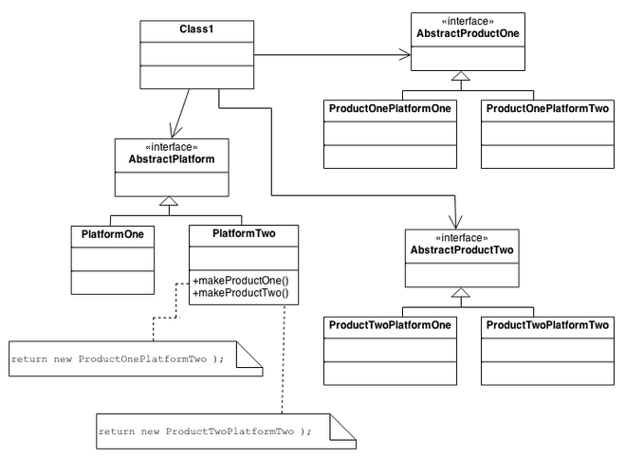
Creational design patterns (cont.)
Abstract Factory Design Pattern (cont.)
Structure (cont.)

Slide 24
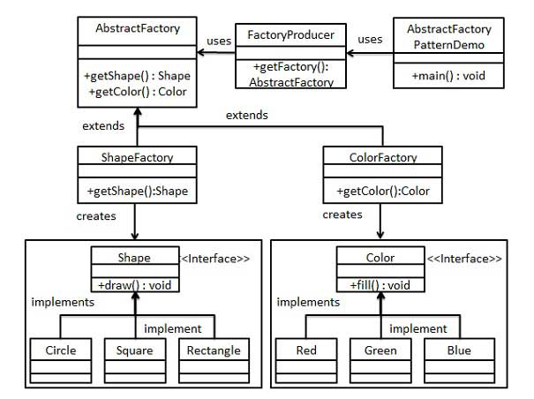
Creational design patterns (cont.)
Abstract Factory Design Pattern (cont.)

Slide 25

Creational design patterns (cont.)
Abstract Factory Design Pattern (cont.)
Create an interface for Shapes.
Create concrete classes implementing the same interface.
Create an interface for Colors.
1
2
3

Slide 26
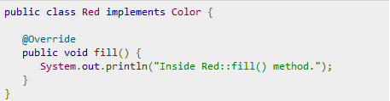
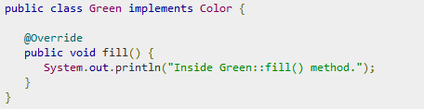
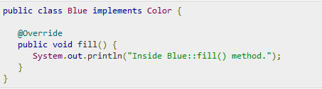

Creational design patterns (cont.)
Abstract Factory Design Pattern (cont.)
Create concrete classes implementing the same interface.
Create an Abstract class to get factories for Color and Shape Objects.
4
5

Slide 27
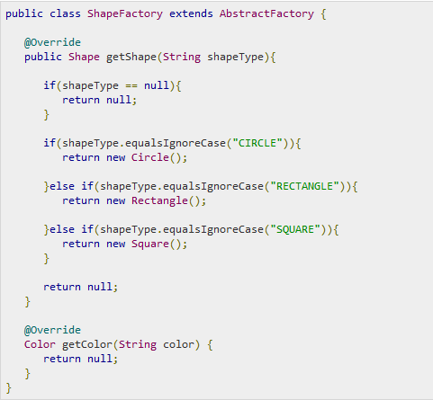
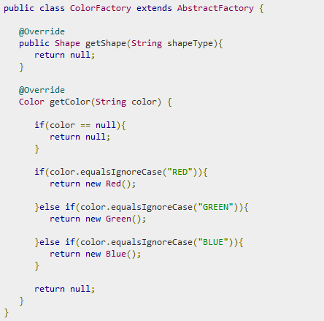
Creational design patterns (cont.)
Abstract Factory Design Pattern (cont.)
6

Slide 28
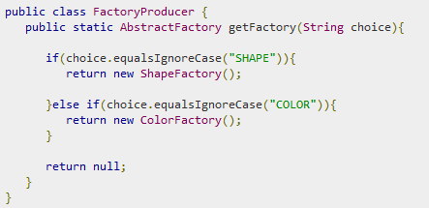
Creational design patterns (cont.)
Abstract Factory Design Pattern (cont.)
Create a Factory generator/producer class to get factories by passing an information such as Shape or Color
7

Slide 29
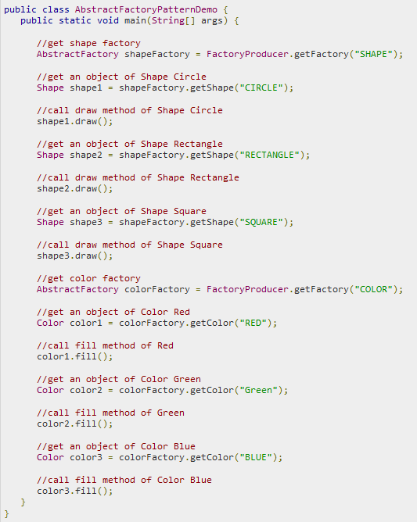
Creational design patterns (cont.)
Abstract Factory Design Pattern (cont.)
8

Slide 30
Structural patterns
In Software Engineering, Structural Design Patterns are Design Patterns that ease the design by identifying a simple way to realize relationships between entities.
Adapter - Match interfaces of different classes
Bridge - Separates an object’s interface from its implementation
Composite - A tree structure of simple and composite objects
Decorator - Add responsibilities to objects dynamically
Façade - A single class that represents an entire subsystem
Flyweight - A fine-grained instance used for efficient sharing
Private Class Data - Restricts accessor/mutator access
Proxy - An object representing another object

Slide 31
Structural patterns (cont.)
Adapter Pattern
Adapter pattern works as a bridge between two incompatible interfaces. This type of design pattern comes under structural pattern as this pattern combines the capability of two independent interfaces.
This pattern involves a single class which is responsible to join functionalities of independent or incompatible interfaces. A real life example could be a case of card reader which acts as an adapter between memory card and a laptop. You plugin the memory card into card reader and card reader into the laptop so that memory card can be read via laptop.

Slide 32
Structural patterns (cont.)
Adapter Pattern (cont.)
Intent
Convert the interface of a class into another interface clients expect. Adapter lets classes work together that couldn’t otherwise because of incompatible interfaces.
Wrap an existing class with a new interface.
Impedance match an old component to a new system

Slide 33
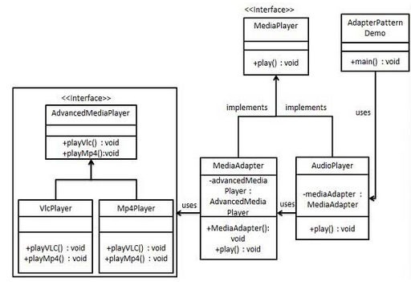
Structural patterns (cont.)
Adapter Pattern (cont.)
Create interfaces for Media Player and Advanced Media Player.
1

Slide 34
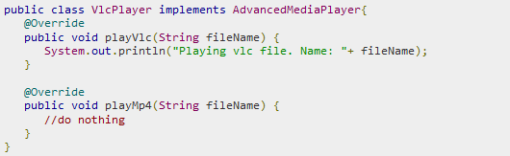
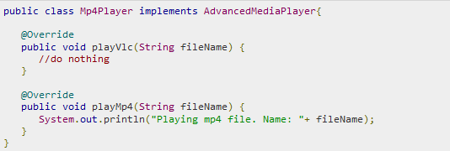
Structural patterns (cont.)
Adapter Pattern (cont.)
Create concrete classes implementing the AdvancedMediaPlayer interface.
2

Slide 35
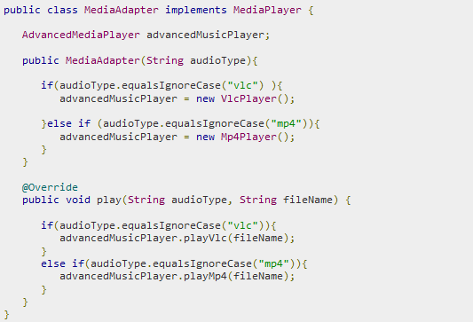
Structural patterns (cont.)
Adapter Pattern (cont.)
Create adapter class implementing the MediaPlayer interface.
3

Slide 36
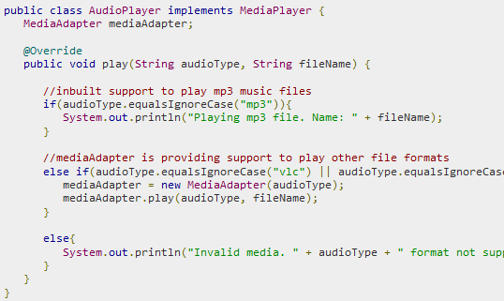
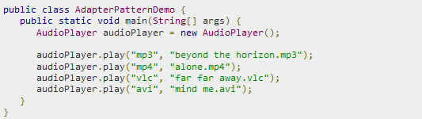
Structural patterns (cont.)
Adapter Pattern (cont.)
Create concrete class implementing the MediaPlayer interface.
Use the AudioPlayer to play
different types of audio formats.
4
5

Slide 37
Structural patterns (cont.)
Bridge Pattern
Bridge is used when we need to decouple an abstraction from its implementation so that the two can vary independently.
This type of design pattern comes under structural pattern as this pattern decouples implementation class and abstract class by providing a bridge structure between them.
This pattern involves an interface which acts as a bridge which makes the functionality of concrete classes independent from interface implementer classes. Both types of classes can be altered structurally without affecting each other.

Slide 38
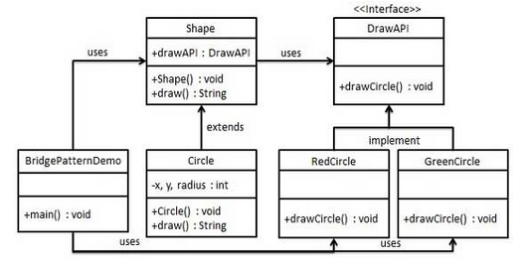
Structural patterns (cont.)
Bridge Pattern (cont.)

Slide 39


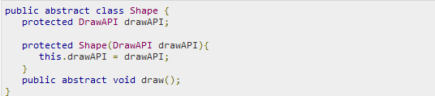
Structural patterns (cont.)
Bridge Pattern (cont.)
Create bridge implementer interface.
Create concrete bridge implementer classes implementing the DrawAPI interface.
Create an abstract class Shape using the DrawAPI interface.
1
2
3

Slide 40
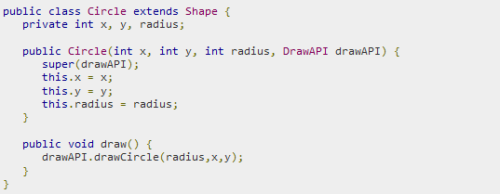
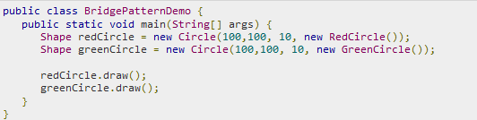
Structural patterns (cont.)
Bridge Pattern (cont.)
Create concrete class implementing the Shape interface.
Use the Shape and DrawAPI classes to draw different colored circles.
4
5

Slide 41
Structural patterns (cont.)
Composite Pattern
Intent
Compose objects into tree structures to represent whole-part hierarchies. Composite lets clients treat individual objects and compositions of objects uniformly.
Recursive composition
“Directories contain entries, each of which could be a directory.”
1-to-many “has a” up the “is a” hierarchy
Problem
You want to build more complex components out of simpler components, combining them together at run-time to create complex objects
However, you don’t want to treat the objects and their containers differently; manipulation should be uniform across all related objects

Slide 42
Structural patterns (cont.)
Composite Pattern (cont.)
Participants
Component
Declares the interface for objects in the composition
Implements default behavior for the interface common to all classes, as appropriate
Leaf
Represents leaf objects in the composition
Defines primitives in the system
Composite
Defines behavior for components having children
Stores children components

Slide 43
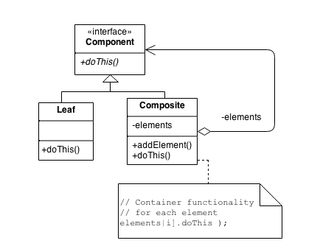
Structural patterns (cont.)
Composite Pattern (cont.)

Slide 44
Structural patterns (cont.)
Composite Pattern (cont.) - Check list
Ensure that your problem is about representing “whole-part” hierarchical relationships.
Divide your domain concepts into container classes, and containee classes.
Create a “lowest common denominator” interface that makes your containers and containees interchangeable. It should specify the behavior that needs to be exercised uniformly across all containee and container objects.
All container and containee classes declare an “is a” relationship to the interface. All container classes declare a one-to-many “has a” relationship to the interface.
Container classes leverage polymorphism to delegate to their containee objects.
Child management methods should normally be defined in the Composite class.

Slide 45
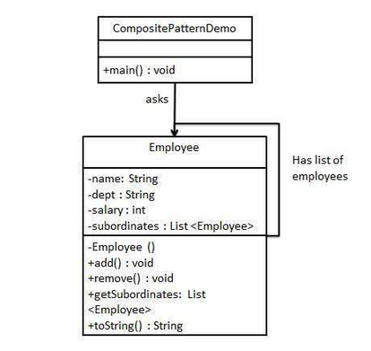
Structural patterns (cont.)
Composite Pattern (cont.) - Example
We have a class Employee which acts as composite pattern actor class. CompositePatternDemo, our demo class will use Employee class to add department level hierarchy and print all employees.

Slide 46
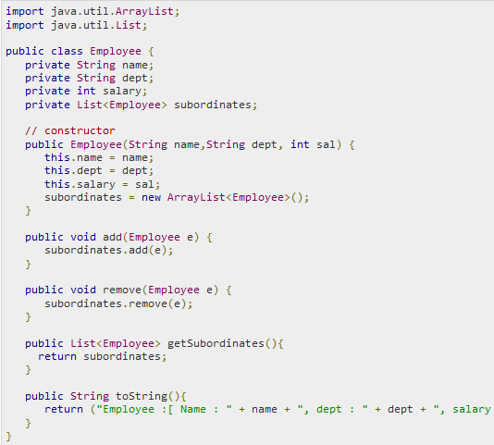
Structural patterns (cont.)
Composite Pattern (cont.)
Create Employee class having list of Employee objects.
1

Slide 47
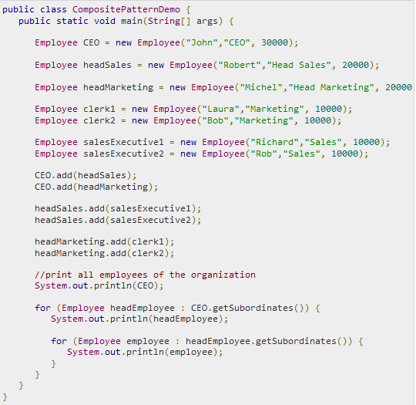
Structural patterns (cont.)
Composite Pattern (cont.)
Use the Employee class to create and print employee hierarchy.
2

Slide 48
Structural patterns (cont.)
Decorator Pattern
You want to add behavior or state to individual objects at run-time. Inheritance is not feasible because it is static and applies to an entire class.
Intent
Attach additional responsibilities to an object dynamically. Decorators provide a flexible alternative to subclassing for extending functionality.
Client-specified embellishment of a core object by recursively wrapping it.
Wrapping a gift, putting it in a box, and wrapping the box.

Slide 49
Structural patterns (cont.)
Decorator Pattern (cont.)
Decorator pattern allows a user to add new functionality to an existing object without altering its structure. This type of design pattern comes under structural pattern as this pattern acts as a wrapper to existing class.
This pattern creates a decorator class which wraps the original class and provides additional functionality keeping class methods signature intact.

Slide 50
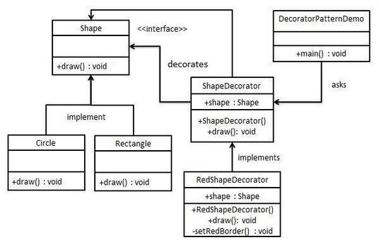
Structural patterns (cont.)
Decorator Pattern (cont.)

Slide 51
Creational design patterns (cont.)
Decorator Pattern (cont.)
Create an interface for Shapes.
Create concrete classes implementing the same interface.
1
2

Slide 52
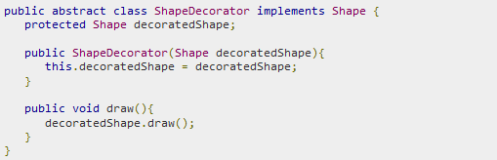
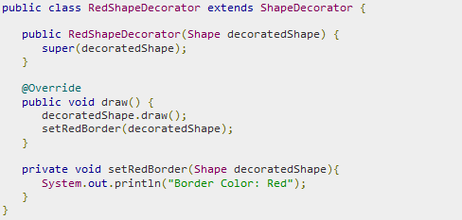
Creational design patterns (cont.)
Decorator Pattern (cont.)
Create abstract decorator class implementing the Shape interface.
Create concrete decorator class extending the ShapeDecorator class.
3
4

Slide 53
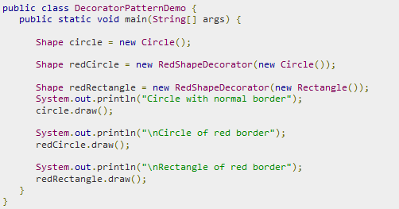
Structural patterns (cont.)
Decorator Pattern (cont.)
Use the RedShapeDecorator to decorate Shape objects.
5

Slide 54
Structural patterns (cont.)
Facade Pattern
Facade pattern hides the complexities of the system and provides an interface to the client using which the client can access the system.
This type of design pattern comes under structural pattern as this pattern adds an interface to existing system to hide its complexities.
This pattern involves a single class which provides simplified methods required by client and delegates calls to methods of existing system classes.
Intent
Provide a unified interface to a set of interfaces in a subsystem. Facade defines a higher-level interface that makes the subsystem easier to use.
Wrap a complicated subsystem with a simpler interface.

Slide 55
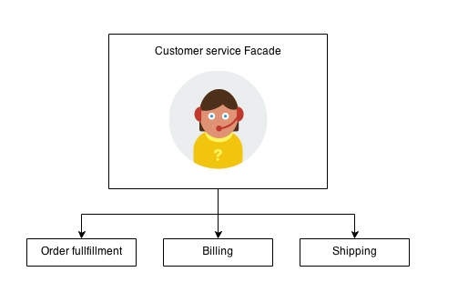
Structural patterns (cont.)
Facade Pattern (cont.)
The Facade defines a unified, higher level interface to a subsystem that makes it easier to use. Consumers encounter a Facade when ordering from a catalog. The consumer calls one number and speaks with a customer service representative.
The customer service representative acts as a Facade, providing an interface to the order fulfillment department, the billing department, and the shipping department.

Slide 56
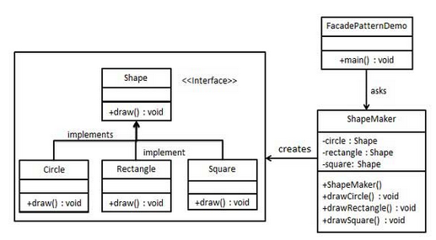
Structural patterns (cont.)
Facade Pattern (cont.)
The implementation

Slide 57
Creational design patterns (cont.)
Facade Pattern (cont.)
Create an interface for Shapes.
Create concrete classes implementing the same interface.
1
2

Slide 58
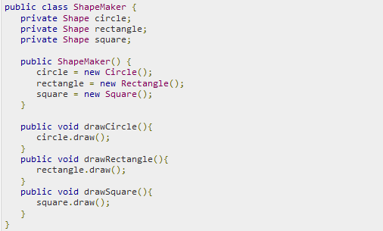
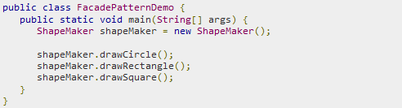
Creational design patterns (cont.)
Facade Pattern (cont.)
Create a facade class.
Use the facade to draw various types of shapes.
3
4

Slide 59
Structural patterns (cont.)
Proxy Pattern
In proxy pattern, a class represents functionality of another class. This type of design pattern comes under structural pattern.
In proxy pattern, we create object having original object to interface its functionality to outer world.
Intent
Provide a surrogate or placeholder for another object to control access to it.
Use an extra level of indirection to support distributed, controlled, or intelligent access.
Add a wrapper and delegation to protect the real component from undue complexity.

Slide 60
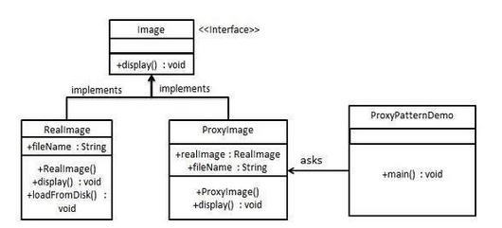
Structural patterns (cont.)
Proxy Pattern (cont.)
Create an interface.
1

Slide 61


Structural patterns (cont.)
Proxy Pattern (cont.)
Create concrete classes implementing the same interface.
2

Slide 62

Structural patterns (cont.)
Proxy Pattern (cont.)
Use the ProxyImage to get object of RealImage class when required.
3

Slide 63
Behavioral patterns
In software engineering, behavioral design patterns are design patterns that identify common communication patterns between objects and realize these patterns. By doing so, these patterns increase flexibility in carrying out this communication.
Chain of responsibility - A way of passing a request between a chain of objects
Command - Encapsulate a command request as an object
Interpreter - A way to include language elements in a program
Iterator - Sequentially access the elements of a collection
Mediator - Defines simplified communication between classes
Memento - Capture and restore an object’s internal state

Slide 64
Behavioral patterns (cont.)
Null Object - Designed to act as a default value of an object
Observer - A way of notifying change to a number of classes
State - Alter an object’s behavior when its state changes
Strategy - Encapsulates an algorithm inside a class
Template method - Defer the exact steps of an algorithm to a subclass
Visitor - Defines a new operation to a class without change

Slide 65
Behavioral patterns (cont.)
Observer Pattern
Observer pattern is used when there is one-to-many relationship between objects such as if one object is modified, its depenedent objects are to be notified automatically. Observer pattern falls under behavioral pattern category.
Intent
Define a one-to-many dependency between objects so that when one object changes state, all its dependents are notified and updated automatically.
Encapsulate the core (or common or engine) components in a Subject abstraction, and the variable (or optional or user interface) components in an Observer hierarchy.
The “View” part of Model-View-Controller.

Slide 66

Behavioral patterns (cont.)
Observer Pattern (cont.)

Slide 67


Behavioral patterns (cont.)
Observer Pattern (cont.)
Create Subject class.
Create Observer class
1
2

Slide 68



Behavioral patterns (cont.)
Observer Pattern (cont.)
Create concrete observer classes
3

Slide 69

Behavioral patterns (cont.)
Observer Pattern (cont.)
Use Subject and concrete observer objects.
4

Slide 70
Behavioral patterns (cont.)
Strategy Pattern
In Strategy pattern, a class behavior or its algorithm can be changed at run time. This type of design pattern comes under behavior pattern.
In Strategy pattern, we create objects which represent various strategies and a context object whose behavior varies as per its strategy object. The strategy object changes the executing algorithm of the context object.
Intent
Define a family of algorithms, encapsulate each one, and make them interchangeable. Strategy lets the algorithm vary independently from the clients that use it.
Capture the abstraction in an interface, bury implementation details in derived classes.

Slide 71

Behavioral patterns (cont.)
Strategy Pattern (cont.)

Slide 72



Behavioral patterns (cont.)
Strategy Pattern (cont.)
Create an interface.
Create concrete classes implementing the same interface.
1
2

Slide 73


Behavioral patterns (cont.)
Strategy Pattern (cont.)
Create Context Class.
Use the Context to see change in behaviour when it changes its Strategy.
3
4

