Slide 1
Home
about
contact
comment
招牌腿庫豬腳飯
NT:180$
醬燒排骨飯
NT:120$
醬烤魷魚飯
NT:115$
See more
See more
清甜蛋包飯
NT:90$
銷魂辣雞飯NT:90$
See more
See more
More conduct
Copyright © 2015
NTUT@CSIE

Slide 2




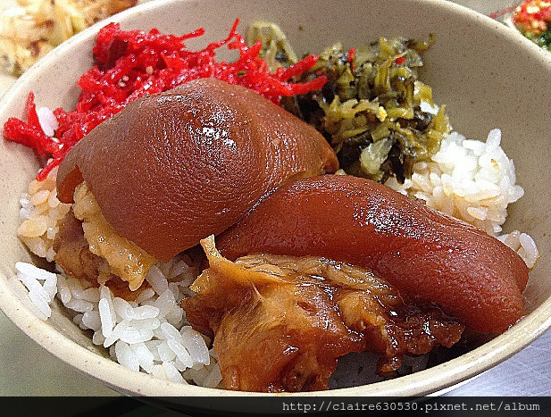
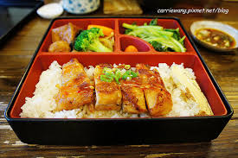
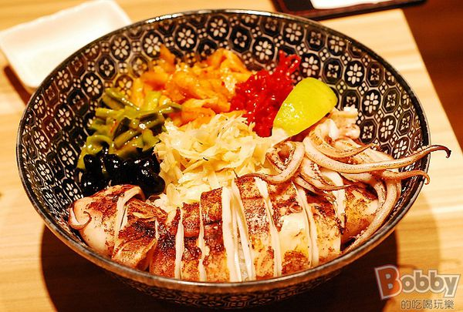
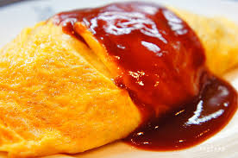
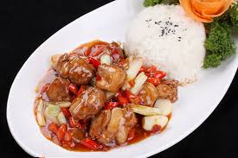
Home
about
contact
comment
招牌腿庫豬腳飯
NT:180$
醬燒排骨飯
NT:120$
醬烤魷魚飯
NT:115$
See more
See more
清甜蛋包飯
NT:90$
銷魂辣雞飯NT:90$
See more
See more
More conduct
Copyright © 2015
NTUT@CSIE

