Slide 1
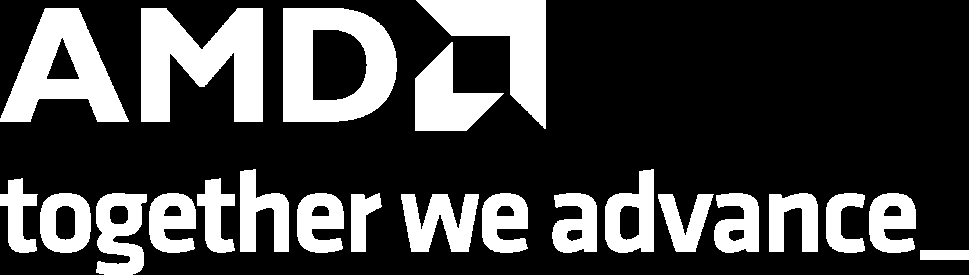
Physical AI SDK - Structure & Workflow
Three Paths — Pick the One That Fits Your Workflow
Option 1: Zero Steps
Option 2: Docker (One Command)
Option 3: Manual Setup
Every example ships with a pre-generated
Pre-installed ROCm + RyzenAI environment
Full local installation — 4 steps:
METRICS_TABLE.md
# Pull & run the container
docker run physical-ai-sdk
# 1. Install ROCm and raizen-ai
./install.sh
examples/yolov12/METRICS_TABLE.md
# Inside the container:
make benchmark-all-devices metrics
# 2. Navigate to example
cd examples/yolov12
CPU, GPU, NPU throughput & latency
Cross-device comparison table
No local installs needed
# 3. Run benchmarks
make benchmark-all-devices metrics
Auto-generated from benchmark runs
Reproducible environment
Output: METRICS_TABLE.md
Plan: expose as a web dashboard
Generates METRICS_TABLE.md automatically
One command to fresh numbers
Most control, most setup
Just open the file — numbers are already
there
1

Slide 2
Easy to Use
Uniform Interface Across Every Example
Make-Based Uniformity
Every Example Includes:
Same commands work in every example directory:
Feature
Description
make benchmark-all-devices metric # all devices
make benchmark-gpu # GPU only
make benchmark-cpu # CPU only
make benchmark-npu # NPU only
make eval # evaluation pipeline
CPU / GPU / NPU
Benchmark each compute device for
flows
throughput & latency
Eval pipeline
Sample inputs → sample outputs to visually
verify correctness
Learn once, use everywhere
Guiding
Per-example tutorial to walk you from setup
No per-model setup surprises
documentation
to results
Consistent output format ( METRICS_TABLE.md )
Principle: If you can run one example, you can run them
all — same commands, same structure, same outputs.
2

Slide 3
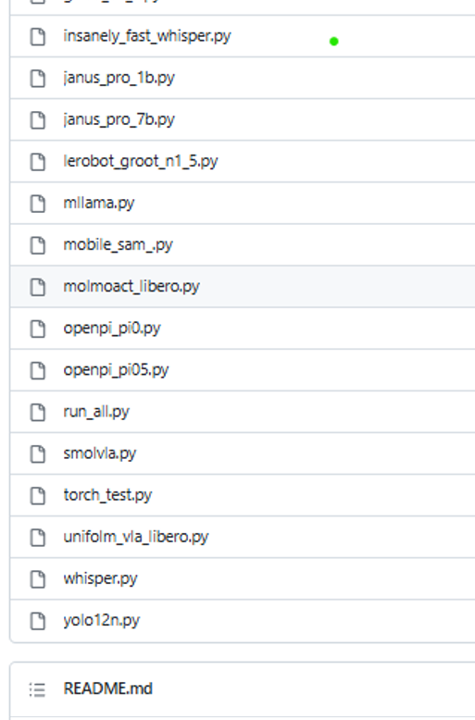
Contributions — Research Desk → Vertical Software
1. PAVS transforms raw researcher code into production-ready vertical software
What we receive: Research Repo
What we receive: Research Code
What we deliver: Vertical Software
# rocm-scripts/test/pytorch/yolo12n.py
#........
# .......
# .......
#........
# .......
# .......
recalled = gt_labels & detected_classes
recall = len(recalled) / len(gt_labels)
sanity_pass = recall >= RECALL_THRESHOLD
assert sanity_pass, (
examples/yolov12/
├── Makefile
├── METRICS_TABLE.md
├── README.md
├── app/
│ ├── routes/
│ ├── services/
│ ├── main.py & config.py
├── scripts/
│ ├── benchmark.py
│ ├── export_onnx.py
│ ├── profile_model.py
│ ├── run_val.py
│ └── update_metrics_table.py
├── tests/
│ ├── test_api.py
│ ├── test_docker.py
│ ├── test_migraphx.py
│ └── test_yolo_workflow.py
├── weights/
├── datasets/
├── requirements.txt
├── requirements_cpu.txt
└── requirements_npu.txt
f"recall {recall:.0%} < {RECALL_THRESHOLD:.0%}")
return lats, {
"architecture": "CNN",
"task": "object_detection",
"num_detections": num_detections,
"recall": round(recall, 4),
}
if __name__ == "__main__":
sys.exit(run(run_benchmark))
Single script, no structure, no device flows
App, scripts, tests, per-device requirements —
production-ready
Flat list of scripts — no structure, no device flows,
no Make targets
Physical AI & Vertical Software: Researcher's Desk → Vertical Software — same commands, every device, production-ready.
3

Slide 4
Contributions(contd.) — Building the AMD AI Ecosystem
2. AIG vs PAVS — Functional Correctness over Operator Validation
3. Developer-Friendly Inference Tools & LLM Infra
AIG
PAVS
Profilers + LLM serving stacks — with tutorials for ease of adoption:
Approach
Operator validation
Functional correctness
Category
Tools
Inputs
Dummy / synthetic
Profilers
Lemonade, NPU AI Analyzer, ROCProfiler
tensors
Real input datasets
Measures
Throughput on isolated
End-to-end accuracy + throughput +
LLM
Infra
vLLM (high-throughput serving), Llama.cpp (edge inference),
FastFlowLM (LLMs on NPU)
ops
latency
Pipeline
Op-level checks
Full inference pipeline (pre → infer →
post)
Bridging the open-source ecosystem
AMD HW ecosystem — making
these tools easy to use across the AMD stack.
4. Vertical Application Platform
PAVS implements the end-to-end working pipeline and ensures the
model produces expected outputs from real input datasets — not
just numbers from dummy inputs.
A platform that evolves with the client — solving, fixing, and growing
together in targeted domains:
Domain
Focus
Healthcare
Medical imaging, diagnostics
Automotive
Perception, safety systems
Industrial
Inspection, anomaly detection
4

Slide 5
Pain Points
Current Challenges on Edge Devices
ROCm Installation Stability
Sudo / Root Access Required
ROCm install on edge devices is not yet stable
Both ROCm and RyzenAI installers need sudo
privileges
Driver/firmware mismatches on some hardware revisions
Workaround: pinned ROCm versions in install scripts
Containers mitigate this
Reboot During Installation
ROCm installation requires a system reboot mid-
process
Breaks unattended / CI-driven installs
Users unfamiliar with the flow find this unexpected
Docker path sidesteps all three issues — pre-built image with ROCm + RyzenAI already configured, no reboot, no sudo
on host.
5

Slide 6
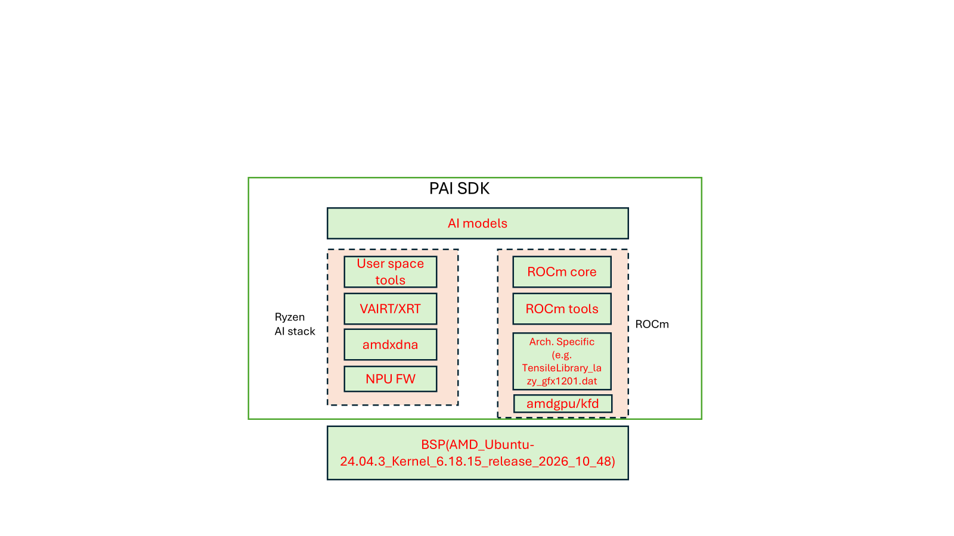
SW Stack (For Reference)
6

