Slide 1
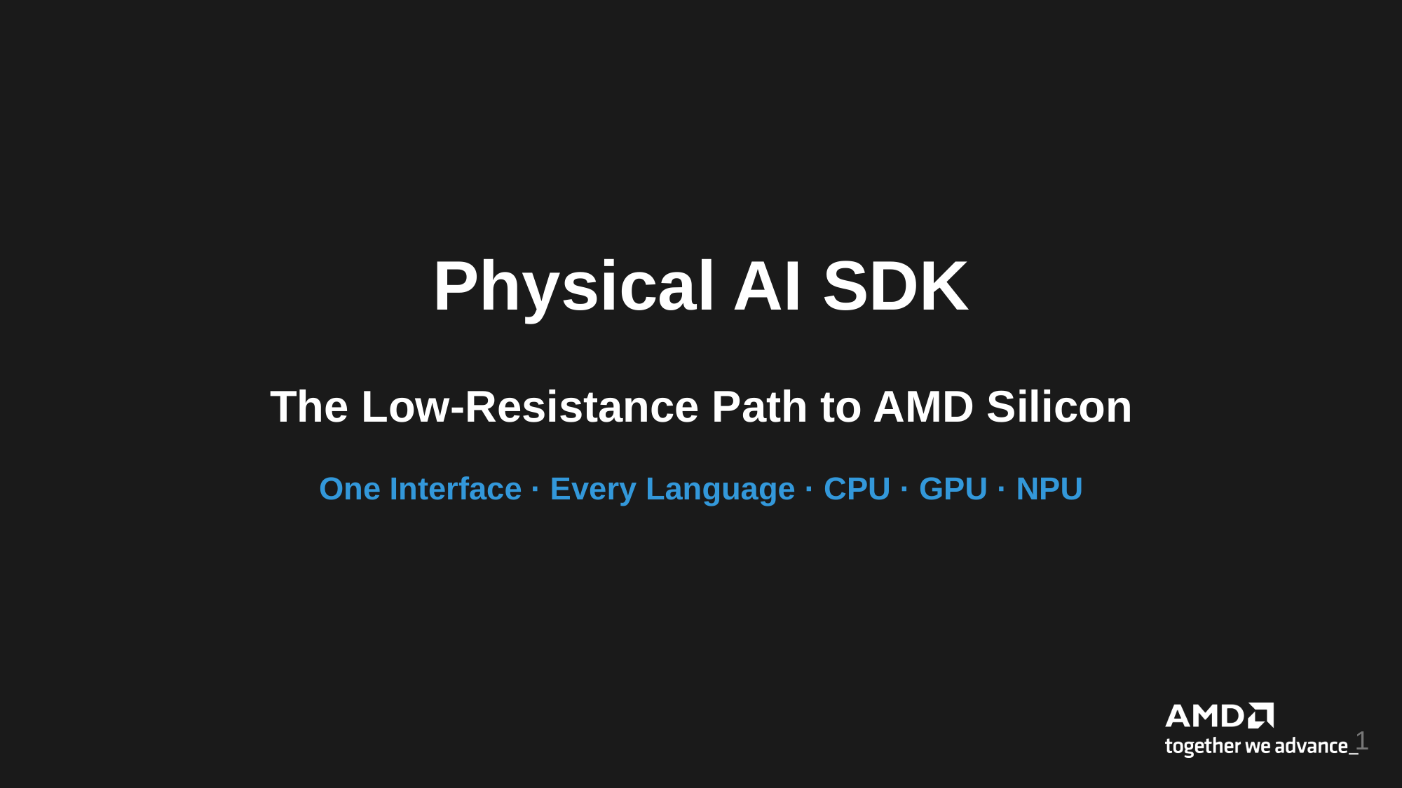
Physical AI SDK
The Low-Resistance Path to AMD Silicon
One Interface · Every Language · CPU · GPU · NPU
1

Slide 2
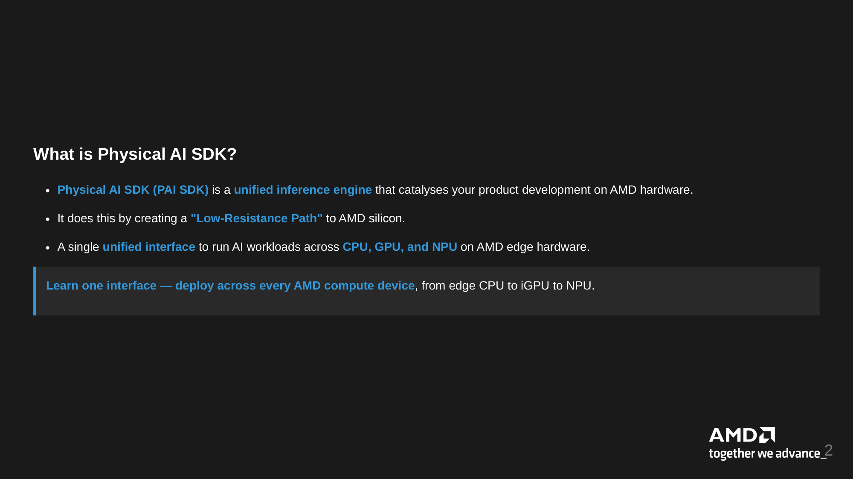
What is Physical AI SDK?
Physical AI SDK (PAI SDK) is a unified inference engine that catalyses your product development on AMD hardware.
It does this by creating a "Low-Resistance Path" to AMD silicon.
A single unified interface to run AI workloads across CPU, GPU, and NPU on AMD edge hardware.
Learn one interface — deploy across every AMD compute device, from edge CPU to iGPU to NPU.
2

Slide 3
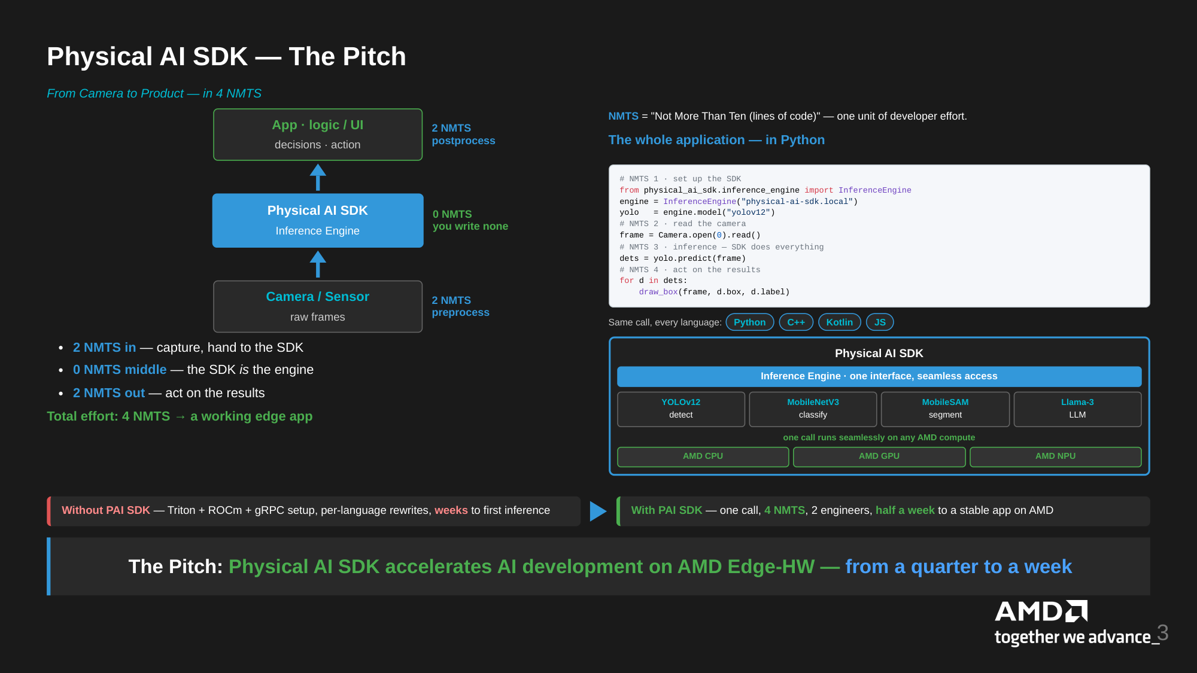
Physical AI SDK — The Pitch
From Camera to Product — in 4 NMTS
App · logic / UI
2 NMTS
postprocess
NMTS = "Not More Than Ten (lines of code)" — one unit of developer effort.
decisions · action
The whole application — in Python
# NMTS 1 · set up the SDK
from physical_ai_sdk.inference_engine import InferenceEngine
engine = InferenceEngine("physical-ai-sdk.local")
yolo = engine.model("yolov12")
# NMTS 2 · read the camera
frame = Camera.open(0).read()
# NMTS 3 · inference — SDK does everything
dets = yolo.predict(frame)
# NMTS 4 · act on the results
for d in dets:
draw_box(frame, d.box, d.label)
Physical AI SDK
0 NMTS
you write none
Inference Engine
Camera / Sensor
2 NMTS
preprocess
raw frames
Same call, every language:
Python
C++
Kotlin
JS
2 NMTS in — capture, hand to the SDK
Physical AI SDK
0 NMTS middle — the SDK is the engine
Inference Engine · one interface, seamless access
2 NMTS out — act on the results
YOLOv12
MobileNetV3
MobileSAM
Llama-3
Total effort: 4 NMTS → a working edge app
detect
classify
segment
LLM
one call runs seamlessly on any AMD compute
AMD CPU
AMD GPU
AMD NPU
Without PAI SDK — Triton + ROCm + gRPC setup, per-language rewrites, weeks to first inference
With PAI SDK — one call, 4 NMTS, 2 engineers, half a week to a stable app on AMD
The Pitch: Physical AI SDK accelerates AI development on AMD Edge-HW — from a quarter to a week
3

Slide 4
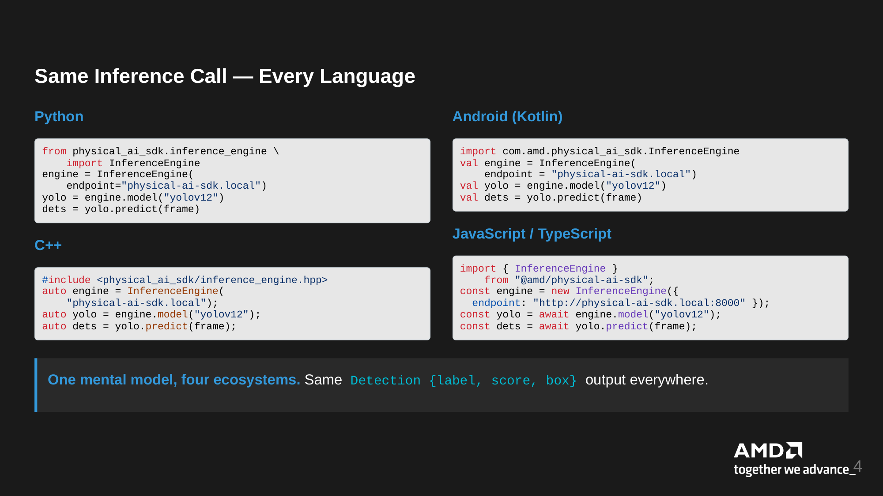
Same Inference Call — Every Language
Python
Android (Kotlin)
from physical_ai_sdk.inference_engine \
import InferenceEngine
engine = InferenceEngine(
endpoint="physical-ai-sdk.local")
yolo = engine.model("yolov12")
dets = yolo.predict(frame)
import com.amd.physical_ai_sdk.InferenceEngine
val engine = InferenceEngine(
endpoint = "physical-ai-sdk.local")
val yolo = engine.model("yolov12")
val dets = yolo.predict(frame)
JavaScript / TypeScript
C++
import { InferenceEngine }
from "@amd/physical-ai-sdk";
const engine = new InferenceEngine({
endpoint: "http://physical-ai-sdk.local:8000" });
const yolo = await engine.model("yolov12");
const dets = await yolo.predict(frame);
#include <physical_ai_sdk/inference_engine.hpp>
auto engine = InferenceEngine(
"physical-ai-sdk.local");
auto yolo = engine.model("yolov12");
auto dets = yolo.predict(frame);
One mental model, four ecosystems. Same Detection {label, score, box} output everywhere.
4

Slide 5
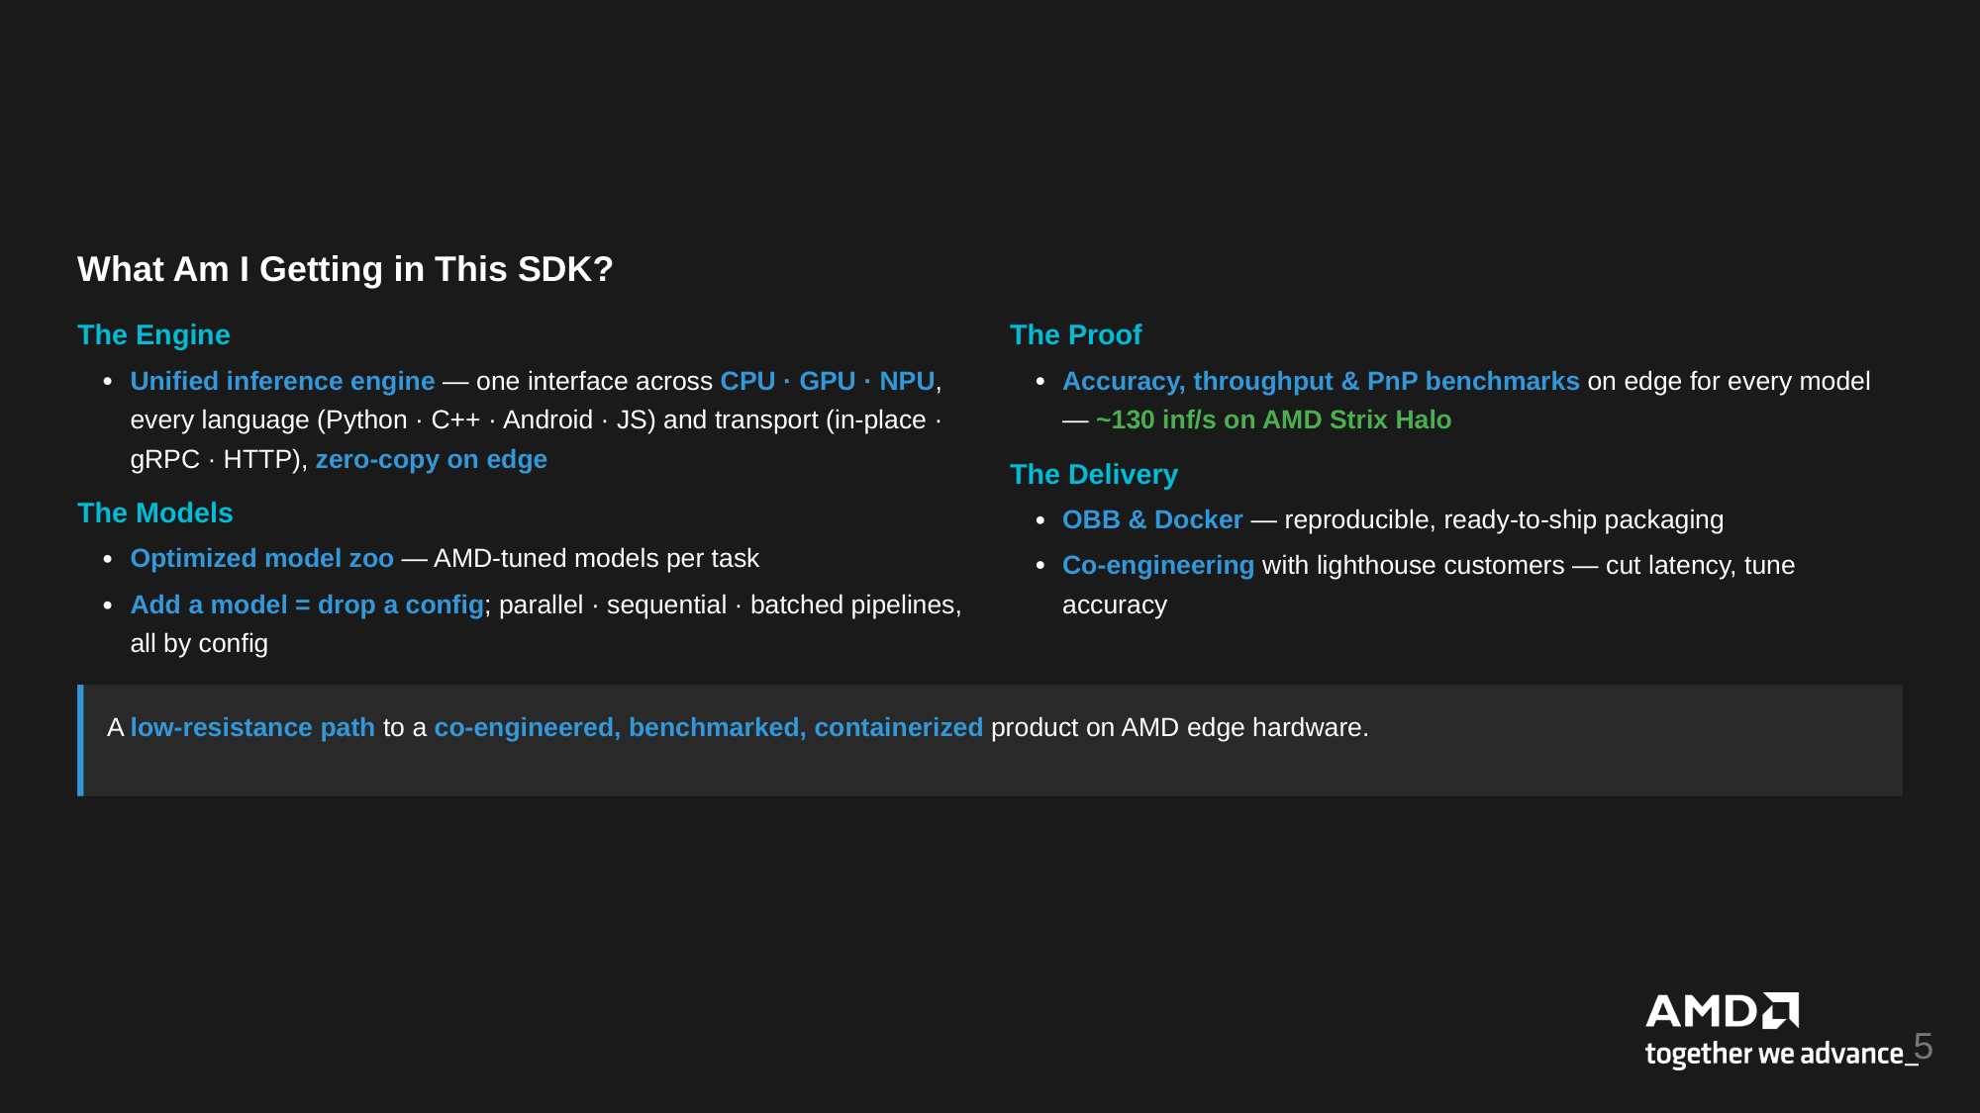
What Am I Getting in This SDK?
The Engine
The Proof
Unified inference engine — one interface across CPU · GPU · NPU,
every language (Python · C++ · Android · JS) and transport (in-place ·
Accuracy, throughput & PnP benchmarks on edge for every model
— ~130 inf/s on AMD Strix Halo
gRPC · HTTP), zero-copy on edge
The Delivery
The Models
OBB & Docker — reproducible, ready-to-ship packaging
Optimized model zoo — AMD-tuned models per task
Co-engineering with lighthouse customers — cut latency, tune
Add a model = drop a config; parallel · sequential · batched pipelines,
all by config
accuracy
A low-resistance path to a co-engineered, benchmarked, containerized product on AMD edge hardware.
5

Slide 6
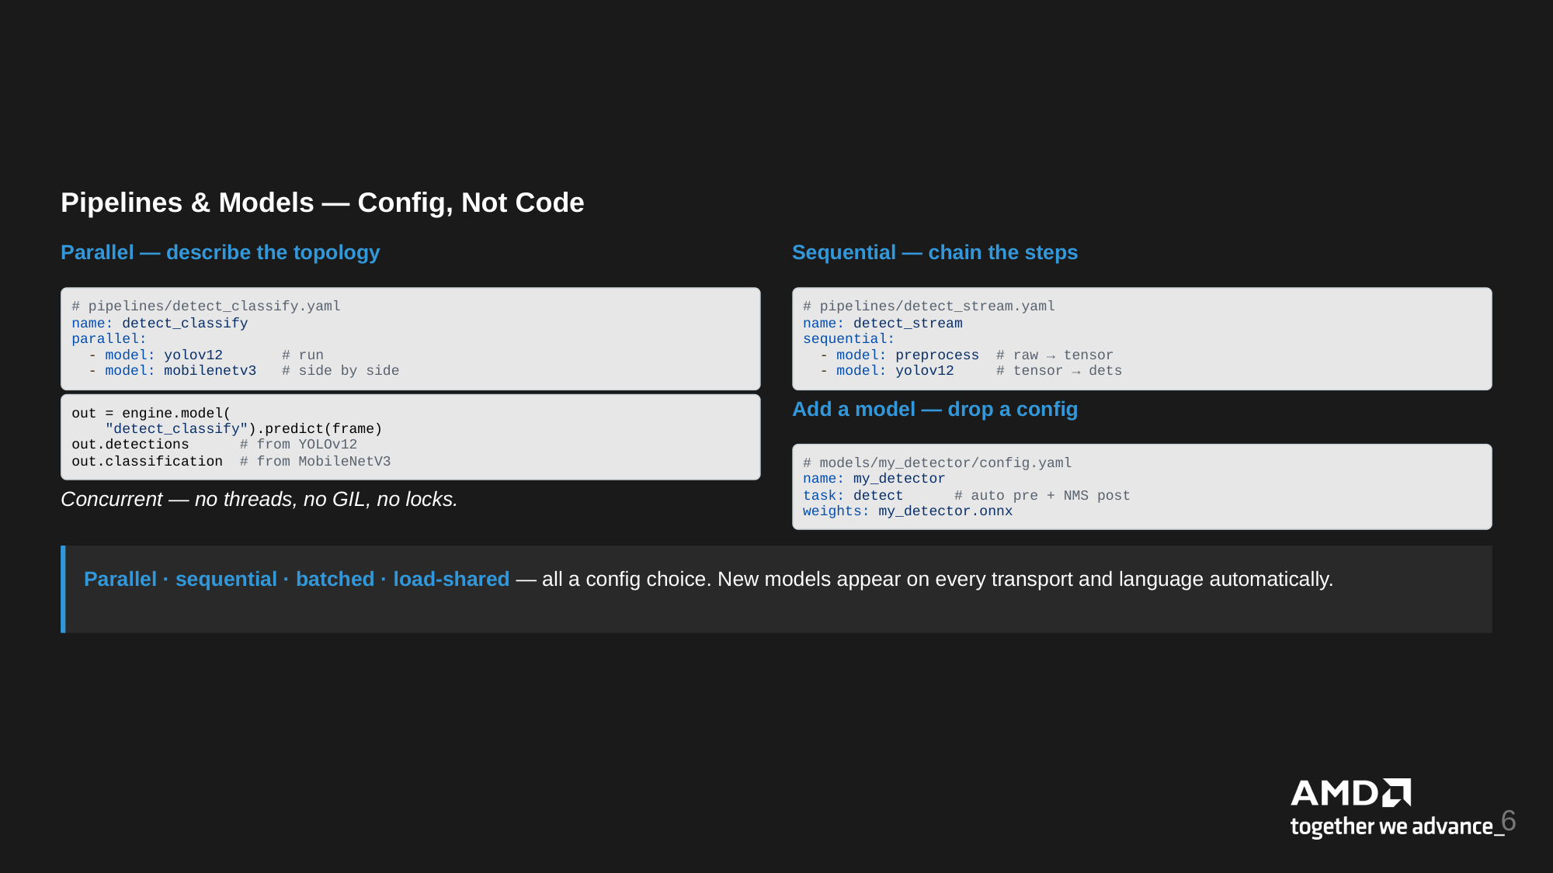
Pipelines & Models — Config, Not Code
Parallel — describe the topology
Sequential — chain the steps
# pipelines/detect_classify.yaml
name: detect_classify
parallel:
- model: yolov12 # run
- model: mobilenetv3 # side by side
# pipelines/detect_stream.yaml
name: detect_stream
sequential:
- model: preprocess # raw → tensor
- model: yolov12 # tensor → dets
out = engine.model(
"detect_classify").predict(frame)
out.detections # from YOLOv12
out.classification # from MobileNetV3
Add a model — drop a config
# models/my_detector/config.yaml
name: my_detector
task: detect # auto pre + NMS post
weights: my_detector.onnx
Concurrent — no threads, no GIL, no locks.
Parallel · sequential · batched · load-shared — all a config choice. New models appear on every transport and language automatically.
6

Slide 7
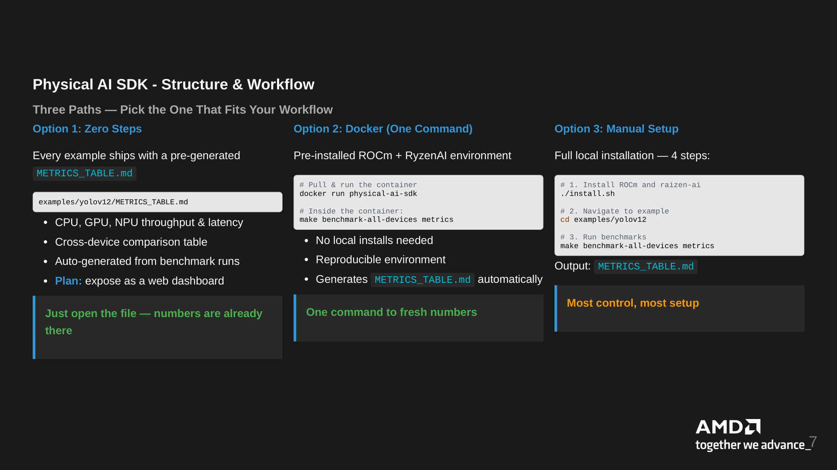
Physical AI SDK - Structure & Workflow
Three Paths — Pick the One That Fits Your Workflow
Option 1: Zero Steps
Option 2: Docker (One Command)
Option 3: Manual Setup
Every example ships with a pre-generated
Pre-installed ROCm + RyzenAI environment
Full local installation — 4 steps:
METRICS_TABLE.md
# Pull & run the container
docker run physical-ai-sdk
# 1. Install ROCm and raizen-ai
./install.sh
examples/yolov12/METRICS_TABLE.md
# Inside the container:
make benchmark-all-devices metrics
# 2. Navigate to example
cd examples/yolov12
CPU, GPU, NPU throughput & latency
Cross-device comparison table
No local installs needed
# 3. Run benchmarks
make benchmark-all-devices metrics
Auto-generated from benchmark runs
Reproducible environment
Output: METRICS_TABLE.md
Plan: expose as a web dashboard
Generates METRICS_TABLE.md automatically
One command to fresh numbers
Most control, most setup
Just open the file — numbers are already
there
7

Slide 8
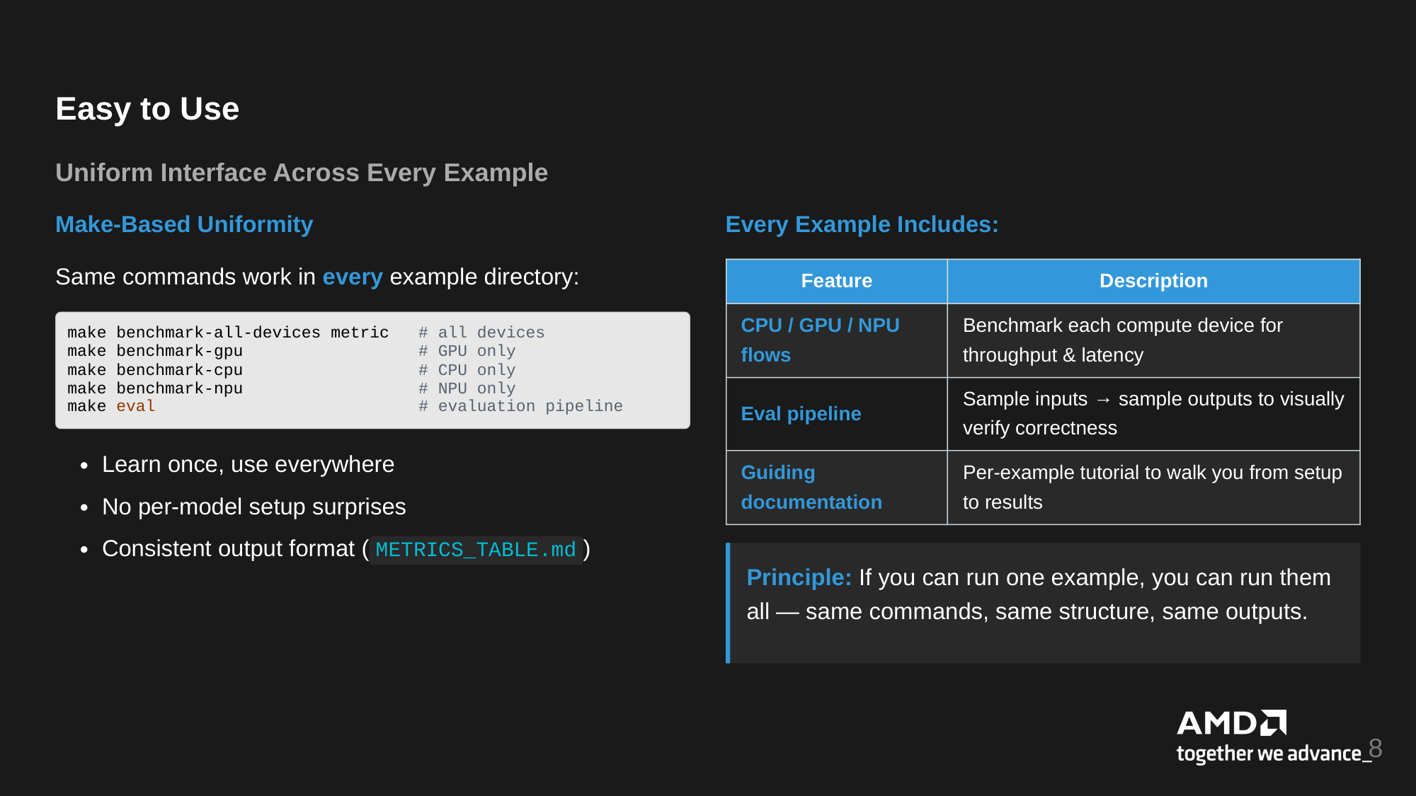
Easy to Use
Uniform Interface Across Every Example
Make-Based Uniformity
Every Example Includes:
Same commands work in every example directory:
Feature
Description
make benchmark-all-devices metric # all devices
make benchmark-gpu # GPU only
make benchmark-cpu # CPU only
make benchmark-npu # NPU only
make eval # evaluation pipeline
CPU / GPU / NPU
Benchmark each compute device for
flows
throughput & latency
Eval pipeline
Sample inputs → sample outputs to visually
verify correctness
Learn once, use everywhere
Guiding
Per-example tutorial to walk you from setup
No per-model setup surprises
documentation
to results
Consistent output format ( METRICS_TABLE.md )
Principle: If you can run one example, you can run them
all — same commands, same structure, same outputs.
8

Slide 9
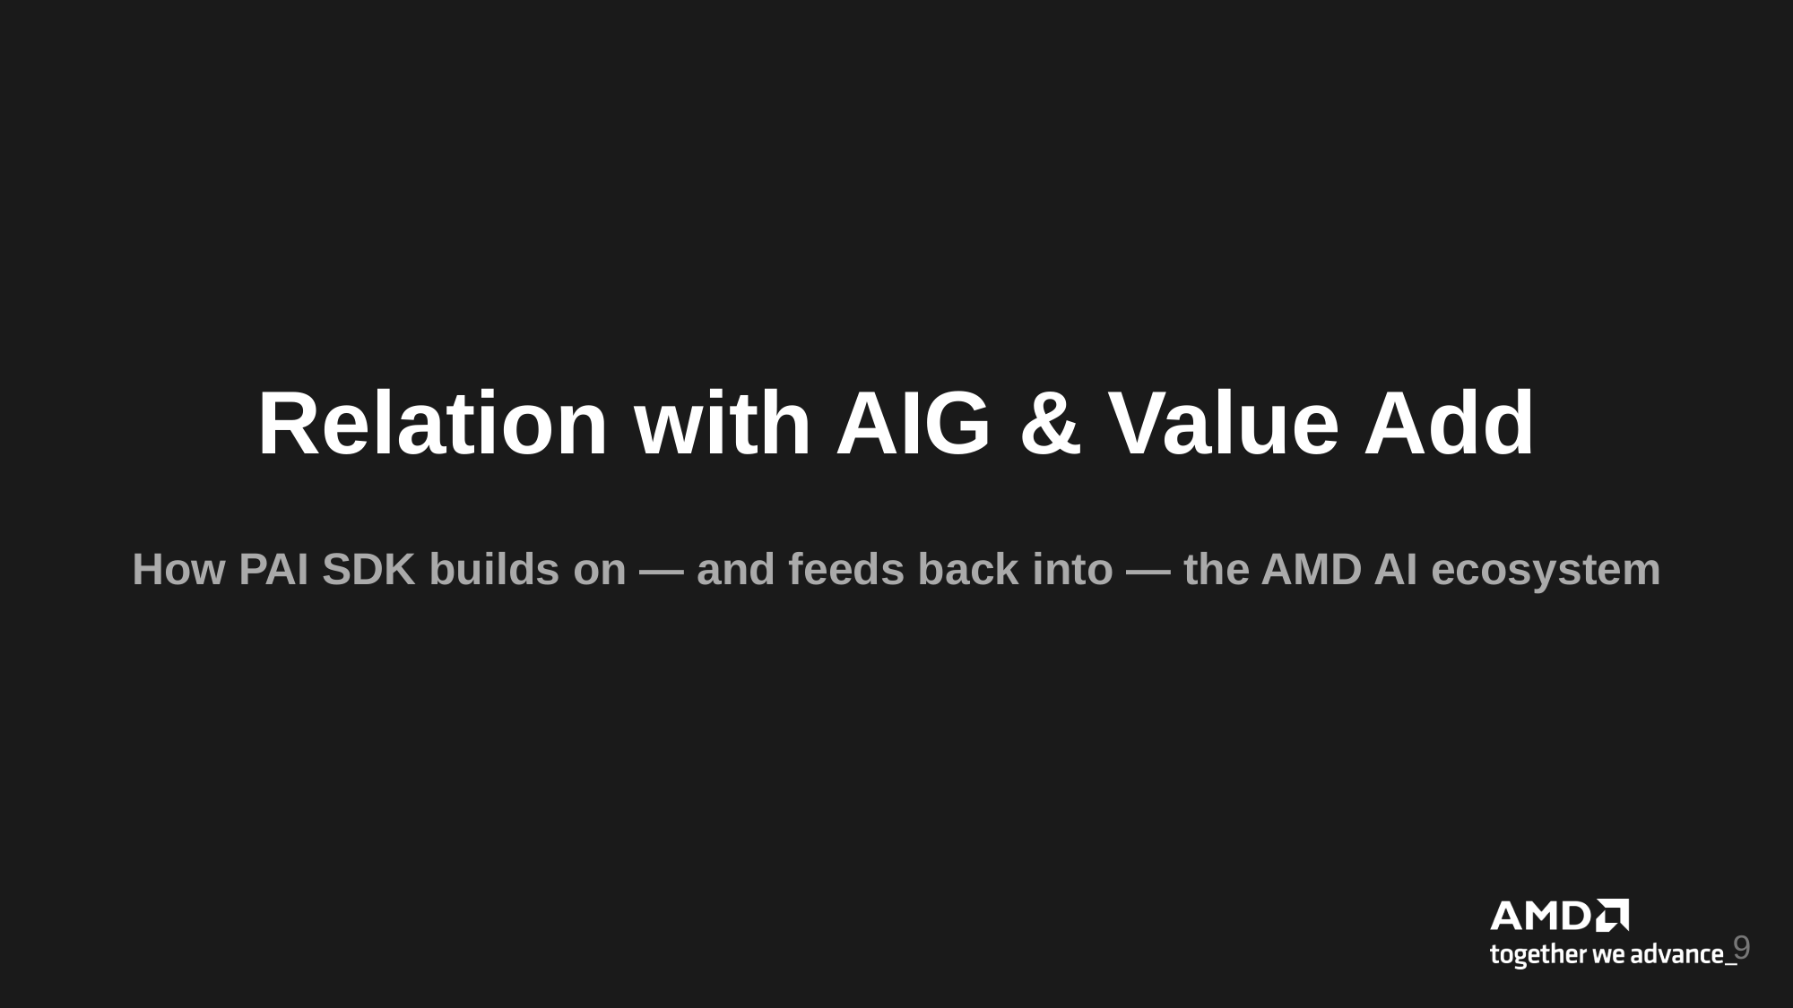
Relation with AIG & Value Add
How PAI SDK builds on — and feeds back into — the AMD AI ecosystem
9

Slide 10
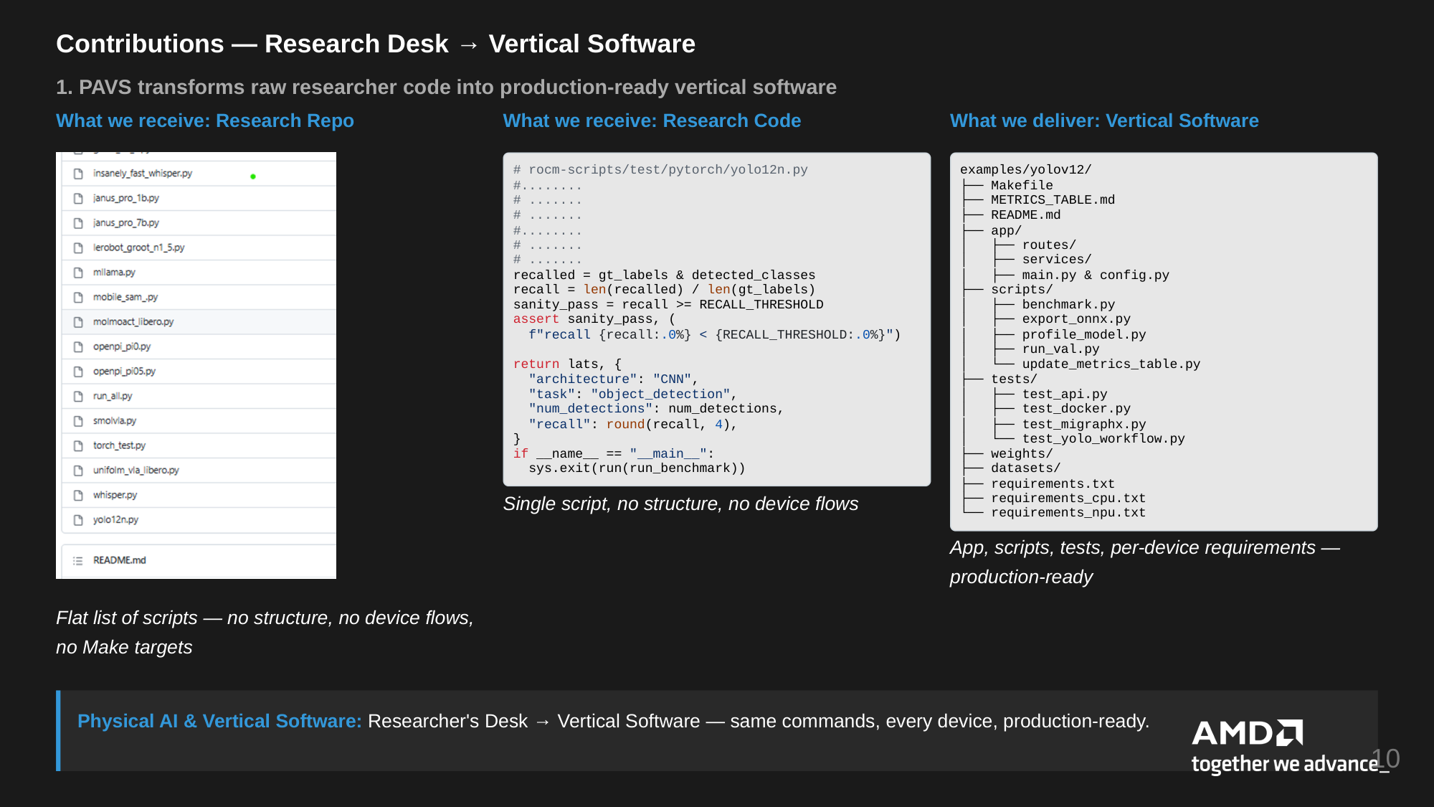
Contributions — Research Desk → Vertical Software
1. PAVS transforms raw researcher code into production-ready vertical software
What we receive: Research Repo
What we receive: Research Code
What we deliver: Vertical Software
# rocm-scripts/test/pytorch/yolo12n.py
#........
# .......
# .......
#........
# .......
# .......
recalled = gt_labels & detected_classes
recall = len(recalled) / len(gt_labels)
sanity_pass = recall >= RECALL_THRESHOLD
assert sanity_pass, (
f"recall {recall:.0%} < {RECALL_THRESHOLD:.0%}")
examples/yolov12/
├── Makefile
├── METRICS_TABLE.md
├── README.md
├── app/
│ ├── routes/
│ ├── services/
│ ├── main.py & config.py
├── scripts/
│ ├── benchmark.py
│ ├── export_onnx.py
│ ├── profile_model.py
│ ├── run_val.py
│ └── update_metrics_table.py
├── tests/
│ ├── test_api.py
│ ├── test_docker.py
│ ├── test_migraphx.py
│ └── test_yolo_workflow.py
├── weights/
├── datasets/
├── requirements.txt
├── requirements_cpu.txt
└── requirements_npu.txt
return lats, {
"architecture": "CNN",
"task": "object_detection",
"num_detections": num_detections,
"recall": round(recall, 4),
}
if __name__ == "__main__":
sys.exit(run(run_benchmark))
Single script, no structure, no device flows
App, scripts, tests, per-device requirements —
production-ready
Flat list of scripts — no structure, no device flows,
no Make targets
Physical AI & Vertical Software: Researcher's Desk → Vertical Software — same commands, every device, production-ready.
10

Slide 11
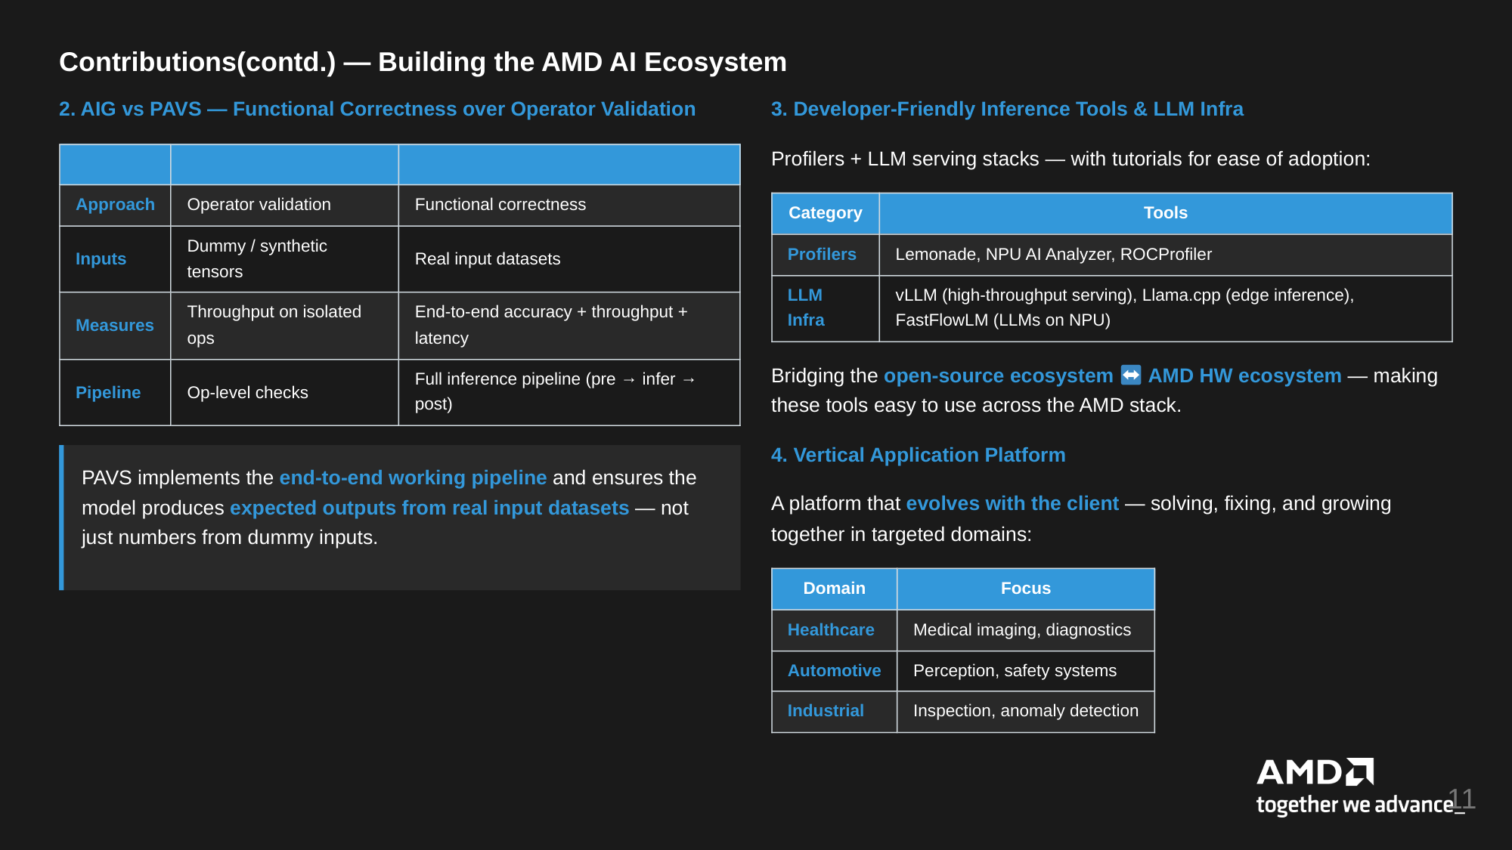
Contributions(contd.) — Building the AMD AI Ecosystem
2. AIG vs PAVS — Functional Correctness over Operator Validation
3. Developer-Friendly Inference Tools & LLM Infra
AIG
PAVS
Profilers + LLM serving stacks — with tutorials for ease of adoption:
Approach
Operator validation
Functional correctness
Category
Tools
Inputs
Dummy / synthetic
Profilers
Lemonade, NPU AI Analyzer, ROCProfiler
tensors
Real input datasets
Measures
Throughput on isolated
End-to-end accuracy + throughput +
LLM
Infra
vLLM (high-throughput serving), Llama.cpp (edge inference),
FastFlowLM (LLMs on NPU)
ops
latency
Pipeline
Op-level checks
Full inference pipeline (pre → infer →
post)
Bridging the open-source ecosystem
AMD HW ecosystem — making
these tools easy to use across the AMD stack.
4. Vertical Application Platform
PAVS implements the end-to-end working pipeline and ensures the
model produces expected outputs from real input datasets — not
just numbers from dummy inputs.
A platform that evolves with the client — solving, fixing, and growing
together in targeted domains:
Domain
Focus
Healthcare
Medical imaging, diagnostics
Automotive
Perception, safety systems
Industrial
Inspection, anomaly detection
11

Slide 12
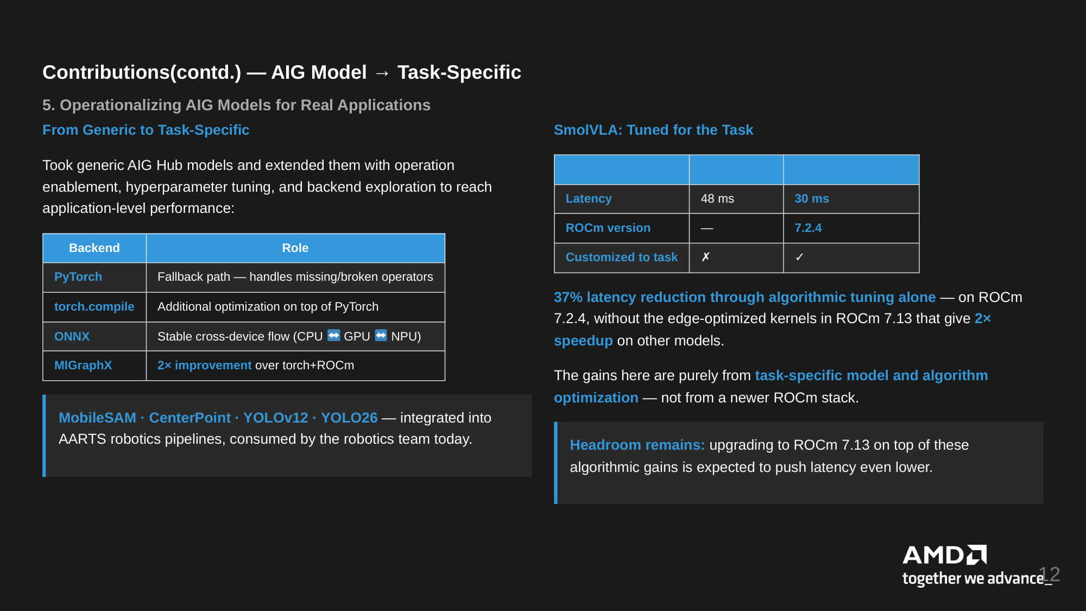
Contributions(contd.) — AIG Model → Task-Specific
5. Operationalizing AIG Models for Real Applications
From Generic to Task-Specific
SmolVLA: Tuned for the Task
Took generic AIG Hub models and extended them with operation
AIG Generic
PAVS Task-Specific
enablement, hyperparameter tuning, and backend exploration to reach
application-level performance:
Latency
48 ms
30 ms
ROCm version
—
7.2.4
Backend
Role
Customized to task
✗
✓
PyTorch
Fallback path — handles missing/broken operators
torch.compile
Additional optimization on top of PyTorch
37% latency reduction through algorithmic tuning alone — on ROCm
7.2.4, without the edge-optimized kernels in ROCm 7.13 that give 2×
ONNX
Stable cross-device flow (CPU
GPU
NPU)
speedup on other models.
MIGraphX
2× improvement over torch+ROCm
The gains here are purely from task-specific model and algorithm
optimization — not from a newer ROCm stack.
MobileSAM · CenterPoint · YOLOv12 · YOLO26 — integrated into
AARTS robotics pipelines, consumed by the robotics team today.
Headroom remains: upgrading to ROCm 7.13 on top of these
algorithmic gains is expected to push latency even lower.
12

Slide 13
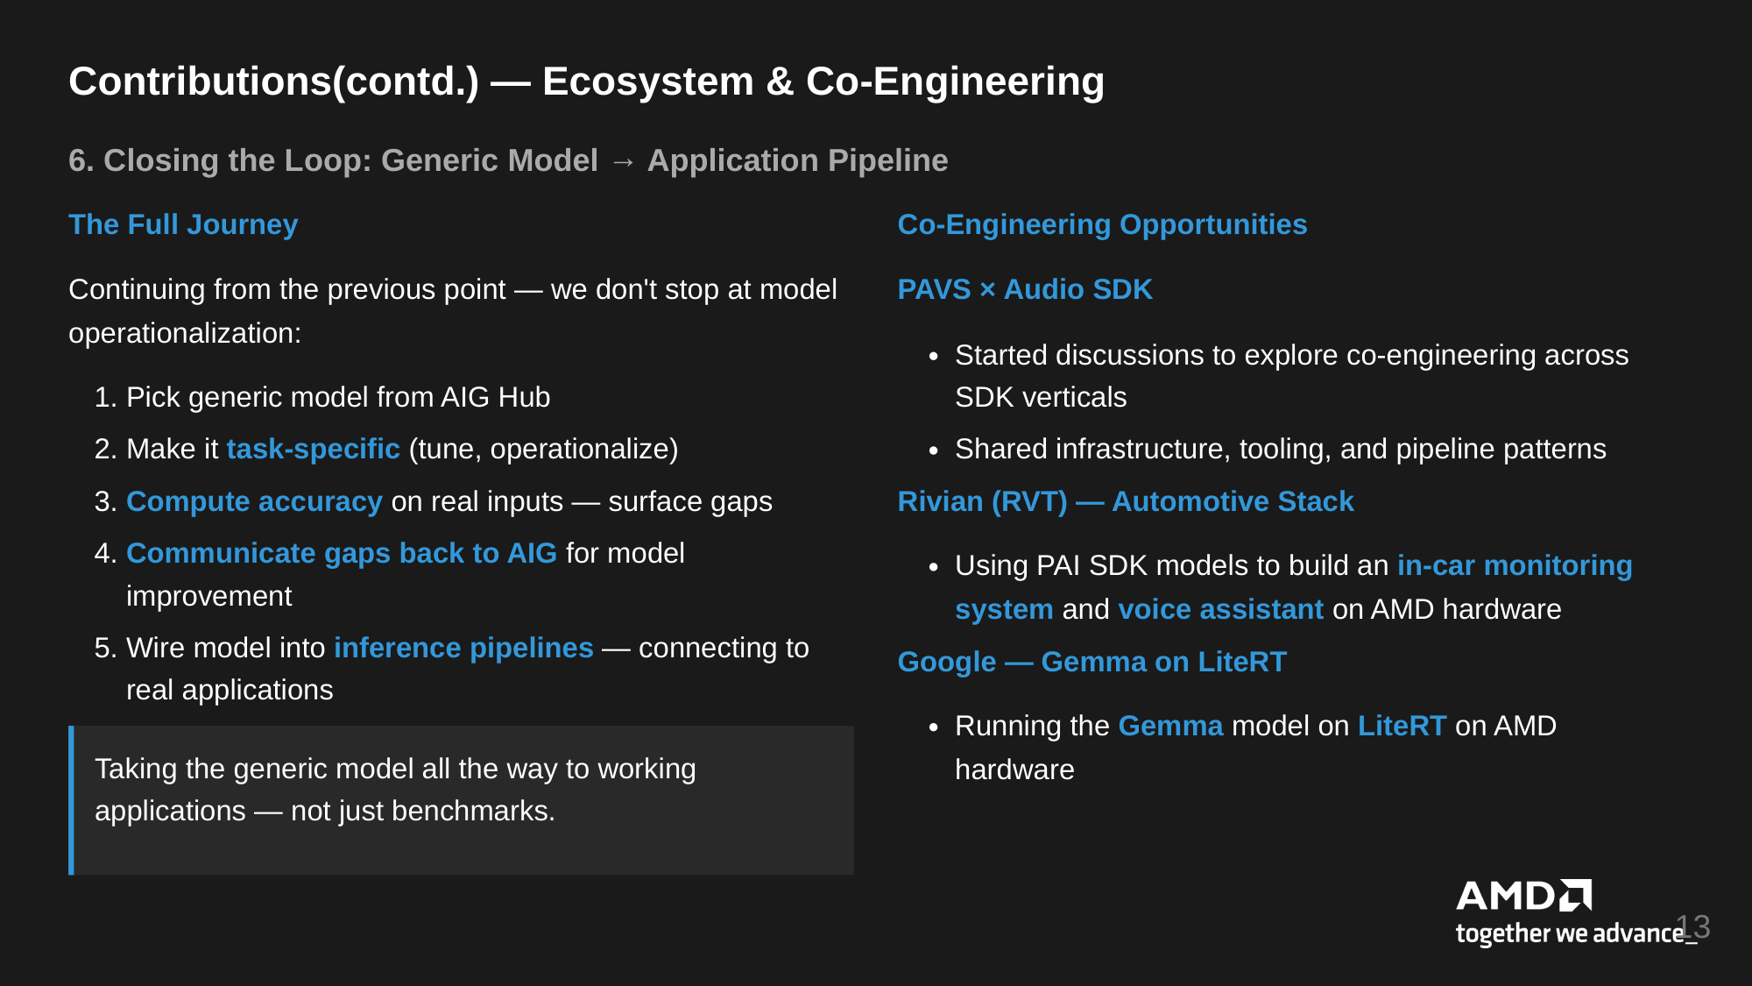
Contributions(contd.) — Ecosystem & Co-Engineering
6. Closing the Loop: Generic Model → Application Pipeline
The Full Journey
Co-Engineering Opportunities
Continuing from the previous point — we don't stop at model
PAVS × Audio SDK
operationalization:
Started discussions to explore co-engineering across
SDK verticals
1. Pick generic model from AIG Hub
2. Make it task-specific (tune, operationalize)
Shared infrastructure, tooling, and pipeline patterns
3. Compute accuracy on real inputs — surface gaps
Rivian (RVT) — Automotive Stack
4. Communicate gaps back to AIG for model
improvement
Using PAI SDK models to build an in-car monitoring
system and voice assistant on AMD hardware
5. Wire model into inference pipelines — connecting to
real applications
Google — Gemma on LiteRT
Running the Gemma model on LiteRT on AMD
Taking the generic model all the way to working
applications — not just benchmarks.
hardware
13

Slide 14
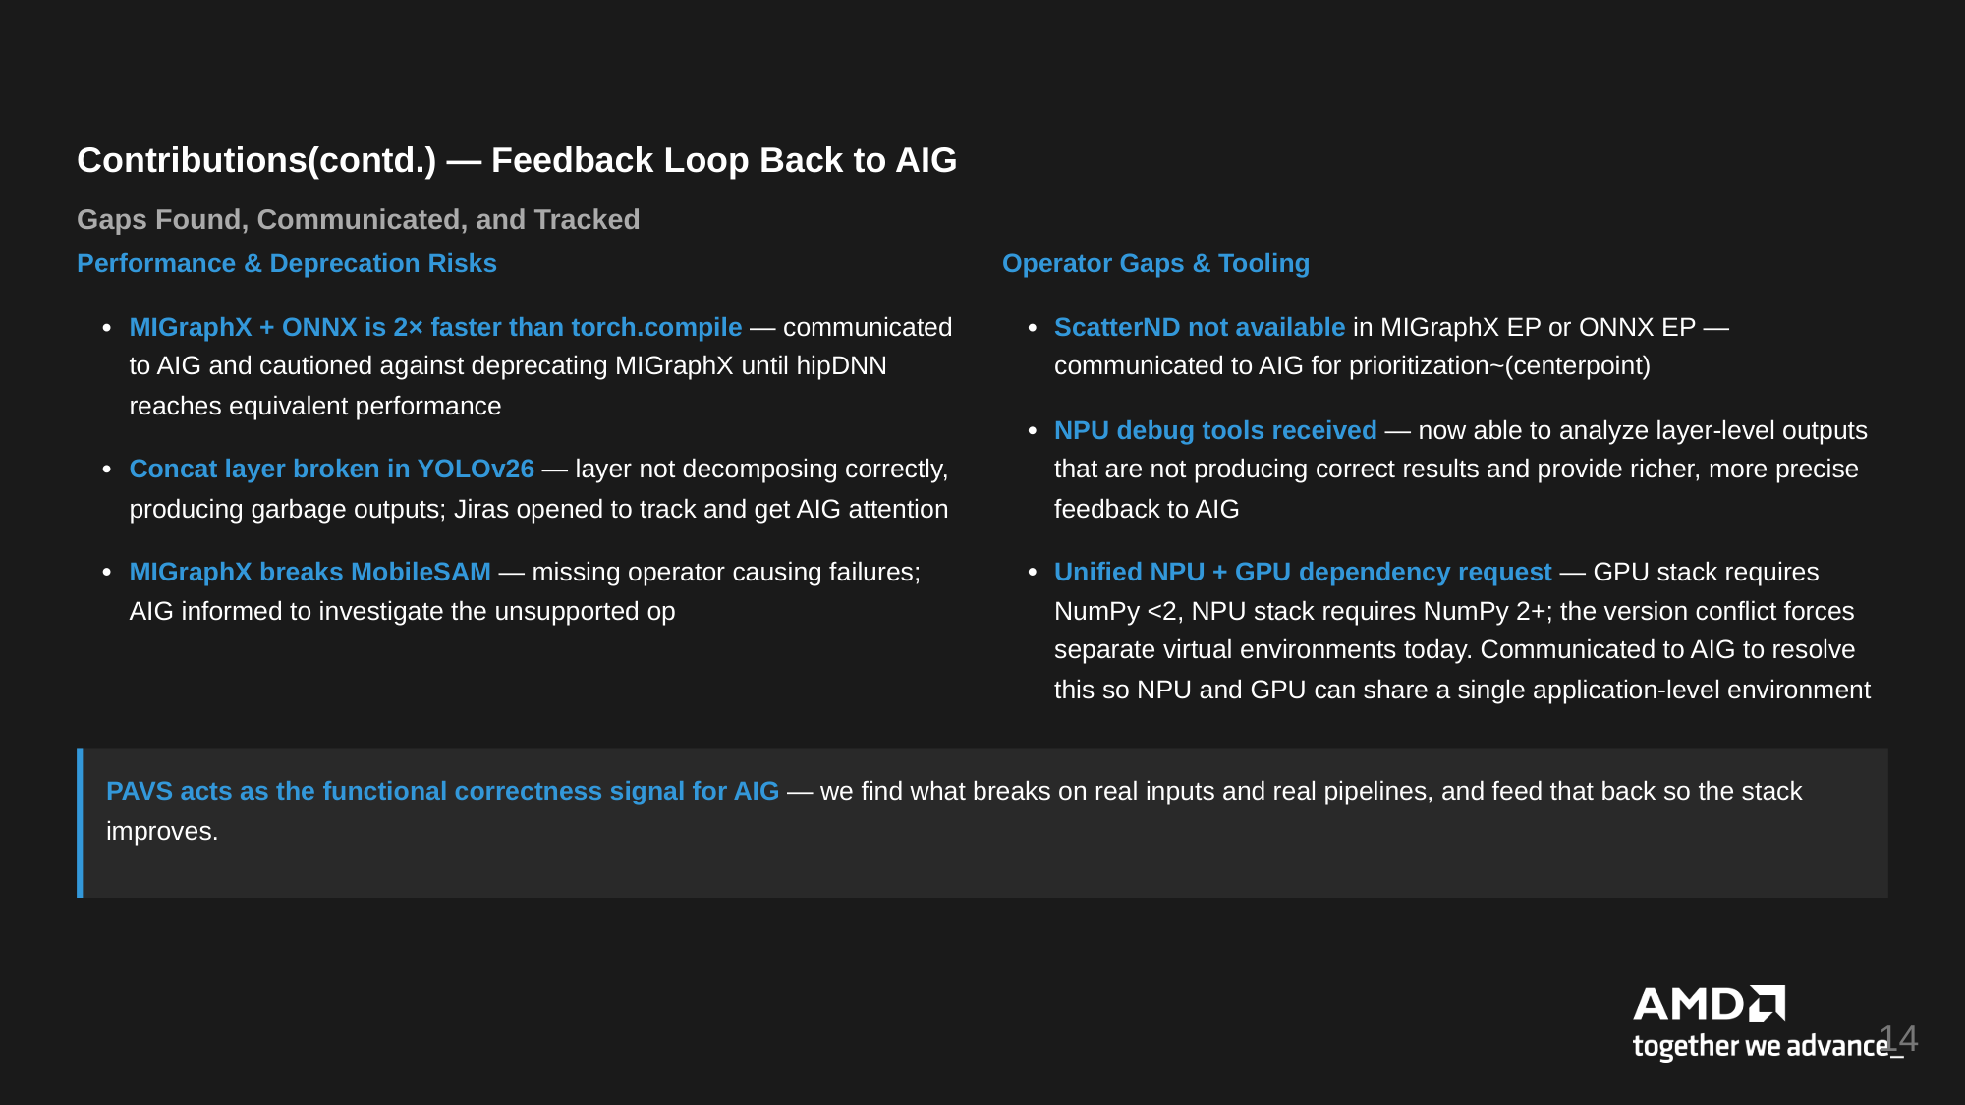
Contributions(contd.) — Feedback Loop Back to AIG
Gaps Found, Communicated, and Tracked
Performance & Deprecation Risks
Operator Gaps & Tooling
MIGraphX + ONNX is 2× faster than torch.compile — communicated
to AIG and cautioned against deprecating MIGraphX until hipDNN
ScatterND not available in MIGraphX EP or ONNX EP —
communicated to AIG for prioritization~(centerpoint)
reaches equivalent performance
NPU debug tools received — now able to analyze layer-level outputs
that are not producing correct results and provide richer, more precise
Concat layer broken in YOLOv26 — layer not decomposing correctly,
producing garbage outputs; Jiras opened to track and get AIG attention
feedback to AIG
MIGraphX breaks MobileSAM — missing operator causing failures;
Unified NPU + GPU dependency request — GPU stack requires
AIG informed to investigate the unsupported op
NumPy <2, NPU stack requires NumPy 2+; the version conflict forces
separate virtual environments today. Communicated to AIG to resolve
this so NPU and GPU can share a single application-level environment
PAVS acts as the functional correctness signal for AIG — we find what breaks on real inputs and real pipelines, and feed that back so the stack
improves.
14

Slide 15
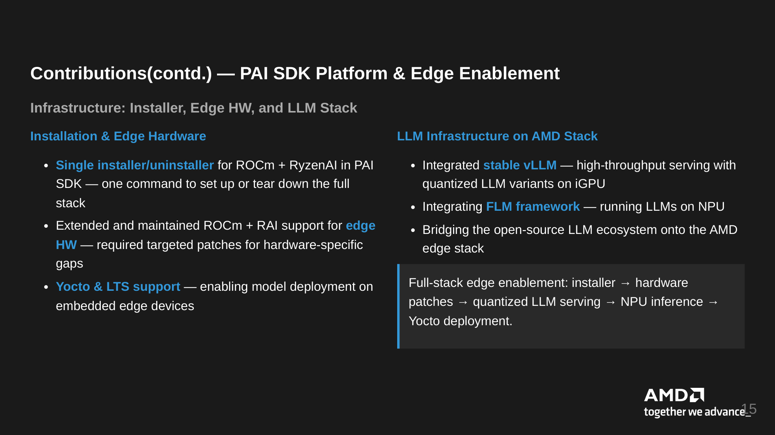
Contributions(contd.) — PAI SDK Platform & Edge Enablement
Infrastructure: Installer, Edge HW, and LLM Stack
Installation & Edge Hardware
LLM Infrastructure on AMD Stack
Single installer/uninstaller for ROCm + RyzenAI in PAI
SDK — one command to set up or tear down the full
Integrated stable vLLM — high-throughput serving with
quantized LLM variants on iGPU
stack
Integrating FLM framework — running LLMs on NPU
Extended and maintained ROCm + RAI support for edge
Bridging the open-source LLM ecosystem onto the AMD
edge stack
HW — required targeted patches for hardware-specific
gaps
Yocto & LTS support — enabling model deployment on
Full-stack edge enablement: installer → hardware
patches → quantized LLM serving → NPU inference →
embedded edge devices
Yocto deployment.
15

Slide 16
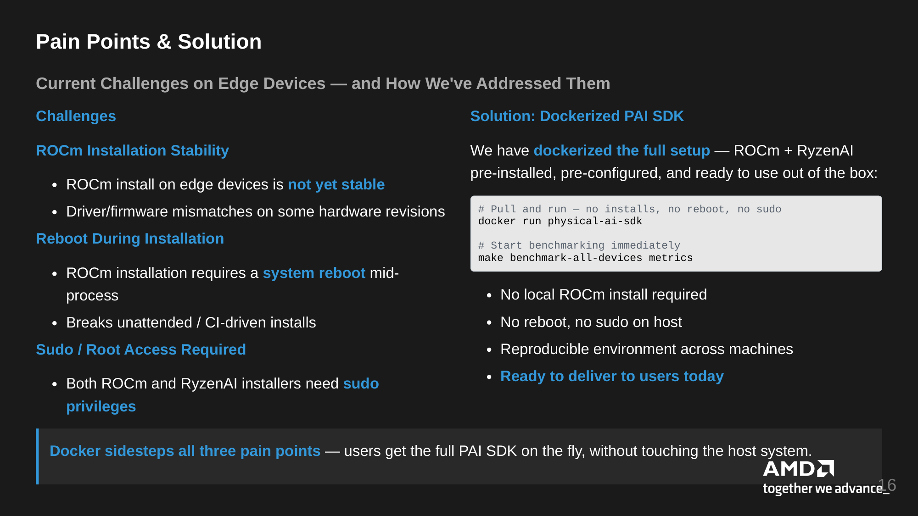
Pain Points & Solution
Current Challenges on Edge Devices — and How We've Addressed Them
Challenges
Solution: Dockerized PAI SDK
ROCm Installation Stability
We have dockerized the full setup — ROCm + RyzenAI
pre-installed, pre-configured, and ready to use out of the box:
ROCm install on edge devices is not yet stable
Driver/firmware mismatches on some hardware revisions
# Pull and run — no installs, no reboot, no sudo
docker run physical-ai-sdk
Reboot During Installation
# Start benchmarking immediately
make benchmark-all-devices metrics
ROCm installation requires a system reboot mid-
process
No local ROCm install required
Breaks unattended / CI-driven installs
No reboot, no sudo on host
Sudo / Root Access Required
Reproducible environment across machines
Both ROCm and RyzenAI installers need sudo
Ready to deliver to users today
privileges
Docker sidesteps all three pain points — users get the full PAI SDK on the fly, without touching the host system.
16

Slide 17
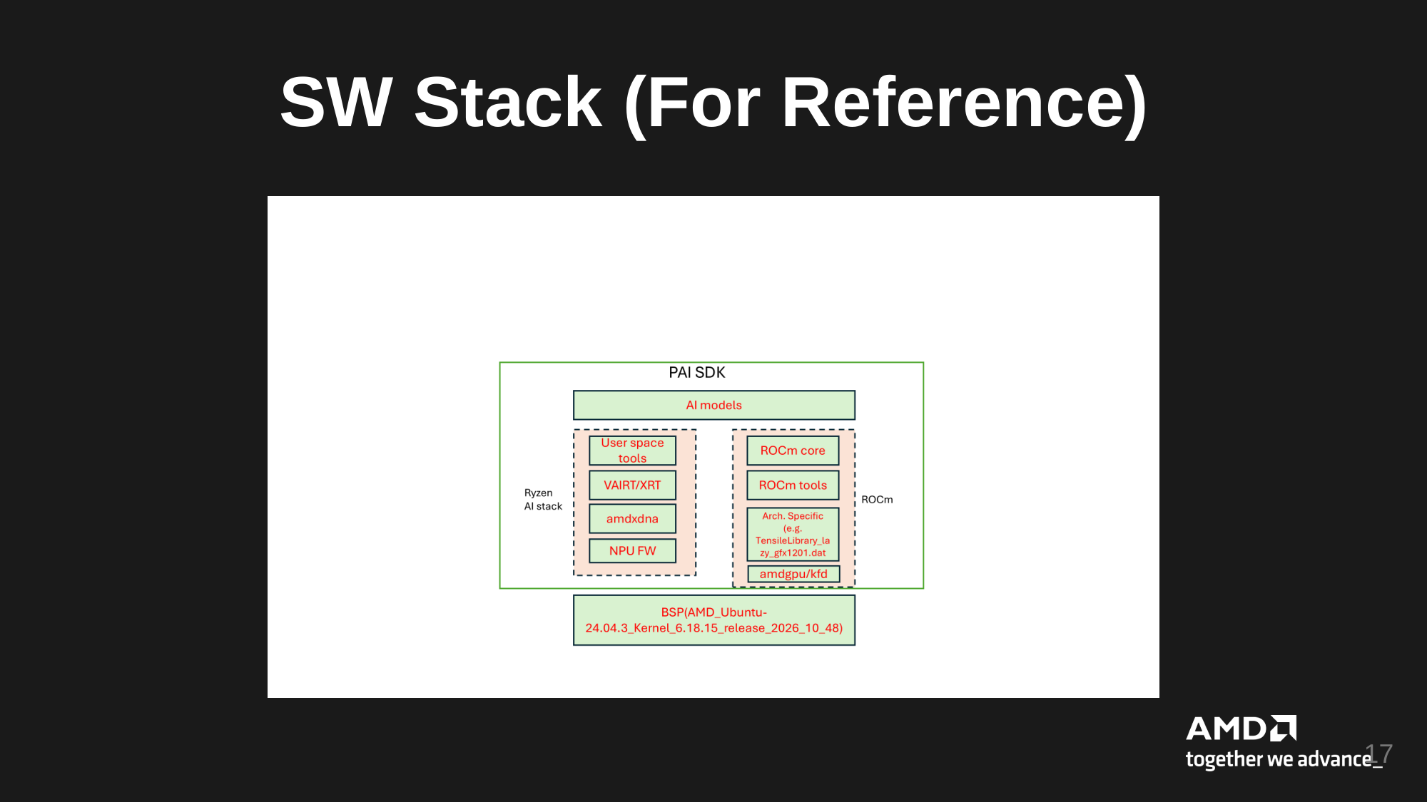
SW Stack (For Reference)
17

